Slide 1


Scattered field formalism in the particle-in-cell method for plasma acceleration in tightly focused ultrashort laser beams
Marianna Lytova (speaker), François Fillion-Gourdeau,
Simon Vallières, François Légaré, Steve MacLean
4th user & training workshop
Prague, November 8, 2023

Slide 2
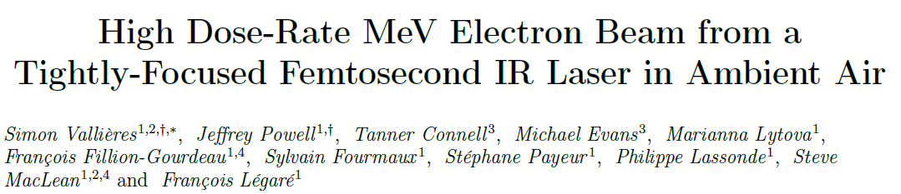
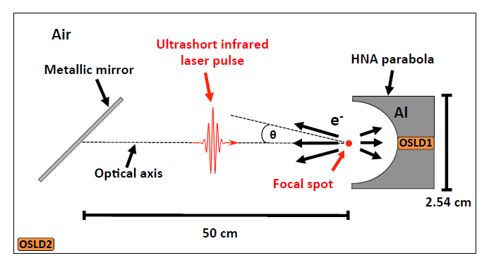

Radiation experiment as motivation for modeling
Laser & Photonics Reviews (2023)

Slide 3
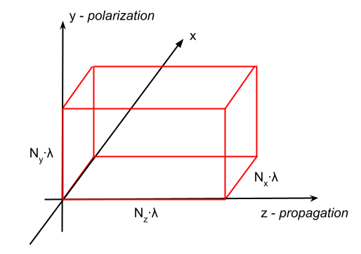
Radiation experiment as motivation for modeling
N~20-60
Laser & Photonics Reviews (2023)

Slide 4
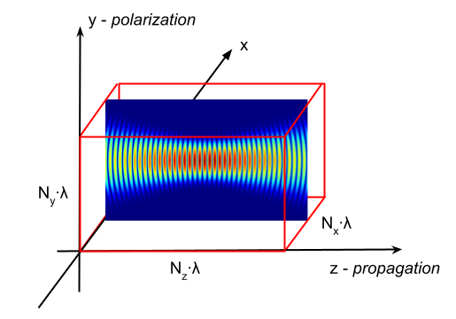
Radiation experiment as motivation for modeling
Laser & Photonics Reviews (2023)

Slide 5
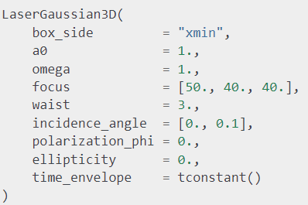

Radiation experiment as motivation for modeling
Laser & Photonics Reviews (2023)

Slide 6
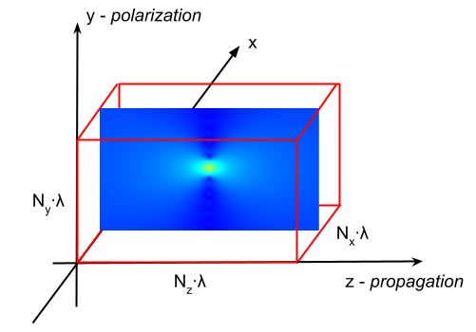
Radiation experiment as motivation for modeling
Laser & Photonics Reviews (2023)

Slide 7
Radiation experiment as motivation for modeling
Laser & Photonics Reviews (2023)
?

Slide 8


Scattered field formulation (SFF) in PIC algorithm
$$F = F_{inc}+F_{scatt}$$
← requires linearity
$$F\left(x,t\right)={\left(E\left(x,t\right),B\left(x,t\right)\right)}^{T}$$

Slide 9



Scattered field formulation (SFF) in PIC algorithm
$$F = F_{inc}+F_{scatt}$$
← requires linearity
$$F\left(x,t\right)={\left(E\left(x,t\right),B\left(x,t\right)\right)}^{T}$$
The Vlasov–Maxwell system of equations

Slide 10




Scattered field formulation (SFF) in PIC algorithm
$$F = F_{inc}+F_{scatt}$$
← requires linearity
Semi-linear system
$$F\left(x,t\right)={\left(E\left(x,t\right),B\left(x,t\right)\right)}^{T}$$
The Vlasov–Maxwell system of equations
$C\left(F\right)= {\left(J\left(E,B\right),0\right)}^{T}$,
$$, analytical solutions E_{inc}\left(x,t\right),B_{inc}\left(x,t\right)$$

Slide 11



Scattered field formulation (SFF) in PIC algorithm
$$F = F_{inc}+F_{scatt}$$
← requires linearity
Semi-linear system
$$F\left(x,t\right)={\left(E\left(x,t\right),B\left(x,t\right)\right)}^{T}$$
The Vlasov–Maxwell system of equations
$C\left(F\right)= {\left(J\left(E,B\right),0\right)}^{T}$,
$$, analytical solutions E_{inc}\left(x,t\right),B_{inc}\left(x,t\right)$$

Slide 12
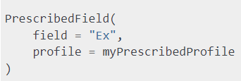
Scattered field formulation (SFF) in PIC algorithm
$$F = F_{inc}+F_{scatt}$$
← requires linearity
Semi-linear system
$$F\left(x,t\right)={\left(E\left(x,t\right),B\left(x,t\right)\right)}^{T}$$
The Vlasov–Maxwell system of equations
$C\left(F\right)= {\left(J\left(E,B\right),0\right)}^{T}$,
$$, analytical solutions E_{inc}\left(x,t\right),B_{inc}\left(x,t\right)$$
Use ctypes when you need to implement a computationally complex function.

Slide 13
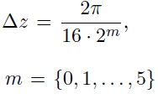
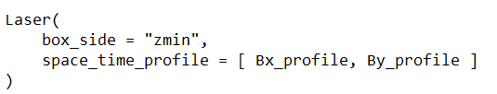
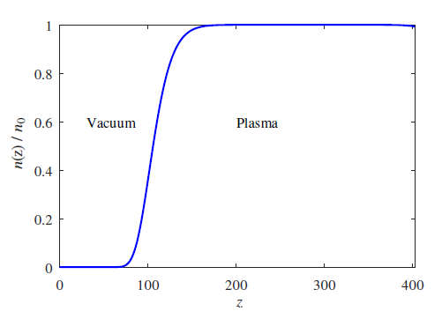
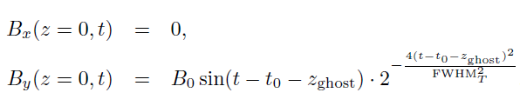
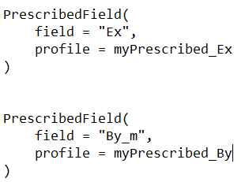
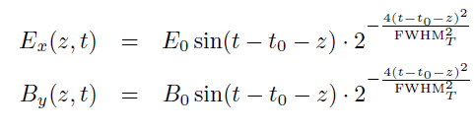
1-D tests : Gaussian laser pulse interacting with a plasma
Model 1:
PIC with Laser creator
Model 2:
SFF-PIC with Prescribed field

Slide 14
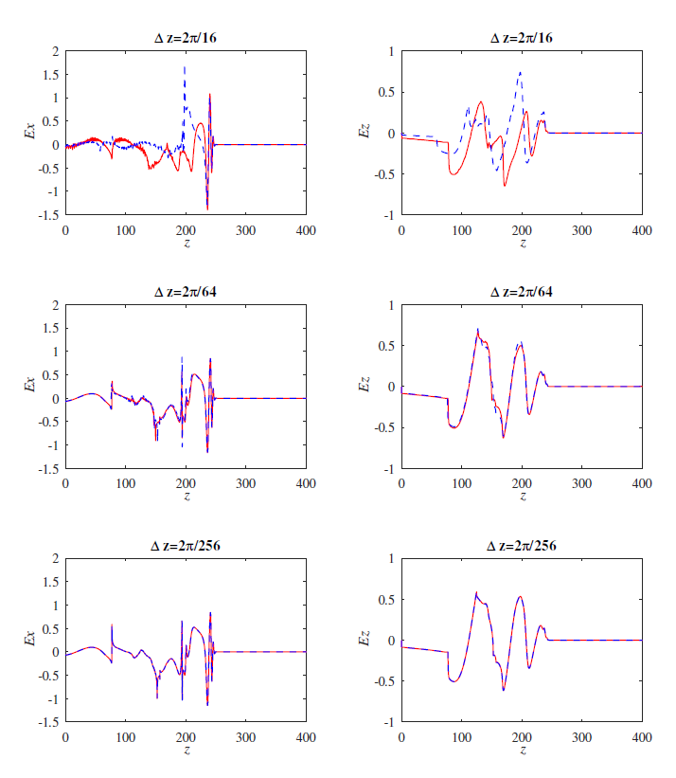
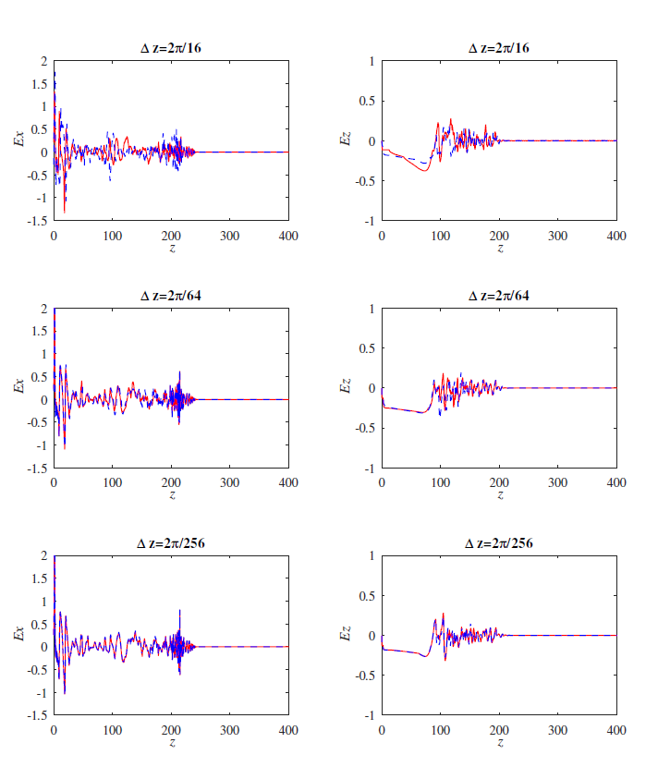


Results of 1D electric field simulations at time = 323: box length 64λ, $a_{0}$= 5; --PIC, −SFF&PIC
$$n_{e0}=0.1$$
$$n_{e0}=0.75$$

Slide 15
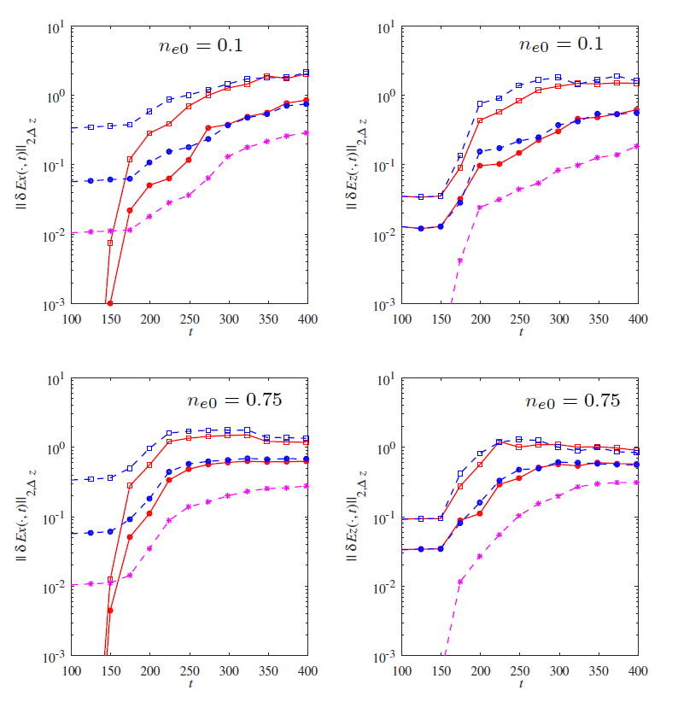
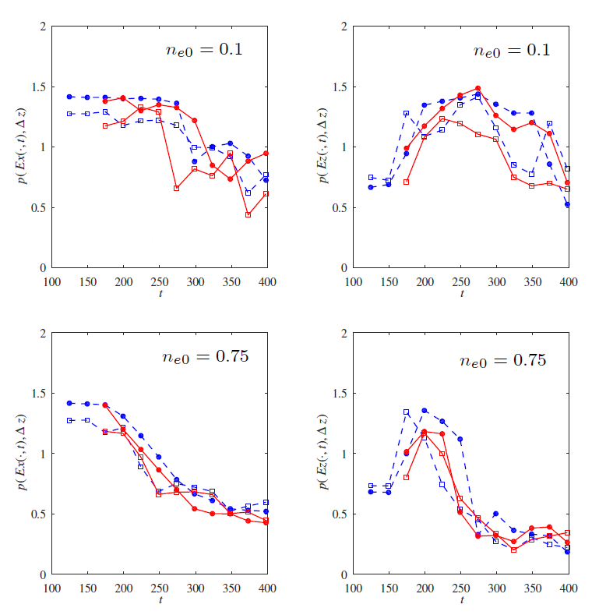
--PIC, −SFF&PIC , € € - Δz=2π/16, • • - Δz=2π/64
$L_{2} error norms wrt solution for \text{Δ}\text{z}\text{=2π/256}$ (“exact” soln)
Order of convergence

Slide 16
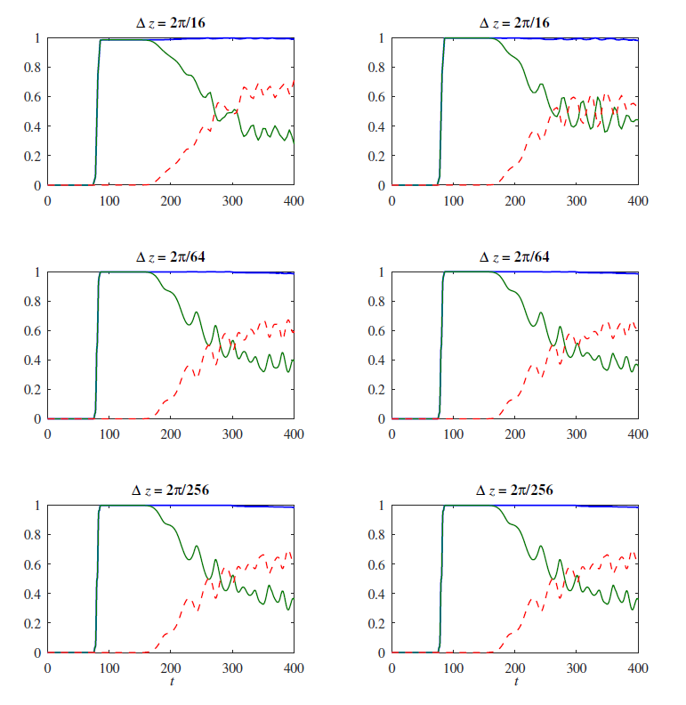
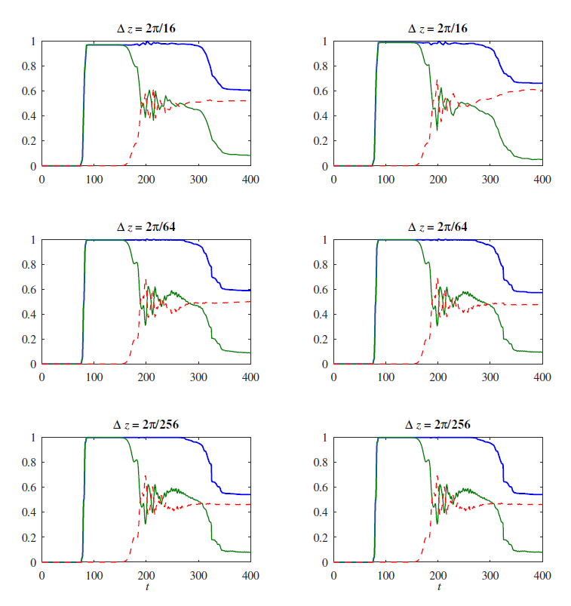


Scalar diagnostic: total energy, electromagnetic energy and kinetic energy of particles
$$n_{e0}=0.1$$
$$n_{e0}=0.75$$
Laser creator (Model 1)
Prescribed field (Model 2)
Laser creator (Model 1)
Prescribed field (Model 2)

Slide 17
Scalar diagnostic: total energy, electromagnetic energy and kinetic energy of particles
$$n_{e0}=0.1$$
$$n_{e0}=0.75$$
Laser creator (Model 1)
Prescribed field (Model 2)
Laser creator (Model 1)
Prescribed field (Model 2)
The stability and convergence of 1D numerical solutions of the PIC code within SFF are no worse than in the case of using the full-field approach.

Slide 18
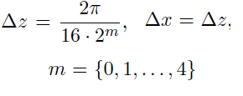
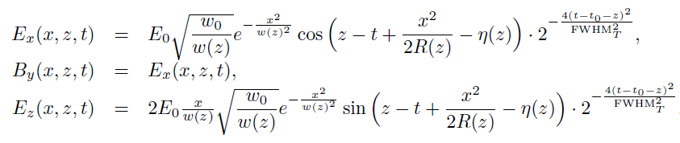

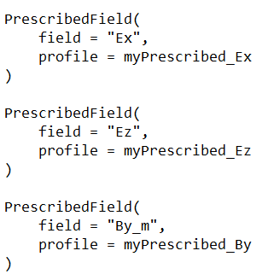

2-D tests : Gaussian beam interacting with a plasma
Model 2: SFF-PIC with Prescribed field
Model 1: PIC with Laser creator

Slide 19
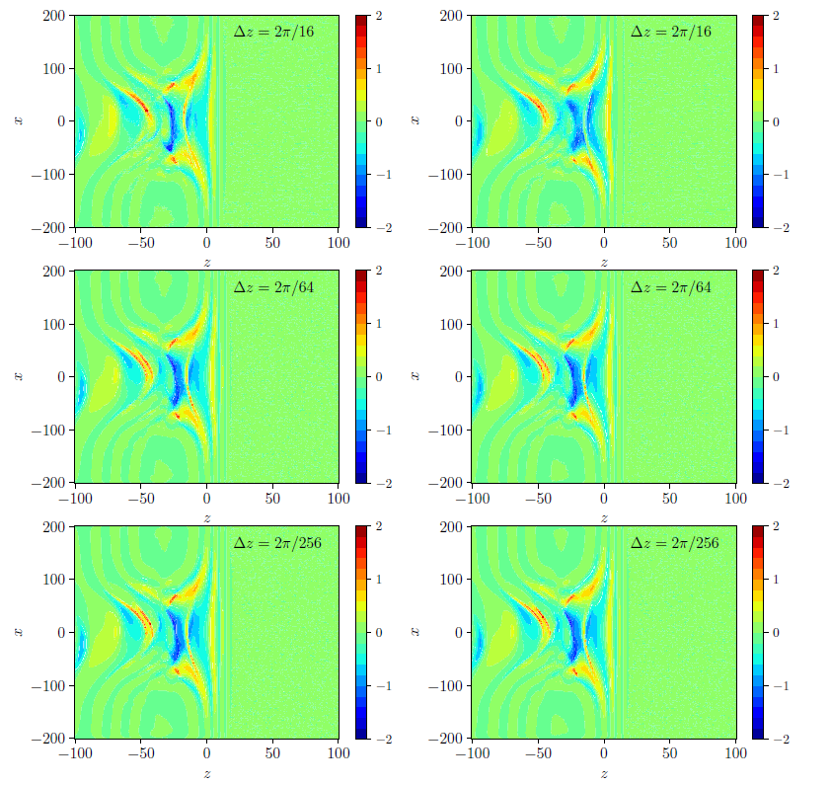
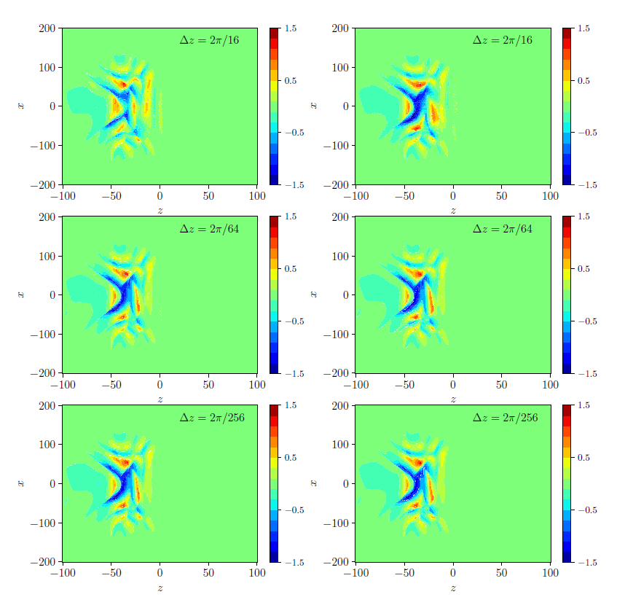


Results of 2D electric field simulations at time = 145: box length 32λ, $a_{0}$= 4.86, $w_{0}$=16λ, $n_{e0}=0.31$
$$E_{x}$$
$$E_{z}$$
Laser creator
Prescribed field (SFF)
Laser creator
Prescribed field (SFF)

Slide 20
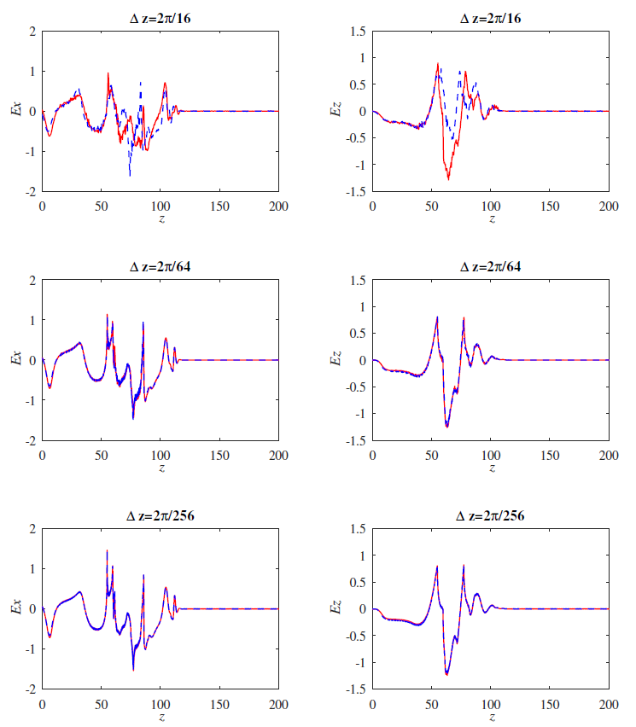
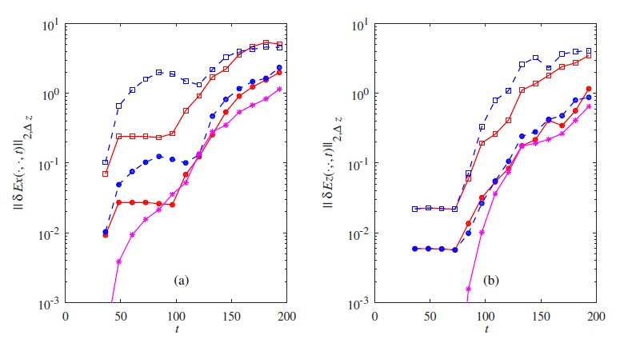



T = 145: box length 32λ, $a_{0}$= 4.86, $w_{0}$=16λ
$$E_{x}\left(0,z,t\right)$$
$$E_{z}\left(0,z,t\right)$$
$L_{2} error norms wrt solution for \text{Δ}\text{z}\text{=2π/256}$ (“exact” solution)
Order of convergence 0.5-2.5

Slide 21
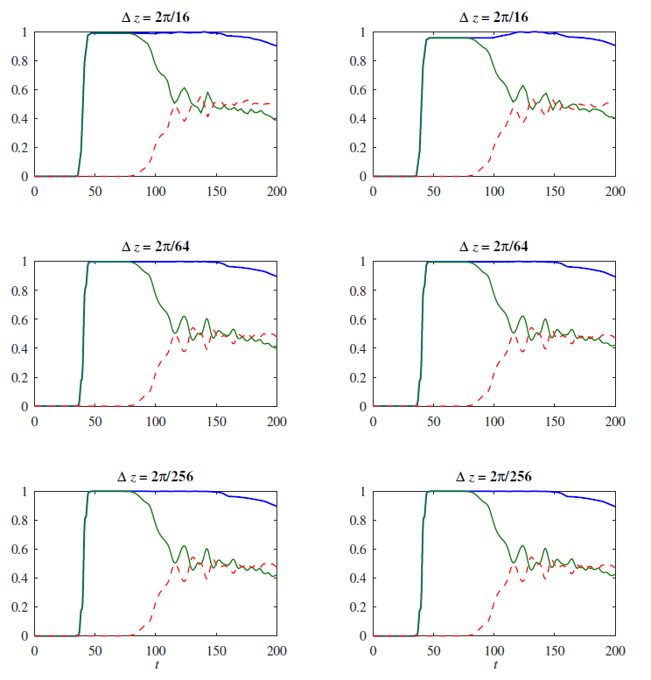
Scalar diagnostic: total energy, electromagnetic
energy and kinetic energy of particles
Laser creator (Model 1)
Prescribed field (Model 2)

Slide 22
Scalar diagnostic: total energy, electromagnetic
energy and kinetic energy of particles
Laser creator (Model 1)
Prescribed field (Model 2)
The stability and convergence of 2D numerical solutions for fields and energies obtained using the PIC code within SFF are no worse than in the case of the full-field approach.

Slide 23
3D analytical solutions for tightly-focused fields in vacuum
Radially polarized pulse

Slide 24
3D analytical solutions for tightly-focused fields in vacuum
Radially polarized pulse
Linearly polarized pulse (this modeling)

Slide 25
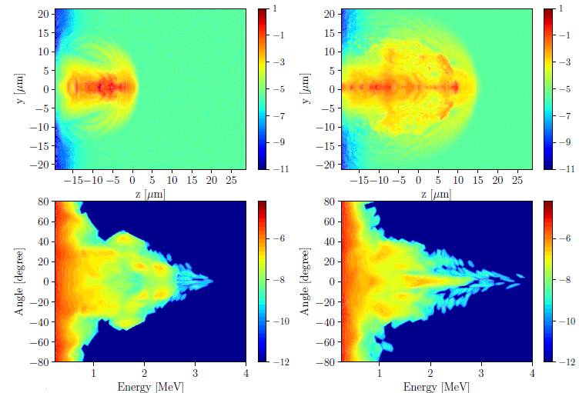
3D simulations: acceleration by tightly-focused linearly polarized pulse; $P_{peak}=0.2$ TW, λ=1.8 μm
T = 132 fs
T = 180 fs
Kinetic energy density
Kinetic energy density
Energy-angle diagram
Energy-angle diagram
Energy-angle diagram
Energy-angle diagram

Slide 26
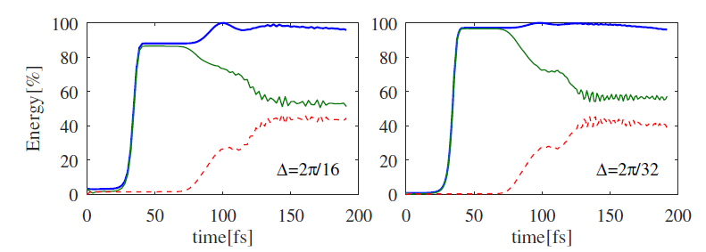
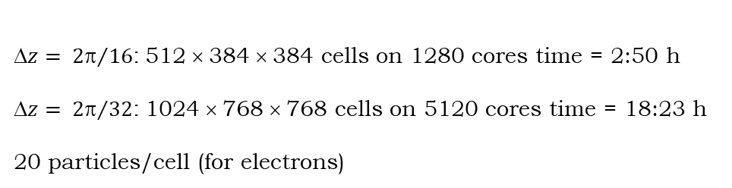
3D simulations: acceleration by tightly-focused linearly polarized pulse; $P_{peak}=0.2$ TW, λ=1.8 μm
T = 132 fs
T = 180 fs
$z= {2}/{16}$: 512 × 384 × 384 cells on 1280 cores time = 2:50 h
$z= {2}/{32}$: 1024 × 768 × 768 cells on 5120 cores time = 18:23 h
20 particles/cell (for electrons)
Kinetic energy density
Kinetic energy density
Energy-angle diagram
Energy-angle diagram
Energy-angle diagram
Energy-angle diagram

Slide 27
Conclusions and outlook
It was demonstrated that a decrease in the cell size leads to the convergence of
the solutions obtained in two models: (i) PIC with Laser creator and (ii) PIC with SFF.
2. SFF coupled with the PIC code is a promising approach for simulating particle
acceleration in tightly focused laser beams linearly and radially polarized.
3. To do: solid targets, tests at shifted laser parameters.
4. To do: tuning computing performance.

Slide 28
Conclusions and outlook
It was demonstrated that a decrease in the cell size leads to the convergence of
the solutions obtained in two models: (i) PIC with Laser creator and (ii) PIC with SFF.
2. SFF coupled with the PIC code is a promising approach for simulating particle
acceleration in tightly focused laser beams linearly and radially polarized.
3. To do: solid targets, tests at shifted laser parameters.
4. To do: tuning computing performance.
arXiv:2310.11393 [physics.optics]
Thank you!

Slide 29
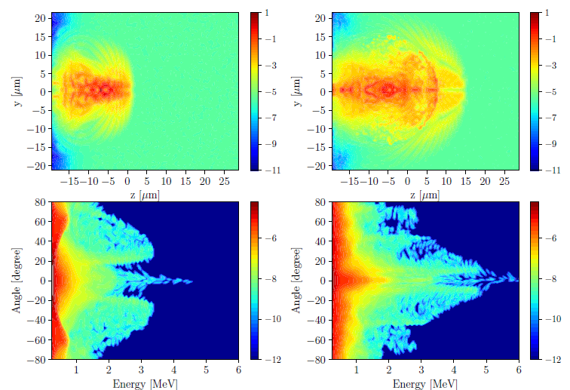
3D simulations: acceleration by tightly-focused radially polarized pulse; $P_{peak}=0.4$ TW, λ=1.8 μm
T = 132 fs
T = 180 fs
Kinetic energy density
Kinetic energy density
Energy-angle diagram
Energy-angle diagram

Slide 30
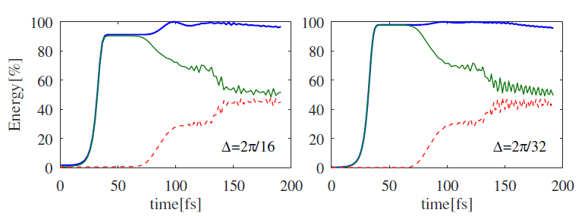
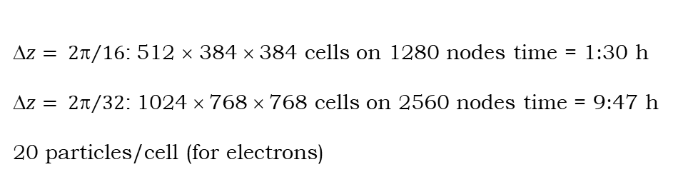
3D simulations: acceleration by tightly-focused radially polarized pulse; $P_{peak}=0.4$ TW, λ=1.8 μm
T = 132 fs
T = 180 fs
$z= {2}/{16}$: 512 × 384 × 384 cells on 1280 nodes time = 1:30 h
$z= {2}/{32}$: 1024 × 768 × 768 cells on 2560 nodes time = 9:47 h
20 particles/cell (for electrons)
Kinetic energy density
Kinetic energy density
Energy-angle diagram
Energy-angle diagram

