Slide 1
Session #1: Project review
The ecosystem

Slide 2
Not only a C++ code
Simple inputs
Post-processing
Installation
Support
License
Quality
Teaching
Training

Slide 3
Download – install – run

Slide 4
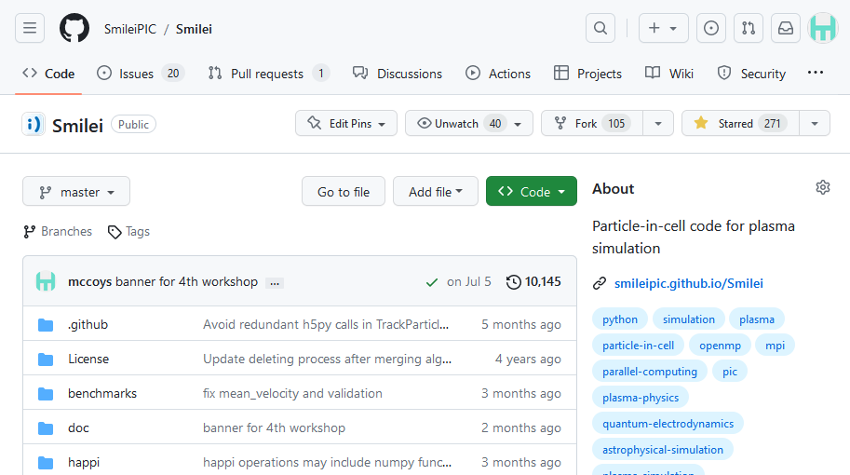
https://github.com/SmileiPIC/Smilei

Slide 5
https://github.com/SmileiPIC/Smilei
Link to documentation

Slide 6
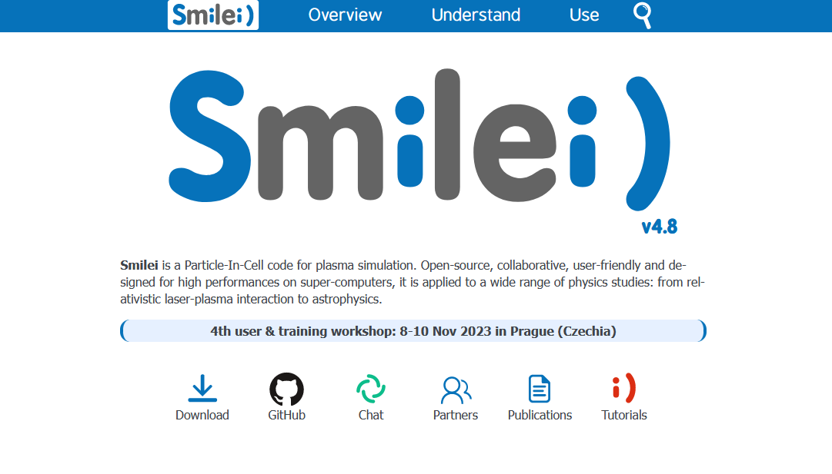
https://smileipic.github.io/Smilei

Slide 7
https://smileipic.github.io/Smilei
News
Description of Smilei)
How to install
How to make a simulation
Post-processing
Links

Slide 8
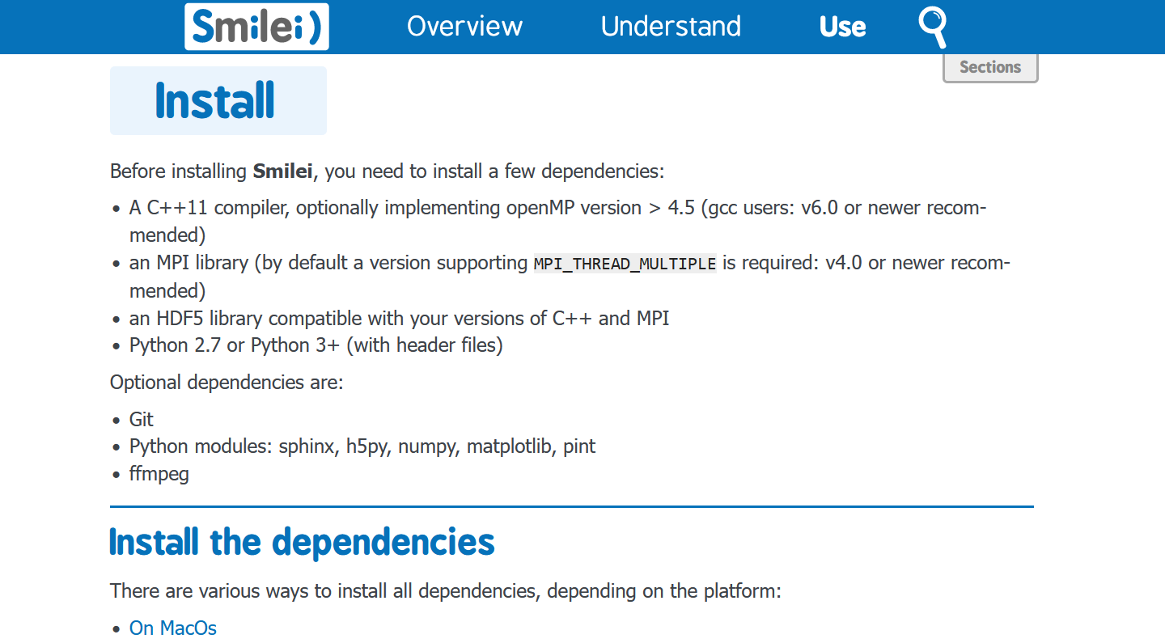
Installation explained in the doc
it’s in
the doc!

Slide 9
https://github.com/SmileiPIC/Smilei
Direct download

Slide 10
Download the code with git

Slide 11
Compile with make

Slide 12
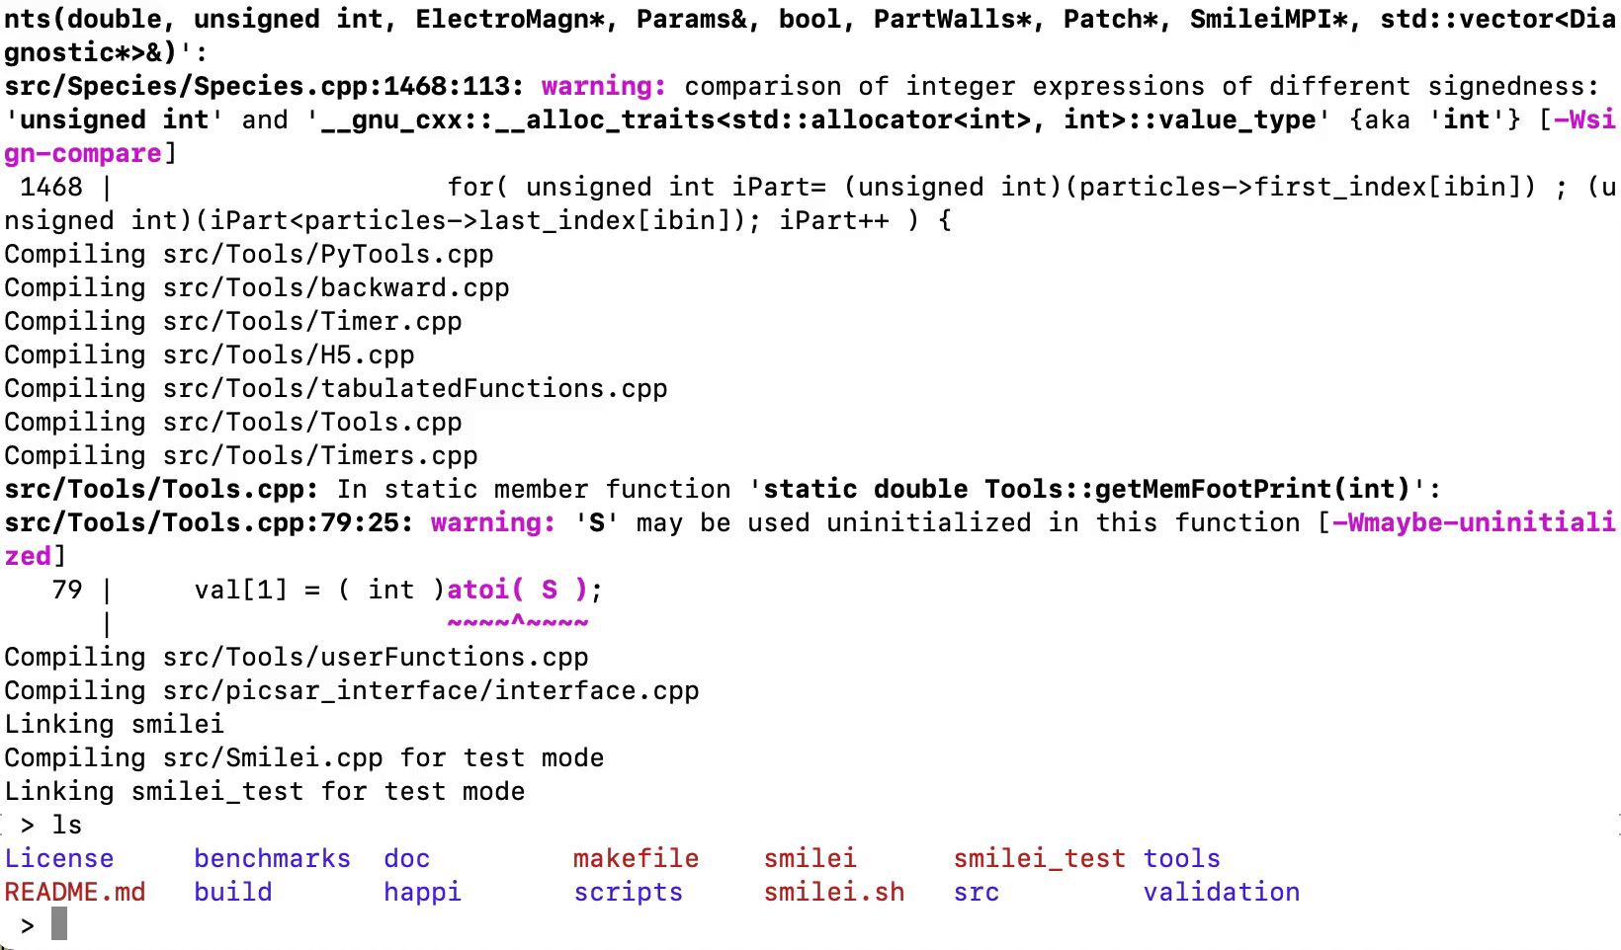
Compile with make

Slide 13
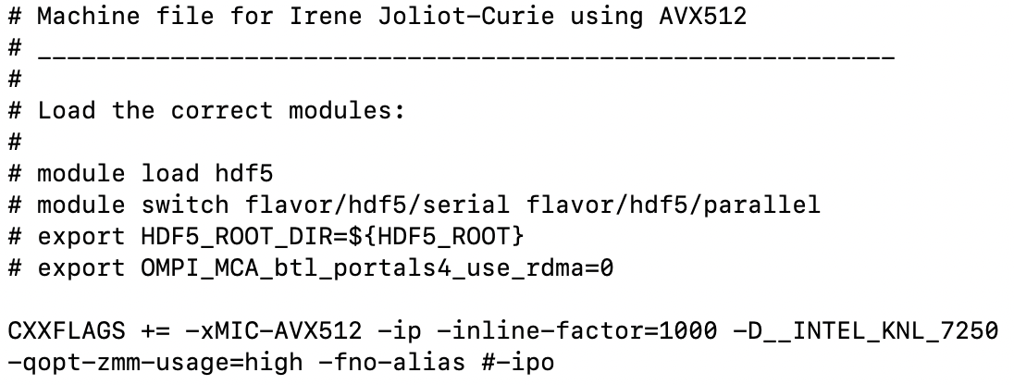
How to compile on a supercomputer?
On a supercomputer, compilation can be cumbersome.
We provide, in Smilei, a number of “machine files” to help.
Example
Contribute by sending us your machine files!
→ make machine=joliot_curie_knl

Slide 14
Run a simple case

Slide 15
User-friendly input file

Slide 16
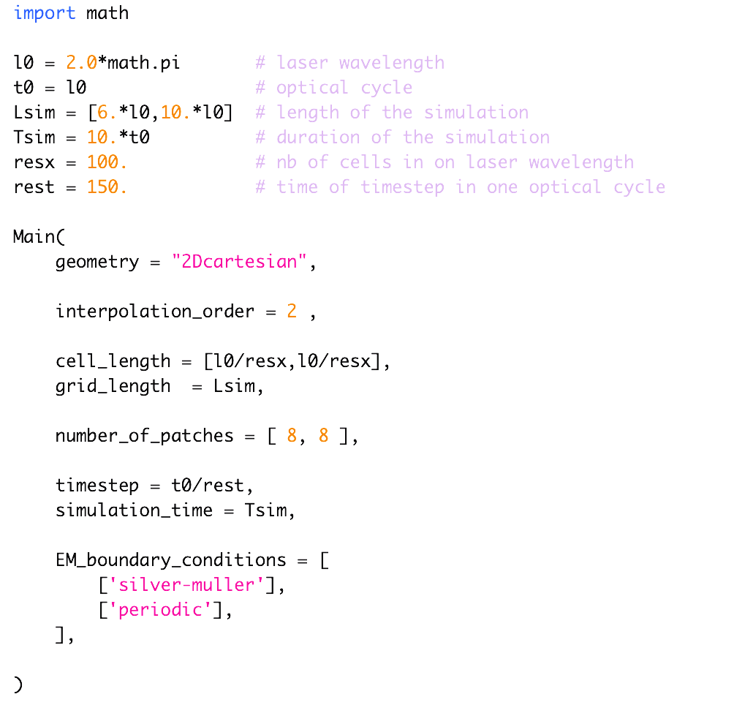
What the does the input file look like?
Smilei) is in C++
But the input file is in python

Slide 17
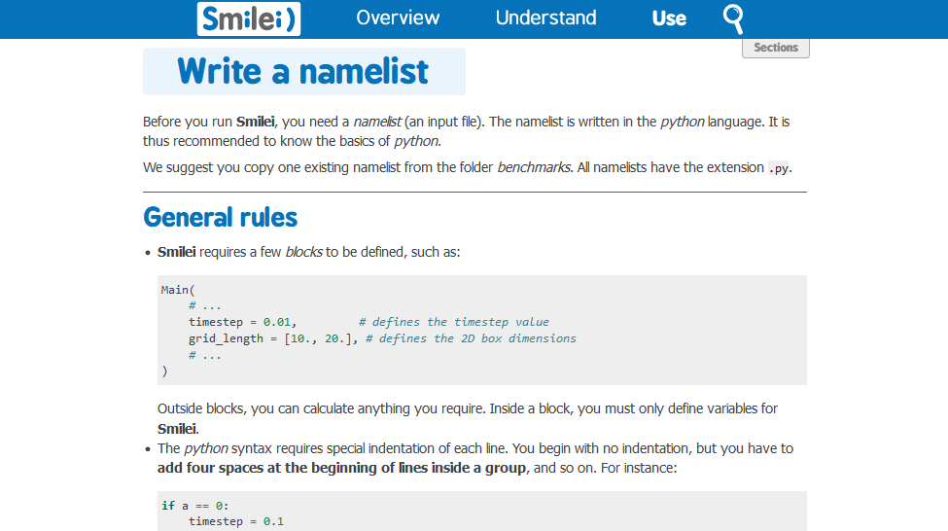
All the details are in the doc
it’s in
the doc!

Slide 18
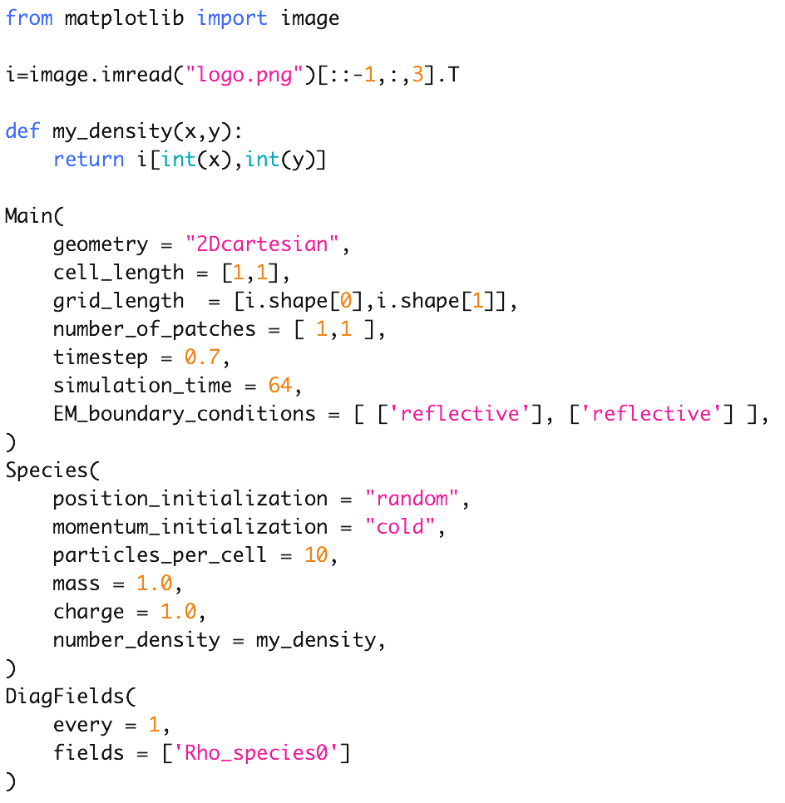
Use any Python package
image 128x128 px

Slide 19
Post-processing

Slide 20
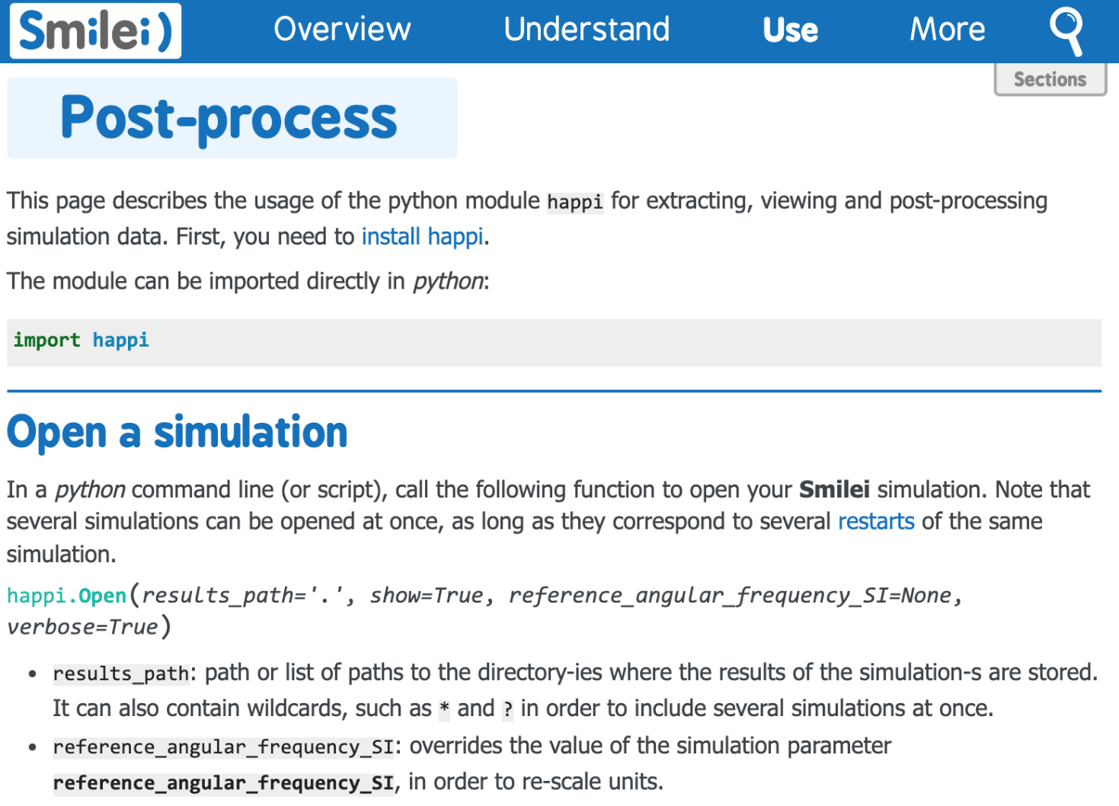
friendly postprocessing
it’s in
the doc!

Slide 21
postprocessing
In [1]: import happi
In [2]: S = happi.Open(".")
Loaded simulation '.'
Scanning for Scalar diagnostics
Scanning for Field diagnostics
Scanning for Probe diagnostics
Scanning for ParticleBinning diagnostics
Scanning for RadiationSpectrum diagnostics
Scanning for Performance diagnostics
Scanning for Screen diagnostics
Scanning for Tracked particle diagnostics
In [3]: my_Ey = S.Field(0, "Ey")
In [4]: my_Ey.slide(aspect='equal',vsym = True)
Field diagnostic #0: E

Slide 22
3D postprocessing
In [1]: import happi
In [2]: s = happi.Open()
[...]
In [3]: f = s.Field(0, "Ey")
In [3]: f.toVTK()
* Processing ./Field0_Ey/Field0_Ey_00000000.pvti
* Processing ./Field0_Ey/Field0_Ey_00000030.pvti
* Processing ./Field0_Ey/Field0_Ey_00000060.pvti
* Processing ./Field0_Ey/Field0_Ey_00000090.pvti
* Processing ./Field0_Ey/Field0_Ey_00000120.pvti
* Processing ./Field0_Ey/Field0_Ey_00000150.pvti
* Processing ./Field0_Ey/Field0_Ey_00000180.pvti
* Processing ./Field0_Ey/Field0_Ey_00000210.pvti
* Processing ./Field0_Ey/Field0_Ey_00000240.pvti

Slide 23
Francesco Massimo

Slide 24
Code verification

Slide 25
Smilei is tested every time it is modified
Many
benchmarks
Results are
compared to
references

Slide 26
Support

Slide 27
https://smileipic.github.io/Smilei

Slide 28
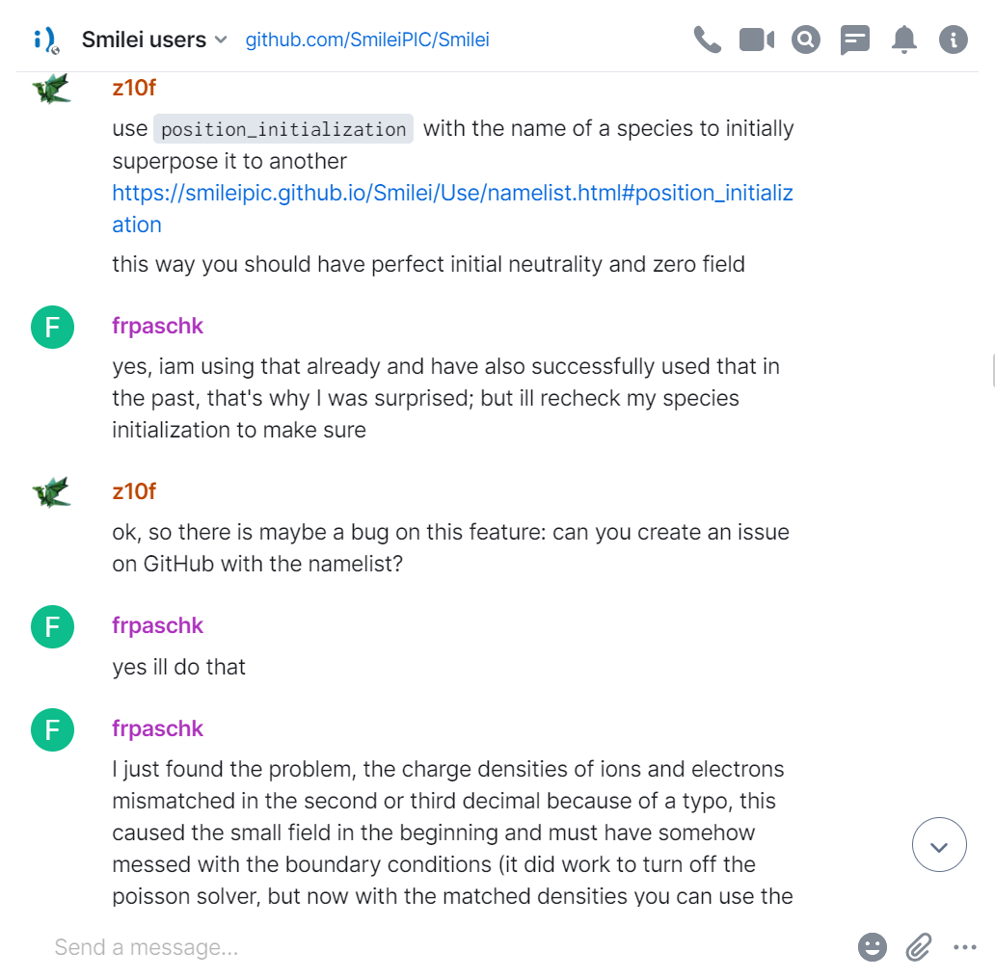
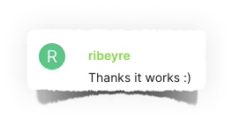
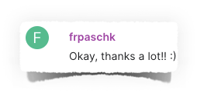
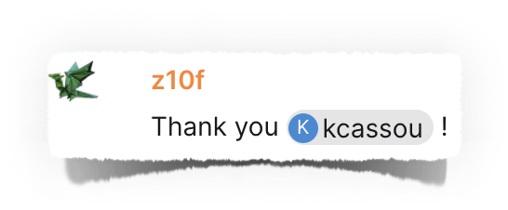
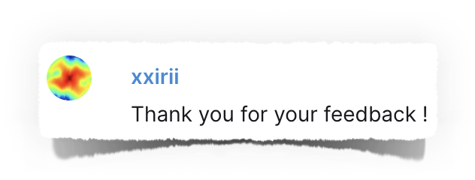
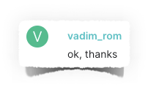
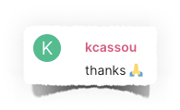
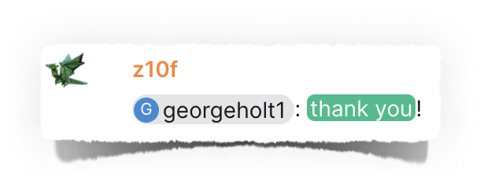
A chatroom for all users
1600 messages in 2021
2800 messages in 2022

Slide 29
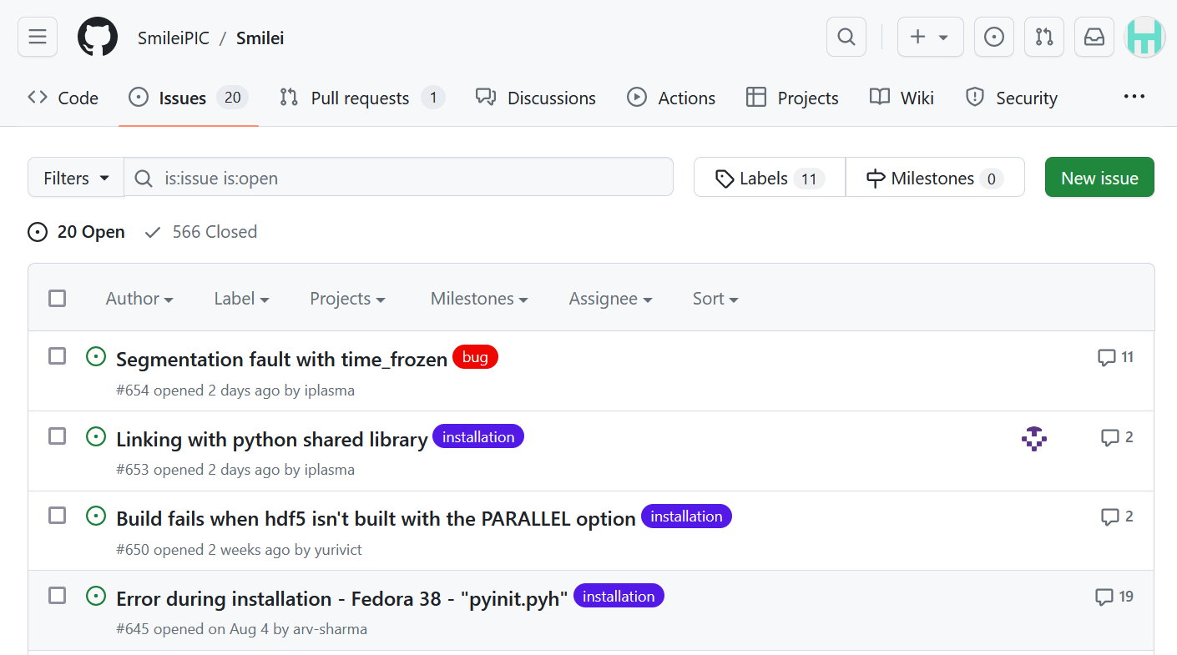
Report bugs / ask for new features

Slide 30
You are welcome to contribute !

Slide 31
Training and teaching

Slide 32
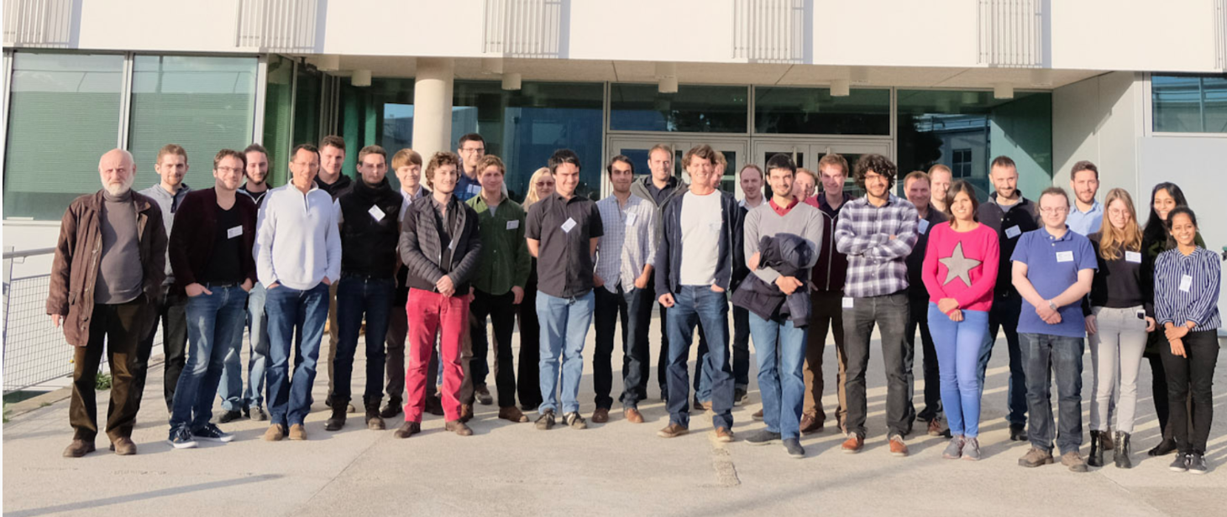
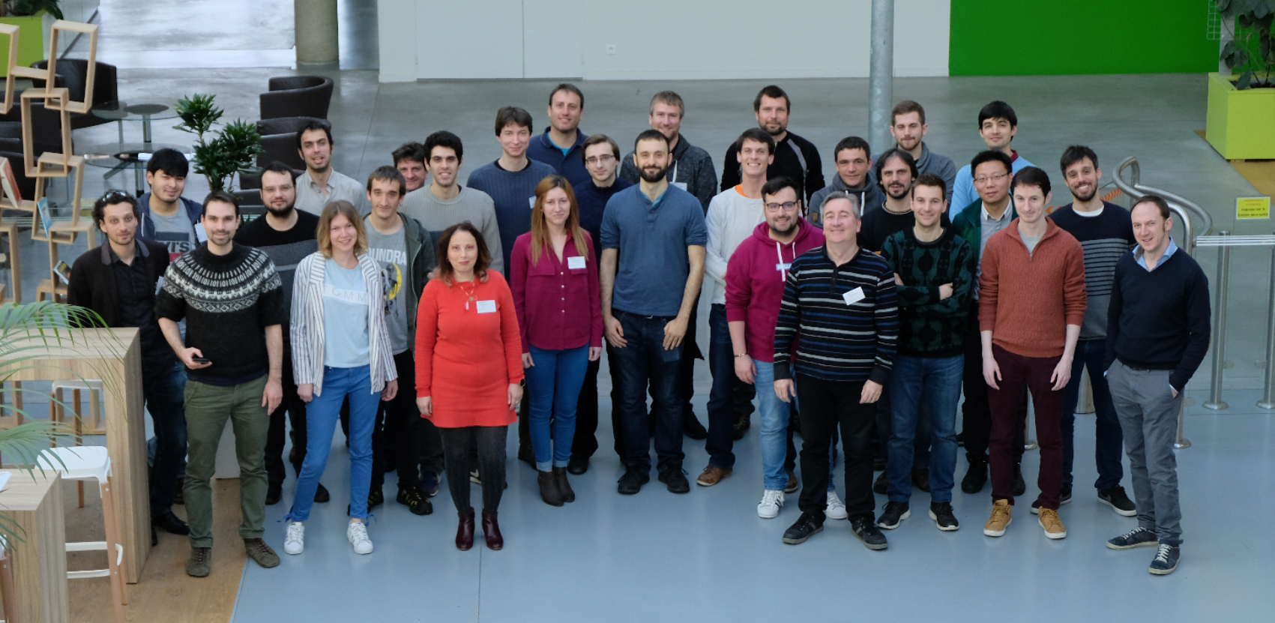
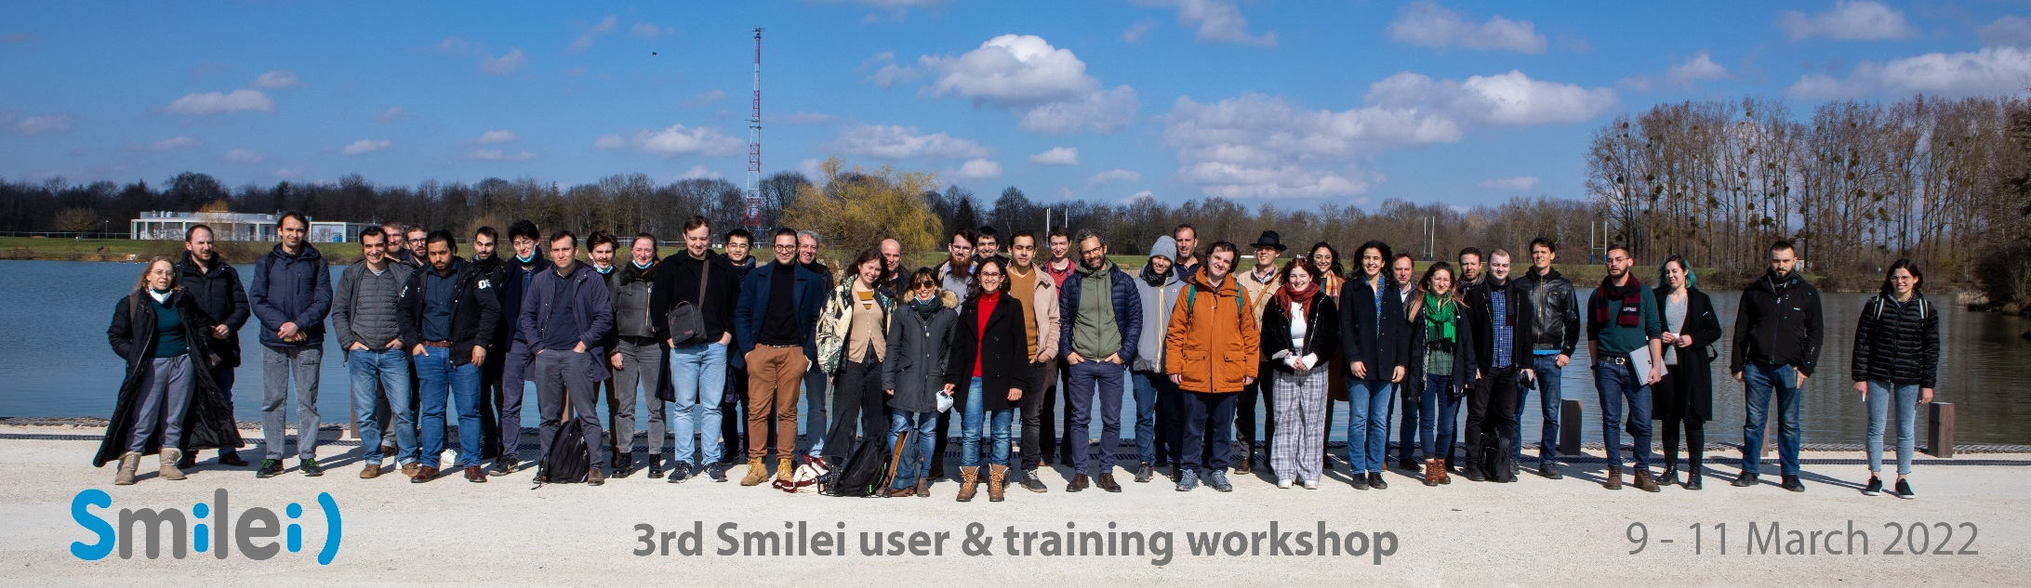
Training workshops
Nov 2017
March 2019
March 2022

Slide 33
https://smileipic.github.io/Smilei

Slide 34
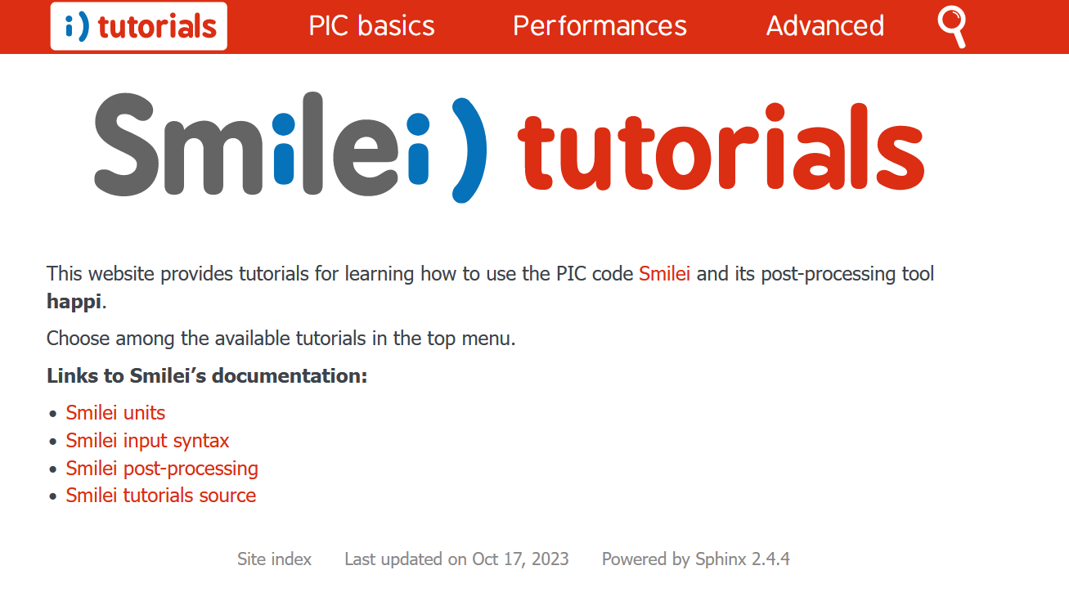
The tutorials can be found online

Slide 35
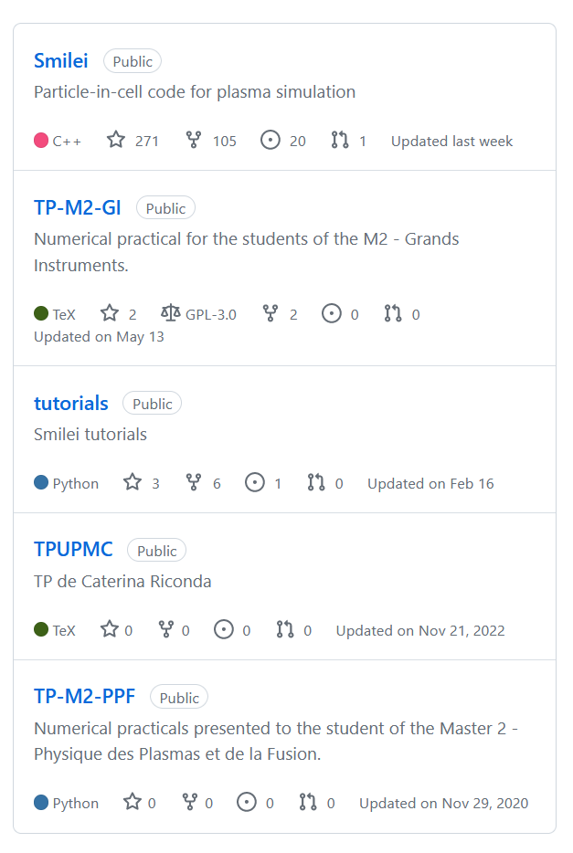
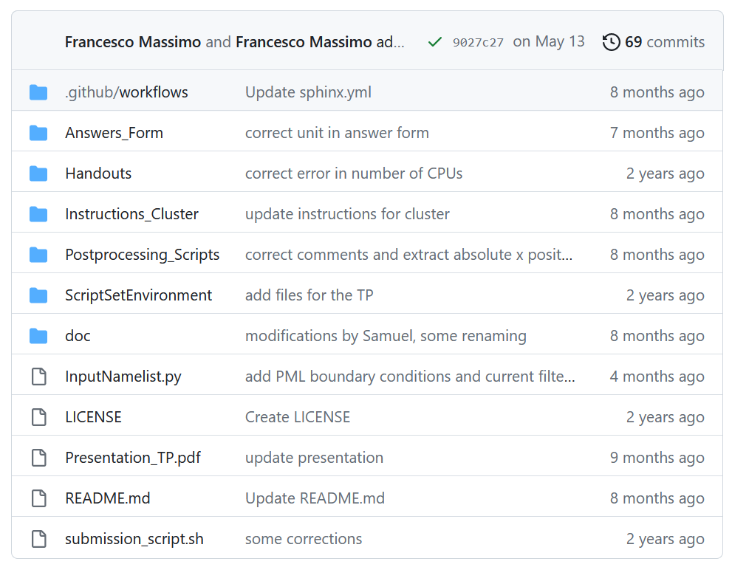
Teaching resources also available online
Contribute by uploading your teaching resources

Slide 36
Acknowledging

Slide 37
Free software license
CeCILL-B license = equivalent of BSD licenses
You may:
Use Smilei
Contribute to Smilei
Distribute Smilei with appropriate credits

Slide 38
Publications

Slide 39
Take-home points
Read the doc !
User-friendly code
Questions → chatroom
Bugs or requests → GitHub
Teach with Smilei)
Use Smilei)

Slide 40
Thanks & Keep Smileing!
Thanks for supporting this event
Contributing labs, institutions & funding agencies

