Slide 1





Multidimensional Strong PUF based on multifunctional thin films
Journées C2 2023
Oct. 15-20, 2023 Najac (France)
Benjamin Malthiery^{1,2} (ORCID 0000-0002-4299-4467), Estelle Wagner¹ (0000-0003-4837-483X),
Philippe Elbaz-Vincent² (0000-0002-8629-3021), Giacomo Benvenuti¹ (0000-0002-8369-636X)
1. 3D-Oxides SAS, 41 rue Henri Fabre, F-01630 Saint-Genis-Pouilly, France
2. Univ. Grenoble Alpes, CNRS, IF, 38000 Grenoble, France

Slide 2
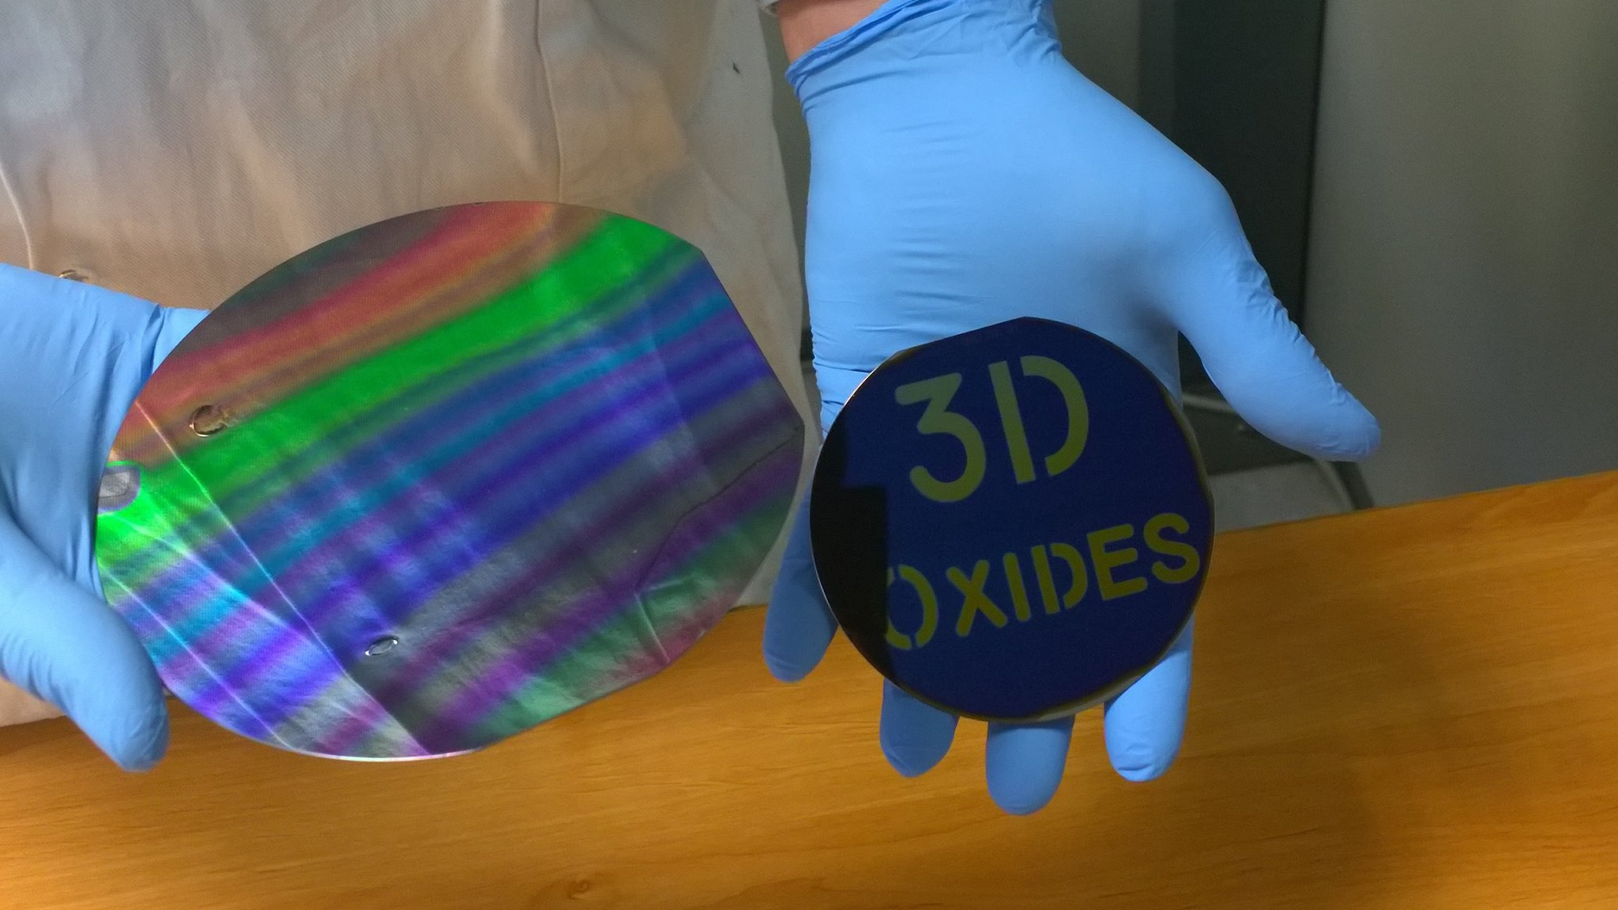
Outline
Introduction
Thesis work
  Objectives
  Experimental results
Outlook

Slide 3
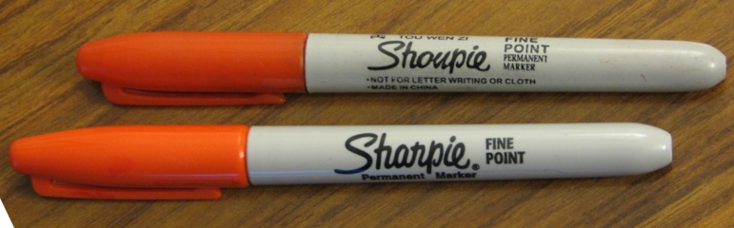
I. Introduction
Need: combat counterfeiting and usurpation at lower cost
  Financial losses
  Deteriorated brand image
  Security & Public health problem
  Data exposed to a malicious actor
Context: IoT growth and process automatization
Concept: Applying biometrics to objects to provide reliable IDs at lower cost
CC BY-SA 3.0 DangApricot (rotated & cropped)

Slide 4
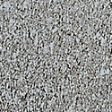

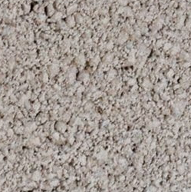
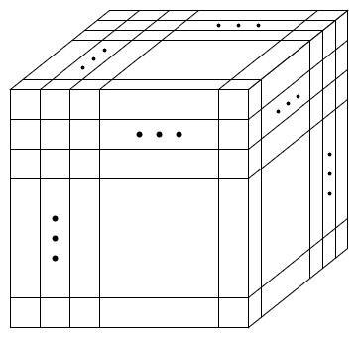
Conceptual definition
Physical Unclonable Function (PUF) [1]
Dimensions
Process
Challenge
Select challenges
Time
Reliability
Responses axis
≠
…
≠
Interrogate PUF instance
PUF
A
PUF
B
PUF
X_{i}
Randomness
Challenges axis
Process responses
Instances axis → Uniqueness
➔ CRPs

Slide 5
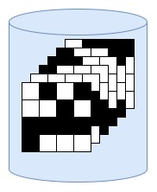

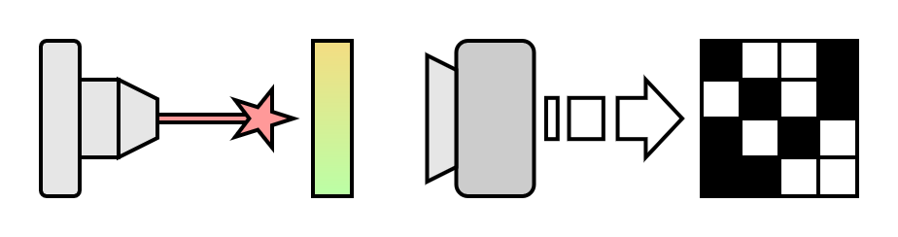

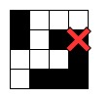
Use-cases and examples 1/2
Process
Optical PUF & Authentication
  Authors: Pappu et al. (2002) [2]
  Challenge: Relative position of the laser beam
  Response: Speckle pattern
Enrolment
Store CRPs in DB
Select challenges
from DB
⊕
Interrogate
PUF instance
=
Laser
PUF
Camera
Response
Check response
➔ Accept OR Reject

Slide 6
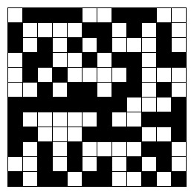
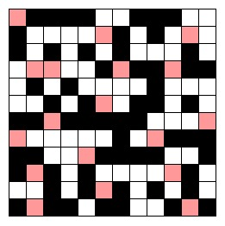


Use-cases and examples (2/2)
Process
SRAM PUF & Cryptographic key generation
  Authors: Guajardo et al. (2007) [3]
  Challenge: Position of the SRAM element
  Response: Power up state
Read power up state
Neglect unstable values
Response
Stable A=1
Generate private seed & helper data
1111001110010000…
Metastable
Challenge
Derive public-private key pair
Power-up
Stable A=0
Power-up behavior of an SRAM cell [4][5]

Slide 7

II. Thesis work – Objectives
PUF advantages vs. Secure Elements:
  Contained cost
  Improved logistics by skipping key provisioning
Identified limitations:
  Reader cost
  Clonability (SRAM) and modelling possibility [6]
Project objective: Develop a new PUF design based on oxides thin films
  Increase capacity of diversification
  Miniaturized and integrated reader

Slide 8
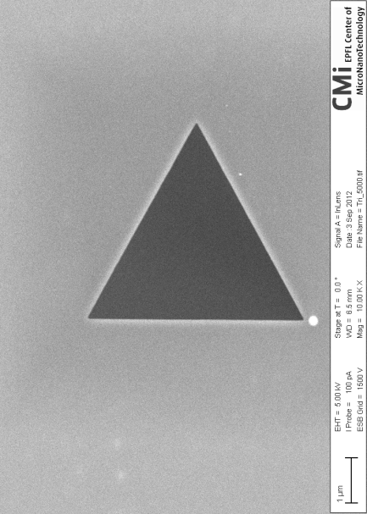
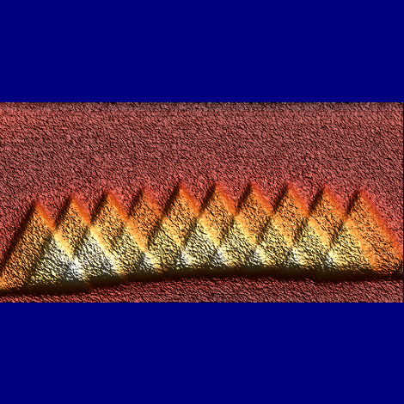
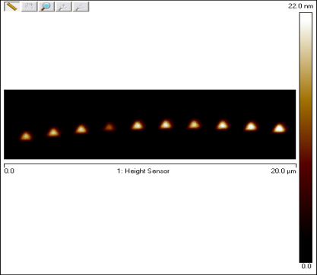
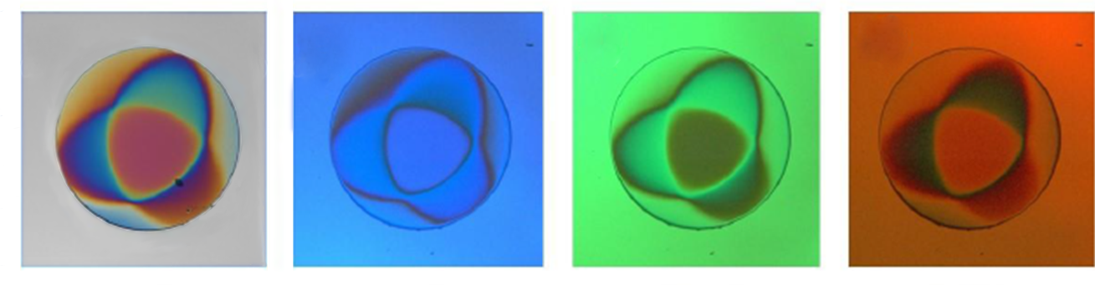

Our approach
Multifunctional oxides thin films
  Multi-values basis
  Multi-properties challenges
Theoretical challenge space:
  L: Number of distinguishable values
  Z: Number of stimuli/properties
  N: Number of points
Property: optical transmittance
Thickness (nm)
1 µm
5 μm
142
0
$$L^{Z∗N}$$
Thin film dots’ thickness AFM measurement (N)
Optical thickness
(A. U.)
Oxides thin films reflectivity at different wavelengths (L&Z)

Slide 9
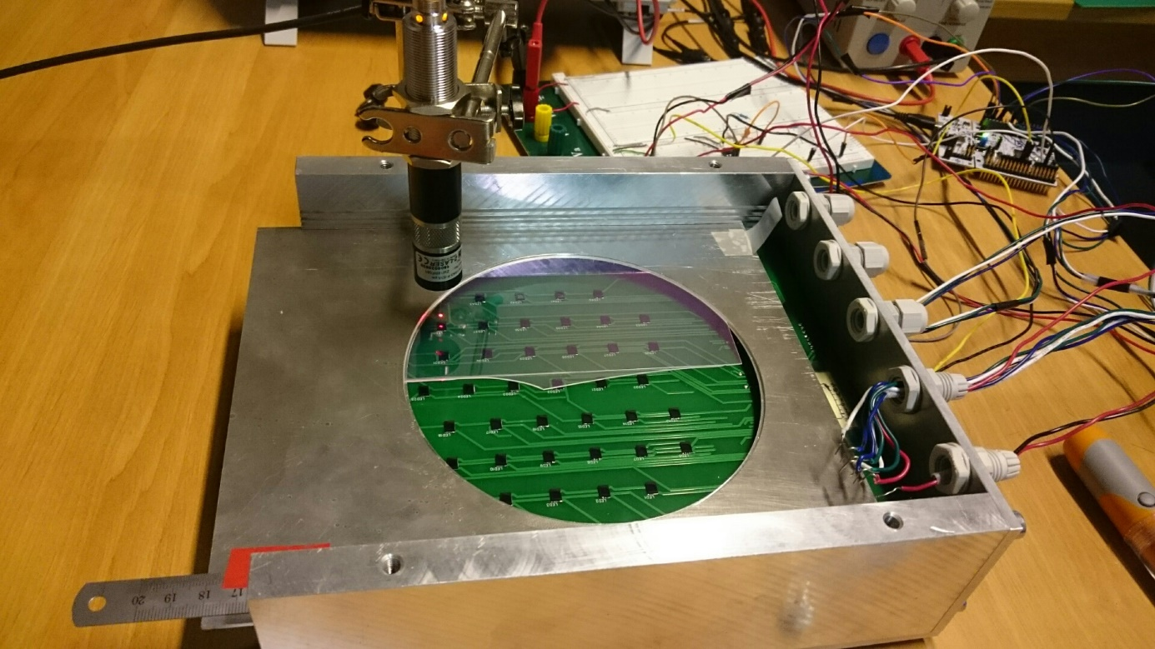
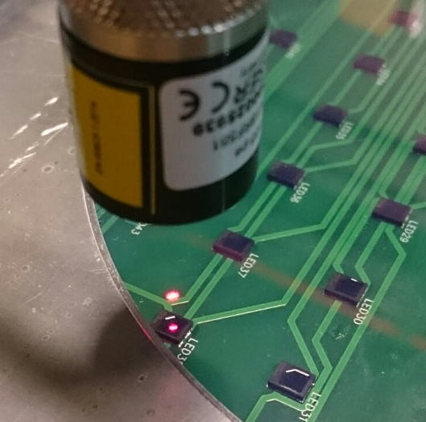
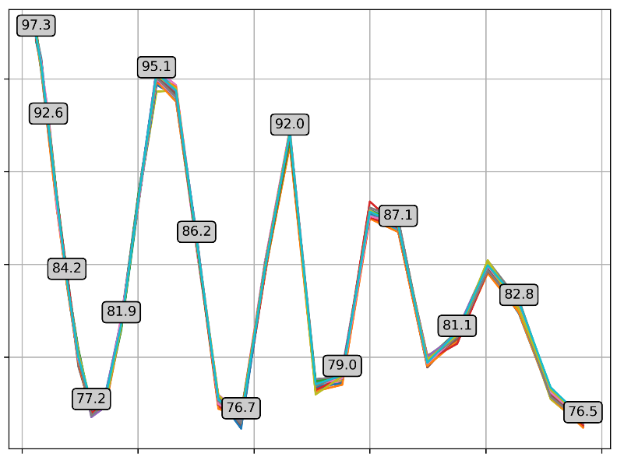
Experimental results – Macro PoC (1/2)
Non-linearity of transmittance
Thickness gradient (112 nm to 584 nm)
Thin film on transparent substrate
50 measurements
95
Movement of the plate
Transmittance (%)
Oscillations between 76% and 97%
Interference effects decreases with increasing thickness (diffusion losses)
80
100
Thickness (nm)
600

Slide 10
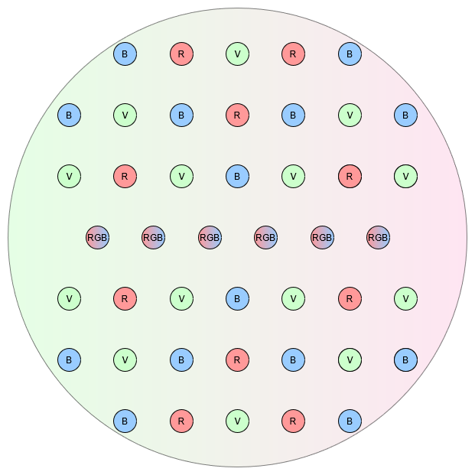
Experimental results – Macro PoC (2/2)
Reproducibility of transmission ratio
Arrangement of LED sources on the macroscopic system

Slide 11
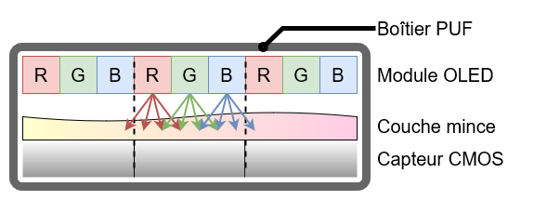
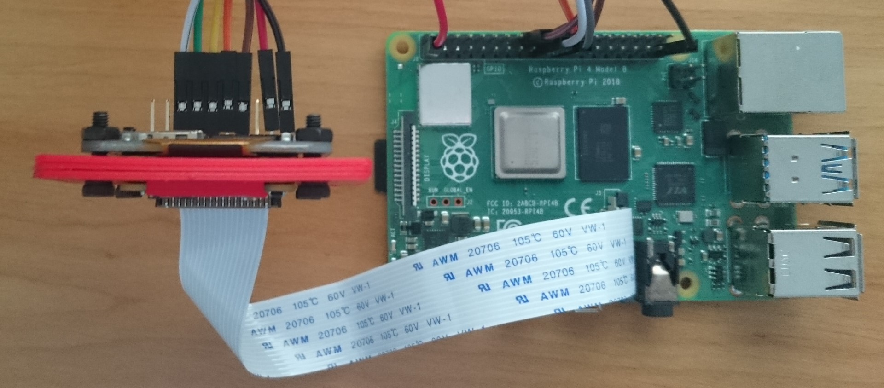
Experimental results – Compact PoC (1/3)
Shift to more compact prototype:
  OLED display replaces LEDs
  CMOS sensor replaces photodiodes
  Peripherals controlled by Raspberry Pi
Preliminary analyses:
  RAW values & sub-pixel control
PUF package
OLED module
Thin film
CMOS sensor
Schematic sectional view
Photograph of the experimental set-up

Slide 12
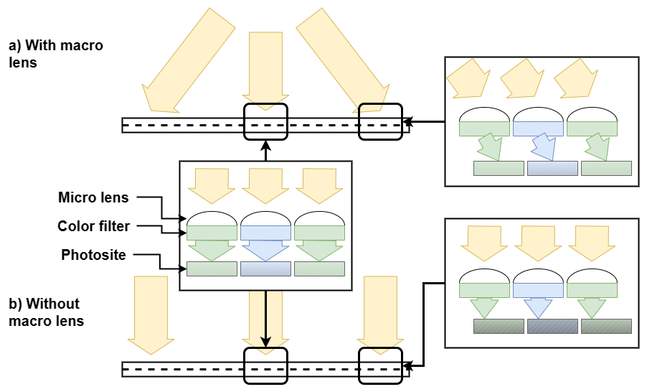
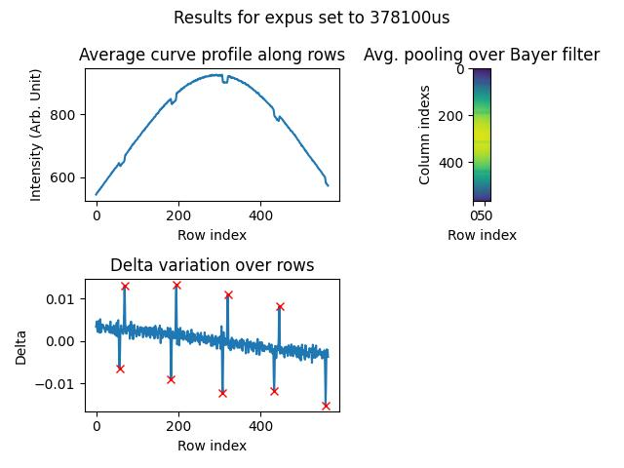
Experimental results – Compact PoC (2/3)
Problems caused by changing components:
Bayer filter pattern (BGGR)
➔ Limit effect of thin film
Micro lens shifted on edges
➔ Crosstalk
Refresh rate + Exposure time
➔ Flickering phenomenon

Slide 13
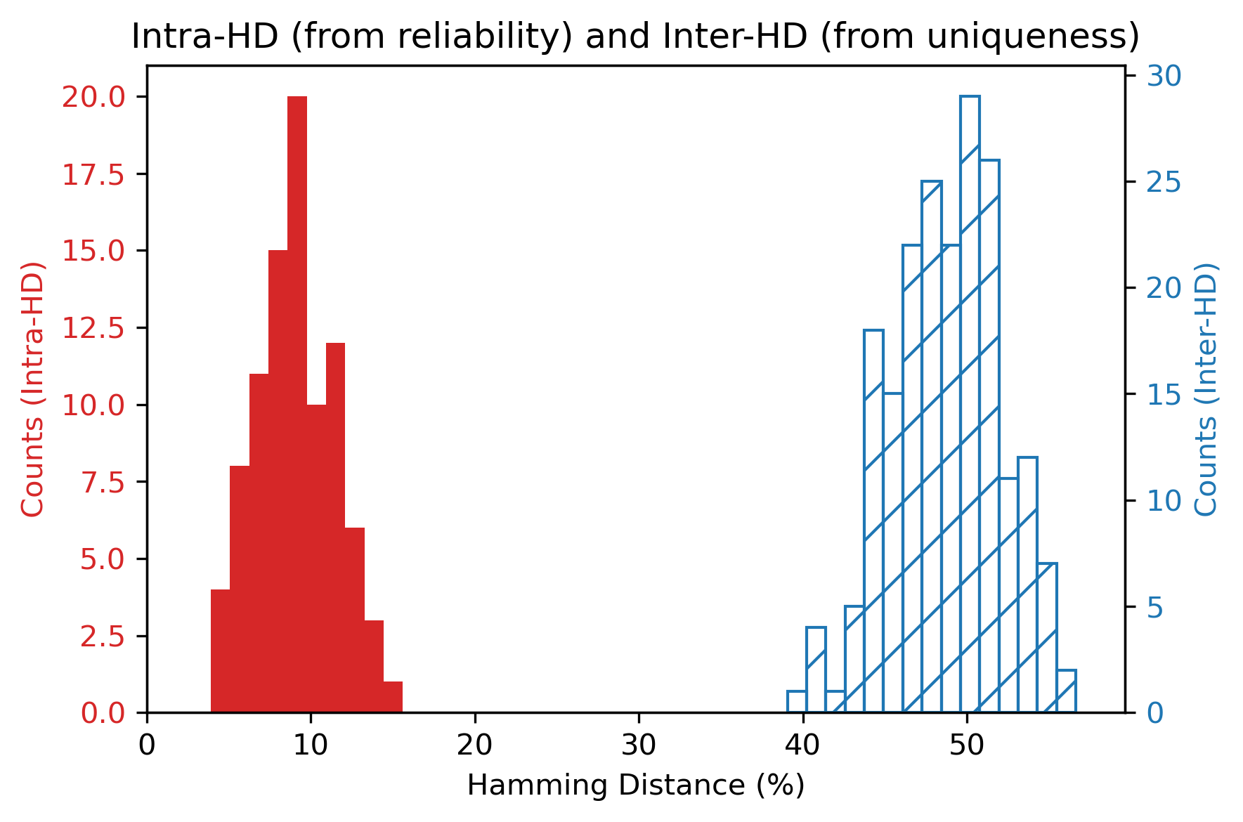
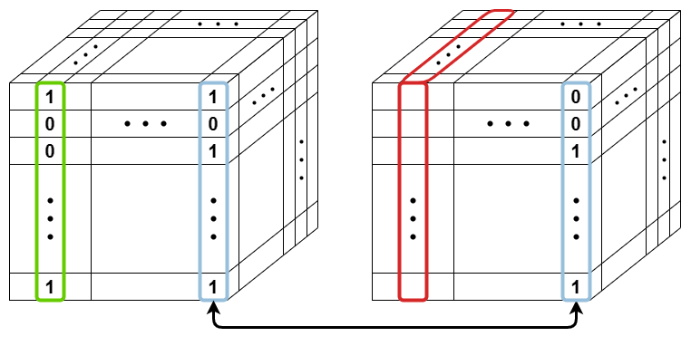
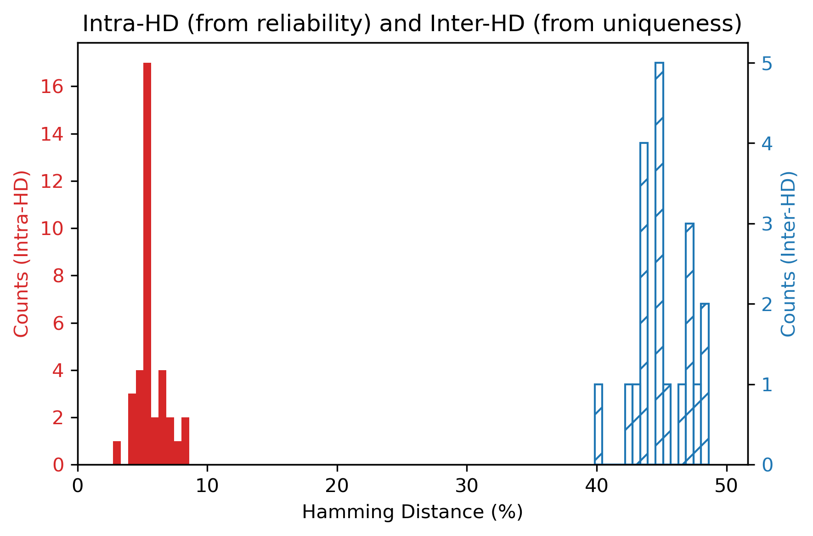
Experimental results – Compact PoC (3/3)
Comparison of results with TiO₂ and LiNbO₃:
TiO₂
 | Target | TiO₂ | LiNbO₃
Uniformity (%) | 50 | 51.4 | 48.7
Reliability (%) | 100 | 91.1 | 94.5
Uniqueness (%) | 50 | 48.5 | 45.0
LiNbO₃

Slide 14

III. Outlook
Results confined to the experimental prototype to date
Several avenues for progress identified:
  Custom CMOS sensor
  FPGA/ASIC-based reader
  Simulation tools (noise, response discrepancy)
  Post-processing operations

Slide 15
Thank you for your attention

Slide 16
References
[1] Maiti, Abhranil, Vikash Gunreddy, et Patrick Schaumont. « A Systematic Method to Evaluate and Compare the Performance of Physical Unclonable Functions ». In Embedded Systems Design with FPGAs, édité par Peter Athanas, Dionisios Pnevmatikatos, et Nicolas Sklavos, 245‑67. New York, NY: Springer, 2013. https://doi.org/10.1007/978-1-4614-1362-2_11.
[2] Pappu, Ravikanth, Ben Recht, Jason Taylor, et Neil Gershenfeld. « Physical One-Way Functions ». Science 297, nº 5589 (20 septembre 2002): 2026‑30. https://doi.org/10.1126/science.1074376.
[3] Guajardo, Jorge, Sandeep S. Kumar, Geert-Jan Schrijen, et Pim Tuyls. « FPGA Intrinsic PUFs and Their Use for IP Protection ». In Cryptographic Hardware and Embedded Systems - CHES 2007, édité par Pascal Paillier et Ingrid Verbauwhede, 63‑80. Lecture Notes in Computer Science. Berlin, Heidelberg: Springer, 2007. https://doi.org/10.1007/978-3-540-74735-2_5.
[4] Maes, Roel. Physically Unclonable Functions: Constructions, Properties and Applications. Physically Unclonable Functions: Constructions, Properties and Applications. Vol. 9783642413957, 2013. https://doi.org/10.1007/978-3-642-41395-7.
[5] Zhang, Shen, Bin Gao, Dong Wu, Huaqiang Wu, et He Qian. « Evaluation and Optimization of Physical Unclonable Function (PUF) Based on the Variability of FinFET SRAM ». In 2017 International Conference on Electron Devices and Solid-State Circuits (EDSSC), 1‑2. Hsinchu: IEEE, 2017. https://doi.org/10.1109/EDSSC.2017.8126474.
[6] Helfmeier, Clemens, Christian Boit, Dmitry Nedospasov, et Jean-Pierre Seifert. « Cloning Physically Unclonable Functions ». In 2013 IEEE International Symposium on Hardware-Oriented Security and Trust (HOST), 1‑6, 2013. https://doi.org/10.1109/HST.2013.6581556.

Slide 17
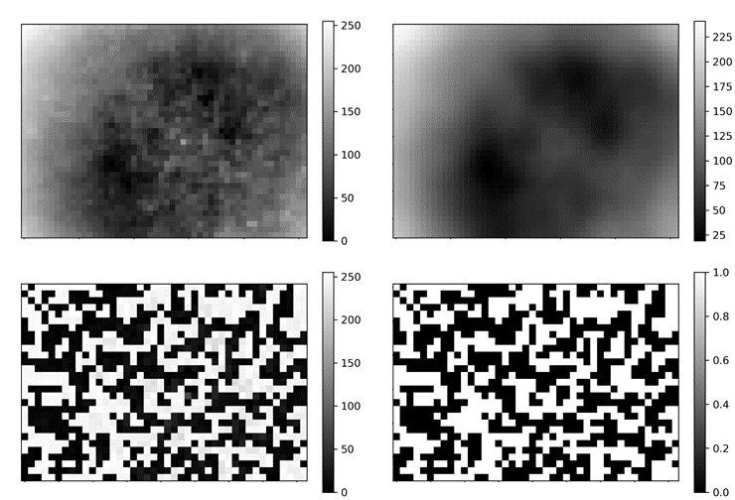
Supplementary Information
Process exploiting local maxima of transmission factor
Acquisitions without thin film
Acquisitions with thin film sample
Calculate transmission factors
Define responses
Analyze responses
Challenge
  OLED pixel position
  Sub-pixel color
  Sensor pixel position
Response
  Binary value
Rescale
Smooth
Mask
Binarize

