Slide 1
How not to use Deep Learning in Side-Channel analysis
CALLEJA ALBILLOS Ninon
&
BOUSSAM Sana
JC2-2023

Slide 2
Context – Side Channel Analysis
Profiled SCA
Access to a copy of the device
Acquire a dataset of traces with the knowledge of the target variable (Training dataset)
Use this dataset to build models
Non-profiled SCA
No access to a copy of the device
4
Analyze Traces to recover the target data
3
Send Traces
1
2
Cryptographic computations
Trace
acquisition

Slide 3
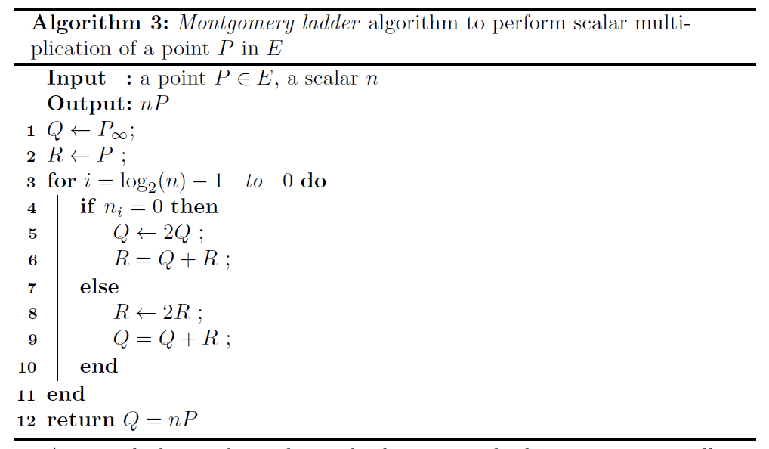
Perin et al. – Context
Attacker’s resource:
Non-profiled attack
Target: $μNaCl$ library
Dataset : $300∗255=76500$(EM) traces
https://tches.iacr.org/index.php/TCHES/article/view/8737/8337

Slide 4
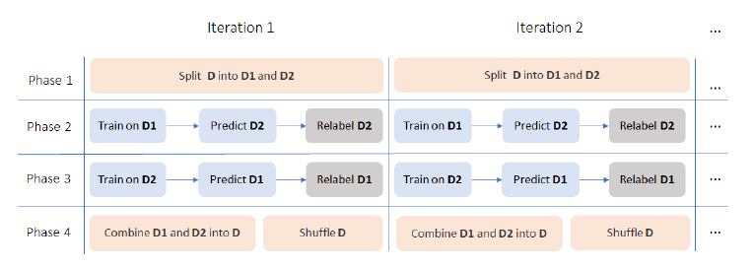
Perin et al. – Attack description
Attack scenario
Deep Learning free attack
SOST (PoI selection)
k-means (clustering)
Average accuracy : 52%
Corrective framework
Corrective framework
Framework accuracy

Slide 5
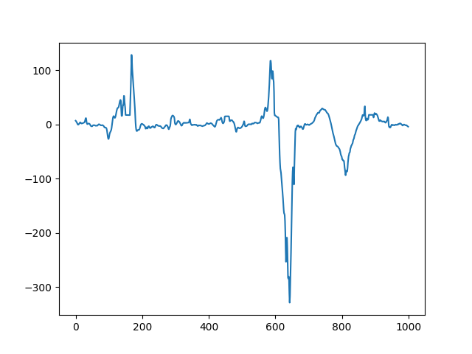
Perin et al. – Dataset analysis
Leakage assessment:
Dataset analysis:
K-means/LDA : Almost 100% accuracy
⇒ The dataset is linearly separable
T-test results

Slide 6
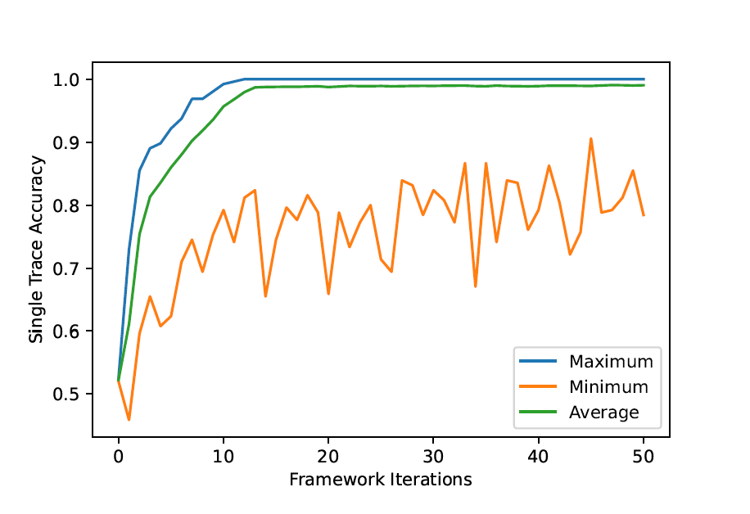
Perin et al. – Corrective framework simplification
Framework accuracy
Framework accuracy

Slide 7
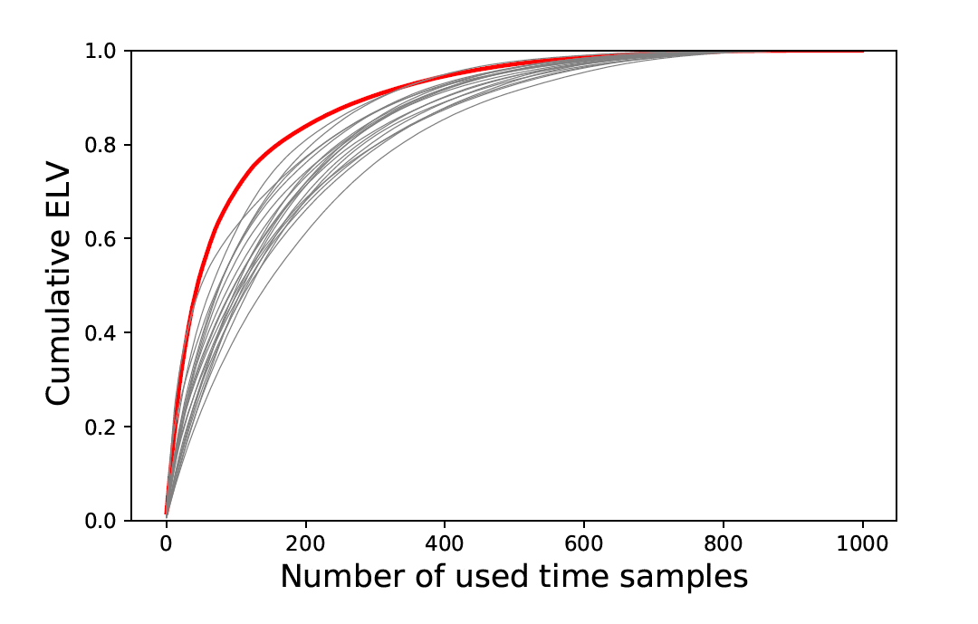
Perin et al. – Deep Learning free attack
Alternative attack scenario :
SOST (PoI selection)
K-means (clustering)
Alternative attack scenario :
SOST (PoI selection)
K-means (clustering)
Alternative attack scenario :
PCA (Dimension reduction)
K-means (clustering)
Component selection
⇒ Average accuracy : 98%
Normalized cumulative ELV trend of principal components.

Slide 8
Conclusion
 | Average accuracy
SOST + k-means (Perin et al.) | 52,24%
SOST + k-means + framework (Perin et al.) | 91%
SOST + k-means + simplified framework | 98.9%
PCA + k-means | 98%
PCA + k-means + simplified framework | 100%
Unsupervised horizontal attack on ECC
Outperforms Perin et al. in terms of
Time complexity
Average accuracy

Slide 9
Merci
CEA-Leti, Grenoble, France
cea-leti.com
ninon.callejaalbillos@cea.fr
+ 33 (0)7 86 48 26 13

Slide 10
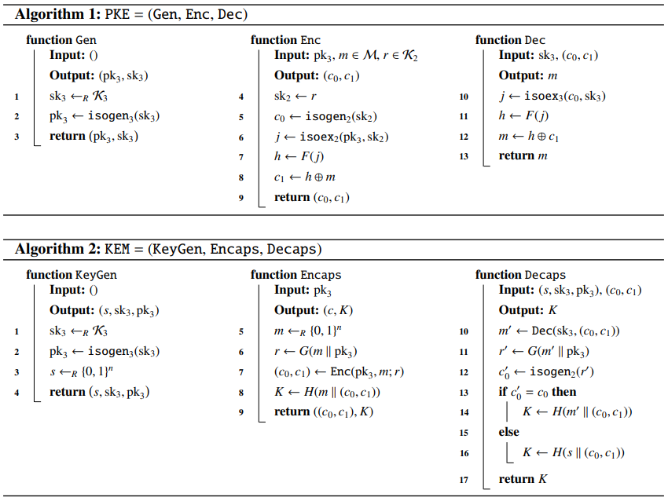
SIKE - Context
Attacker’s resources:
Static key
Chosen ciphertext attack
Non-profiled

Slide 11
SIKE – Attack description
Attack scenario : (Collision attack)
Target : $sk=\sum_{i}{α_{i}3^{i}}$ used in $R=skP+Q$, $P$ and $Q$ are public
Acquisition of reference traces $T_{ref,σ}$, $σ∈\left\{0,1,2\right\}$using:
For each ternary $α_{i}$
Acquisition of attack traces $T_{att,i}$ using:
Use of oracle $O$ to detect collision between $T_{att,i}$ and one of the three $T_{ref,σ}$
Notes:
Au moment du calcul du kernel de l’isogenie : multiplication scalaire avec les points public P, Q = R = skP + Q

Slide 12
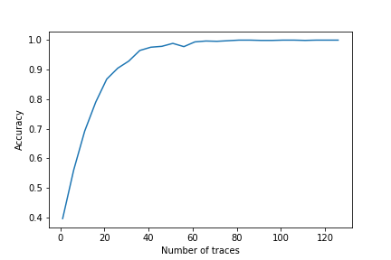
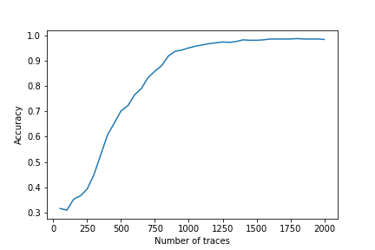
SIKE – Oracle description
Oracle based on Euclidean distances (ED)
Oracle based on LDA
 | Average accuracy | Number of traces
ED-based oracle | 100% | 27400
LDA-based oracle | 100% | 685 + 1500
Ueno et al. Oracle (using CNN) | 100% | 548 +30 000
https://tches.iacr.org/index.php/TCHES/article/view/9298/8864

Slide 13
Conclusion
Unsupervised horizontal attack on ECC
Outperforms Perin et al. in terms of
Time complexity
Average accuracy
Unsupervised collision attack on SIKE
Outperforms Ueno et al. in terms of
Time complexity
Overall number of traces

Slide 14
Merci
CEA-Leti, Grenoble, France
cea-leti.com
ninon.callejaalbillos@cea.fr
+ 33 (0)7 86 48 26 13

