Slide 1
Anomalous heat transport
David Mukamel
J. Cividini, A. Kundu, A. Miron, DM JSTAT 013203 (2017)

Slide 2
Heat transport
$$T_{+}$$
$$T_{−}$$
Fourier law
$$J=κ\frac{ΔT}{N}$$
$$ΔT=T_{+}−T_{−}$$
$κ$ is the thermal conductivity
In diffusive systems Fourier law is naturally obeyed
$$\frac{∂e}{∂t}=−∇J$$
$$J=−κ∇T$$
in steady state $∆T=0$and the temperature profile is linear

Slide 3
In many 1d models and in some 2d one observes anomalous heat conduction
Main observations:
$$J∝\frac{ΔT}{N^{1−α}}$$
$$0<α≤1$$
divergent heat conductance
($J=κ\frac{ΔT}{N}$)
Long range time correlations
Total current
$$J_{tot}\left(t\right)=\sum_{x}{J(x,t)}$$
$$\frac{1}{N}{\left\langle J_{tot}\left(t\right)J_{tot}(0)\right\rangle }_{eq}\sim t^{−(1−δ)}$$
$$0≤δ<1$$
Non trivial temperature profile

Slide 4
T
0
N
x
$$\frac{dT}{dx}∝x^{−ν}$$
(meniscus exponent)
$$ν>0$$
Divergent temperature gradient at the boundaries for any $ΔT$
Anomalous conduction is a result of heat transport models which are faster
than diffusion (say ballistic sound modes).

Slide 5
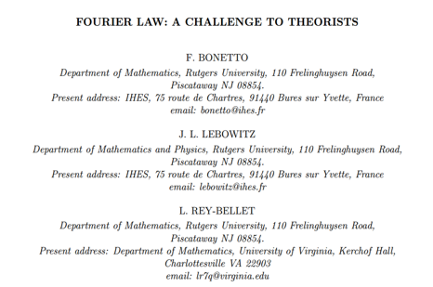
Mathematical Physics (2000)
…this is what we would consider a satisfactory answer to the challenge in the title of this article and we offer a bottle of very good wine to anyone who provides it.

Slide 6
Typical models:
A chain of nonlinear coupled oscillators
$$H=\frac{1}{2}\sum_{i=1}^{N}{p_{i}^{2}+\sum_{i=1}^{N−1}{V(q_{i+1}−q_{i})}}$$
e.g. Fermi-Pasta-Ulam chain
$$V\left(x\right)=x^{2}+αx^{3}+βx^{4}$$
Note: Harmonic chain is a non-generic case in which the modes
are non-interacting. As a result $J∝ΔT$rather then $J∝ΔT/N$

Slide 7
Hard disks model with alternating masses
$$H=\frac{1}{2m_{1}}\sum{p_{2i}^{2}}+\frac{1}{2m_{2}}\sum{p_{2i+1}^{2}}$$
note: when the masses are equal the model does not relax to equilibrium
(when $ΔT=0).$Due to energy and momentum conservation particles
just exchange momenta in collisions.

Slide 8
Stochastic models
Hard disks with three particle collisions
$$p_{1}+p_{2}+p_{3}=q_{1}+q_{2}+q_{3}$$
$$p_{1}^{2}+p_{2}^{2}+p_{3}^{2}=q_{1}^{2}+q_{2}^{2}+q_{3}^{2}$$

Slide 9
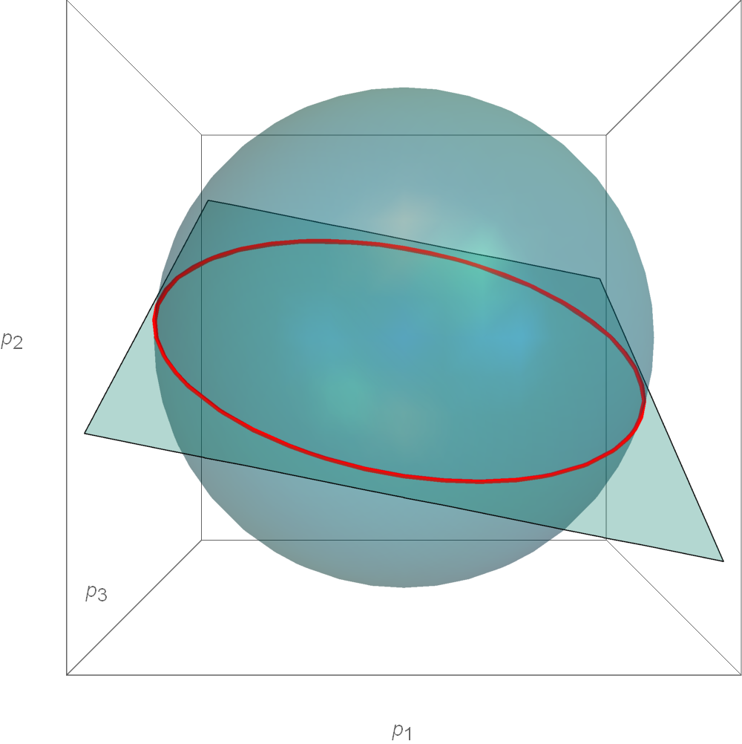

Slide 10
Two broad classes of approach
Non equilibrium setting
Equilibrium setting: make use of linear response and
apply Green-Kubo formula for the conductivity.
$$κ=\lim_{τ→∞}{\lim_{N→∞}{\frac{1}{NT^{2}}\int_{0}^{τ}{dt}\int_{0}^{N}{dx dy{\left\langle J\left(x,t\right)J\left(y,0\right)\right\rangle }_{N,eq }}}}$$
$$κ=\frac{1}{NT^{2}}\int_{0}^{∞}{dt\left\langle J_{tot}\left(t\right)J_{tot}(0)\right\rangle }$$

Slide 11
$$κ=\frac{1}{NT^{2}}\int_{0}^{∞}{dt\left\langle J_{tot}\left(t\right)J_{tot}(0)\right\rangle }$$
For
$$\frac{1}{N}{\left\langle J_{tot}\left(t\right)J_{tot}(0)\right\rangle }_{eq}\sim t^{−(1−δ)}$$
$$0≤δ<1$$
the integral diverges and the conductivity becomes infinite.
To obtain the conductivity of a finite systems one usually introduces
a cutoff in time $t≈\frac{N}{c} , c$ is a characteristic sound velocity
$$κ\sim \int_{x}^{\frac{N}{c}}{t^{−(1−δ)}dt\sim N^{δ}}$$
$$α=δ$$

Slide 12
Calculating the temperature profile
apply linear response for the average local current
$$J\left(x\right)=−\int_{0}^{N}{K_{N}(x,y)\frac{dT(y)}{dy}dy}$$
$$K_{N}\left(x,y\right)=\frac{1}{T^{2}}\int_{0}^{∞ }{dt {\left\langle J\left(x,t\right)J\left(y,0\right)\right\rangle }_{N,eq }}$$
In order to carry out this calculation one has to compute the
current correlation function for finite system taking into account
the coupling to the bath (through the boundary terms).

Slide 13
$$\int_{0}^{N}{K_{N}\left(x,y\right)dy}$$
For anomalous heat conduction the integral
should diverge with $N$.
Ignoring boundary terms and taking a large $N$ scaling limit for large $x−y$
$$K_{N}\left(x,y\right)∝\frac{1}{∣x−y∣^{1−α}}$$
$$J\left(x\right)∝−\int_{0}^{N}{\frac{1}{∣x−y∣^{1−α}}\frac{dT}{dy}dy}$$
$$J\left(u\right)∝−\int_{0}^{1}{\frac{1}{∣u−v∣^{1−α}}\frac{dT}{dv}dv}$$
$$u=\frac{x}{N} v=\frac{y}{N}$$

Slide 14
$$J\left(u\right)∝−\int_{0}^{1}{\frac{1}{∣u−v∣^{1−α}}\frac{dT}{dv}dv}$$
Using Sonin inversion formula the temperature profile is obtained
$$\frac{dT}{dv }∝{\left[v(1−v)\right]}^{−\frac{α}{2}}$$
$$ν=\frac{α}{2}$$
$$\frac{dT}{dx}∝x^{−ν}$$
This result does not agree with some explicit model calculation.

Slide 15
outline
Introduce a model for which the current correlation
function can be computed where the coupling to the
heat bath is taken into account.
Use it to obtain the temperature profile.
Show that the meniscus exponent $ν$ varies continuously
with the coupling to the bath.

Slide 16
Harmonic chain with momentum exchange model
$$H=\frac{1}{2}\sum_{i=1}^{N}{p_{i}^{2}+\frac{ω^{2}}{2}\sum_{i=1}^{N−1}{{\left(q_{i+1}−q_{i}\right)}^{2}}}$$
bulk dynamics:
$$\frac{dq_{i}}{dt}=p_{i}$$
$$\frac{dp_{i}}{dt}=ω^{2}(q_{i+1}−2q_{i}+q_{i−1})$$
$$i=2,…N−1$$
In addition: stochastic momentum exchange $p_{i}↔p_{i+1 }$with rate $γ$
$$γ$$

Slide 17
boundary terms (free bc) and coupling to the bath
$$\frac{dp_{1}}{dt}{=ω}^{2}\left(q_{2}−q_{1}\right)+ξ_{1}−λp_{1}$$
$$\frac{dp_{N}}{dt}=ω^{2}\left(q_{N−1}−q_{N}\right)+ξ_{N}−λp_{N}$$
$ξ_{1} , ξ_{N}$ -zero mean Gaussian noise with variances $2λT_{+} , 2λT_{−}$
$$γ$$
1
N

Slide 18
In terms of the difference variables
$$s_{i}=q_{i+1}−q_{i}$$
$$\frac{ds_{i}}{dt}=p_{i+1}−p_{i}$$
$$\frac{dp_{i}}{dt}=ω^{2}(s_{i}−s_{i−1})$$
$$i=2,…N−1$$
$$\frac{dp_{1}}{dt}{=ω}^{2}s_{1}+ξ_{1}−λp_{1}$$
$$\frac{dp_{N}}{dt}={−ω}^{2}s_{N−1}+ξ_{N}−λp_{N}$$
$ξ_{1} , ξ_{N}$ -zero mean Gaussian noise with variances $2λT_{+} , 2λT_{−}$

Slide 19
The hydrodynamic limit-bulk equations
Three conserved quantities: density, momentum, energy
$$s_{i} , { p}_{i , }{ e}_{i}=\frac{p_{i}^{2}}{2}+ω^{2}\frac{s_{i}^{2}+s_{\left\{i−1\right\}}^{2}}{4}$$
$$γ$$
1
N
$$\frac{ds_{i}}{dt}=p_{i+1}−p_{i}$$
$$\frac{∂s}{∂t}=\frac{∂p}{∂x}$$
$$\frac{dp_{i}}{dt}=ω^{2}(s_{i}−s_{i−1})$$
$$\frac{∂p}{∂t}=ω^{2}\frac{∂s}{∂x}$$
$$\frac{de_{i}}{dt}=2ω^{2}\left[\left(p_{i}+p_{i+1}\right)s_{i}−\left(p_{i−1}+p_{i}\right)s_{i−1}\right]$$
$$\frac{∂e}{∂ t}=4ω^{2}\frac{∂(ps)}{∂x}$$

Slide 20
Normal modes
$$φ_{+i}=ωs_{i}−p_{i}$$
$$φ_{+}=ωs−p$$
sound modes
$$φ_{−i}=ωs_{i}+p_{i}$$
$$φ_{−}=ωs+p$$
$${φ_{0}≡e}_{i}=\frac{1}{2}p_{i}^{2}+\frac{ω^{2}}{4}(s_{i}^{2}+s_{i+1}^{2})$$
energy mode
$$φ_{0}=e$$
$$\frac{∂s}{∂t}=\frac{∂p}{∂x}$$
$$\frac{∂}{∂t}φ_{±}=−\frac{∂}{∂x}(±ωφ_{±})$$
$$\frac{∂p}{∂t}=ω^{2}\frac{∂s}{∂x}$$
$${\frac{∂}{∂t}φ}_{0}=−\frac{∂}{∂x}(\frac{ω}{4}\left(φ_{+}^{2}−φ_{−}^{2}\right))$$
$$\frac{∂e}{∂ t}=4ω^{2}\frac{∂(ps)}{∂x}$$

Slide 21
Within the fluctuating hydrodynamic framework- add noise and dissipation
$$\frac{∂}{∂t}φ_{±}=−\frac{∂}{∂x}(±ωφ_{±} −D\frac{∂}{∂x}φ_{±}−\sqrt{2D}η_{±})$$
$${\frac{∂}{∂t}φ}_{0}=−\frac{∂}{∂x}[\frac{ω}{4}\left(φ_{+}^{2}−φ_{−}^{2}\right)−D_{0}\frac{∂}{∂x}φ_{0}−\sqrt{2D_{0}}η_{0}]$$
$η^{′}s −$ uncorrelated Gaussian white noise
The stochastic momentum exchange enters through the $D^{′}s$

Slide 22
Instantaneous energy current
$$J\left(x,t\right)=\frac{ω}{4}\left(φ_{+}^{2}\left(x,t\right)−φ_{−}^{2}(x,t)\right)$$
Thus one needs to solve only the equations for the sound modes
in order to obtain the energy current

Slide 23
Boundary conditions at $i=1,N$
$$\frac{ds_{i}}{dt}=p_{i+1}−p_{i}$$
$$\frac{dp_{1}}{dt}{=ω}^{2}s_{1}−λp_{1}$$
$$\frac{dp_{i}}{dt}=ω^{2}(s_{i}−s_{i−1})$$
add variables $s_{0}$ and $p_{0}$ such that the equation for $p_{1}$ becomes regular
$$\frac{dp_{1}}{dt}=ω^{2}\left(s_{1}−s_{0}\right)+ω^{2}s_{0}−λp_{1}$$
$$ω^{2}s_{0}−λp_{1}=0$$
Take time derivative to get an equation for $p_{0}$
$$ω^{2}\left(p_{1}−p_{0}\right)−λω^{2}\left(s_{1}−s_{0}\right)=0$$
$$\left(p_{1}−p_{0}\right)−λ\left(s_{1}−s_{0}\right)=0$$

Slide 24
Boundary conditions for the sound modes
$$ω^{2}s_{0}−λp_{1}=0$$
$$\left(p_{1}−p_{0}\right)−λ\left(s_{1}−s_{0}\right)=0$$
for the sound modes in the hydrodynamic limit
$$φ_{+}=ωs−p$$
$$φ_{−}=ωs+p$$
$${\left(\frac{∂}{∂x}φ_{+}+r\frac{∂}{∂x}φ_{−}\right)}_{x=0}=0$$
$${\left(φ_{+}−rφ_{−}\right)}_{x=0}=0$$
$$r=\frac{λ−ω}{λ+ω}$$

Slide 25
The boundary condition
${\left(φ_{+}−rφ_{−}\right)}_{x=0}=0$or ${\left(\frac{φ_{+}}{φ_{−}}\right)}_{x=0}=r$
means that if a - Gaussian sound peak hits the left boundary it is
reflected and becomes a + sound peak with a reduced amplitude
by a factor of r.

Slide 26
when a Gaussian $φ_{+}$ peak hits the right boundary it turns into
a $φ_{−}$ peak whose integral is multiplied by $r$
t=200
240
300
$$ω=1 γ=1 λ=0.25 N=500 r=−0.6$$
Initial condition: momentum kick to the particles at the center

Slide 27
Comments on the reflection coefficient
$$r=\frac{λ−ω}{λ+ω}$$
$λ=ω →r=0$ this is the case or resonance, no reflection
$λ=∞ →r=1$ fixed boundary condition
$r<0$means change of phase at reflection

Slide 28
Consider first the case r=0 and solve for the sound modes
$$\frac{∂}{∂t}φ_{±}=−\frac{∂}{∂x}(±ωφ_{±} −D\frac{∂}{∂x}φ_{±}−\sqrt{2D}η_{±})$$
Using the Green’s function of the diffusion equation (for $N→∞)$
$$f_{σ}(x,y,t)=\frac{1}{\sqrt{4πDt}}e^{− \frac{{\left(x−y−σωt\right)}^{2}}{4Dt}}$$
The solution is
$φ_{σ}\left(x,t\right)=\int_{0}^{N}{{dyf}_{σ}\left(x,y,t\right)φ_{σ}(y,0)}$+$\sqrt{2D}\int_{0}^{N}{dy\int_{0}^{t}{dt^{′}f_{σ}\left(x,y,t−t^{′}\right)∂_{y}η_{σ}(y,t^{′})}}$

Slide 29
For non-vanishing reflection coefficient r
The Green’s function is
$$f_{σ,τ}\left(x,y,t\right)=\frac{1}{\sqrt{4πDt}}\sum_{n=−∞}^{+∞}{r^{2n+(σ−τ)/2}e^{− \frac{{\left(x−στy+2σnN−σωt\right)}^{2}}{4Dt}}}$$
And the solution is
$$φ_{σ}\left(x,t\right)=\sum_{τ=±}{\left[\int_{0}^{N}{{dyf}_{σ,τ}\left(x,y,t\right)φ_{τ}(y,0)}\right]}$$
$$+\sqrt{2D}\sum_{τ=±}{\int_{0}^{N}{dy\int_{0}^{t}{dt^{′}f_{σ,τ}\left(x,y,t−t^{′}\right)∂_{y}η_{τ}(y,t^{′})}}}$$

Slide 30
Calculating the temperature profile
$$J\left(x,t\right)=\frac{ω}{4}\left(φ_{+}^{2}\left(x,t\right)−φ_{−}^{2}(x,t)\right)$$
$$J_{st}=−\int_{0}^{N}{K_{N}(x,y)\frac{dT(y)}{dy}dy}$$
$$K_{N}\left(x,y\right)=\frac{1}{T^{2}}\int_{0}^{∞}{dt{\left\langle J\left(x,t\right)J\left(y,0\right)\right\rangle }_{N, eq}}$$
needs to calculate
$$\left\langle J\left(x,t\right)J(y,0)\right\rangle ∝\left\langle (φ_{+}^{2}\left(x,t\right)−φ_{−}^{2}\left(x,t\right))(φ_{+}^{2}\left(y,0\right)−φ_{−}^{2}(y,0)\right\rangle$$
this can be done using the solution of $φ_{±}\left(x,t\right)$ and averaging over the
initial condition and the noise

Slide 31
$$Κ\left(u,v\right)=A\left[\frac{1}{\sqrt{∣u−v∣}}+ \sum_{n=1}^{∞}{\left(\frac{R^{2n}}{\sqrt{2n+u−v}}+\frac{R^{2n}}{\sqrt{2n−u+v}}−\frac{R^{2n−1}}{\sqrt{2n−2+u+v}}−\frac{R^{2n−1}}{\sqrt{2n−u−v}}\right)}\right]$$
$$R=r^{2}≡{\left(\frac{λ−ω}{λ+ω}\right)}^{2}$$
$$u=\frac{x}{N} v=\frac{y}{N}$$

Slide 32
For $R=0 \left(λ=ω\right)$one recovers the kernel of the infinite system
$$Κ\left(u,v\right)=A\frac{1}{∣u−v∣^{α}}$$
$$α=\frac{1}{2}$$
The stationary current
$$J_{st}=−A\frac{ΔT}{N}√N\int_{0}^{1}{\frac{1}{∣u−v∣^{α}}\frac{dT(v)}{dv}dv}$$
Sonin inversion formula
$$\frac{dT}{dv}∝{\left[v\left(1−v\right)\right]}^{−\frac{α}{2}}$$
meniscus exponent $ν=\frac{1}{4}$

Slide 33
For $R=1$ (fixed, or fully reflecting bc) the temperature profile
has been calculated to yield $ν=\frac{1}{2}$
S. Lepri, C. Mejia-Monasterio, A. Politi, J. Phys. A 42, 025001 (2009)
Thus the meniscus exponent $ν$ depends on the coupling to the
heat bath through $R$

Slide 34
calculate $ν(R)$
$$J_{st}=−\int_{0}^{N}{K_{N}(x,y)\frac{dT(y)}{dy}dy}$$
take derivative with respect to x
$$\int_{0}^{1}{\frac{∂Κ(u,v)}{∂u}\frac{dT(v)}{dv}dv=0}$$
$$u=\frac{x}{N} v=\frac{y}{N}$$
P.V.

Slide 35
P.V.
$$\int_{0}^{1}{\frac{∂Κ(u,v)}{∂u}\frac{dT(v)}{dv}dv=0}$$
$$Κ\left(u,v\right)=A\left[\frac{1}{\sqrt{∣u−v∣}}+ \sum_{n=1}^{∞}{\left(\frac{R^{2n}}{\sqrt{2n+u−v}}+\frac{R^{2n}}{\sqrt{2n−u+v}}−\frac{R^{2n−1}}{\sqrt{2n−2+u+v}}−\frac{R^{2n−1}}{\sqrt{2n−u−v}}\right)}\right]$$
Suppose $\frac{dT}{dv}∝v^{−ν}$ for small $ν$
The integral yields a $u^{−ν−\frac{1}{2}}$singularity originating from two terms in $Κ(u,v)$

Slide 36
$$Κ\left(u,v\right)=A\left[\frac{1}{\sqrt{∣u−v∣}}+ \sum_{n=1}^{∞}{\left(\frac{R^{2n}}{\sqrt{2n+u−v}}+\frac{R^{2n}}{\sqrt{2n−u+v}}−\frac{R^{2n−1}}{\sqrt{2n−2+u+v}}−\frac{R^{2n−1}}{\sqrt{2n−u−v}}\right)}\right]$$
$$\int_{0}^{u}{\frac{1}{{(u−v)}^{3/2}}\frac{dT}{dv}}dv+\int_{u}^{1}{\frac{1}{{(v−u)}^{3/2}}\frac{dT}{dv}}dv =$$
$$\int_{0}^{u}{\frac{1}{{(u−v)}^{3/2}}v^{−ν}}dv+\int_{u}^{1}{\frac{1}{{(v−u)}^{3/2}}v^{−ν}}dv$$
$$∝u^{−ν−1/2}$$
$$\int_{0}^{1}{\frac{w^{−ν}−w^{ν−\frac{1}{2}}}{{\left(1−w\right)}^{\frac{3}{2}}}dw−R\int_{0}^{1}{\frac{w^{−ν}+w^{ν−1/2}}{{\left(1+w\right)}^{3/2}}dw=0}}$$

Slide 37
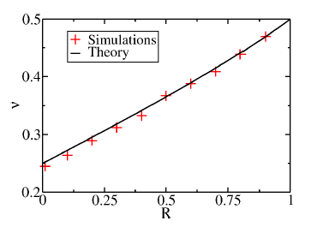

Slide 38
R=0
R=1/2
$$T_{+}=1.5 T_{−}=0.5 ω=γ=1 N=100$$

Slide 39
One may consider different $λ$’s for the two reservoirs
$$γ$$
$$λ_{+}$$
$$λ_{−}$$
The kernel $K(u,v)$ is the same as before but with reflection coefficients
$$R=r_{+}r_{−}$$
$$r_{±}=\frac{λ_{±}−ω}{λ_{±}+ω}$$

Slide 40
Levy flight picture of heat transfer
S. Lepri, A. Politi PRE, 83 030107 (2011)
A. Dhar, K. Saito, B. Derrida PRE 87, 010103 (2013)
Levy flight model:
Non-interacting particles hop on a 1d line with hopping rate from $y$ to $x$
at large $|x−y| w\left(x;y\right)∝\frac{1}{{|x−y|}^{1+β}}$ $1≤β≤2$
The model has anomalous current with $α=2−β$
Bath densities:
$$Q\left(x<0\right)=Q_{+} Q\left(x>L\right)=Q_{−}$$
$$Q_{+}$$
$$Q_{−}$$
What is the density profile for $0≤x≤L ?$

Slide 41
One finds
$$J\left(x\right)=\int_{0}^{L}{K_{L}\left(x;y\right)Q^{′}\left(y\right)dy}$$
$$w\left(x;y\right)=∂_{x}∂_{y}K_{L}(x;y)$$
Thus, for boundaries with reflection coefficient R, Levy flight with the
following hopping rate yields the same density profile as the temperature
Profile of the heat conduction model with reflection coefficient R.
$$w\left(x,y\right)=A\left[\frac{1}{{\left|x−y\right|}^{5/2}}+ \sum_{n=1}^{∞}{\left(\frac{R^{2n}}{{(2n+x−y)}^{5/2}}+\frac{R^{2n}}{{\left(2n+x−y\right)}^{5/2}}−\frac{R^{2n−1}}{{\left(2n−2+x+y\right)}^{5/2} }−\frac{R^{2n−1}}{{\left(2n−x−y\right)}^{5/2}}\right)}\right]$$

Slide 42
The meniscus exponent was conjectured to satisfy
$$ν=\frac{β}{2}+R(\frac{β}{2}−1)$$
$$β=2−α$$
For the harmonic chain with momentum exchange $α=1/2$
$$ν=\frac{3}{2}−\frac{1}{2}R$$
But actually
$$\int_{0}^{1}{\frac{w^{−ν}−w^{ν−\frac{1}{2}}}{{\left(1−w\right)}^{\frac{3}{2}}}dw−R\int_{0}^{1}{\frac{w^{−ν}+w^{ν−1/2}}{{\left(1+w\right)}^{3/2}}dw=0}}$$

Slide 43
summary
Fluctuating hydrodynamic approach is used to calculate
the temperature profile in heat conducting systems.
The approach is used for a specific model where the profile
and the meniscus exponent are shown to depend on the
coupling to the heat bath.
Close connection with the Levy flight picture is suggested.
Application to other model and how universal are the profiles
remain to be explored.

