Slide 2
Implementation of Shor : 15 = 3 x 5

Slide 3
Why the brain is probably not a quantum computer (Tegmark Phys Rev E 61:4194)

Slide 4
Outline
Neuro-electrodynamics in the classical brain
Quantum mechanics does not improve higher brain functions
Consciousness does not demystify quantum mechanics

Slide 5
Human cerebral cortex (left)

Slide 6
Neurons in the primary visual cortex V1 of the cat

Slide 7
Fine-structure of synapses

Slide 8
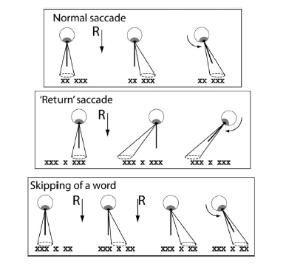
Eye movements during reading

Slide 9
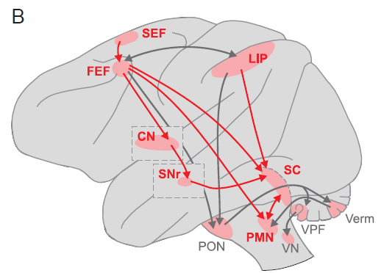
Descending pathways for saccades

Slide 10
Interaction between V1 and FEF during grouping Khayat et al., J Neurophysiology 101 (2009) 1813

Slide 11
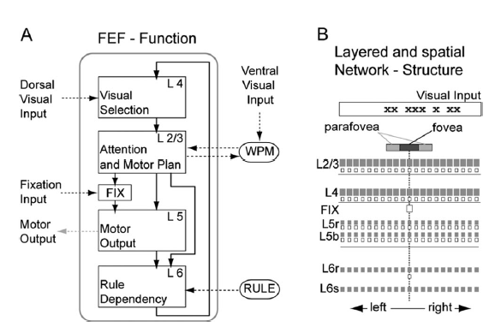
FEF model for reading in the brain (Heinzle et al. J Neurosci 27:9341)

Slide 12
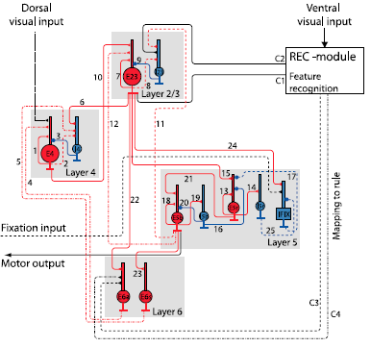
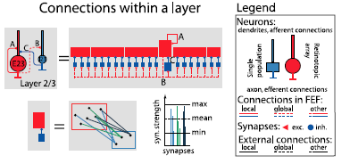
Complete network architecture

Slide 13
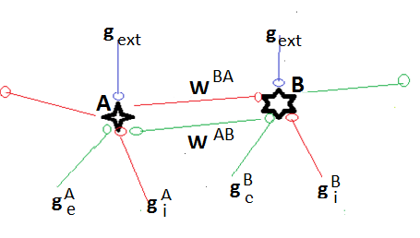
Interactions: B excitatory, A inhibitory

Slide 14
Dynamics

Slide 15
Normal reading and word skipping

Slide 16
How quantum brain biology can rescue conscious free will (Penrose: Pauli Lectures ETHZ 1997)

Slide 17
Quantum entanglement in photosynthetic light-harvesting complexes (Sarovar et al. Nature Phys 6:462)

Slide 18
Global entanglement in the FMO protein

Slide 19
Consciousness in the universe (Hameroff and Penrose Phys Life Sci 11:39-78 (2014))

Slide 20
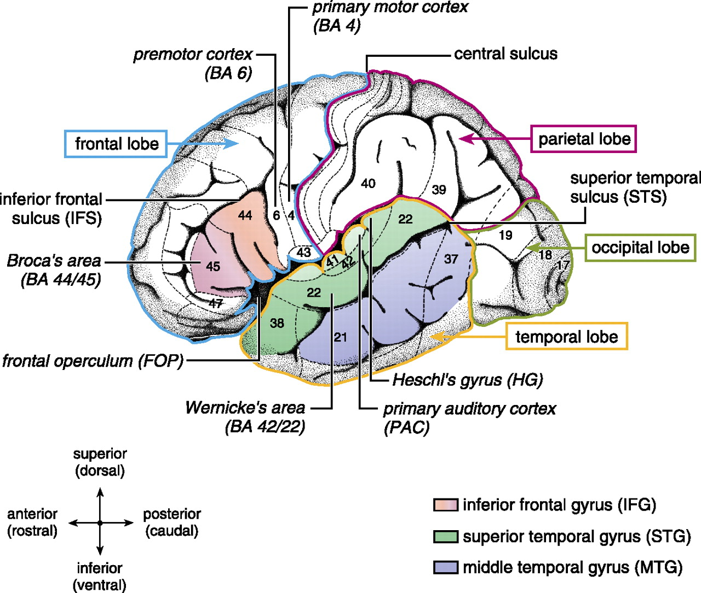
Anatomical and cytoarchitectonic details of the left hemisphere.
Friederici A D Physiol Rev 2011;91:1357-1392
©2011 by American Physiological Society
Notes:
Anatomical and cytoarchitectonic details of the left hemisphere. The different lobes (frontal, temporal, parietal, occipital) are marked by colored borders. Major language relevant gyri (IFG, STG, MTG) are color coded. Numbers indicate language-relevant Brodmann Areas (BA) which Brodmann (1909) defined on the basis of cytoarchitectonic characteristics. The coordinate labels superior/inferior indicate the position of the gyrus within a lobe (e.g., superior temporal gyrus) or within a BA (e.g., superior BA 44; the superior/inferior dimension is also labeled dorsal/ventral). The coordinate labels anterior/posterior indicate the position within a gyrus (e.g., anterior superior temporal gyrus; the anterior/posterior dimension is also labeled rostral/caudal). Broca's area consists of the pars opercularis (BA 44) and the pars triangularis (BA 45). Located anterior to Broca's area is the pars orbitalis (BA 47). The frontal operculum (FOP) is located ventrally and more medially to BA 44, BA 45. The premotor cortex is located in BA 6. Wernicke's area is defined as BA 42 and BA 22. The primary auditory cortex (PAC) and Heschl's gyrus (HG) are located in a lateral to medial orientation.

Slide 21
The brain processes syntax in the absence of conscious awareness (Batterink&Neville)
Syntactic violations in a stream of words were made undetectable by a brief auditory distraction. The undetected violations still evoked an early left anterior negativity, indicating that syntactic processing can proceed without awareness. Only detected violations evoked a later P600 response, confirming that the late positive event-related potentials are a marker of conscious processing.

Slide 22
Free Will Theorem (Conway&Kochen)
SPIN: Measurement of the squared components of spin of a spin 1 particle in 3 orthogonal directions always give the answer 1,0,1 in some order.
TWIN: For twinned spin 1 particles, suppose experimenter A performs a triple measurement of the squared spin components of a particle a in 3 orthogonal directions x,y,z while the experimenter B measures the twinned particle b in one direction w. If w belongs to {x,y,z}, then experimenter B will necessarily yield the same answer as A.

Slide 23
Free Will Theorem (Conway&Kochen)
MIN: Assume that the experiments performed by A and B are space-like separated. Then B can freely choose any direction w and A‘s response is independent of this choice. Similarly and independently A can freely choose any triple x,y,z and B‘s reponse is independent of that choice.
THEOREM: SPIN, TWIN and MIN imply that the response of a spin 1 particle to a triple experiment is ‚free‘, i.e. not a function of the properties of that part of the universe that is earlier than the response with respect to any given inertial frame.

Slide 24
From the QBism interpretation of quantum mechanics (Fuchs, Mermin and Schack):
The collapse of the wave function is nothing but the updating of an agent‘s state assignment on the basis of her experience.
Quantum correlations refer only to time-like separated events: the acquisition of experiences by any single agent. Quantum mechanics cannot assign correlations to space-like separated events, since they cannot be experienced by any single awareness.

Slide 25
References
Koch&Hepp, Nature 440:611 (2006)
Shor, SIAM J Computation 26:1484 (1997)
Schlosshauer ‚Decoherence‘, Springer (2007)
Joos&Zeh, Z Phys B 59:223 (1985)
Hepp, Helv Phys Acta 45:237 (1972)
Ishizaki&Fleming, PNAS 106:17255 (2009)
Wilkins&Dattani, arXiv 1411.3654 (2014)
Dehaene&Changeux, PNAS 94:13293 (1997)

Slide 26
References
Batterink&Neville, J Neurosci 33:8528 (2013)
Libet, Brain 102:193 (1979)
Conway&Kochen, Notices AMS 56:226 (2009)
Fuchs et al., Am J Phys 82:749 (2014)

