Slide 1
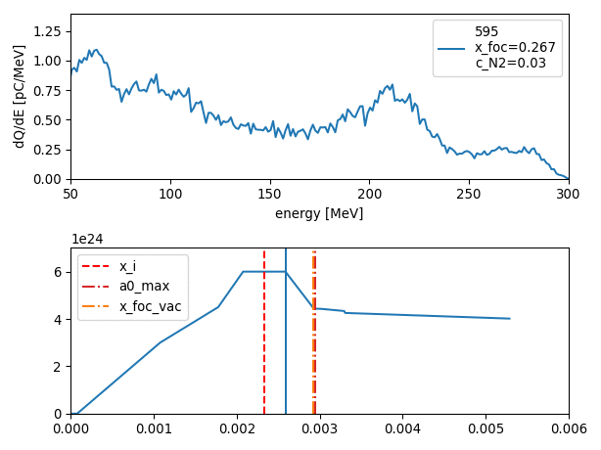
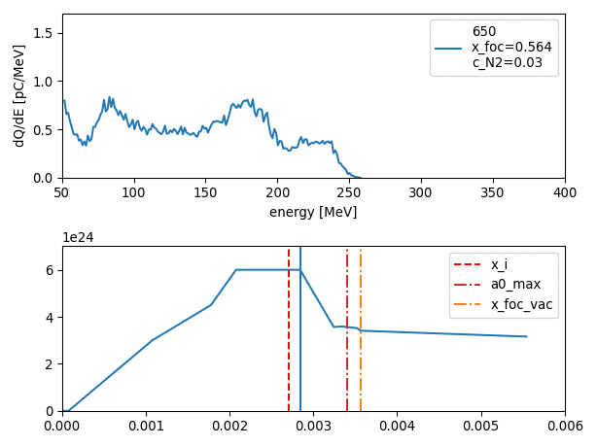
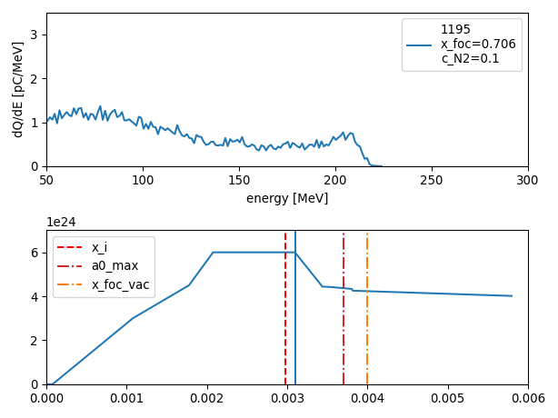
Fast PIC-simulation for LWFA target design optimization
Pierre Drobniak

Slide 2
Summary
Project and objectives
Pre-study based on a state of the art electronic density profile
Large grid scan on electronic density polygonal fit based on CFD simulation
3 dimensional Bayesian optimization using CFD simulated density profile
Conclusion and future development

Slide 3
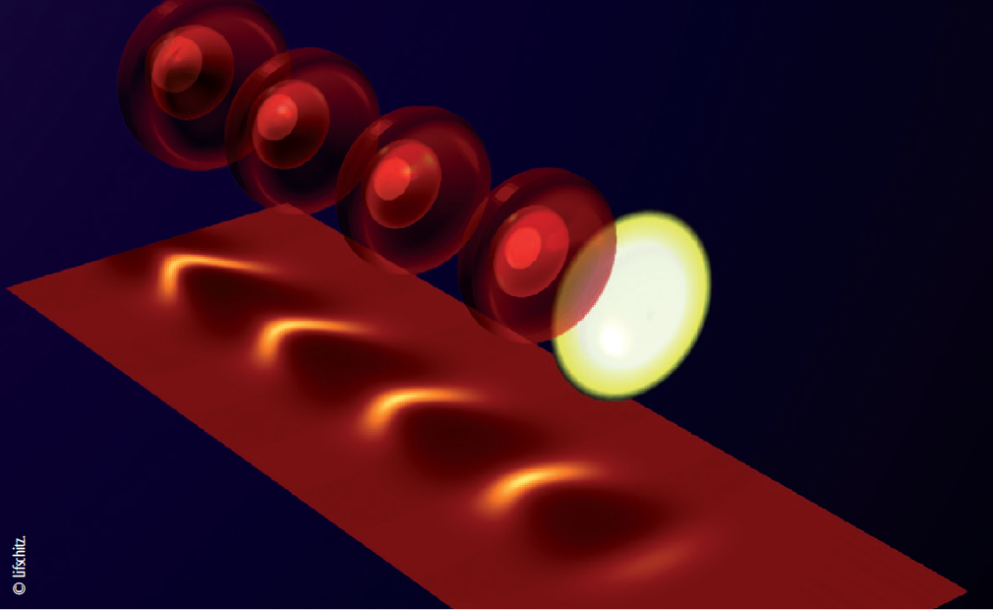
1. Project and objectives
Plasma Cell design
Laboratory project
2 gas injection (multizone)
150-200 MeV
30 pC
10Hz
1 mm.mrad ΔE/E <5%
Plasma cell
Stability at 10 Hz
Plasma Cell design
e-
Beam transport -> multi-stage
high quality electron beam
40 fs, 30TW, ~1.2J, 10 Hz
on target (from LaseriX platform)
Plasma wake
Prototyping Accelerator based on Laser-pLASma technology
Laser pulse
Participation to R&D Technical Design Report in preparatory phase on high-quality laser-plasma injector (LPI) for EUPRAXIA Horizon 2020 European project
Ionization injection assisted by density modulation
e- bunch
Laser Wake Field Acceleration (LWFA) [1]
https://pallas.ijclab.in2p3.fr/
http://www.eupraxia-project.eu/
[1] Malka et Al. (2013). Accélérateurs à plasma laser: principes et applications. Reflets de la physique, (33), 23-26.

Slide 4
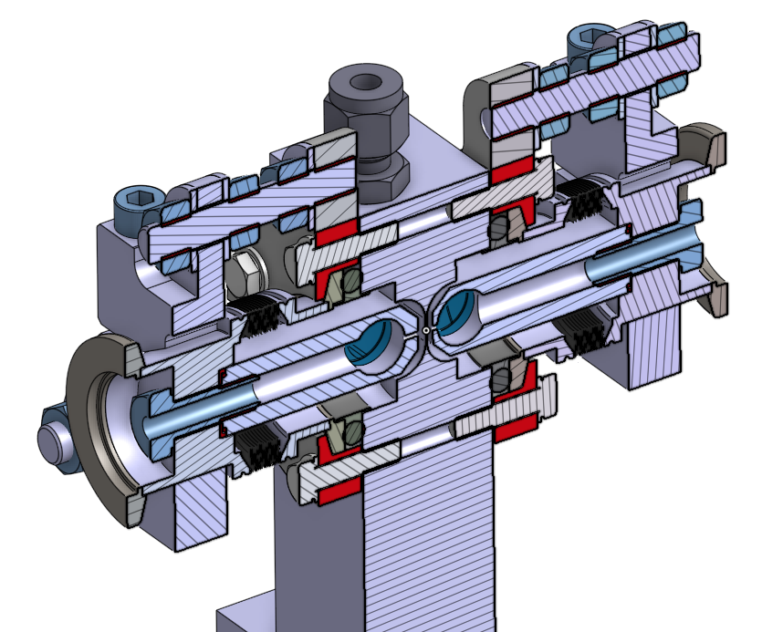
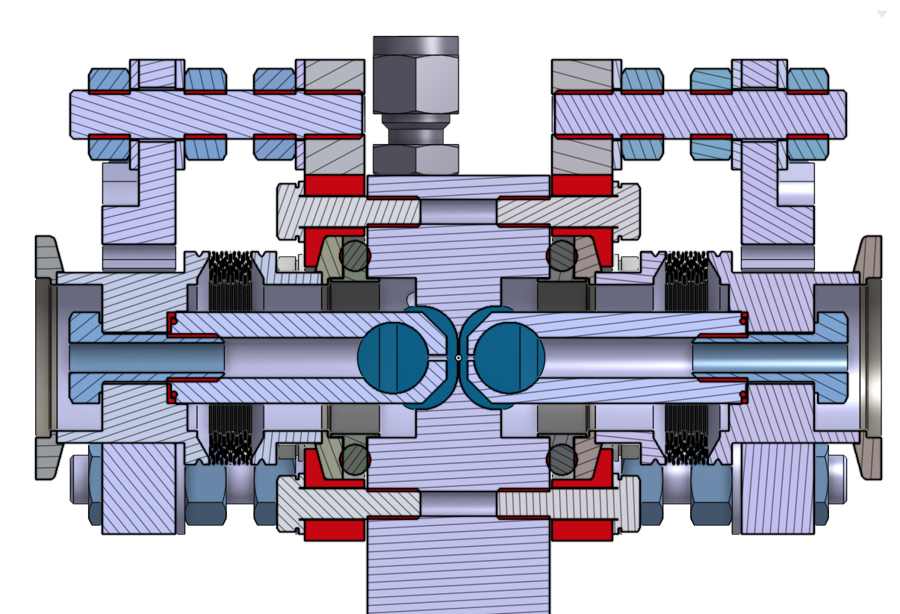
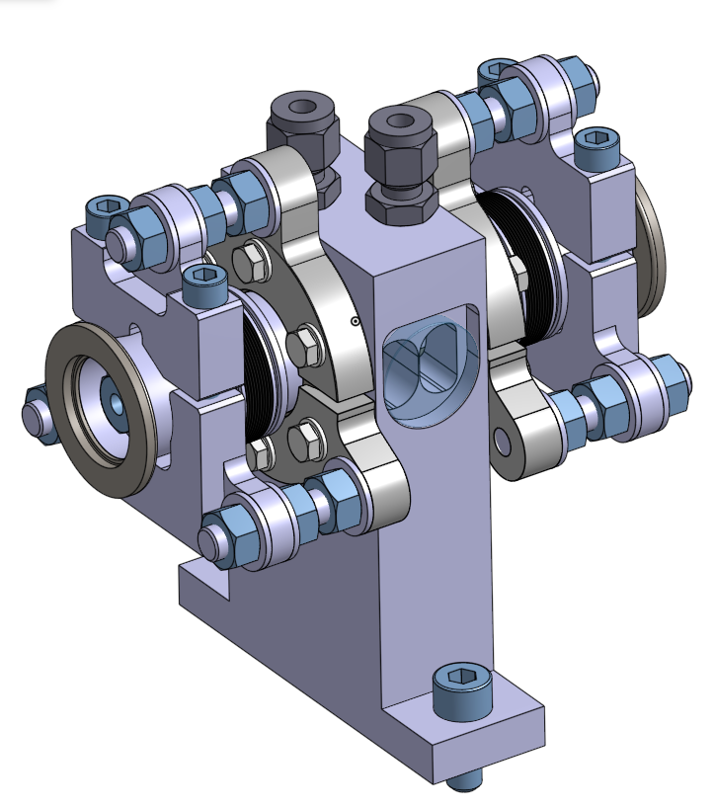
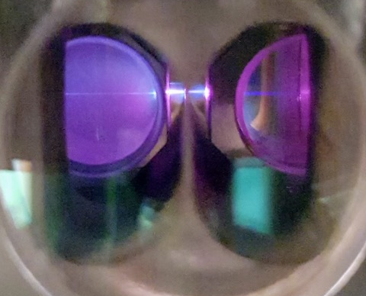
1. Project and objectives
Plasma Cell design
Zone 1
Zone 2
Longitudinal cut
Design zoomed in
Two-gas prototype
Gas 1
Gas 2
Laser
1 mm
Actual cell zoomed in

Slide 5
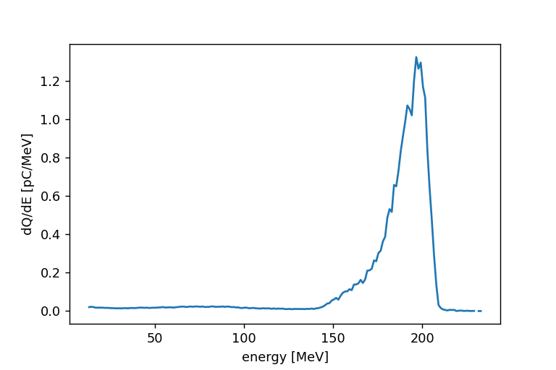
1. Project and objectives
Electronic density profile and PIC simulated laser variation
Spectrum of a PIC simulated electron beam
Laser direction
1st plateau
a₀ , -- a₀_vac
Spectrum [pC/MeV]
n_{e} , -- C_{N2} [x10¹⁸ cm⁻³, %]
2nd plateau
Longitudinal distance
Energy [MeV]
Zone 1
Zone 2
Main objective: find the configuration (laser parameters, electronic density distribution) yielding the “best” electron beam
Questions:
How to proceed ? -> particular configurations (from papers), brute force scan, Bayesian Optimization
Which parameters ? -> laser (a0, x_foc), density profile (dopant concentration c_N2, plateau values)
What does “best” mean ? -> objective function (charge, peak energy, energy spread)

Slide 6
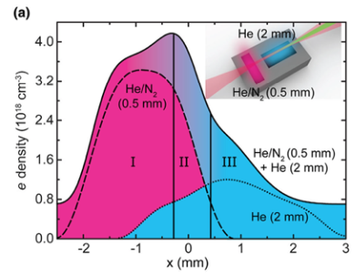
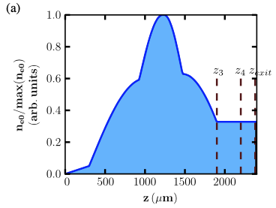
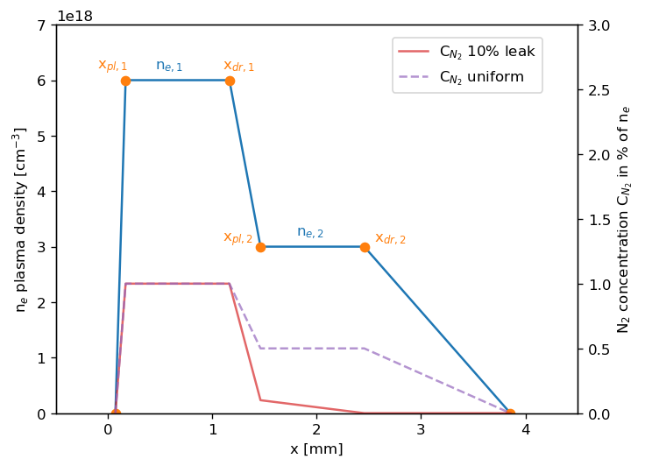
2. Pre-study based on a state of the art electronic density profile
Starting point : with a 30-40 TW laser does a tailored density profile induce a localized ionization injection ?
Golovin, G. et al. Tunable monoenergetic electron beams from independently controllable laser-wakefield acceleration and injection. Phys. Rev. ST Accel. Beams 18, 011301 (2015).
Lee, P. et al. Dynamics of electron injection and acceleration driven by laser wakefield in tailored density profiles. Phys. Rev. Accel. Beams 19, 112802 (2016).
Couperus, J. P. Optimal Beam Loading In A Nanocoulomb-Class Laser Wakefield Accelerator. (2018) doi: 10.5281/zenodo.1463709
Target: two region gas cell
Parameters varied
x_{foc}
n_{e,1}
r = n_{e,1} / n_{e,2} (1st plateau / 2nd plateau ratio of elec. density)
c_{N2} with leak (from zone 1 -> zone 2) or uniform
c_{N2} value
“Chair-like” Helium density profile with uniform or non-uniform (leak) N2-dopant

Slide 7
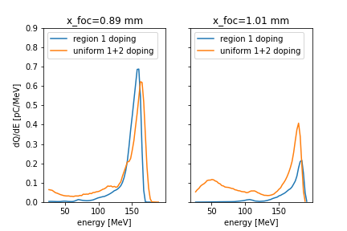
2. Pre-study based on a state of the art electronic density profile
Namelist
AM cylindrical
Envelope + Ionization (Massimo, Francesco, et al. "Numerical modeling of laser tunneling ionization in particle-in-cell codes with a laser envelope model." Physical Review E 102.3 (2020): 033204.)
Window parameters
Process & post-process
Simulations done on: TGCC VIRTUALAPLACE A7 supercomputer (10 nodes of 24 CPU, 45 simulations)
Post-process on: IJCLab remote computer “sera03” (Jupyter compatible)
Computation time: 2h / sim, 44µm/min
Simulation size: [20 – 50 ] GB
Computational cost: 10kh.cpu
Example of sensitivity to “x_foc” parameter
Conclusion:
High sensitivity to x_foc and density -> highly non-linear process
Use chair like profile + dopant in zone 1

Slide 8
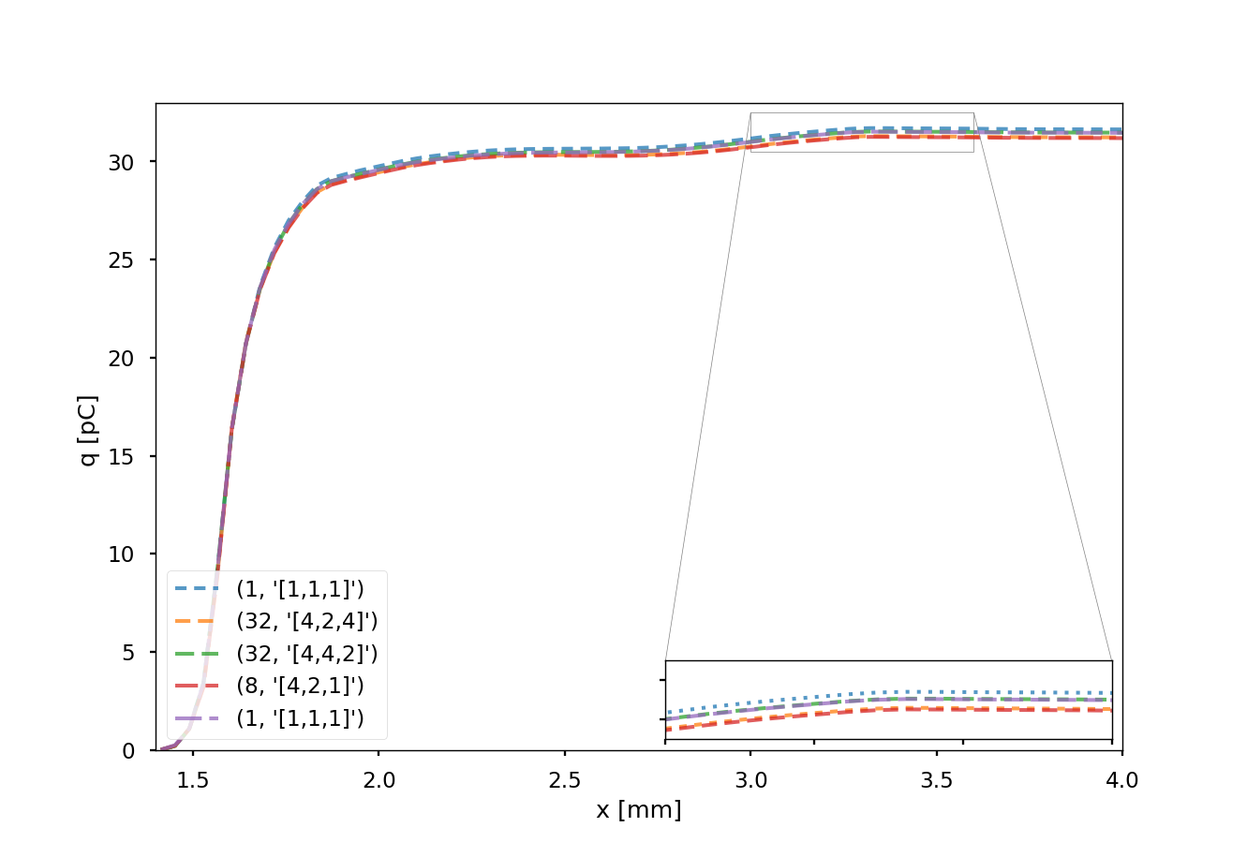
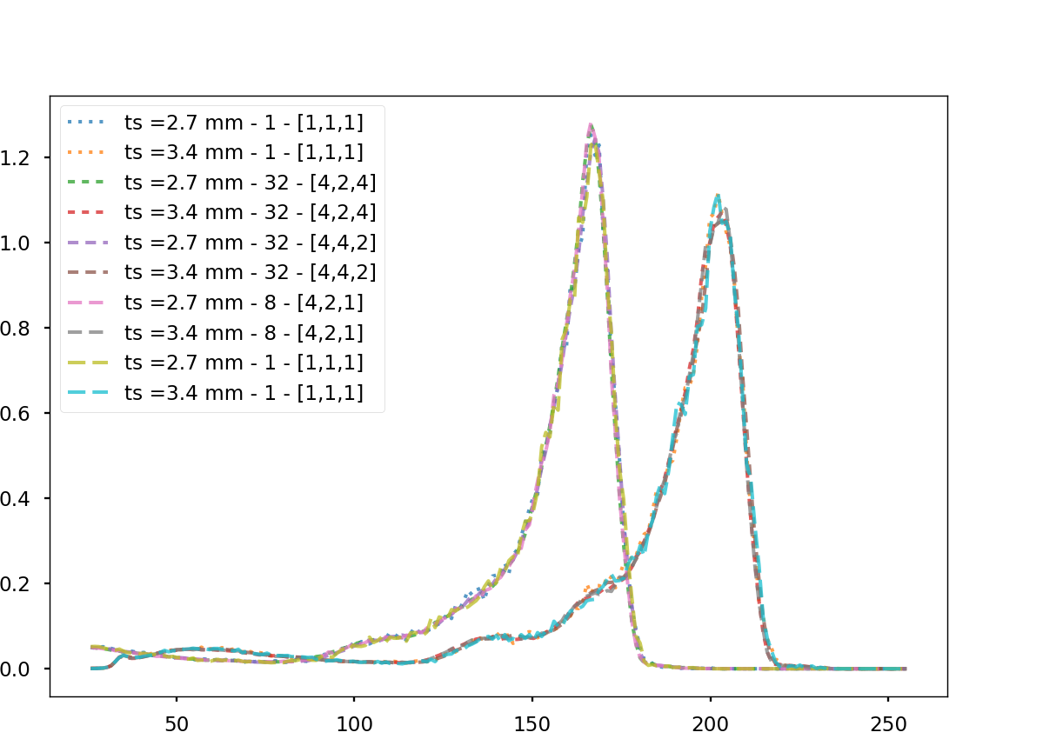
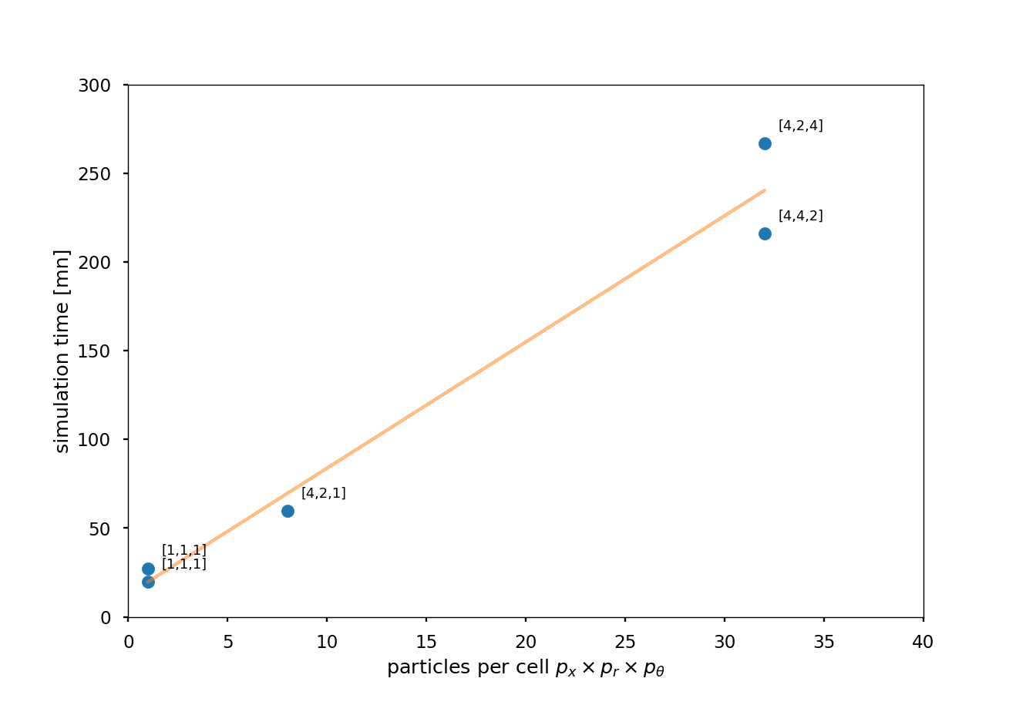
3. Large grid scan on electronic density polygonal fit based on CFD simulation
Can extensive scan search be performed ? -> yes if:
We decrease the ppc (particle per cell)
&
Simulations remain robust
Results:
ppc = 32 -> ppc = 1
200 min -> 20 min
Great robustness
Charge for different numbers of particles per cell
Spectra at 2 different sim. times for 1, 8 and 32 particles per cell
Computation time for different ppc

Slide 9
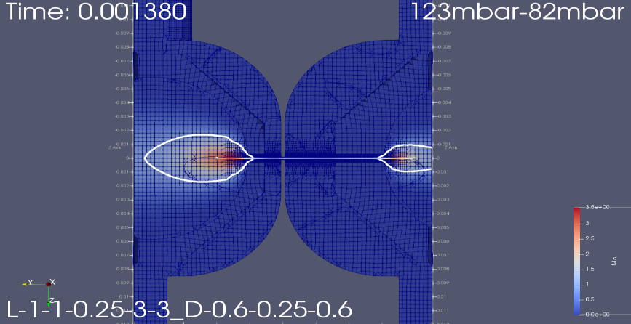
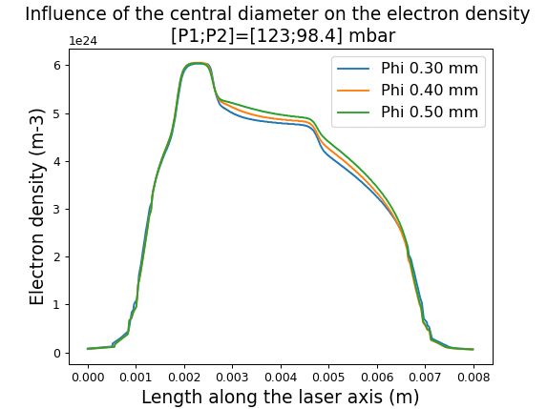
3. Large grid scan on electronic density polygonal fit based on CFD simulation
CFD simulation
2. Automatic meshing (snappyHexMesh utility)
3. Compressible flow simulation
1. Design zoomed in
200 000 cells
Optimized mesh
Compressible simulation
1 processor
1 hour simulation (with optimized geometry)
4. Gas density plot along propagation axis

Slide 10
3. Large grid scan on electronic density polygonal fit based on CFD simulation
Polygonal fits on CFD profiles:
To quickly change ratio « r » and vary it continuously
To avoid copying each OpenFOAM profile in namelist directory
Comments:
Focus on injection and acceleration -> shortened profile (for faster simulations)
Higher pressure difference -> more leak from zone 1 to 2 -> stronger gradient (for Helium & for N2-dopant)
Polygonal fits on CFD helium profiles and dopant distribution for several “r” ratios
(c_N2 = 1%)

Slide 11
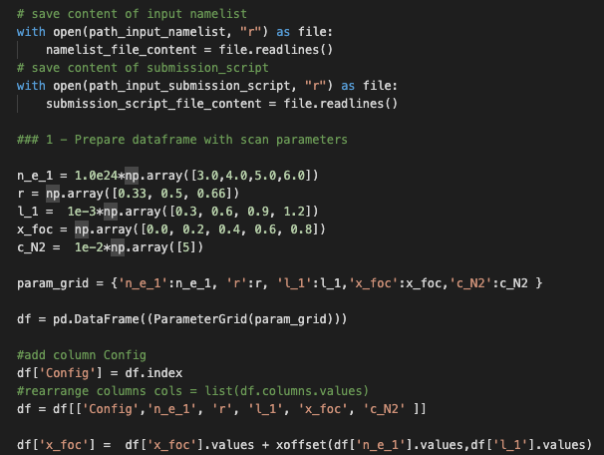
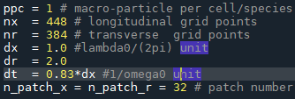
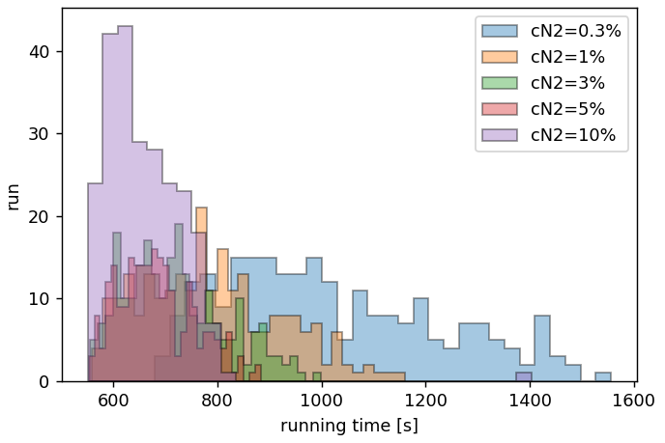
3. Large grid scan on electronic density polygonal fit based on CFD simulation
Scan/sim. properties
1200 cases
AM Cylindrical + Envelope
240 cpu / sim
Parameters varied
n_{e,1} (1st plateau value)
1st plateau length “l_1”
r = n_{e,1} / n_{e,2}
x_foc
c_N2 (dopant concentration)
Submission script (F. Massimo, V. Kubytsky)
Comments
Submission script to create namelists and directories from parameters
limit of 300 simultaneous jobs on IRENE -> additional script to submit job once space is available
Average sim. time = 12min 53s -> 316 µm/min
Total computer time = 258 h on 240 cpu -> 61,92 kh.cpu
Total real time duration: 4 h
Parameters range
Simulation time for different c_N2

Slide 12
3. Large grid scan on electronic density polygonal fit based on CFD simulation
E_med histogram filtered for: all simulations (blue), objectiveFunction > 1000 (orange), top 10 objectiveFunctions (red)
Div_rms histogram filtered for: all simulations (blue), E_med > 140 MeV (orange), top 10 highest E_med
E_mad histogram filtered for: all simulations (blue), E_med > 140 MeV (orange), top 10 highest E_med
$$optFunc= \frac{\sqrt{q} E_{med}^{3}}{E_{mad}}$$
goal
goal
goal

Slide 13
3. Large grid scan on electronic density polygonal fit based on CFD simulation
Only 852 out of 1200 have a peak
Statistical properties of brute force scan (1200 simulations)
Statistical properties of brute force scan (10 best simulations)
important dispersion
Comments
The range of output parameters gets lower -> thanks to obj. function
Produces the desired e-bunch
Parameter sensitivity requires to finely tune the search
Produces the desired electrons + “min-max range less wide”

Slide 14
4. 3-dimensional Bayesian optimization using CFD simulated density profile
Points of space where we already evaluated the function
Fit of what the real function is, using kernel functions
Bayesian Optimization working principle
Take a set of parameters (xfoc, cN2, a0) -> 3-dimensional parameters space in this case
For each configuration, give a value to the result: -> objective function
$$f=\frac{q E}{∆E}$$
Use an algorithm to know where to explore the parameters space, step after step and try to find a minimum/maximum of the the objective function.
Intelligent search using « kernel » functions, giving a certain weight to the evaluated points
Possible to tune the search: exploration vs exploitation (high variance vs high maxima)
Charge
Peak energy
Energy spread
Example of a Gaussian kernel
Probability of where the minimum could be
Source: https://youtu.be/x-fJAtMijME

Slide 15
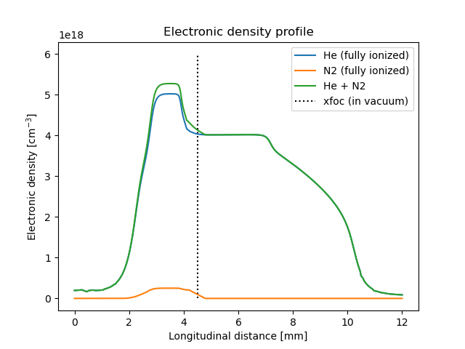
4. 3-dimensional Bayesian optimization using CFD simulated density profile
Simulations:
Density profile used
Parallel Bayesian Optimization (multiple points at each step)
Library used: « skopt » (https://scikit-optimize.github.io/stable/auto_examples/bayesian-optimization.html)
Parameters search space :
min max
xfoc 0.000 0.008
CN2 0.001 0.100
a0 0.900 1.500
Simulation characteristics:
dataframe_length: 500
Bayesian Optimization
Gaussian process
Parallel: 10 sim. / step
Window size: 512 x 1216
Patch: 32*64
1 ppc
ADK Envelope + AM cylindrical
Laser direction
Long target (12mm)
+
Larger window (avoid reflections)

Slide 16
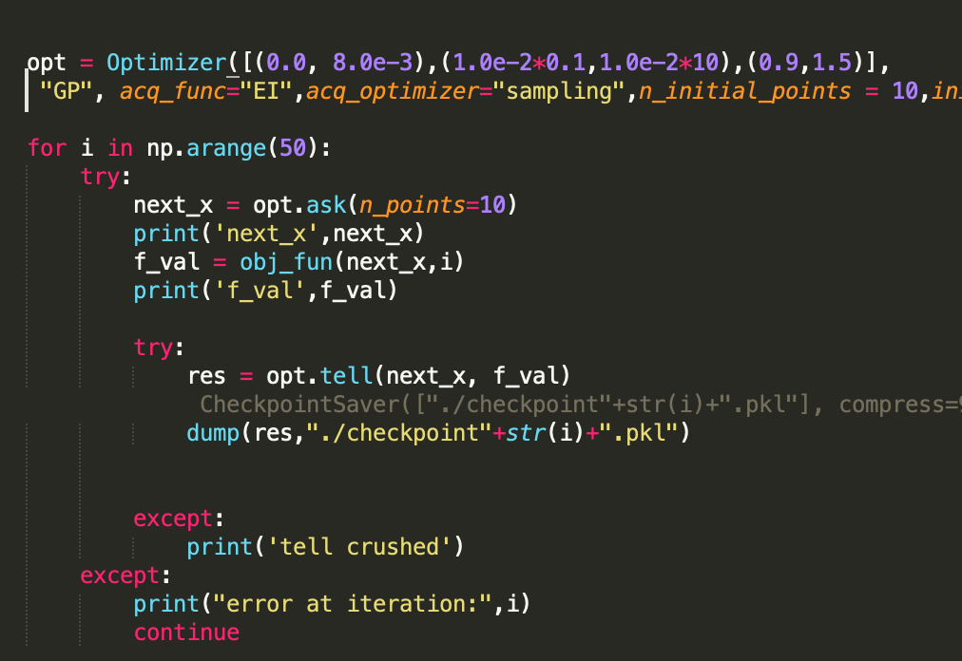
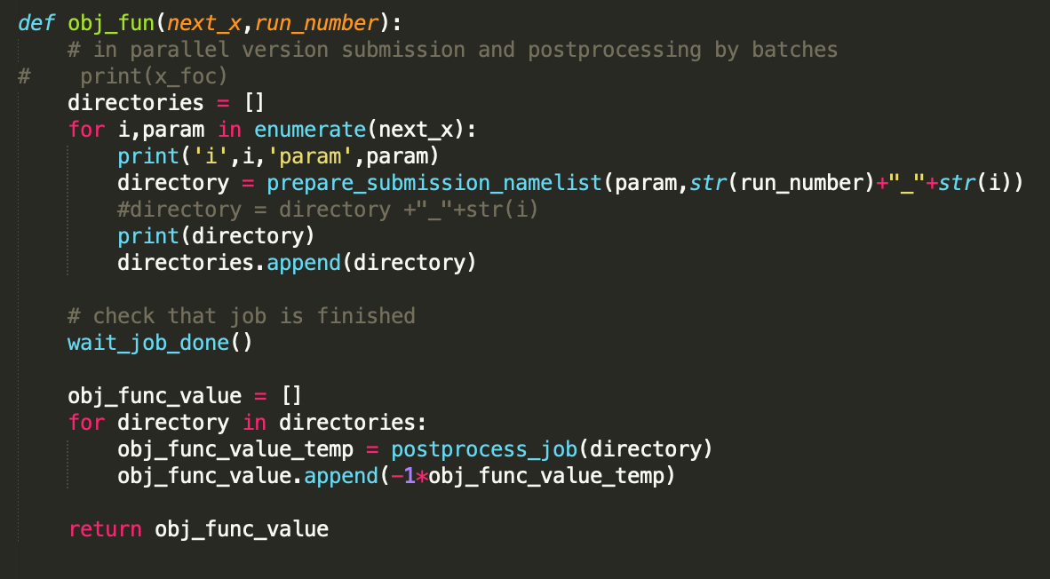
4. 3-dimensional Bayesian optimization using CFD simulated density profile
Parameters range
Function used to prepare namelists and launch simulations in parallel
N° of iterations
Number of sim. / step

Slide 17
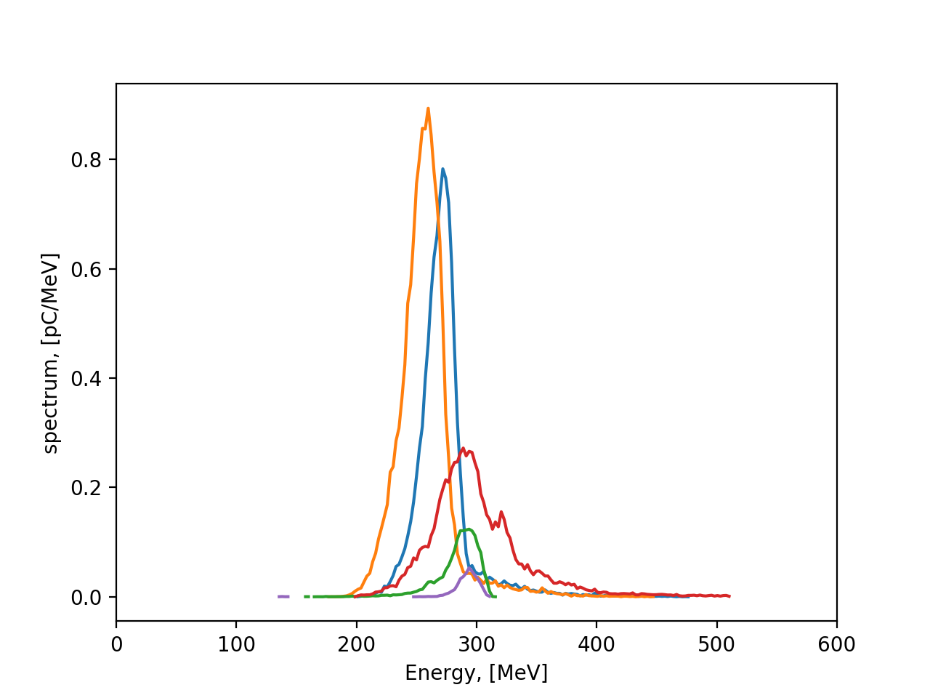
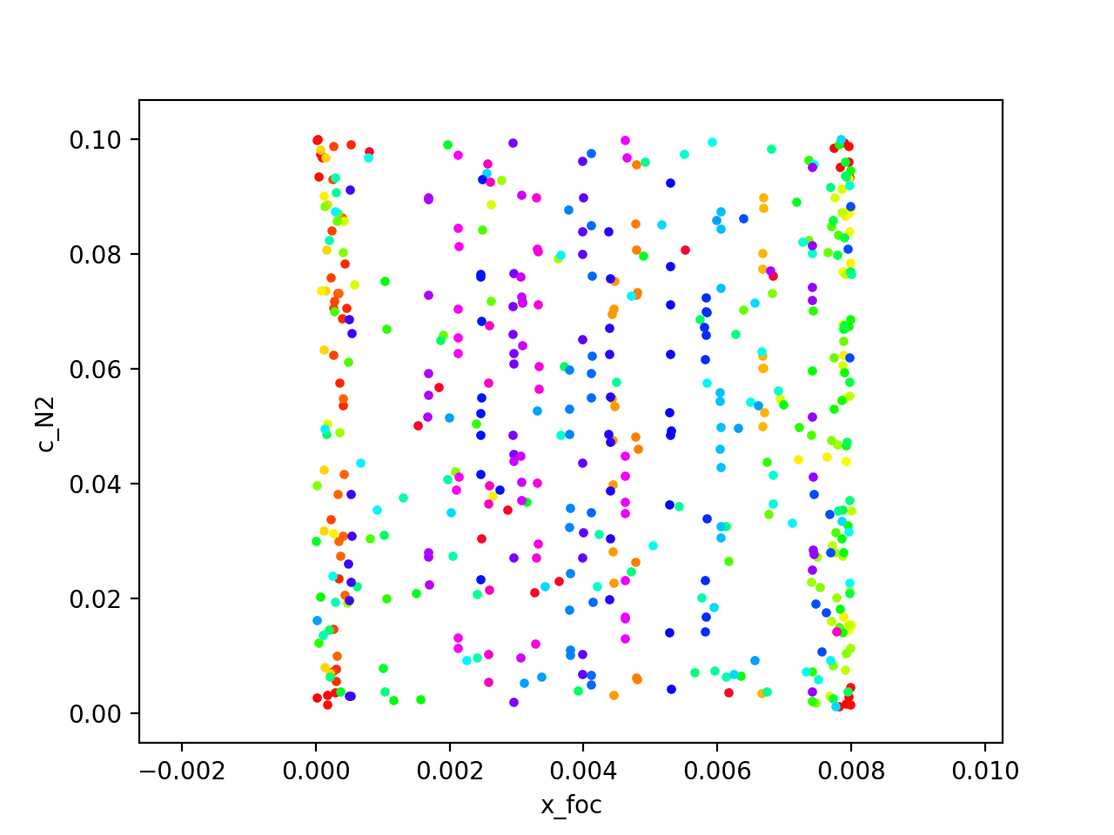
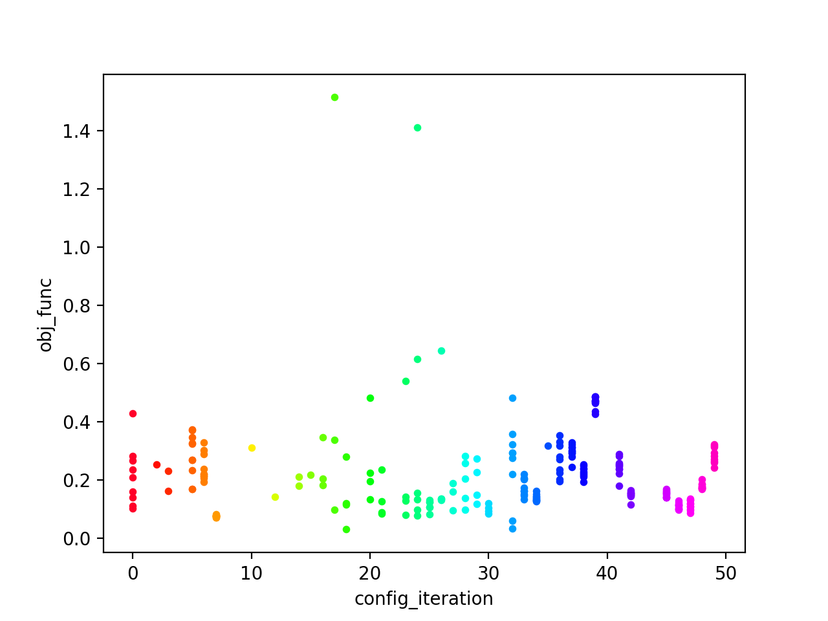
4. 3-dimensional Bayesian optimization using CFD simulated density profile
$$obj1= \frac{q E_{med}}{E_{mad}}$$
Results
Sim. characteristics:
Sim. time: 2,5h (large window + density distribution length 12mm) -> 80 µm/min
Total: approx. 50 x 2,5h = 125h = 5 days
Size: 30 GB per sim
Comments:
Higher a0 -> higher charge
Broad search
2D view (cN2,xfoc) of parameter search
Spectrum of 5 best simulations (highest objective function)
Objective function distribution after each iteration

Slide 18
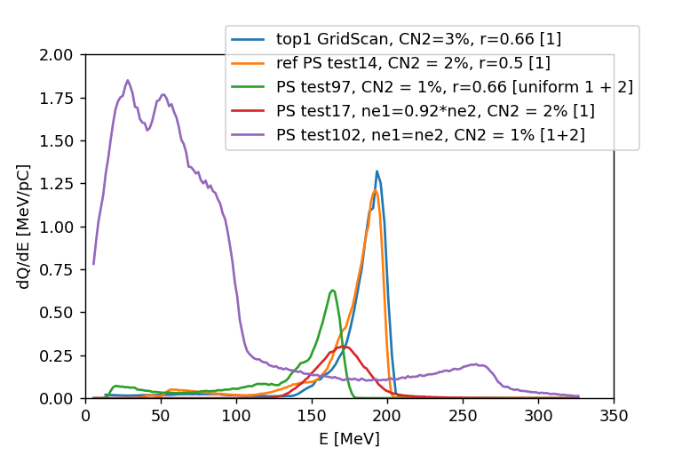
5. Conclusion and future developments
 | Pre-study (bibliography driven search) | Brute Force Scan | Bayesian Optimization
Sim. Duration (µm/min) | 44 (ppc 8) | 316 (ppc 1) | 80 (ppc 1)
Number of config. | 45 | 1200 | 500
Parallelizable ? | + | +++ | ++
Best result so far | ++ | +++ | +
Promising ? | + | + | +++
Conclusion:
our approach is accessible through extensive Fast PIC simulation thanks to AM + envelop + low PPC => 5min / mm -> could be less with PML (perfectly match layer)
Gridscan has allowed us to confirm the interest of the multizone target under development, to test objective function, postprocessing tools etc …
3D-Bayesian Optimization yields better results than large scan grid (fine tuning for x_foc) with a sensitivity less than 50 µm
Future studies:
shift laser spatial profile to more realistic profile Gaussian to FGB already tested (laser is complex to simulate accurately)
On PALLAS project there will be full set of laser diagnostics
10 Hz: pulse duration, energy, focal plane spatial distribution, pointing stability
1 Hz: spectral phase, spatial phase (wavefront), spatio-spectral distribution
multi-objective B.O is accessible we are starting the exploration 4Ds
refine density profile with experimental data
Outcoupling of the plasma, optimize the outramp -> avoid emittance/divergence explosion (Migliorati, M. et al. Intrinsic normalized emittance growth in laser-driven electron accelerators. Phys. Rev. ST Accel. Beams 16, 011302 (2013).)
Best spectra for Pre-study & Brute Force Scan
Best spectra with Bayesian Optimization

Slide 19
Thank you
And many thanks to
Kevin CASSOU, Viacheslav KUBYTSKYI, Sophie KAZAMIAS, Bruno LUCAS, Yann PEINAUD, Moana PITTMAN, Elsa BAYNARD, Julien DEMAILLY, Alexandre GONNIN, Stéphane JENZER

Slide 20
2. Pre-study based on a state of the art electronic density profile
Starting point : with a 30-40 TW laser does a tailored density profile induce a localized ionization injection ?
Golovin, G. et al. Tunable monoenergetic electron beams from independently controllable laser-wakefield acceleration and injection. Phys. Rev. ST Accel. Beams 18, 011301 (2015).
Lee, P. et al. Dynamics of electron injection and acceleration driven by laser wakefield in tailored density profiles. Phys. Rev. Accel. Beams 19, 112802 (2016).
Couperus, J. P. Optimal Beam Loading In A Nanocoulomb-Class Laser Wakefield Accelerator. (2018) doi: 10.5281/zenodo.1463709
Target: two region gas cell
Parameters varied
x_{foc}
n_{e,1}
r = n_{e,1} / n_{e,2} (1st plateau / 2nd plateau ratio of elec. density)
c_{N2} with leak (from zone 1 -> zone 2) or uniform
c_{N2} value
Namelist
AM cylindrical
Envelope + Ionization (Massimo, Francesco, et al. "Numerical modeling of laser tunneling ionization in particle-in-cell codes with a laser envelope model." Physical Review E 102.3 (2020): 033204.)
Window parameters
Process & post-process
Simulations done on: TGCC VIRTUALAPLACE A7 supercomputer (10 nodes of 24 CPU, 45 simulations)
Post-process on: IJCLab remote computer “sera03” (Jupyter compatible)
Results computational characteristics
Computation time: 2h / sim.
Simulation size: [20 – 50 ] GB
Computational cost: 10kh.cpu
“Chair-like” Helium density profile with uniform or non-uniform (leak) N2-dopant

Slide 21
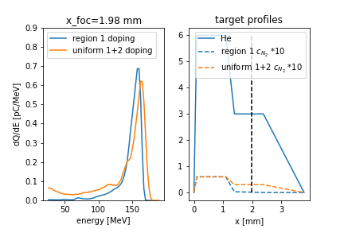
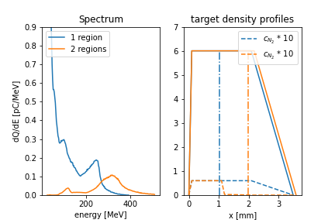
2. Pre-study based on a state of the art electronic density profile
Choice of chair-like profile.
Choice of zone 1 doping
Dopant in zone 1 or uniform ?
Influence of x_foc ? of density?
1-region cell VS chair-like profile ?
x_foc position
Example of sensitivity to “x_foc” parameter
Spectrum and density profile for zone 1 and uniform dopant. Chair-like profile in both cases
Spectrum and density profile for 1-region and 2-region targets. Uniform dopant for both cases.
Comments:
High sensitivity to x_foc and density -> highly non-linear process
Comments:
No clear peak for 1-region cell
2-region target -> better control of injection
Conclusion: use a “chair-like” profile
Comments:
Uniform dopant -> remaining low energy electrons
Zone 1 dopant -> high pass filter

Slide 22
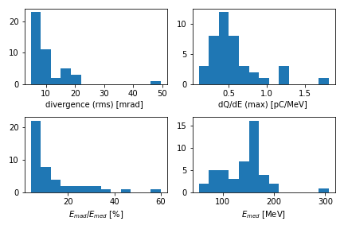
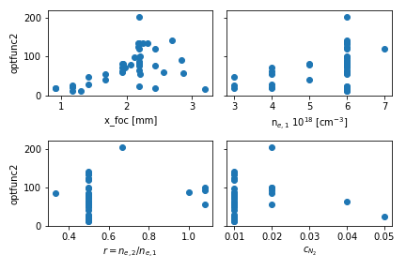
2. Pre-study based on a state of the art electronic density profile
45 Simulations histograms
Objective function values as a function of optimization parameters
$$optfunc2= \frac{q E_{med}}{E_{mad}}$$
Conclusion:
2 regions cell works
Use localized doping (zone 1)
Sensitivity to parameters (x_foc, density)
Range to explore for parameters
Search time: 45x2h = 90h (& sequential) -> not optimized
Objective function:
could be higher ?
Is it the best obj. function?
Median energy
= $\frac{Median Absolute Deviation}{Median Energy}$
Best simulation (accord. to obj. function)

Slide 23
5. Development of a realistic “Flattened Gaussian Beam” envelope

Slide 24
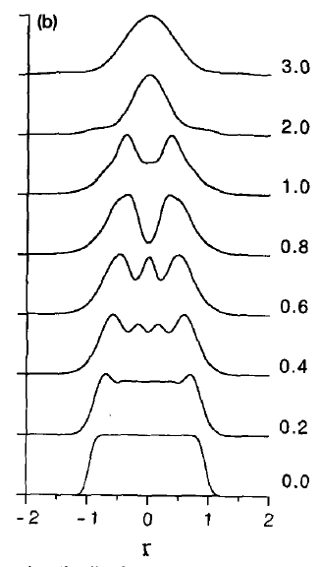
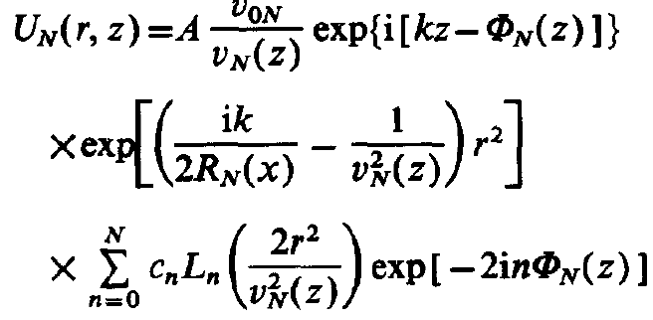
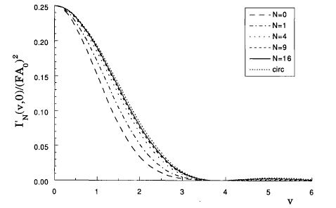
5. Development of a realistic “Flattened Gaussian Beam” envelope
Definition of a Flattened Gaussian Beam (FGB)
Gori, F. (1994). Flattened gaussian beams. Optics Communications, 107(5-6), 335-341.
What happens when we focus it ?
Santarsiero et Al (1997). Focusing of axially symmetric flattened Gaussian beams. Journal of Modern Optics, 44(3), 633-650.
Isophotes in the (u,v) plane for focused a FGB of order 4 near focus
Each “Laguerre mode” of the laser has it own:
Weight
Waist
Phase
Close to a “top hat” at its waist
wings
Intensity distribution along a diameter for an FGB of order 49. Transverse coordinates are in millimeters while the number on each curve gives the distance in meters from the waist
Intensity profile (along transverse direction) of focused FGBs on the focal plane, for different values of N (order), together with the case corresponding to the “circ” function

Slide 25
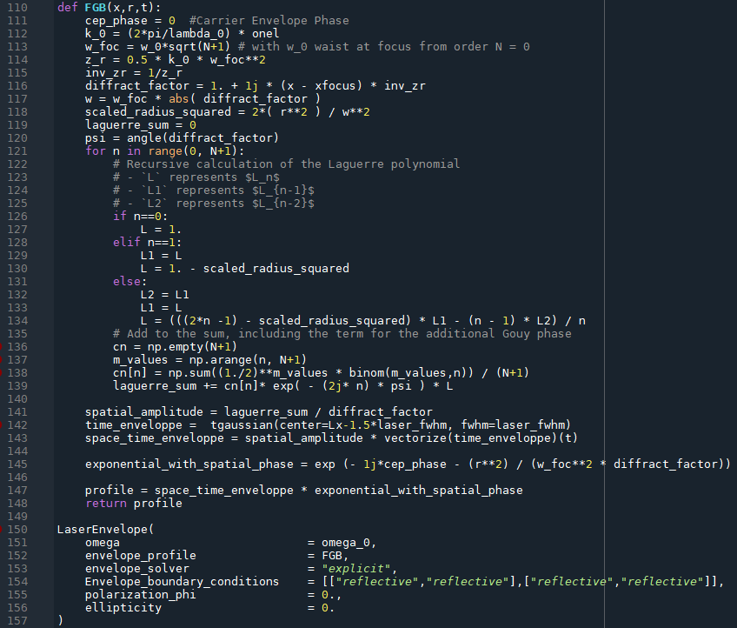
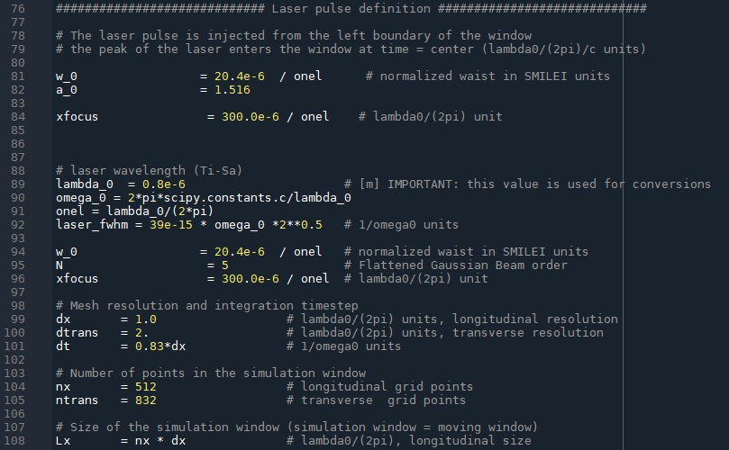
5. Development of a realistic “Flattened Gaussian Beam” envelope
Implementation in Smilei
Based on Gilles Maynard’s work in FBPIC (and a code structure given by Francesco Massimo)
Theoretical description: https://fbpic.github.io/api_reference/lpa_utilities/laser_profiles/flattened.html
FBPIC source code: https://fbpic.github.io/_modules/fbpic/lpa_utils/laser/laser_profiles.html#FlattenedGaussianLaser
Useful variables
FGB definition + integration

Slide 26
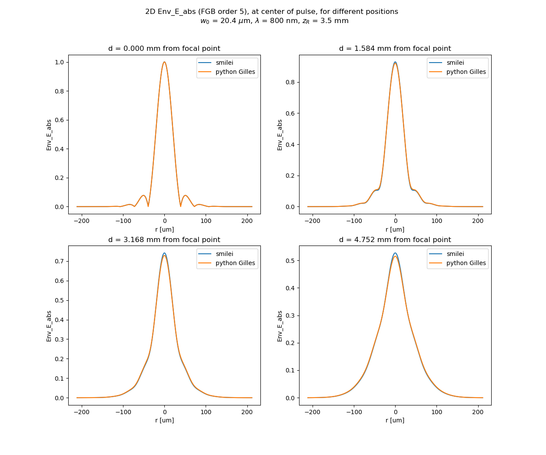
5. Development of a realistic “Flattened Gaussian Beam” envelope
Conclusion:
good agreement between FBPIC (direct python plots using the raw formula) and Smilei simulated Env_E_abs envelope, for a 5th order FGB.
Small difference far from focus
box transverse size 212 um
choice of slice might induce slight peak change
Comments:
do the same benchmark with FBPIC, but with plasma to compare:
Autofocalisation
Electron injection/acceleration
Ultimately, compare with experimental data:
Fit the FGB order with the experimentally measured one
Compare the ionization between simulation and experiment

