Slide 1
Gravitational Wave Detectors
Gravitational waves: a new messenger to explore the universe
3-4 March 2021
David Shoemaker
MIT LIGO/LISA
Notes:
<number>

Slide 2

Thanks to…
Persons loaning slides and more: J. McIver, M. Evans, S. Whitcomb, J.Kissel, J. Kanner, S.L. Danilishin, and many others hopefully acknowledged on slides
The LIGO Lab – MIT, Caltech, Hanford and Livingston Observatories
The LIGO Scientific Collaboration; Virgo and KAGRA
LISA Consortium and Pulsar Timing Array Collaborations
The US National Science Foundation for extraordinary support and perseverance for LIGO
<number>

Slide 3
References
Weiss R. Electromagnetically coupled broadband gravitational antenna, 1972 – historical interest. https://dcc.ligo.org/LIGO-P720002/public
Advanced LIGO The LIGO Scientific Collaboration https://arxiv.org/pdf/1411.4547
Saulson PR. Fundamentals of interferometric gravitational wave detectors (second edition). World Scientific, 2017 – good general introduction
Siegman AE. Lasers (revised). University Science Books; 1986
Reitze D, Saulson P, Grote H. Advanced interferometric gravitational-wave detectors. World Scientific Publishing; 2019.
Harms J. Terrestrial gravity Fluctuations. Living Reviews in Relativity. 2019 https://link.springer.com/article/10.1007/s41114-019-0022-2
Harry G, Bodiya T, DeSalvo R. Optical coatings and thermal noise in precision measurement. Cambridge
Heinert D, Hofmann G, Nawrodt R. Fluctuation dissipation at work: Thermal noise in Reflective optical coatings for GW detectors. In: 2014 IEEE Metrology for Aerospace (MetroAeroSpace); 2014. p. 293
Martynov D, Hall E, Abbott B, et al. Sensitivity of the advanced LIGO detectors at the beginning of gravitational wave astronomy https://arxiv.org/abs/1604.00439
McCuller L, Whittle C, Ganapathy D, et al. Frequency-dependent squeezing for Advanced LIGO https://export.arxiv.org/pdf/2003.13443
A guide to LIGO-Virgo detector noise and extraction of transient gravitational-wave signals https://arxiv.org/pdf/1908.11170
Einstein telescope http://www.et-gw.eu
Cosmic explorer https://cosmicexplorer.org
Hobbs G, Dai S. Gravitational wave research using pulsar timing arrays https://export.arxiv.org/pdf/1707.01615
The NANOGrav 12.5-year Data Set: Search For An Isotropic Stochastic Gravitational-Wave Background https://arxiv.org/pdf/2009.04496
LISA Mission Proposal https://dms.cosmos.esa.int/COSMOS/doc_fetch.php?id=3753414
<number>

Slide 4
Scope
This is the only talk in the Workshop addressing the practical issues of detectors
  GWs creating a real, measurable strain in space already discussed
  Data analysis with real-world constraints coming in a later lecture
Designed to give those interested in the theory and astrophysics an idea of the techniques, challenges, and opportunities
Some discussion of detection approaches for all frequency domains
Deeper focus on ground-based detectors for stellar-mass events
Qualitative in orientation; references for deeper study
<number>

Slide 5


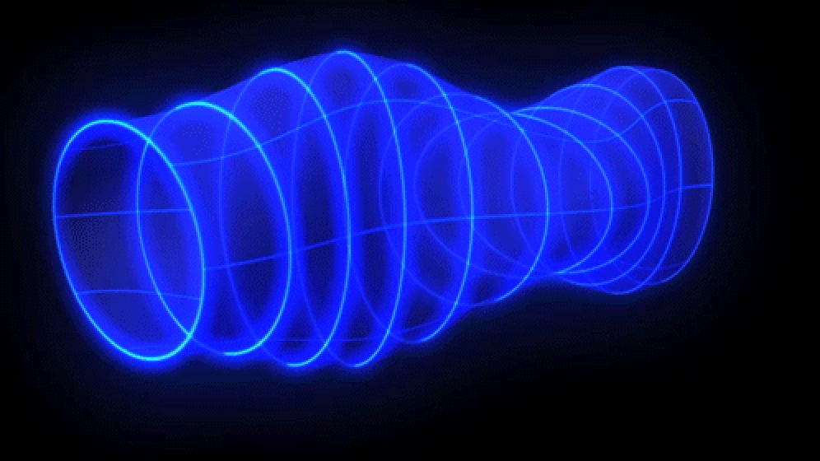
GWs in GR
While tests of deviation from GR are important, the detectors I will discuss are built to be sensitive to GR-predicted signals, so assume waves:
Propagating at the speed of light
Creating strain in space with (in general) a time dependence h(t)
Wavelengths – ground based currently in short-antenna limit
Two polarizations, 45º to each other
Ring of free ‘test masses’ is deformed by a passing GW – this enables observation
ESA
<number>

Slide 6
Detection methods, Projects
B-mode Polarization of the Cosmic Microwave Background
  Search for a primordial GW Background: A very interesting target!
  Does not provide a time series h(t) of strain; not discussed further here
Pulsar timing arrays
  Use pulsars as test masses with clocks
  Look using radio telescopes for timing shifts in spatially-separated pulsars
  Astrophysical stochastic background the initial target
  Science target ~10⁷ – 10¹⁰ M⦿ systems
Space-based laser interferometric detectors
  LISA for example (launch in mid-2030’s)
  Science target ~10³ – 10⁷ M⦿ systems; 2.5x10⁶ km arms
  and: DECIGO concept targeting primordial Background around 0.1 Hz
Ground-based laser interferometric detectors
  LIGO, Virgo, KAGRA Current; 3 – 4 km arms
  Einstein Telescope, Cosmic Explorer future; 10 – 40 km arms
  Science target ~ <1 – 10³ M⦿ systems
<number>

Slide 7
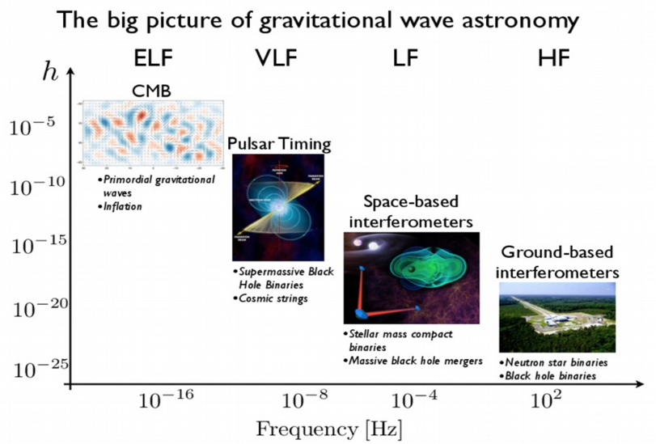
Detection methods, Projects
<number>

Slide 8
Detection methods, Projects
<number>

Slide 9
Ground-based Detector requirements → specifications
Ground-based detectors: presently best-effort technically
  Where were optical or radio telescopes, X-ray satellites, etc. 5 years after their first successful operation? That’s where GW detectors are!
  Seek observational science enabled with what can be built now
  Parallel development of future science-driven observatories/detectors
Low frequency limit enable studies of BH systems up to ~150M⦿
  enables long observation times for lighter systems
  NSNS system seen for >30sec
High frequency limit to enable studies of NS coalescence
  Ideally 3-4 kHz, currently more like 0.7-1 kHz
Data must be sufficiently stationary and free of defects; good data segments significantly longer than transient signals
Signal rate impedance matched to human impatience - ~1/week
<number>

Slide 10
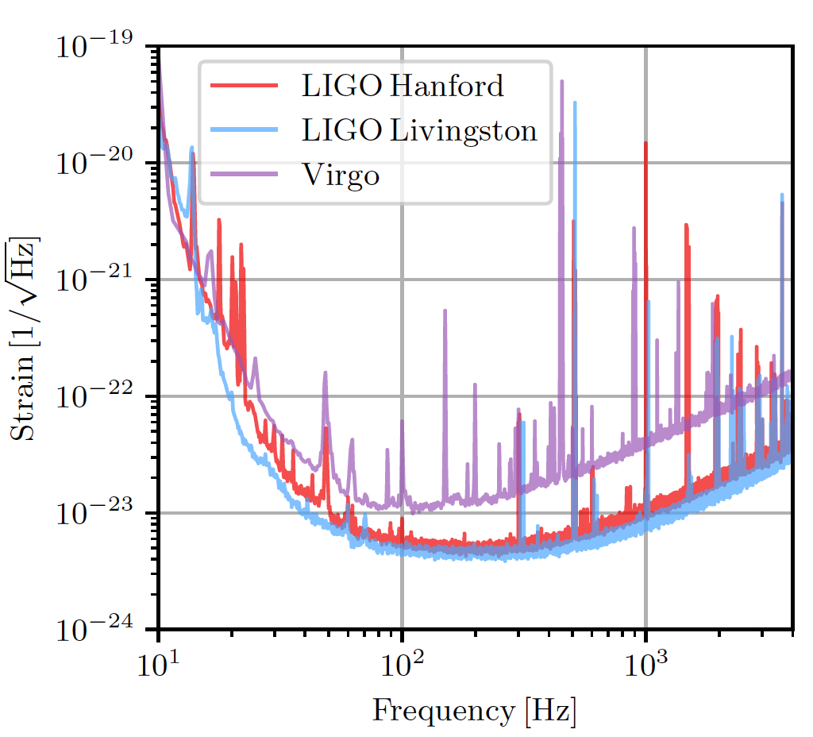
Current sensitivity
LIGO-Virgo noise floor h = ΔL/L ~10⁻²³ in a 1 Hz bandwidth
<number>

Slide 11
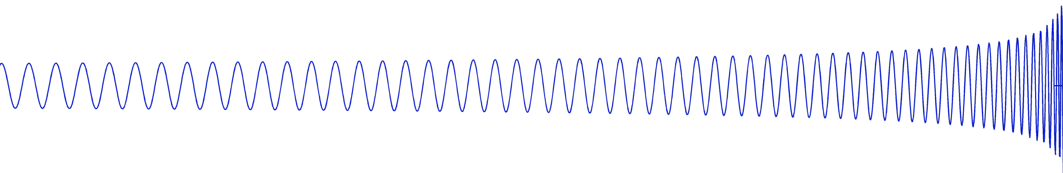
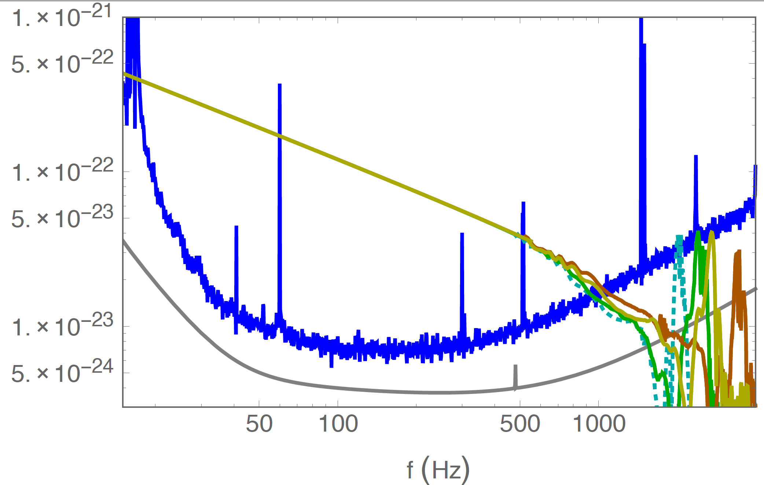
NS-NS inspiral mapped onto detector sensitivity
J. Read
<number>

Slide 12
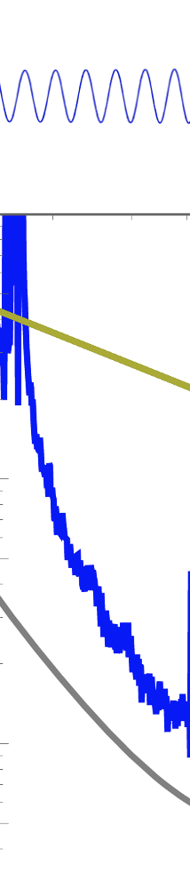
NS-NS inspiral mapped onto detector sensitivity
Low frequency ‘wall’ – limits duration of signal in band
J. Read
<number>

Slide 13
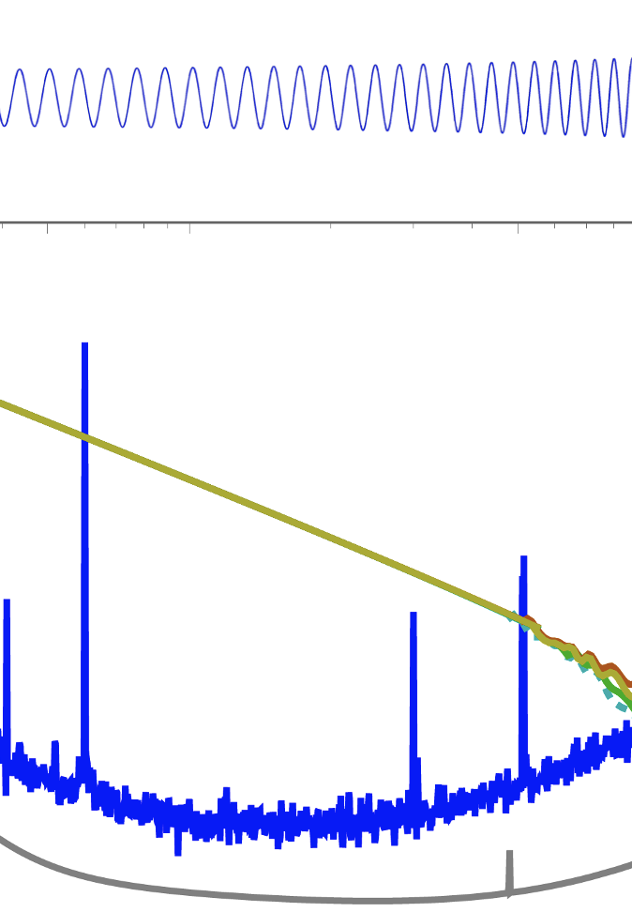
NS-NS inspiral mapped onto detector sensitivity
Mid-frequency ‘bucket’ – determines reach, rate
J. Read
<number>

Slide 14
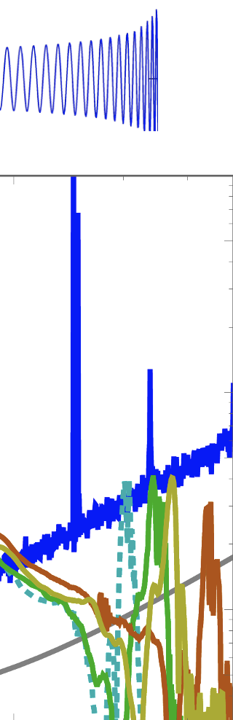
NS-NS inspiral mapped onto detector sensitivity
High frequency limit – masks final coalescence of BNS
J. Read
<number>

Slide 15
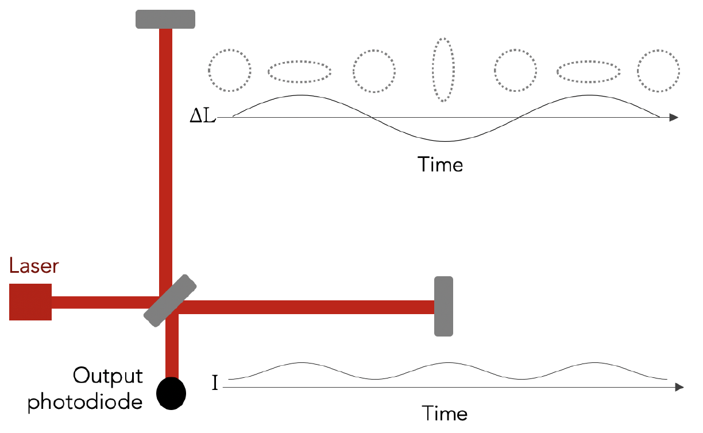
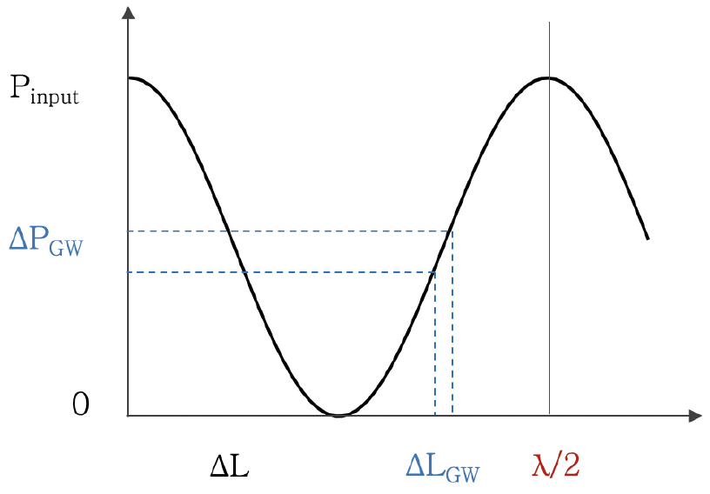
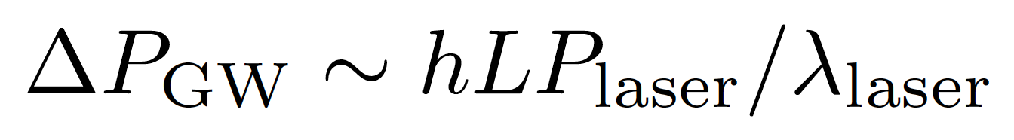
What is our measurement technique?
Enhanced Michelson interferometers
GWs modulate the distance between the end test mass optic and the beam splitter
The interferometer acts as a transducer, turning GWs into photocurrent proportional to the strain amplitude
For a given strain h = ΔL/L,
Output power
<number>
Path length difference ΔL

Slide 16



What is our measurement technique?
Enhanced Michelson interferometers
GWs modulate the distance between the end test mass optic and the beam splitter
The interferometer acts as a transducer, turning GWs into photocurrent proportional to the strain amplitude
For a given strain h = ΔL/L,
Increase arm length
Increase
Use short wavelength laser
Magnitude of h at Earth:
Detectable signals h ~ 10⁻²¹
(1 hair / Alpha Centauri)
For L = 1 m, ΔL= 10⁻²¹ m
For L = 4km, ΔL= 4x10⁻¹⁸ m
<number>

Slide 17
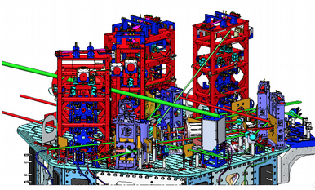

Reality axis
The real
instrument is
far more complex than a simple Michelson…
<number>

Slide 18
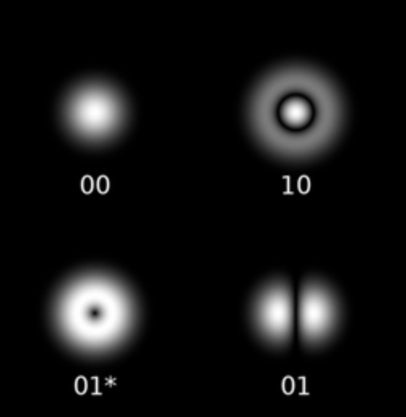

Basic building blocks:
Optical Resonant Cavities
Provides spatial and frequency boundary conditions for laser light
  If the length is constant, the resonant frequency is also; provides a frequency reference
  For a given mirror separation and radius of curvature, fixed transverse modes are resonant; others anti-resonant (so acts as a ‘mode cleaner’)
    Need to ‘focus’ the light to match the supported spatial mode
  Provides ‘optical gain’ G – stores photons; typically 10² – 10³ for LIGO
t_{1,} r₁
t_{2,} r₂
L
F. Bondu; Siegman, Lasers
<number>

Slide 19
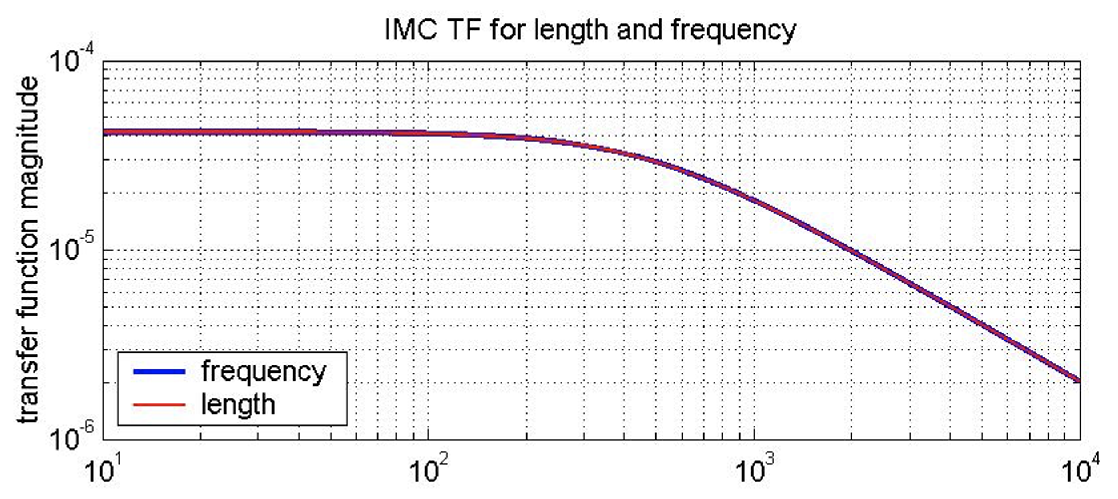
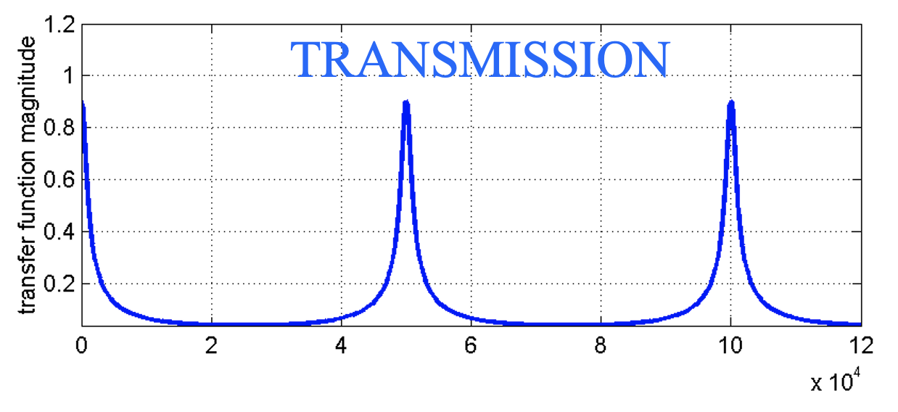
Basic building blocks:
Optical Resonant Cavities
Triangular cavities are practical for use in transmission
Defines an optical axis; rejects light not in Gaussian fundamental mode
Acts as a ‘low pass filter’ for intensity fluctuations
F. Bondu
<number>

Slide 20
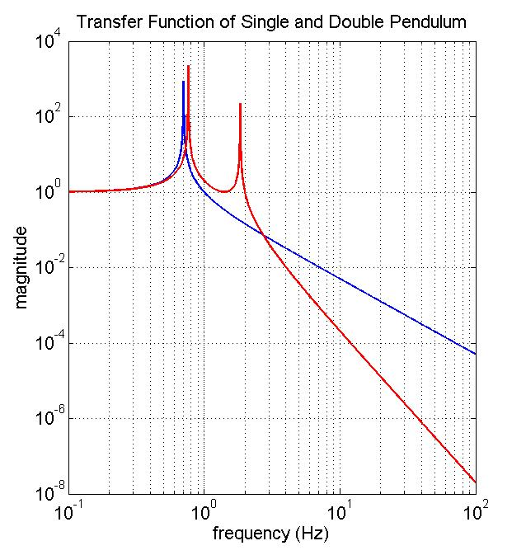
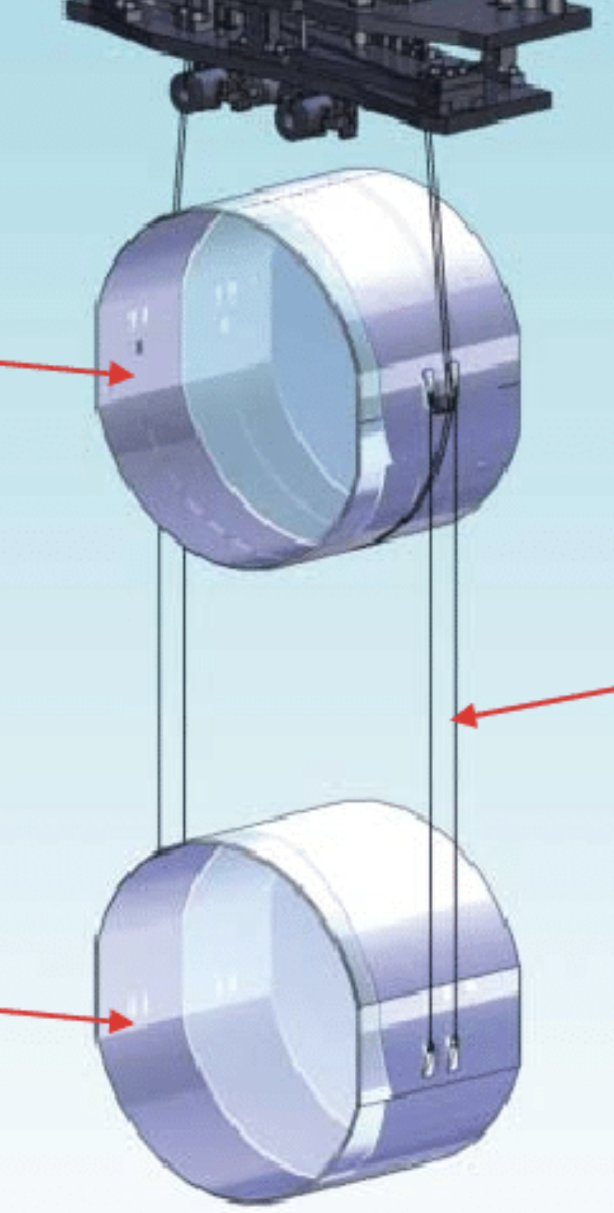
Basic Building Blocks:
Pendulums
Pendulum suspensions for optics which serve as test masses
Need test masses to be ‘free’ in along the relevant measurement axis
Ground-based detectors operate in Earth’s gravitational field
Hang optics like a clock pendulum;
above the resonant frequency, mirror is ‘free’
Inertia of the mass provides seismic isolation
  Single stage (f_{o}/f)²; two stages (f_{o}/f)⁴…
Provides flexibility for alignment and actuation
Penultimate
Mass
Suspension
Fibers
Optic
<number>

Slide 21
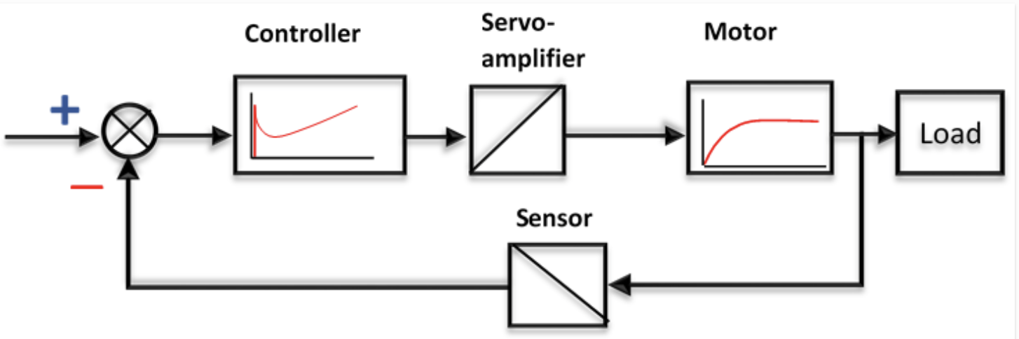
Basic Building Blocks:
Servo control systems
Used throughout gravitational-wave detectors
Longitudinal control: holding optical cavities on resonance
  Maintaining laser frequency compatible with reference cavity
Angular controls: keeping optical cavities aligned with optical axes
Suppressing noise – ‘Null’ servoes maintaining measured quantity to zero, and reading out control signal as measure of system
<number>

Slide 22
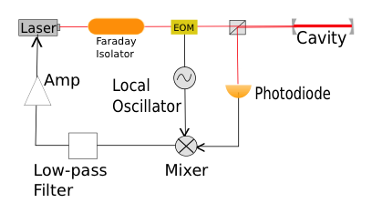
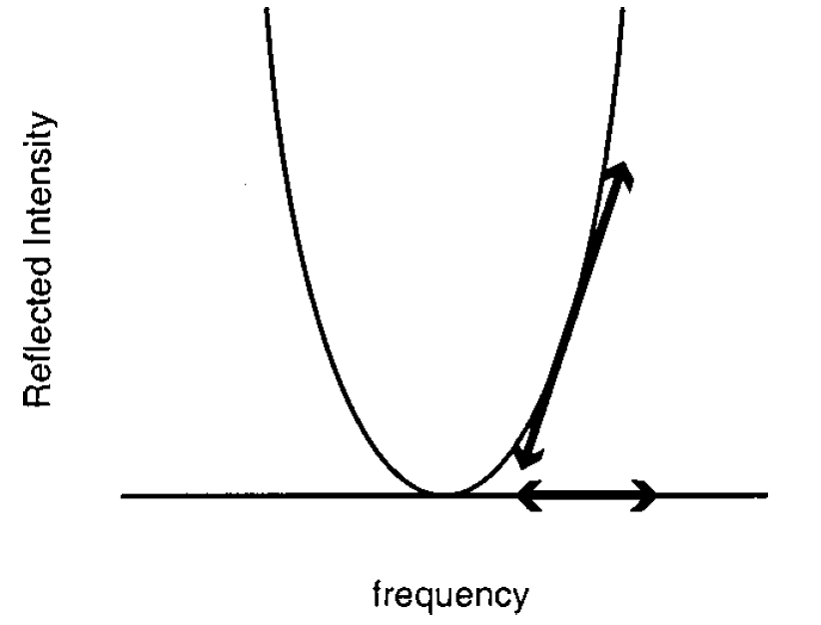
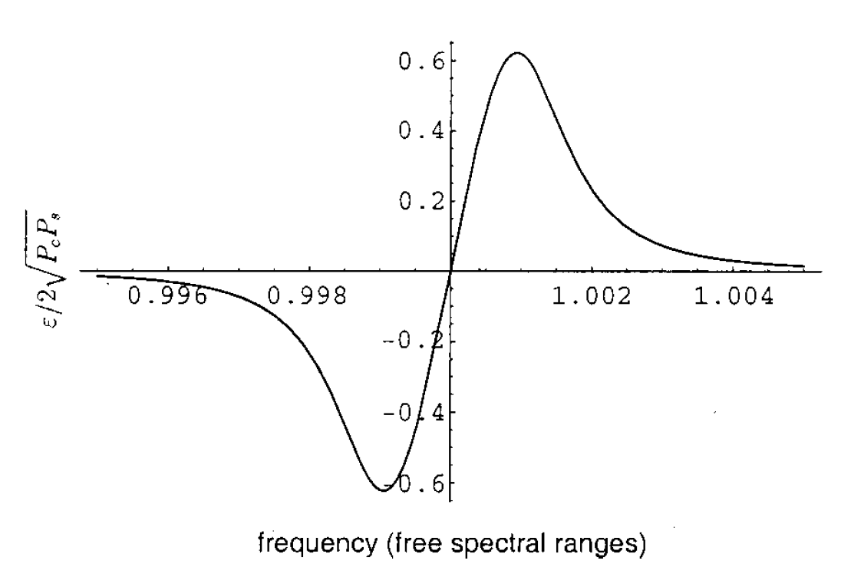
Basic Building Blocks:
Pound-Drever-Hall Cavity control
Modulation (Electro-Optic Modulator) effectively sweeps the frequency back and forth over cavity resonance
Mixer effectively takes difference of signal above and below resonance
  Equals zero if on resonance
Send this ‘error signal’ back to control laser frequency – or cavity length
^{E.Black,AJP 69-79, 2001}
<number>

Slide 23
Basic Building Blocks:
Pound-Drever-Hall Cavity control
Modulation (Electro-Optic Modulator) effectively sweeps the frequency back and forth over cavity resonance
Mixer effectively takes difference of signal above and below resonance
  Equals zero if on resonance
Send this ‘error signal’ back to control laser frequency – or cavity length
^{E.Black,AJP 69-79, 2001}
<number>

Slide 24
Basic Building Blocks:
Pound-Drever-Hall Cavity control
Modulation (Electro-Optic Modulator) effectively sweeps the frequency back and forth over cavity resonance
Mixer effectively takes difference of signal above and below resonance
  Equals zero if on resonance
Send this ‘error signal’ back to control laser frequency – or cavity length
^{E.Black,AJP 69-79, 2001}
<number>

Slide 25
Useful paradigm in considering
limits to detector sensitivity
Ability to measure the position of our test mass
  Shot noise
  Scattered light
  Laser light defects – intensity, position, mode shape, frequency noise
  Electronics noise
True noise motions of the reference surface on our ‘free test mass’ which can mask GWs
  Thermal noise
  Radiation pressure
  Environmental mechanical forces – seismic, anthropogenic, weather
  Stray electric, magnetic fields
  Accidental noise forces from our control systems and sensors
<number>

Slide 26
What are the ‘fundamental’ limits to sensitivity?
<number>

Slide 27
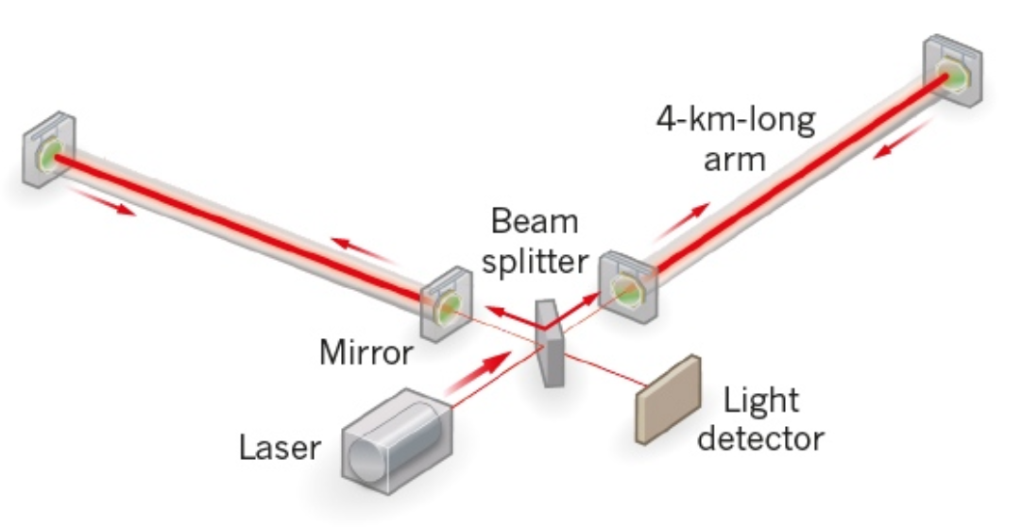
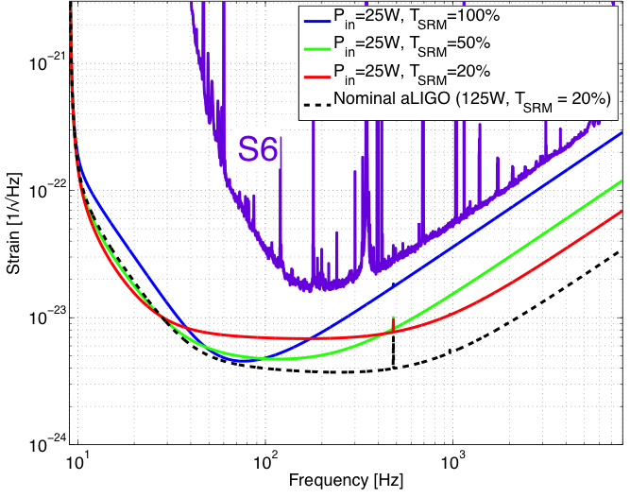
Measuring ΔL= 4x10⁻¹⁸ m
Readout
Shot noise – ability to resolve a fringe shift due to a GW (Poisson counting statistics)
Zum gegenwärtigen Stand
des Strahlungsproblems,
A. Einstein, 1909
Fringe Resolution at high frequencies improves as as
(laser power)^{1/2}
<number>

Slide 28
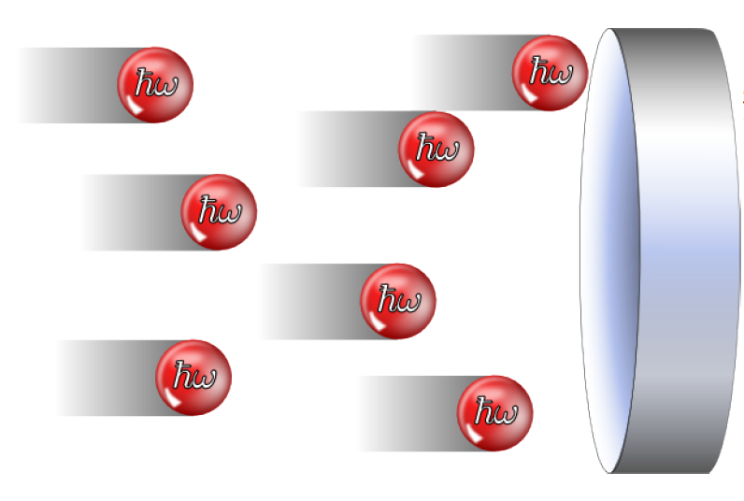
Measuring ΔL= 4x10⁻¹⁸ m
Readout
Shot noise – ability to resolve a fringe shift due to a GW (counting statistics)
Radiation Pressure noise –buffeting of test mass
by photons increases
low-frequency noise –
use heavy test masses!
‘Standard Quantum Limit’
<number>

Slide 29
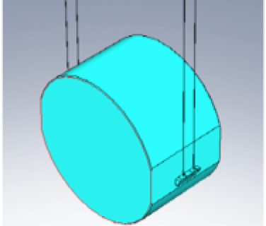
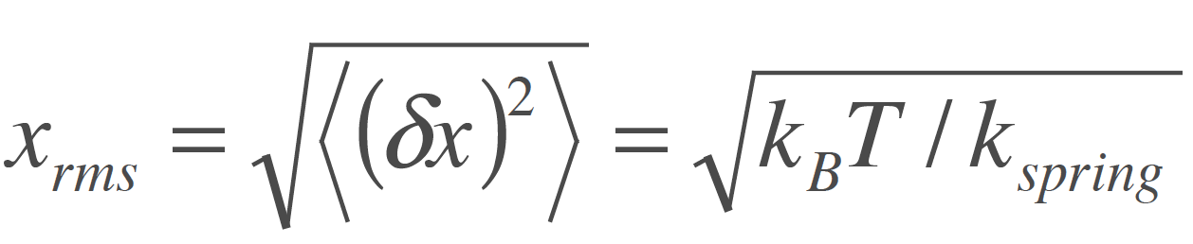
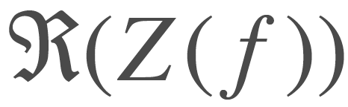
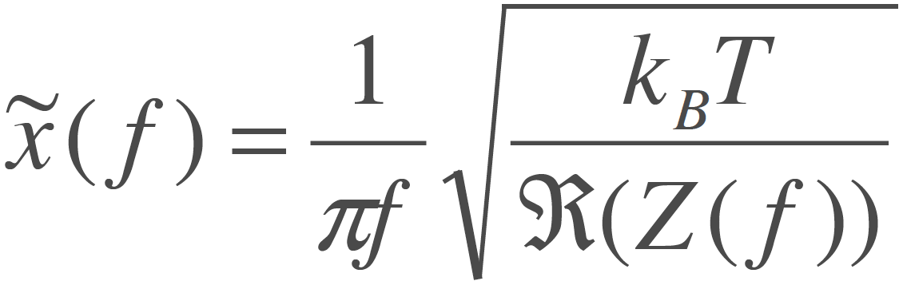
Measuring ΔL= 4x10⁻¹⁸ m
Internal motion
Thermal noise – kT of energy
per mechanical mode
Über die von der molekularkinetischen Theorie
der Wärmegeforderte Bewegung
von in ruhenden Flüssigkeiten suspendierten Teilchen,
A. Einstein, 1905
Simple Harmonic Oscillator:
Distributed in frequency according to real part of impedance
Low-loss materials, monolithic construction
Low Q
High Q
<number>

Slide 30
Measuring ΔL= 4x10⁻¹⁸ m
Internal motion
Thermal noise – kT of energy
per mechanical mode
Über die von der molekularkinetischen Theorie
der Wärmegeforderte Bewegung
von in ruhenden Flüssigkeiten suspendierten Teilchen,
A. Einstein, 1905
Simple Harmonic Oscillator:
Distributed in frequency according to real part of impedance
Low-loss materials, monolithic construction
<number>

Slide 31
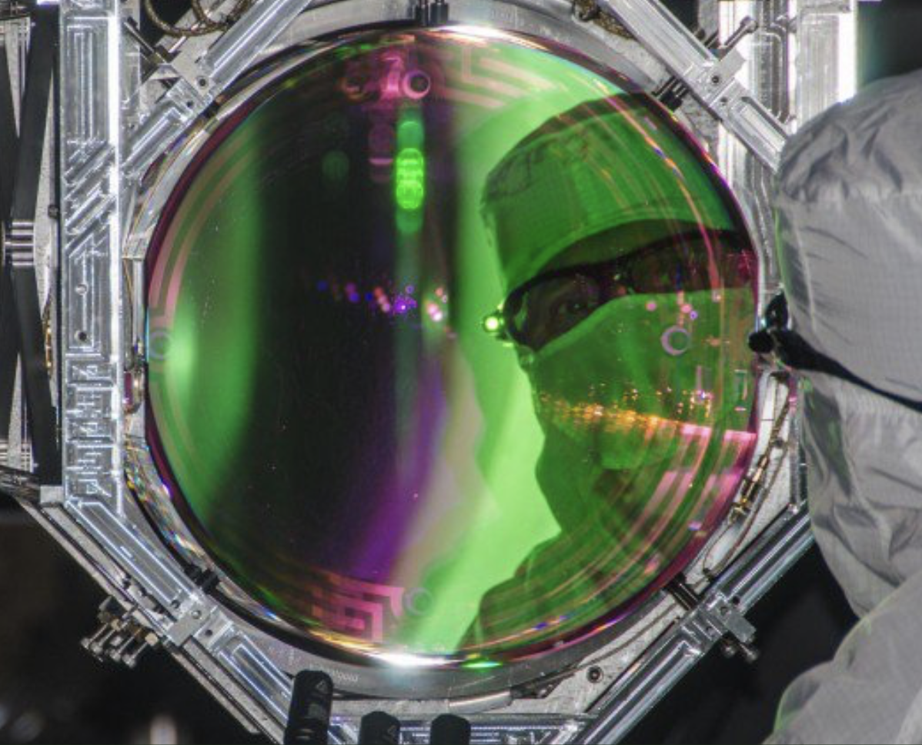
Measuring ΔL= 4x10⁻¹⁸ m
Internal motion
In Advanced LIGO, the dielectric optical coating has a rather large loss tangent
  Some 10⁻⁴ , compared to
  10⁻⁸ for fused silica
The Fluctuation-Dissipation theorem says this is where the greatest motion is found
And: the coating is the surface that is sensed by the laser
This is the dominant limit in the critical 50-200 Hz band
<number>

Slide 32
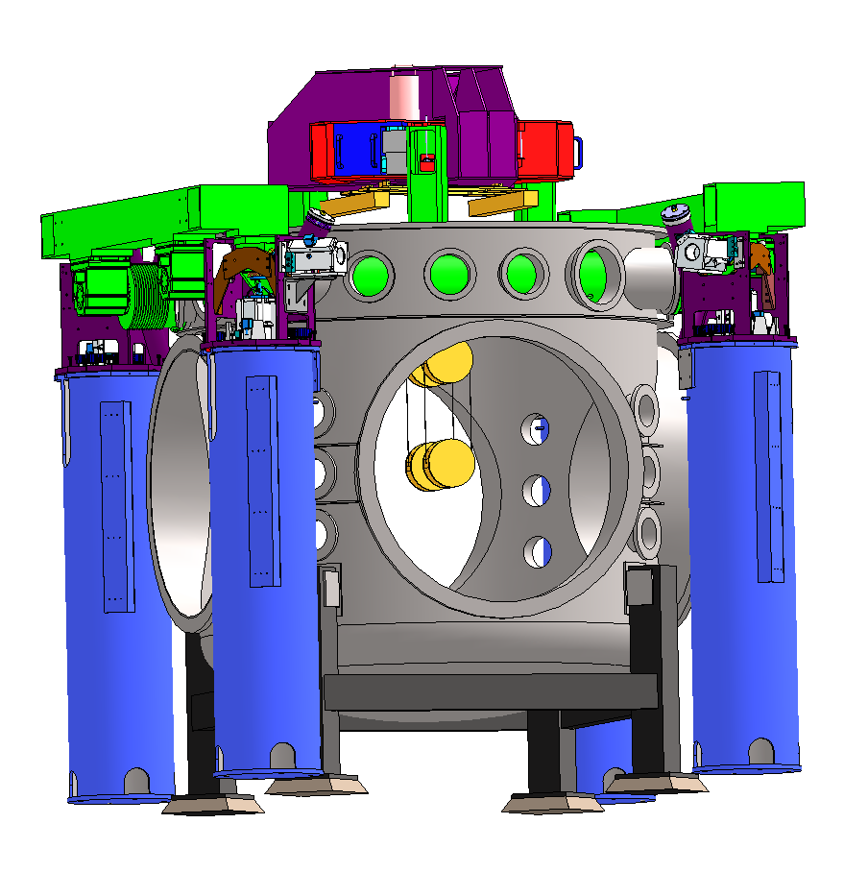
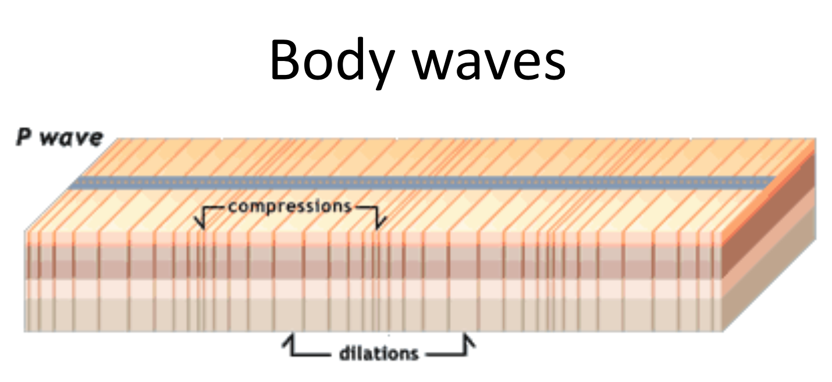
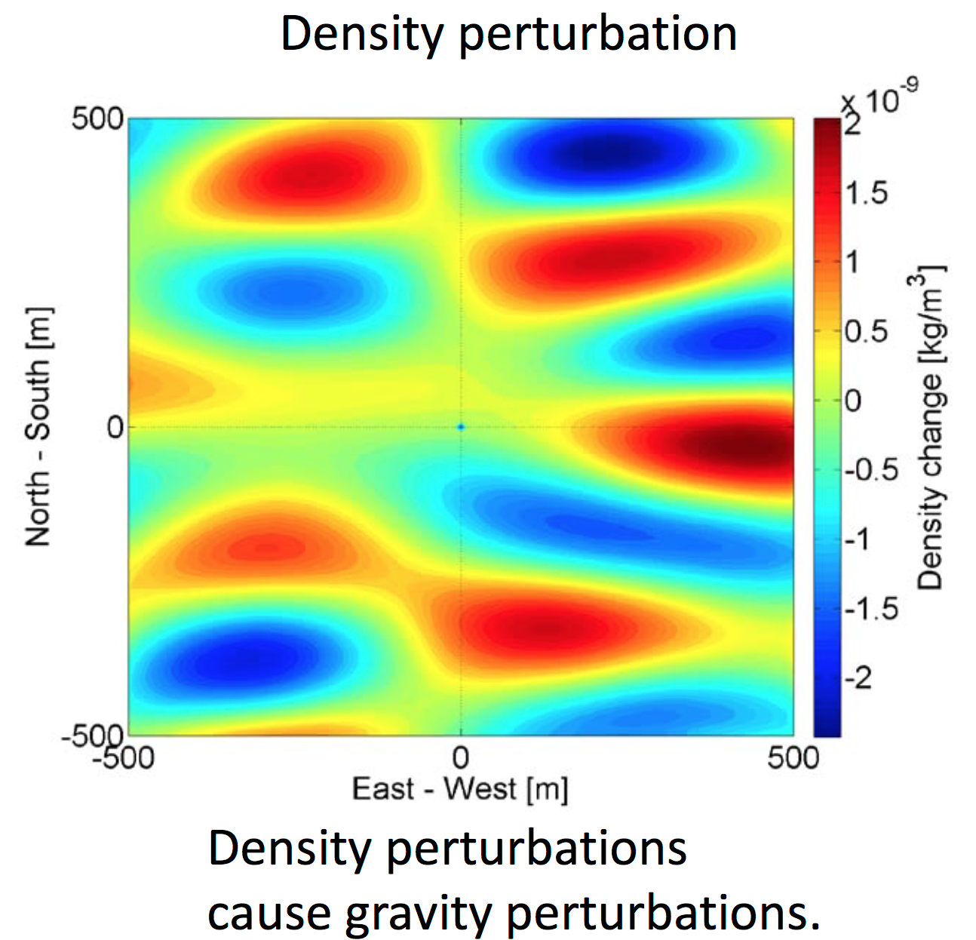
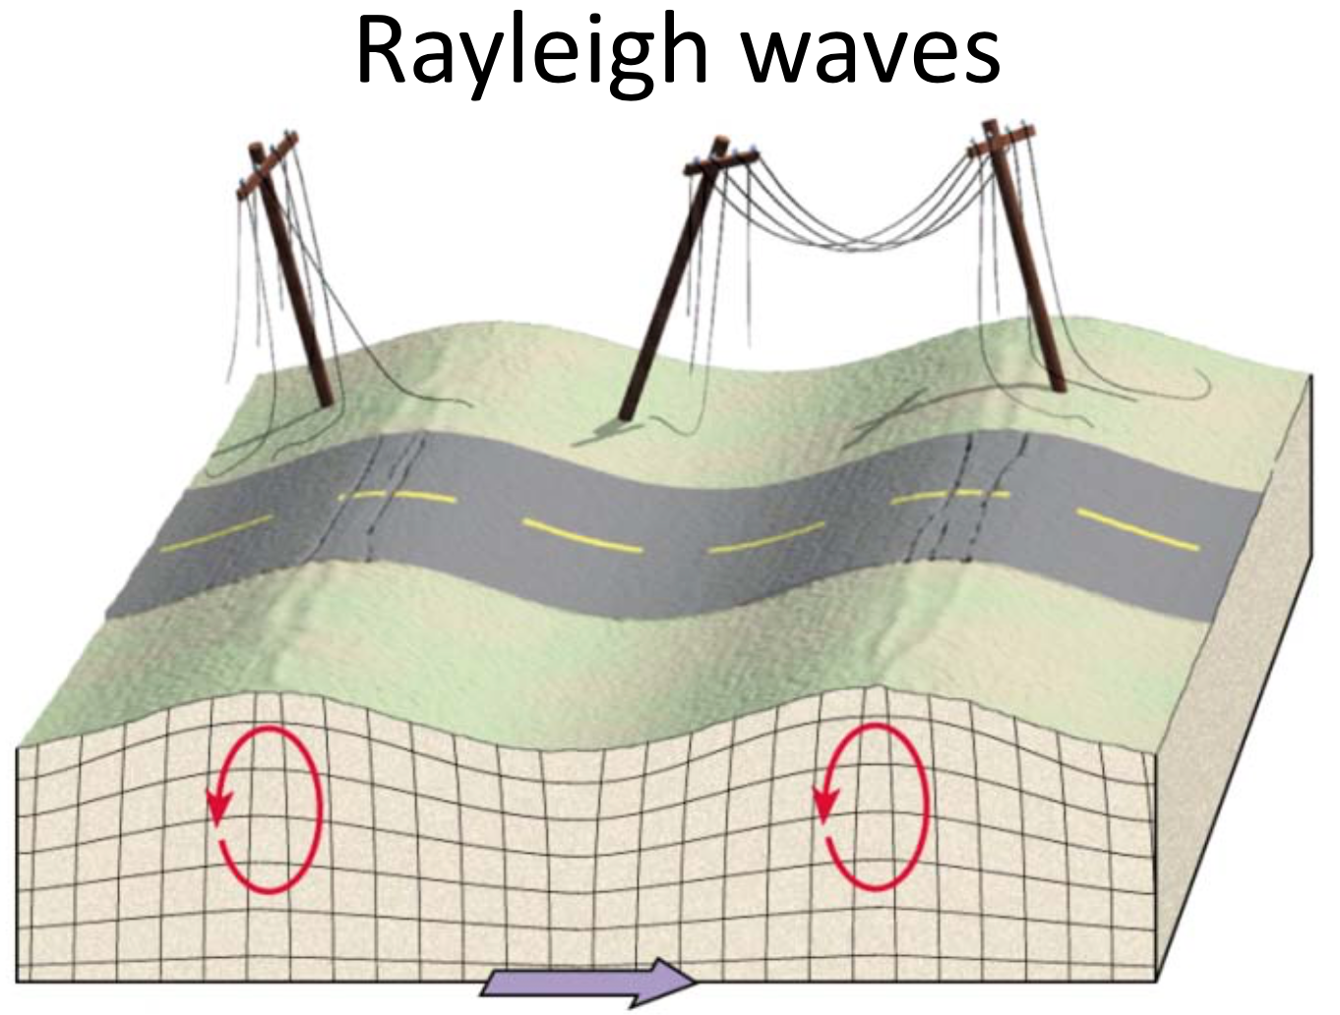
Measuring ΔL= 4x10⁻¹⁸ m
Forces on test mass
Ultimate limit on the lowest frequency detectors
on- or under-ground:
Newtownian background – wandering net gravity vector;
Forbiddingly large for ~3Hz and lower
Images: J. Harms
<number>
Notes:
<number>

Slide 33
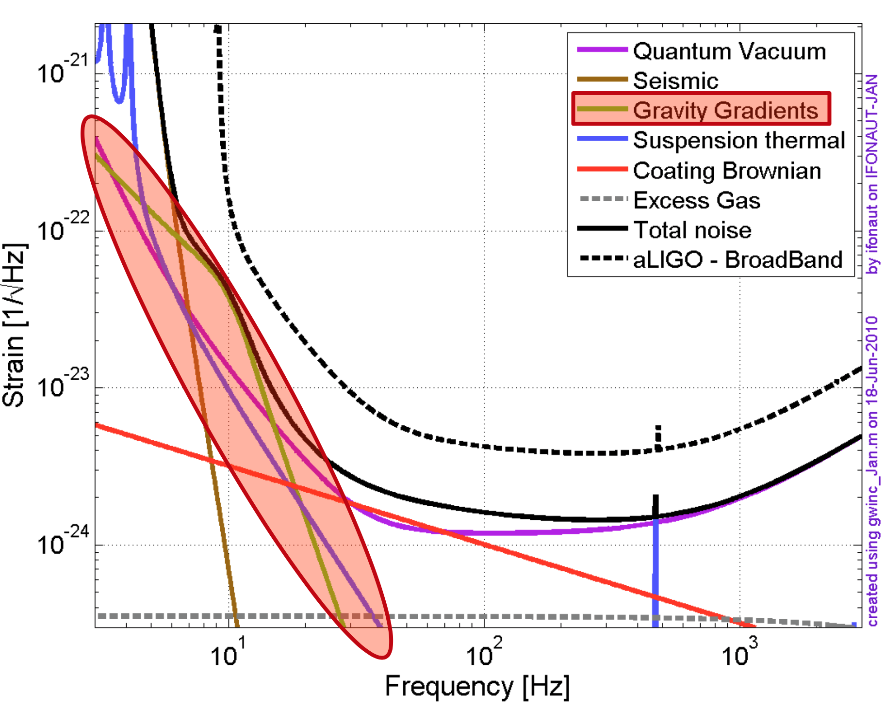
Measuring ΔL= 4x10⁻¹⁸ m
Forces on test mass
Advanced LIGO (and Virgo) expect to be limited by this noise source –
  After all technical noise sources beaten down
  At low optical power (no radiation pressure noise)
  In the 10-30 Hz range
We would love to be limited only by this noise source!
Want to go a bit lower?
Go underground.
Want to go much lower?
Go to space.
Images: J. Harms
<number>
Notes:
<number>

Slide 34
Interferometry
Quantum measurement effects present both limits to sensitivity and means to improve the sensitivity
First, increase the light power to reduce shot noise
  High power laser
  Low loss, high-precision optical components
  Optical topologies to increase circulating light power
  Optical topologies to distribute light power optimally
  ….until radiation pressure starts to dominate
Second, use squeezed light to improve sensitivity
  Manage coupling between light intensity and light phase (pondermotive squeezing)
  Sneak around Heisenberg’s uncertainty principle
<number>

Slide 35
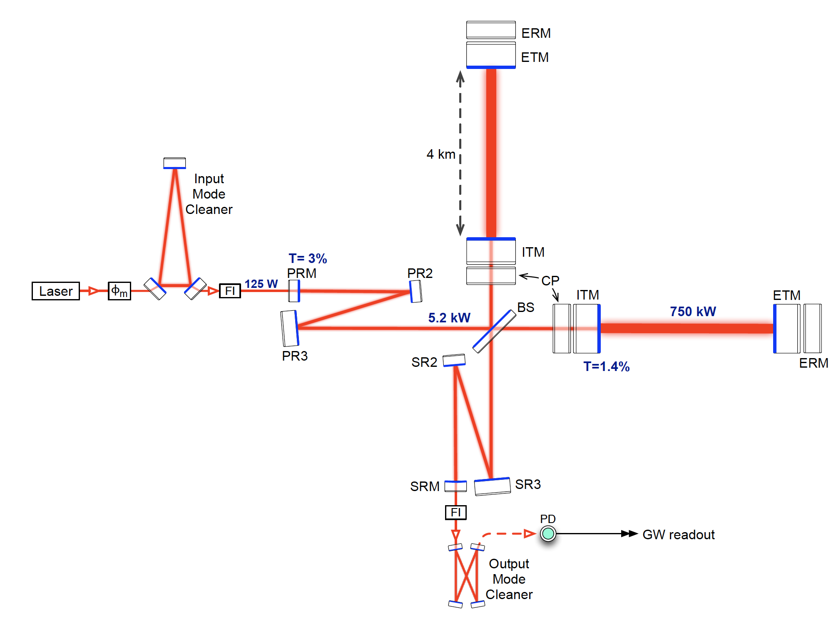
Power and Signal Recycling
Advanced LIGO, ~2016
<number>

Slide 36
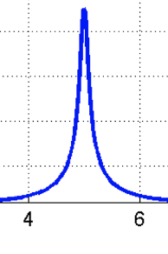
Power and Signal Recycling
4km FP cavities on resonance;
low loss, high input transmission
Most (~97%) input light reflected back
to BeamSplitter
<number>

Slide 37
Power and Signal Recycling
Michelson Interferometer phase set
to minimum in output, so maximum
in reflection toward laser
Output power
Path length difference ΔL
<number>

Slide 38
Power and Signal Recycling
Form resonant cavity with the ‘mirror’
formed by Michelson, and the
Power Recycling Cavity
Increases circulating light power ~30x
<number>

Slide 39
Power and Signal Recycling
Add the Signal Recycling Mirror,
forming a cavity with Michelson
Can set to resonant, anti-resonant,
or inbetween to extract or store the
GW signal
<number>

Slide 40

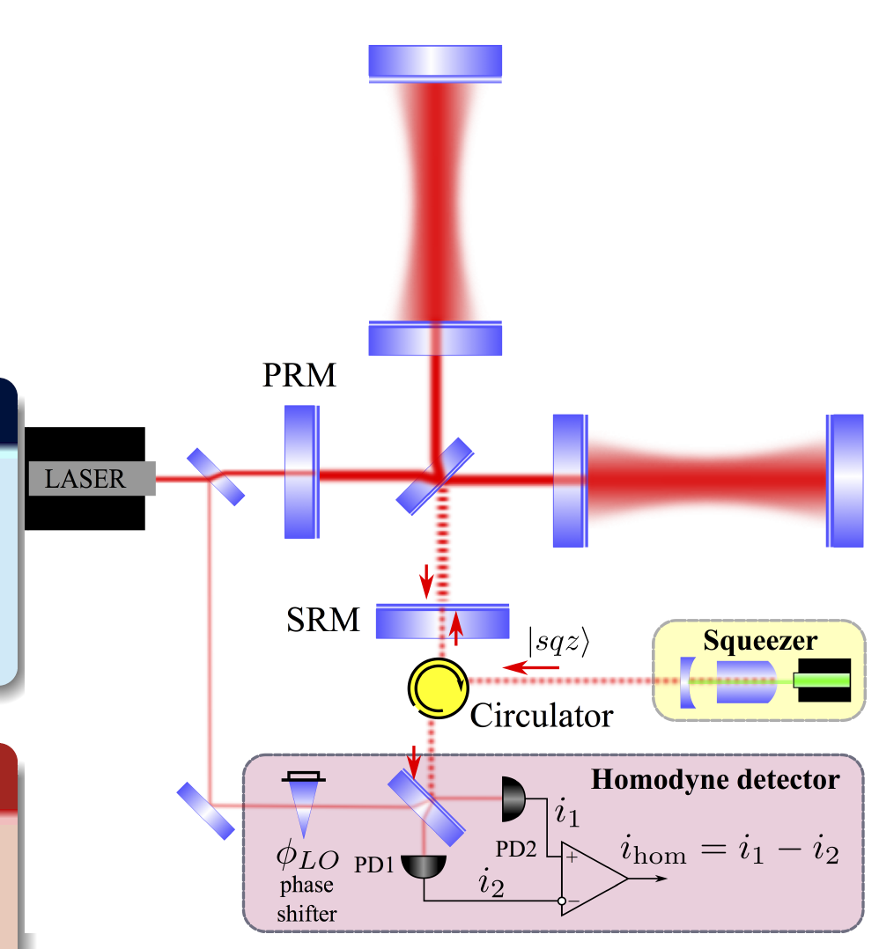
Squeezed light to
reduce quantum noise
Heisenberg Uncertainty Principle of QM dictates that precise values of phase, and amplitude, of light cannot be known at the same time:
We can choose however to e.g., know the amplitude less well
and look more closely at the phase
This corresponds to reducing the high-frequency Shot Noise
in our interferometer noise budget
  BUT increasing the low-frequency
  Radiation Pressure noise
This is frequency independent squeezing
Squeezing is made by creating pairs of photons
using an optical parametric oscillator
The pairs are quantum-mechanically entangled
and have correlated arrival times at the detector
This reduces the randomness of the time distribution
W. Unruh, PRD 19, 2888 (1979); S.L. Danilishin
<number>

Slide 41
Quantum shot noise limits the
high frequency sensitivity
RADIATION PRESSURE
NOISE
P = stored power
m = mirror mass
SHOT NOISE
RADIATION PRESSURE NOISE: Back-action noise caused by random motion of optics due to fluctuations of the number of impinging photons
Additional displacement noise
SHOT NOISE: Photon counting noise due to fluctuations of the number of photon detected at the interferometer output → Limitation of the precision to measure arm displacement
M. Evans, Amaldi 11
<number>
Notes:
<number>

Slide 42
Frequency Independent Squeezing
M. Evans
RADIATION PRESSURE NOISE
gets worse
SHOT NOISE
gets better by a factor of 2
➔ High frequency improvement, no benefit in BNS-BNS range
M. Evans, Amaldi 11
<number>

Slide 43
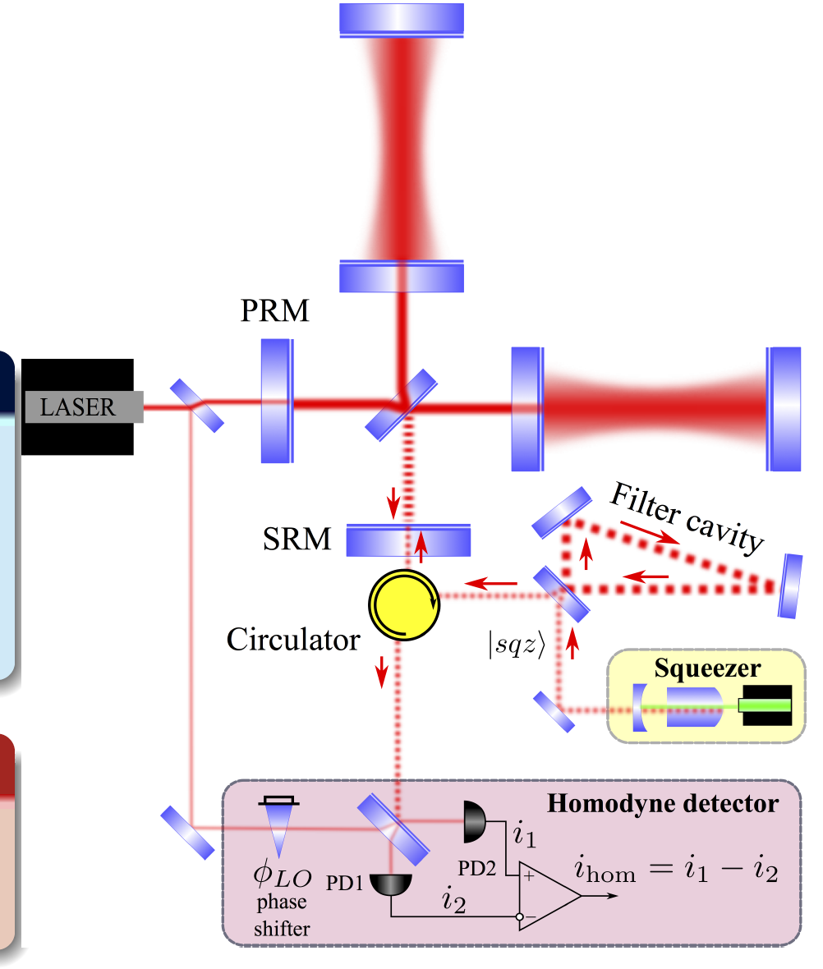
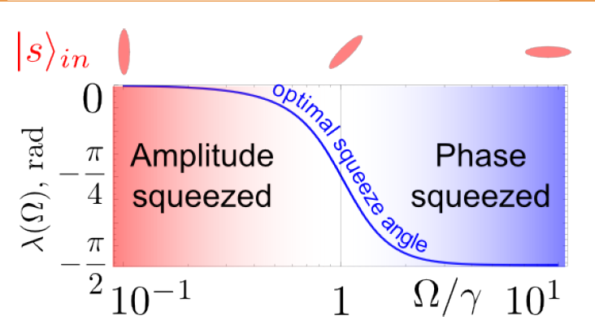
Frequency Dependent Squeezing
We can be more clever!
We can adjust the phase of the squeezed light used
  Pass through an optical resonant cavity acting as a filter tuned to the transition from Radiation Pressure to Shot Noise
Heisenberg’s principle still holds at any given frequency, but
we look more carefully at the amplitude at low frequencies
and the phase at high frequencies
Being implemented in Virgo and LIGO, probably for
next observing run O5
J. Kimble et al., PRD 65, 022002 (2001); S.L. Danilishin
<number>

Slide 44
Frequency Dependent Squeezing
M. Evans
RADIATION PRESSURE NOISE
gets better
SHOT NOISE
gets better by a factor of 2
High frequency improvement, + 25% BNS-BNS range (200 → 250 Mpc)
M. Evans, Amaldi 11
<number>

Slide 45
Frequency Dependent Squeezing
M. Evans
RADIATION PRESSURE NOISE
gets better
SHOT NOISE
gets better by a factor of 2
Thermal noise in optical coatings
High frequency improvement, + 25% BNS-BNS range (200 → 250 Mpc)
M. Evans, Amaldi 11
<number>

Slide 46
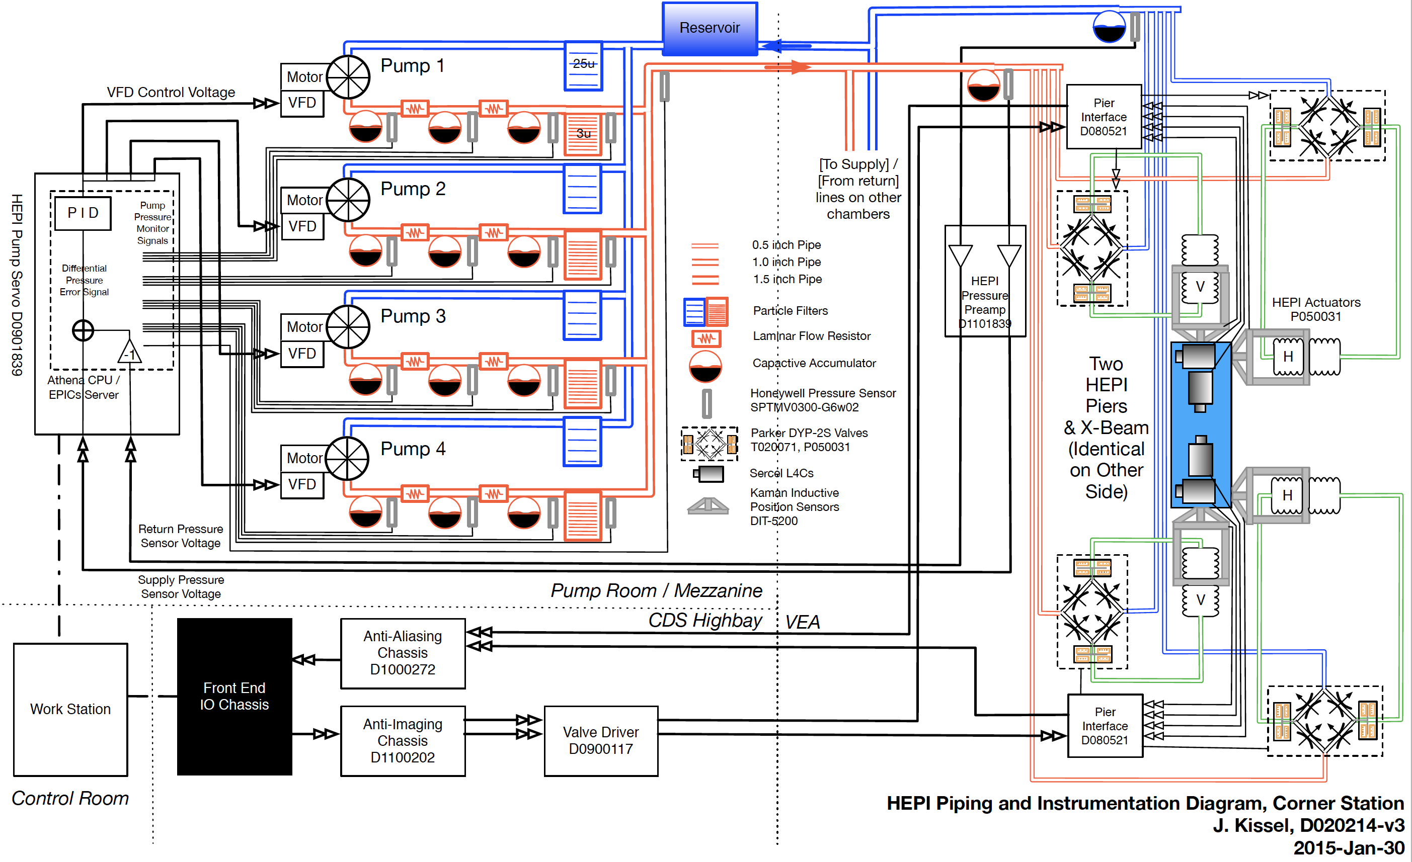
Keeping it all aligned
All cavities require precision alignment
4 cavity optics – ‘Test Masses’ as pendulums, but also…
Beamsplitter, ‘recycling’ mirrors, filter cavities all suspended
Over 4km baseline
10⁻⁵ m motions at 1 Hz,
10⁻²⁰ m at 20 Hz;
dynamic range challenge
Nanoradian alignment
Guided control from
micron to picometer motion,
coupled cavities on resonance
Fully digital distributed system
15μsec delay over 4km a
limit to servo bandwidth
Control system demands
are extraordinary
1/3 of Seismic controls:
The external laminar flow hydraulic positioning system
<number>
Notes:
<number>

Slide 47
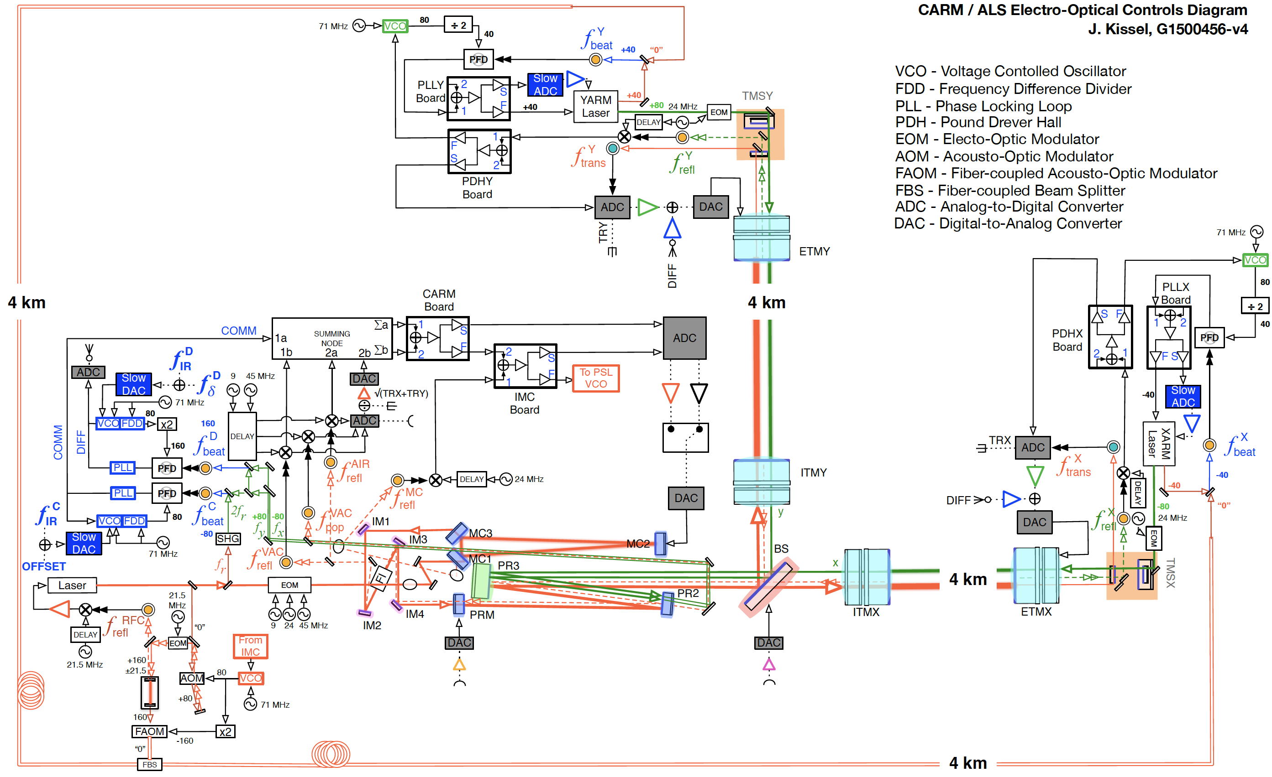
Partial Servo-control diagram for interferometer control
<number>

Slide 48
Adv LIGO Target Design Sensitivity, basic noise sources
L1: O2
Total noise
Seismic
Quantum
Test mass coating thermal noise
Suspension thermal
Gravity gradients
<number>

Slide 49
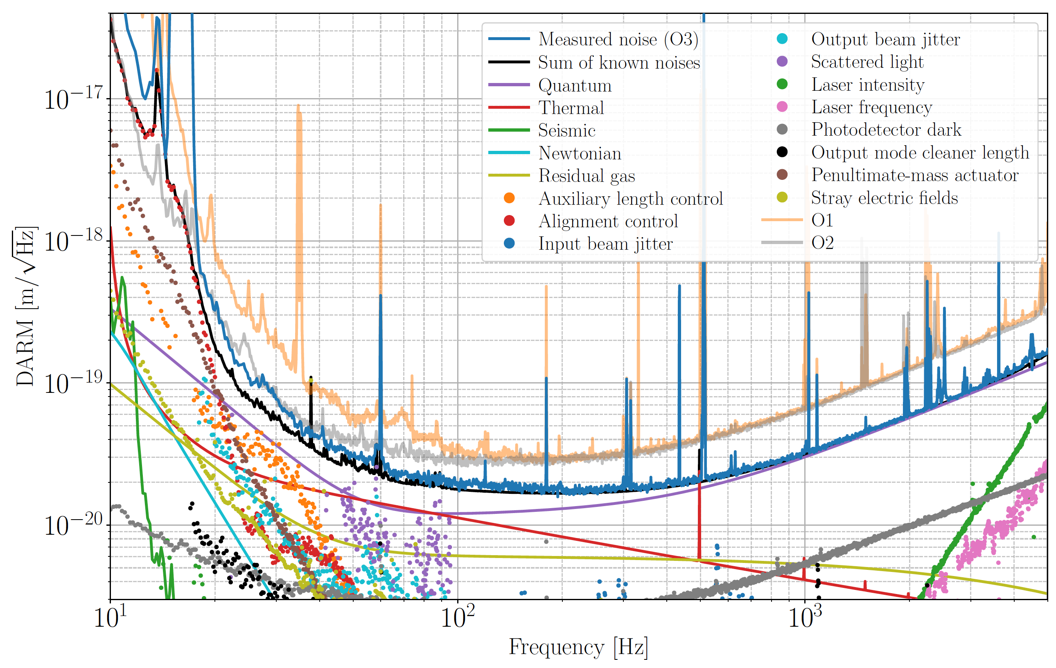
Then there are the technical noise sources….
<number>

Slide 50
Observatory Infrastructure
<number>

Slide 51
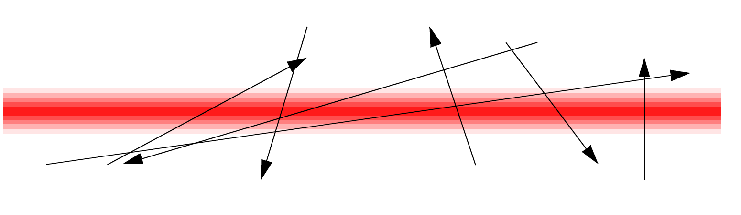
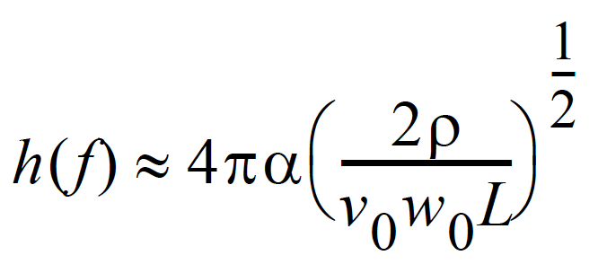
Vacuum System
The 3 or 4km path of the laser from BeamSplitter to end mirror must be in an excellent vacuum
Polarizability ⍺ of the remaining gas molecules induces path-length fluctuations; again, Poisson Statistics, and an effect proportional to square root of density ⍴^{1/2} along the path
Connect locomotive transformer to tubing for I²R heating to outgas
1 pump every 2km (We just spent ~$50M!)
<number>

Slide 52
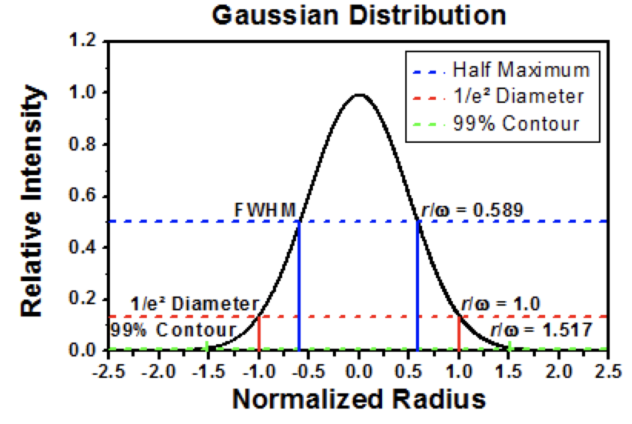
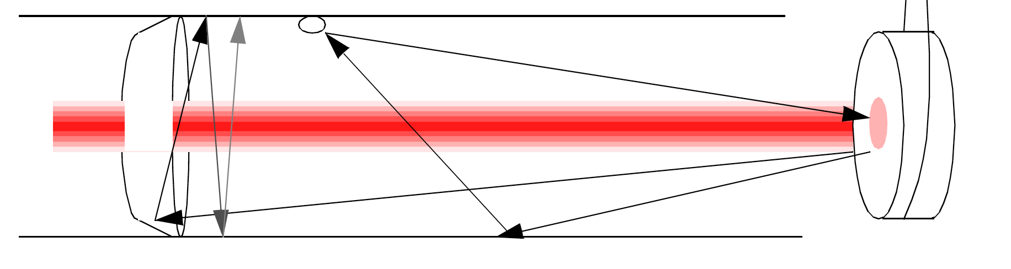
Beam Tube Scattered Light
Laser wavelength determines the minimum beam size after 4km propagation – for 1064nm Nd:YAG, this leads to 10-12cm diameter for 1/e² – but in fact must be much further in the tails of Gaussian to 10⁻⁶
In addition, the mirrors are not perfect
  ‘dust’ and point defects
  Large-scale ‘waviness’ (~10 nm over 10 cm)
→ 1.2m diameter beam tube
→ baffles to catch scattered light
Thorlabs
<number>

Slide 53
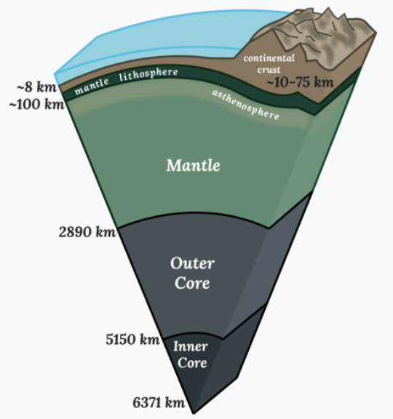
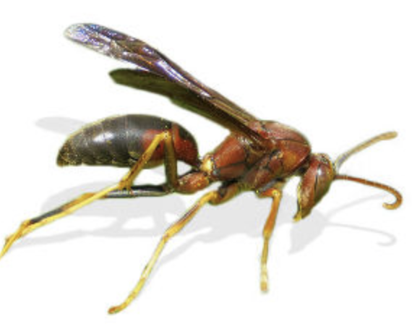
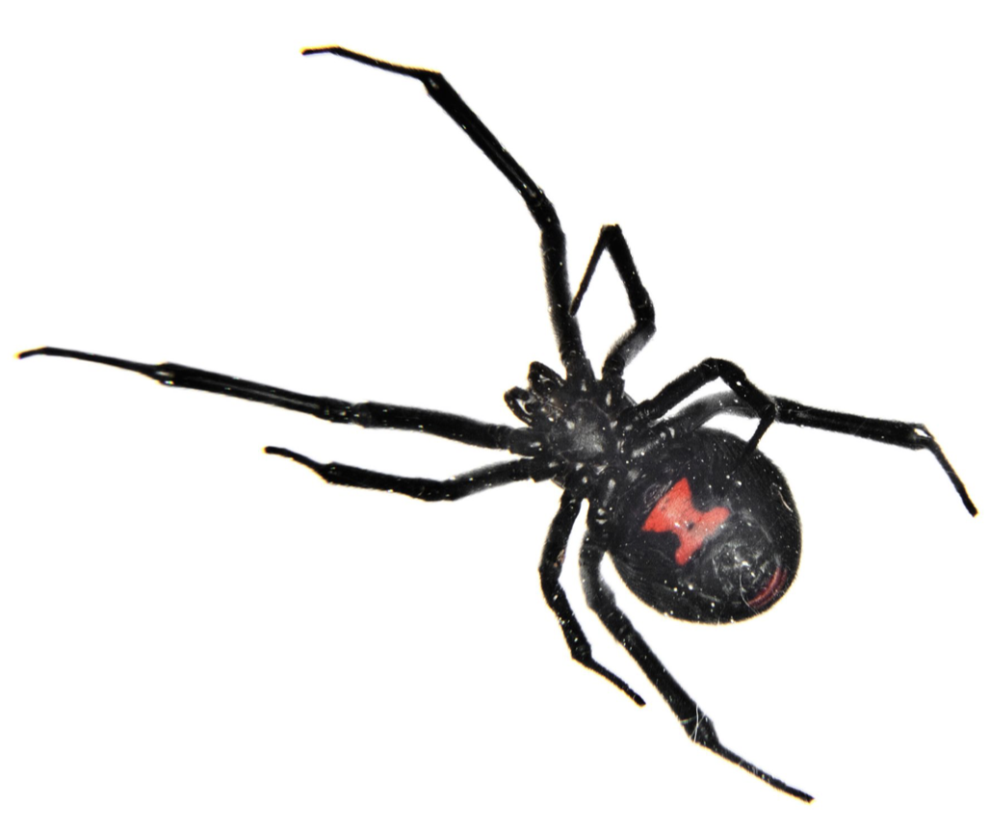
Civil Construction
Light travels in straight lines (when far from black holes)
  The Earth is not flat (whatever some political partisans may say)
  Sagitta for 4km is some 1/3m – some earthmoving needed
Also need stable foundation to support 1.2m beam tube
And some weather protection for the beam tube
  Turns out that there are are stainless-steel eating microbes
  Also wasps and black-widow spiders
  And rodents
  …and, worst of all, humans
(We just spent
another ~$60M)
Wikipedia
fantasticpestcontrol.co.uk, terro.com
<number>

Slide 54
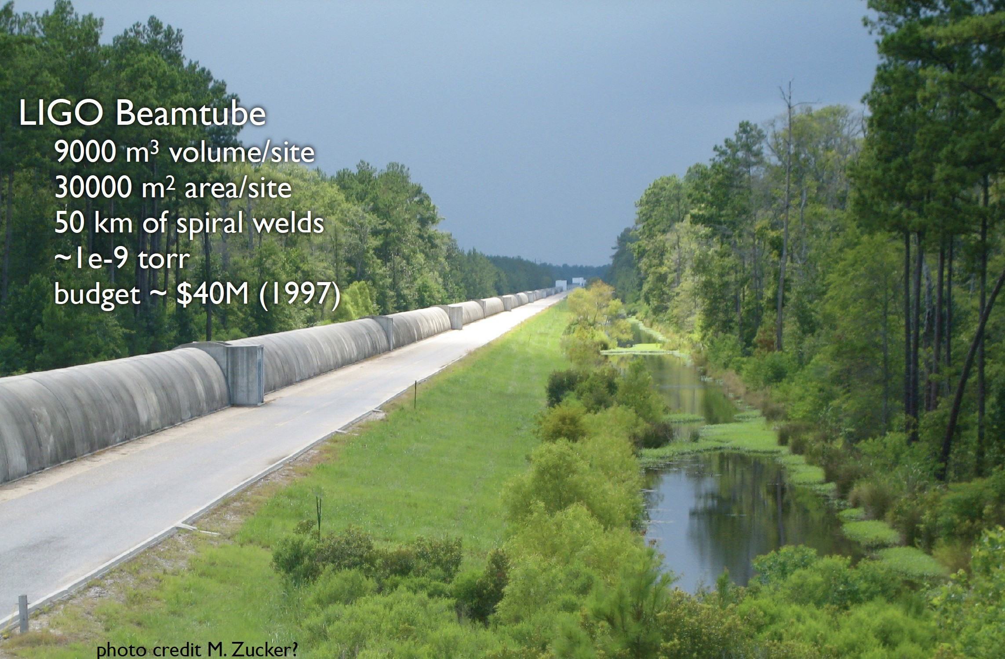

Civil Construction:
Beam Tube cover, foundation, earthmoving
<number>

Slide 55

…and worst of all, humans
Notes:
Airbag se deployé
Aucun policier etait blesse dans cet experience
<number>

Slide 56
Then there are the technical noise sources….
Resolution of
~2x10⁻²⁰
meters in 1 sec.
<number>

Slide 57
Let’s look at the actual LIGO
layout and hardware
<number>

Slide 58

Laser Clean Room; extraterrestrials for scale
200 W, single frequency, single mode, Nd:YAG laser
Challenging requirements:
δf ∼ 10⁻⁶ Hz/Hz^{1/2}
δ I/I ~ 10⁻⁸ /Hz^{1/2}
<number>

Slide 59


Vacuum chambers to
protect and isolate optics
<number>
Notes:
<number>

Slide 60

Inspecting mirror during fabrication

Slide 61

Test Mass
~35 cm diameter, 40 kg
Ultra-high purity fused silica
Challenging requirements:
λ/1000 surface figure
< 1 ppm absorption
~10 ppm scatter
0.1 % coating uniformity
<number>

Slide 62

End-mirror assembly
(humans removed before pumpdown)
<number>

Slide 63

Optic Suspensions
Reaction Chain
Main (test) Chain
Electromagnetic sensors/actuators measure position relative to a reaction chain that is also passively isolated
Lower stage actuators used to control/maintain optic cavity length and alignment
‘Monolithic’ – optic, penultimate mass, and suspension fibers welded together
R0, M0
L1
L2
L3

Slide 64


Test Mass Suspension
40 cm
<number>

Slide 65
Measuring ΔL= 4x10⁻¹⁸ m
Forces on test mass
Not ‘fundamental physics’, but ‘fundamental to success’
Seismic noise – must prevent masking of GWs, enable
practical control systems
aLIGO uses active servo-controlled platforms,
multiple pendulums
3 layers, each of
6 degrees-of-freedom
<number>
Notes:
<number>

Slide 66


Active and passive seismic isolation

Slide 67

Seismic Isolation Platform
<number>

Slide 68
Getting from electronic signals to gravitational-wave data
<number>

Slide 69
Enabling Scientific Interpretation:
Calibration
GR makes predictions for the luminosity of coalescing binaries
  Signal at the detector depends on the distance as 1/r
    Not as 1/r² !
    Degeneracy with inclination of orbit
Can obtain a measure of distance to source from the best-fit amplitude
  But this requires absolute calibration of the detector in Strain
<number>

Slide 70



Calibration technique
LIGO’s calibration method uses photon pressure on the test masses
1W laser sinusoidally modulated makes an easy-to-see motion of the mirror
<number>

Slide 71

Calibration
Accuracy is ~5% and ~3º currently
  May be able to improve by ~factor 2
  Uncertainty in the world standards for light intensity a real limit!
Secondary system based on ‘gravitational attraction’ in development
  A dynamic Cavendish experiment
  Signal depends mainly on the rotor geometry, mass and position
  Need to ensure no cross-coupling from mechanical, magnetic, electrostatics, electronics
The ability of GW detectors to give distance to source is very nice!
B. Mours
<number>

Slide 72
Enabling Scientific Interpretation:
Data Quality
Output of detector
is not frequency-independent Gaussian Stationary noise!
<number>

Slide 73
LIGO data in time and frequency
LIGO-Hanford h(t)
Made with GWpy by Duncan Macleod. Code: https://git.io/gwpy-ligo-scattering-animation
0.5 second FFT; 5 averages covering 1.5 seconds; 50% overlap
<number>
Notes:
Sense the spacetime strain through the phase difference between 2 perpendicular arms

Slide 74


Time-frequency spectrograms
Made with GWpy by Duncan Macleod
<number>
Notes:
Sense the spacetime strain through the phase difference between 2 perpendicular arms

Slide 75


Examples of spectrograms
of data defects
Blip glitches
The biggest contributor to the transient GW search backgrounds
Seen in both LIGO detectors
Non-coincident…2 detectors good!
No known correlation with instrument behavior or environment.
60-200 Hz non-stationary noise
Pollutes LIGO-Livingston data in a critical frequency range (~50-500Hz)
Longer duration (10s or 100s of seconds)
Major contributor to CBC and burst backgrounds
<number>

Slide 76


Tracking down strain defects:
Using environmental monitors
h(t)
h(t)
Microphone
end station
End-Y microphone
<number>

Slide 77




Ravens!
Hanford alog https://alog.ligo-wa.caltech.edu/aLOG/# 37630
<number>

Slide 78
Tracking down data defects
h(t)
Spectrogram of h(t) –
the interferometer output
Laser microphone
Noise monitoring microphone
in Laser enclosure
LHO alog #32503: https://alog.ligo-wa.caltech.edu/aLOG/index.php?callRep=32503
<number>
<number>

Slide 79

Physical Environment Monitor
Sensors distributed throughout observatories
Sensing all known and suspected coupling from environment to the acquired signal
Sensitivity greater than the detector to each of the measured parameters
‘Transfer functions’ (true, or ratio of powers) for all
Acquisition; monitoring for excess, inspection at times of events
47 Accelerometers, 18 Microphones, 11 in-building Magnetometers,
6 in-building Seismometers, 5 RF antennas and receivers, 5 weather stations, 3 Tiltmeters,2 high-sensitivity vault Magnetometers,
2 high-sensitivity vault Seismometers, 1 Cosmic-ray detector,
Power voltmeters, Interior and exterior video cameras,
1 turtledove in a pear tree
<number>

Slide 80



The impact of detector characterization
GW151226 analysis
“LVT”
“GW”
The false alarm rate of GW151226:
1 in 320 years with raw data
1 in 183000 years with data quality information applied
LIGO-Virgo collaboration (2017) - arXiv 1710.02185
<number>

Slide 81
Gravitational-wave
detector networks
<number>

Slide 82
GW170817
LIGO-Virgo/Geoffrey Lovelace, Duncan Brown, Duncan Macleod, Jessica McIver, Alex Nitz
https://doi.org/10.1103/PhysRevLett.119.161101
1

Slide 83
Antenna pattern for a single detector
Maximal for overhead or underfoot source
1/2 for signals along one arm
…and zero at 45 degrees
Good: A detector sees almost the entire sky with good sensitivity
Bad: A single detector gives very limited information on the source direction
Solution: Use multiple detectors working together to perform ‘triangulation’
<number>

Slide 84
Antenna pattern for a single detector
Maximal for overhead or underfoot source
1/2 for signals along one arm
…and zero at 45 degrees
GW170817 fell on Virgo close to 45 degrees!
Virgo data were critical for
localization; knowledge of
~zero signal carries very
good position information
GW170817
<number>

Slide 85

LIGO and Virgo
Similar instruments in concept; differences in details
  Virgo: 3km arms, LIGO: 4km arms, 2 detectors
  Different starting dates for upgrades, so sensitivity a bit out of synch
Instruments observe together, share data in real time, perform position identification
Collaborations share all data, analysis tasks, and publications
Win-win-win (win win win win….)
<number>

Slide 86




GW170817 Volume Localization by the
GW detector network
Virgo, Cascina, Italy
LIGO, Livingston, LA
LIGO, Hanford, WA
Notes:
<number>

Slide 87




Virgo
Hanford
Livingston
13

Slide 88
What enabled the remarkable achievements in this new field?
<number>

Slide 89
Collaboration
Table-top scientists – precision measurement, laser, atomic – started the field; tradition of small groups, small projects, and some competition
Early general relativists, theorists, astrophysicists much the same
Transformation when High Energy Physics types got involved
  Engineering, project organization, computing, analysis
Funding agencies also saw a need for a shift
  There is a real skill in spending hundreds of millions of Euros!
Goal pre-discovery was crystal-clear: Make a detection
Afer the Collaborations formed and were stable, meta-collaborations: ‘The LVK’ – KAGRA, Virgo, and LIGO Scientific Collaborations all sharing data
  The science that is possible is qualitatively greater
  The sociology of a (mostly) non-competitive environment nurturing and supportive
LISA and Pulsar Timing also in collaborations/consortia
Now perhaps 3000 persons worldwide
<number>

Slide 90
What does the future hold?
<number>

Slide 91

Planned Observing Timeline
O4 start no earlier than June 2022 – pandemic delays
Binary Neutron Star Range

Slide 92





The advanced GW detector network
Advanced
Virgo
2016
Advanced
LIGO
Hanford,
Livingston
2015
KAGRA
2019
LIGO-India
2025
<number>
<number>
<number>

Slide 93

2018-19 Sensitivity/configuration:
3 detectors
~1 signal per week
Notes:
<number>
P0900125-v8

Slide 94

~2025 Sensitivity/configuration:
5 detectors (add India and Japan)
far improved source localization
~60% in 10 sq deg
2024
Notes:
<number>
P0900125-v8

Slide 95


Sensitivity improvements are very well rewarded
LIGO ‘A+’ – Incremental changes to the
Advanced LIGO design
  Similar changes planned for Virgo
Rough doubling of reach
  2³ = 8 greater volume
  8x higher rate
  17-300 BBH/month
  1-13 BNS/month
  2-11 BNS x SGRB
  coincidences/year
Population studies
Hubble Constant
…higher SNR for e.g.,
tests of GR
Plan to be observing
~2024 (plus pandemic delay)
<number>

Slide 96
Then…
One of my early slides had the headline:
Now can envision the transition:
Ground-based Detector requirements → specifications
Ground-based Detector specifications → requirements
<number>

Slide 97

Designing instruments for Astrophysical goals
Suppose we want to focus on the nuclear physics of Neutron Stars –
Denis Martynov
<number>

Slide 98

NEMO: A ‘Neutron Star Explorer’
Target the 1-5 kHz range
Modest length requirements –
3-4 km
Stressful on the optical design (high circulating power)
…easy on the 1/f ^{n} noise sources
Australian
future detector working group
BNS
aLIGO
Post-
Merger
High-
Freq
Detector
BNS-BH

Slide 99

Next Generation Observatories: Einstein Telescope
<number>

Slide 100

Next Generation Observatories: Cosmic Explorer
<number>

Slide 101

Einstein Telescope: Underground multi-ifo Triangle
10km arms – philosophy is to stretch technologies to overcome
test-mass motions
Underground to reduce seismic and
Newtonian noise
  Also helps with site in Europe
Triangular to give 2 polarizations,
‘null stream’
High- and low-frequency detectors
  High-power for NSNS signals
  Cryogenic low-frequency
  for BHBH
<number>

Slide 102


Cosmic Explorer:
Make arms 10x longer
Philosophy is the stretch the arms, and start with known technologies
Signal grows with length – not most noise sources
Thermal noise, radiation pressure, seismic, Newtonian unchanged
Coating thermal noise improves faster than linearly with length
Concept offers sensitivity without new measurement challenges;
start at room temperature, modest laser power, etc.
  Will install more challenging technologies
  when timely – Low initial risk is key
Baseline of two detectors:
  40km arms: maximize reach for cosmology
  20km arms: focused on NSNS
Have identified many possible sites
  Sagitta is 31 meters…
  Find ‘bowls’ which are in fact flat
    US; elsewhere, e.g., Australia
Work on reducing cost of vacuum system
<number>

Slide 103

Sensitivity
<number>

Slide 104

Reach of 3G detectors for BH:
Edge of the universe
wq
<number>

Slide 105
Next Generation Observatories
When could this new wave of ground instruments come into play?
Appears 15 years from t=0 is a feasible baseline
  Initial LIGO: 1989 proposal, and at design sensitivity 2005
  Advanced LIGO: 1999 White Paper, GW150914 in 2015
Modulo funding, could envision 2030’s
Should hope – and strive and plan – to have great instruments ready to ‘catch’ the end phase of binaries seen in space-based LISA
Worldwide community working together on concepts and the best observatory configuration for the science targets, e.g.,
  GWIC https://gwic.ligo.org/3Gsubcomm/documents.shtml
Crucial for all these endeavors: to expand the scientific community planning on exploiting these instruments far beyond the GR/GW enclave
  Costs are like TMT/GMT/ELT – needs a comparable audience
  Events like GW170817 help!
<number>

Slide 106

Broad spectrum of GW sources
Nanograv

Slide 107

Pulsar Timing Arrays
Pulsars: spinning Neutron Stars; magnetic fields lead to beamed EM emission
Significant number have their ‘beacons’ pointing at Earth
Form extremely stable clocks
If a GW passes between us and
the pulsar, the time-of-arrival
of the clock pulse will be shifted
Looking at a collection of
pulsars scattered in space,
unique signal corresponding
to GWs can be inferred
Sensitive to very massive BH
  ~10⁷ - 10¹⁰ M⦿
Astrophysical stochastic
background best candidate
Some indication of a signal!
  Measurements continuing…
David J Champion
<number>

Slide 108

PTA ‘Instrument’
Test Mass offered by the Pulsar and its rotation
Radio Telescope catches many low-SNR ‘blips’
De-dispersion (originating in the interstellar medium)
Blips ‘folded’ on top of eachother to increase SNR
‘Fit’ of signals from multiple pulsars to models of passing GWs
<number>

Slide 109

The International Pulsar Timing Array:
Radio telescopes
RIP
IPTA
<number>

Slide 110

The International Pulsar Timing Array:
People
Groups in Europe, India, Australia, US working together to join data
Requires allocation of time on instruments worldwide, bringing data sets into common formats, and number crunching
Pulsars also have personalities – glitches
Finding additional pulsars also improves the sensitivity
Ultimately, the h(t) of some individual sources should be seen
<number>

Slide 111
Broad spectrum of GW sources
Nanograv

Slide 112



LISA, targeting
super-massive Black Holes
2.5x10⁶ km arms: moves best sensitivity to 0.01 Hz, target masses to 10⁶ solar masses
‘Servo’ the shield satellites to follow the test masses, protecting against solar wind etc.
Orbit scans sky; sources last years, viewed from 2AU baseline
Use interferometry to sense path length changes due to passing GW
LISA L3 Mission Concept Proposal

Slide 113
LISA Orbit

Slide 114


The measurement concept
Test-mass to test-mass
measurement is
synthesized from:
test-mass to spacecraft
→spacecraft to spacecraft
→→spacecraft to test-mass
2 W broadcast, 10⁻¹⁰ W received
  Not LIGO-style interferometry!
  6 independent lengths
Combine 6 links on ground
‘Time Delay Interferometry’ to
reconstruct GW waveform,
suppress technical noise
<number>

Slide 115


The basic sensing assembly
Telescope
~30cm
Optical Bench
Test Mass
Housing
Most all elements tested in the ‘LISA Pathfinder’
All requirements for LISA demonstrated with margin
Telescope is one new element, along with
the 2.5x10⁶ km path
Images courtesy of Airbus D&S GmbH,
Friedrichshafen
<number>

Slide 116

LISA Path Finder
LPF was two test masses, separated by and optical bench of some tens of cm; LISA uses the same test mass setup
Sensors measure distance from test mass to the cage
Low-force thrusters push on spacecraft to keep the cage equidistant from the test mass
Initial balancing is critical!
The ‘gravitational attraction’*
of the test mass to a paperclip
would be fatal, causing the
spacecraft to chase the paperclip
to oblivion…
*‘gravitational attraction’ =
warpage of spacetime
<number>

Slide 117

Comparison Ground and Space
From a talk I gave in 1998…
<number>

Slide 118

LISA Sensitivity curve
Again: stray forces at low frequencies, shot noise at high frequency
See the effect of GW wavelengths shorter than arms at HF
<number>

Slide 119
LISA Astrophysics
Credit: LISA L3 Mission Concept Proposal

Slide 120
Done, at last!
instrumentation touches fundamental physics in many domains
systems are complex and rich
all source domains are currently mostly or entirely unexplored
all detector domains have clear paths to refinement, improvement, extensions
An interesting environment from a social and career perspective
<number>

Slide 121

Just the beginning of a new field –
new instruments, new discoveries, new synergies
LIGO/Virgo
LISA
Pulsar Timing Array
Cosmology Probes

