Slide 1



Localization of strands in random trivial braids
Sergei Nechaev
LPTMS, CNRS & Universite Paris Saclay, France

Slide 2
Motivation:
Puzzling numerical simulations of fluctuations in a melt of unentangled directed polymers
by
Pablo Serna, Guy Bunin, and Adam Nahum (PRL, 2015)
Work in collaboration with:
Pieter Hendrik Willem Van Der Hoek SISSA, Trieste, Italy
and
Daniil Fedotov
Universite Paris Saclay, Orsay, France

Slide 3
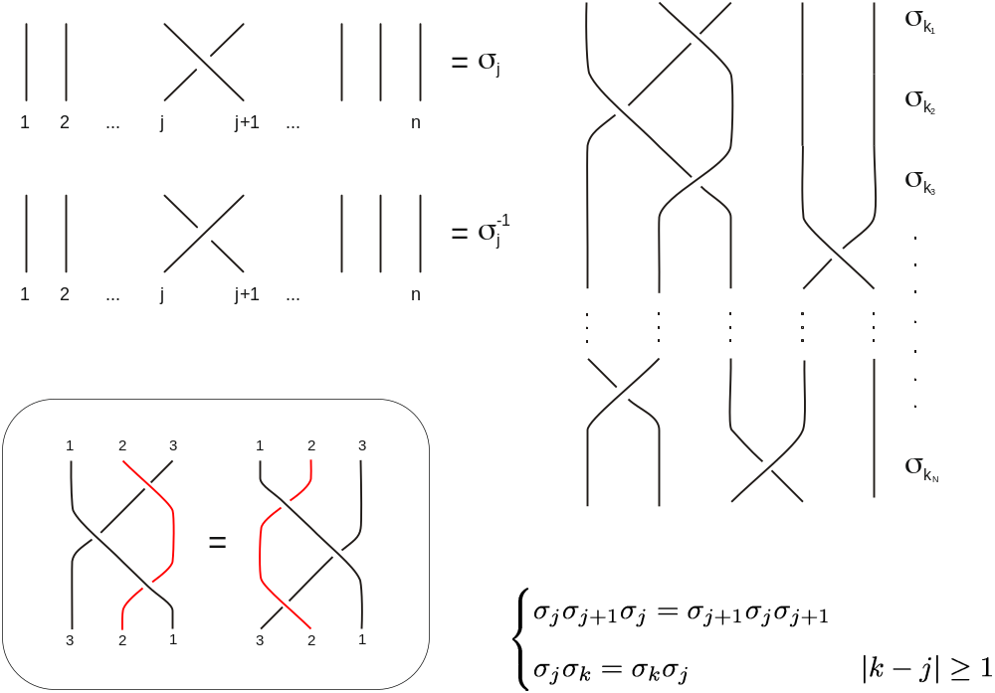
What are braids?
generators of braid group B_{n}
braid group relations

Slide 4
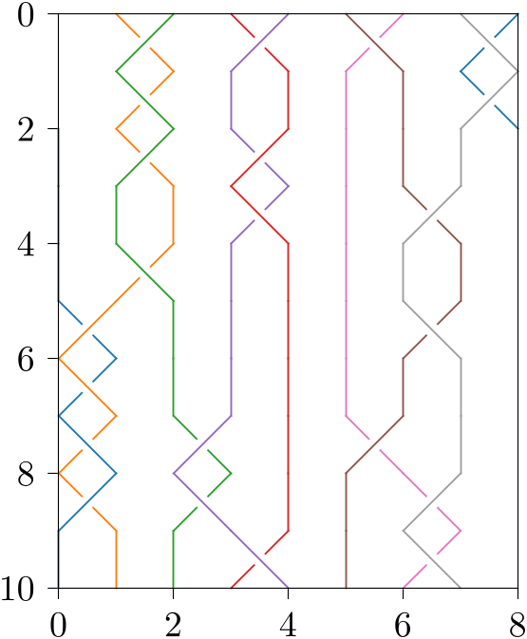
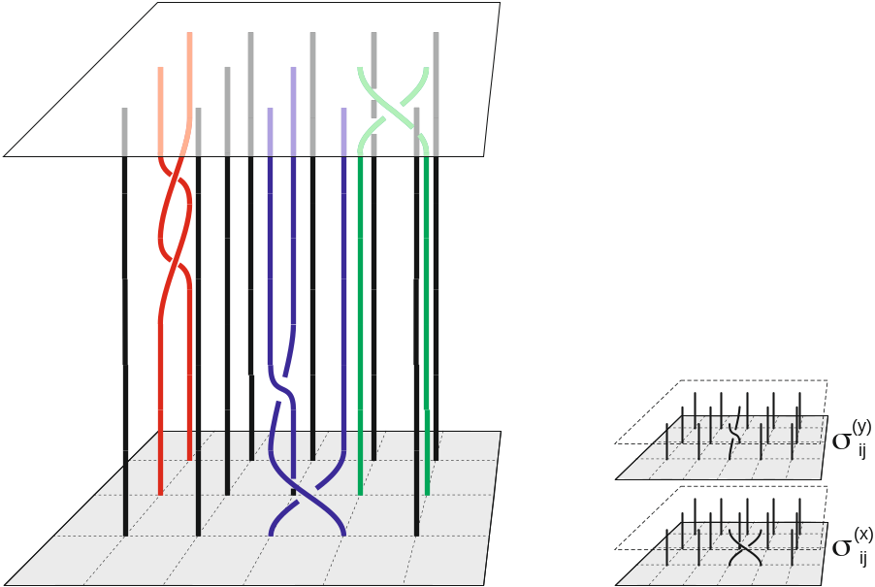
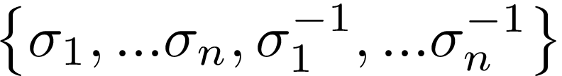
Typical examples of 2D- and 3D-braids
2D braid
3D (surface) braid
generators of surface
braid group
Identifying upper and lower ends of directed polymers (threads) we get a collection of mutually entangled loops
Random braid is obtained by assuming some distribution on the set of generators .

Slide 5

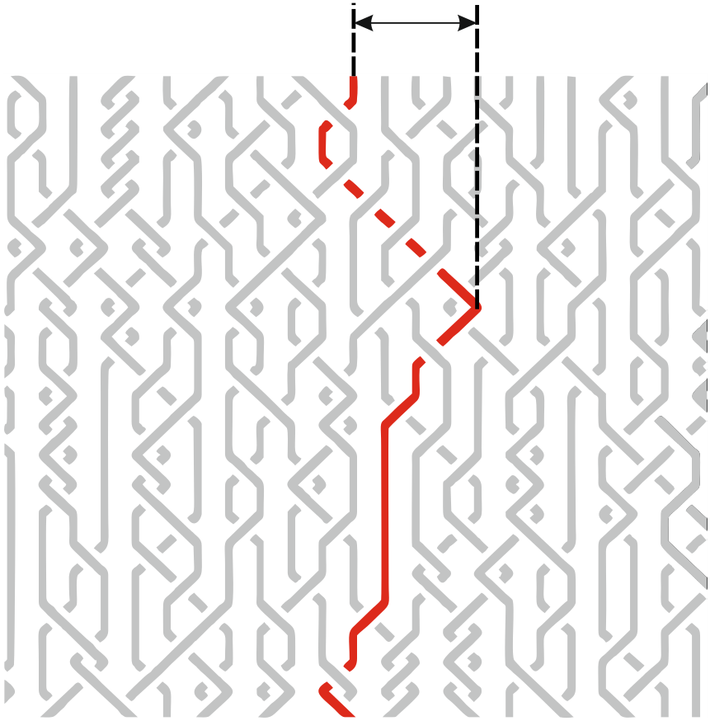
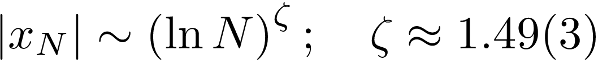
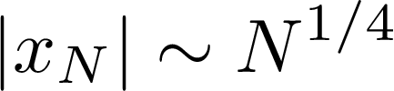
Anomalous fluctuations of threads in trivial braids
Consider uniform distribution on the set and demand the braid to be trivial, i.e. each thread is not entangled with all others. Such a braid is topologically equivalent to the set of parallel lines. We are interested in the mean transversal span of threads in subset of random trivial braids.
Challenging numerical observation
P. Serna, G. Bunin and A. Nahum, in Phys. Rev. Lett (2015), 115, 228303 claimed the asymptotic logarithmic dependence
The claim of P. Serna, G. Bunin and A. Nahum contradicts a mean-field-like theory of unentangled random walks in the uniform lattice of obstacles (E. Helfand and D. Pearson, 1983; M. Rubinstein and E. Helfand, 1985; A. Khokhlov and S.N., 1985), which should give

Slide 6
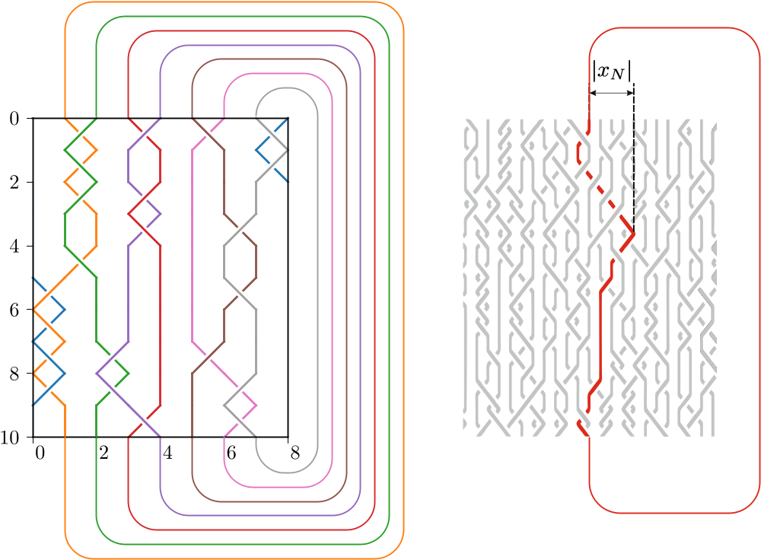

Slide 7
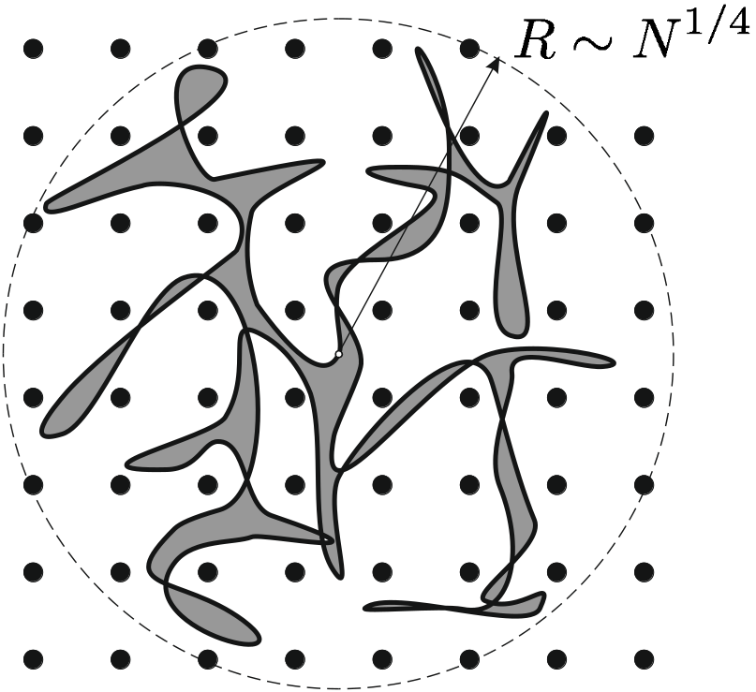

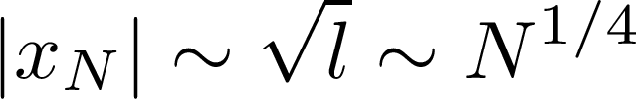
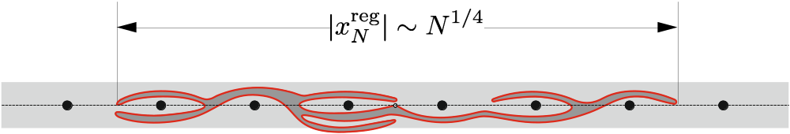
Reference model: Unentangled loop in a lattice of obstacles
Typical size of a random loop (“Brownian bridge”) on a uniform tree
Distances on the tree randomly fluctuate in space, and have typical spatial size

Slide 8
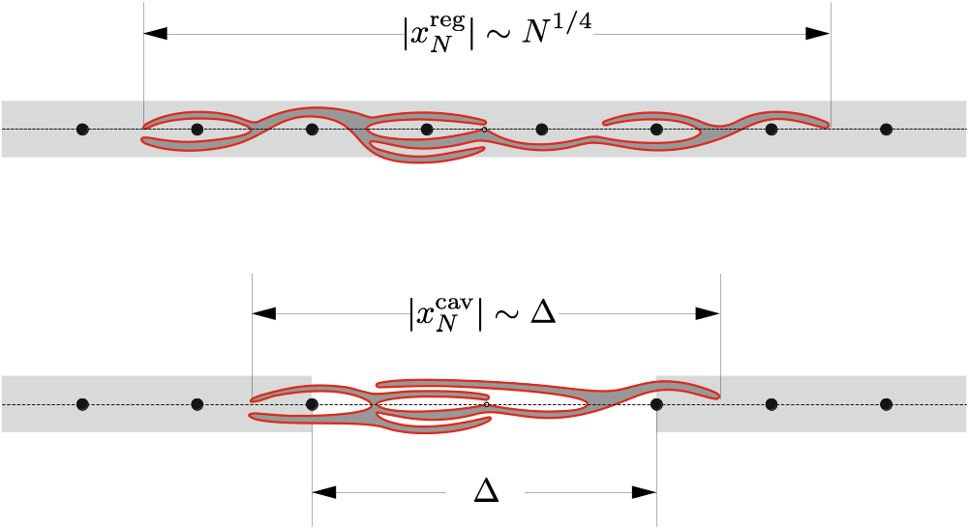
Unentangled loop in a lattice of obstacles with a cavity
Unentangled loop is localized on a cavity

Slide 9
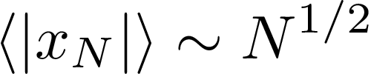
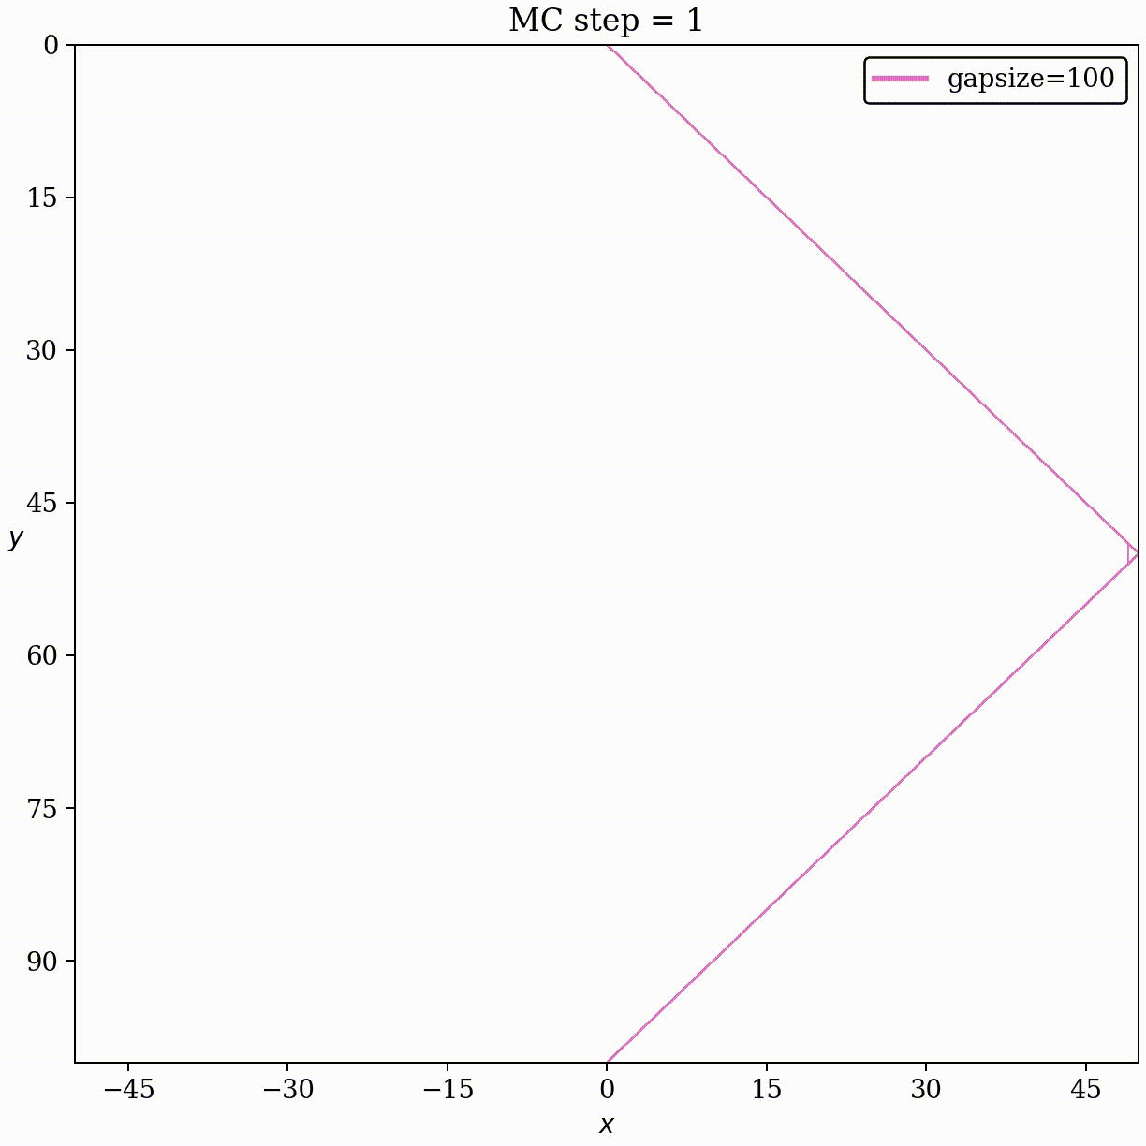
What happens with unentangled paths in the nonuniform array of obstacles
Loop on a line without lattice of obstacles, .

Slide 10
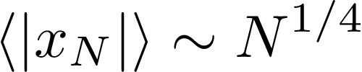
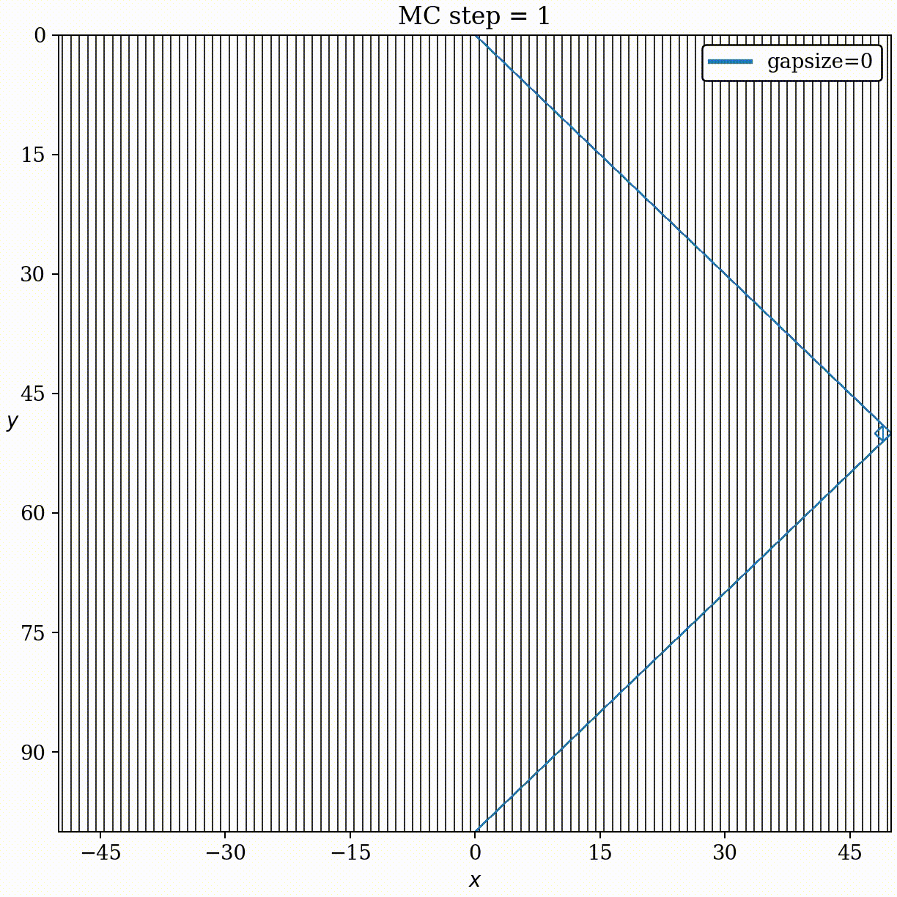
What happens with unentangled paths in the nonuniform array of obstacles
Loop on a line without lattice of obstacles, .
Unentangled loop in uniform lattice of obstacles, .

Slide 11

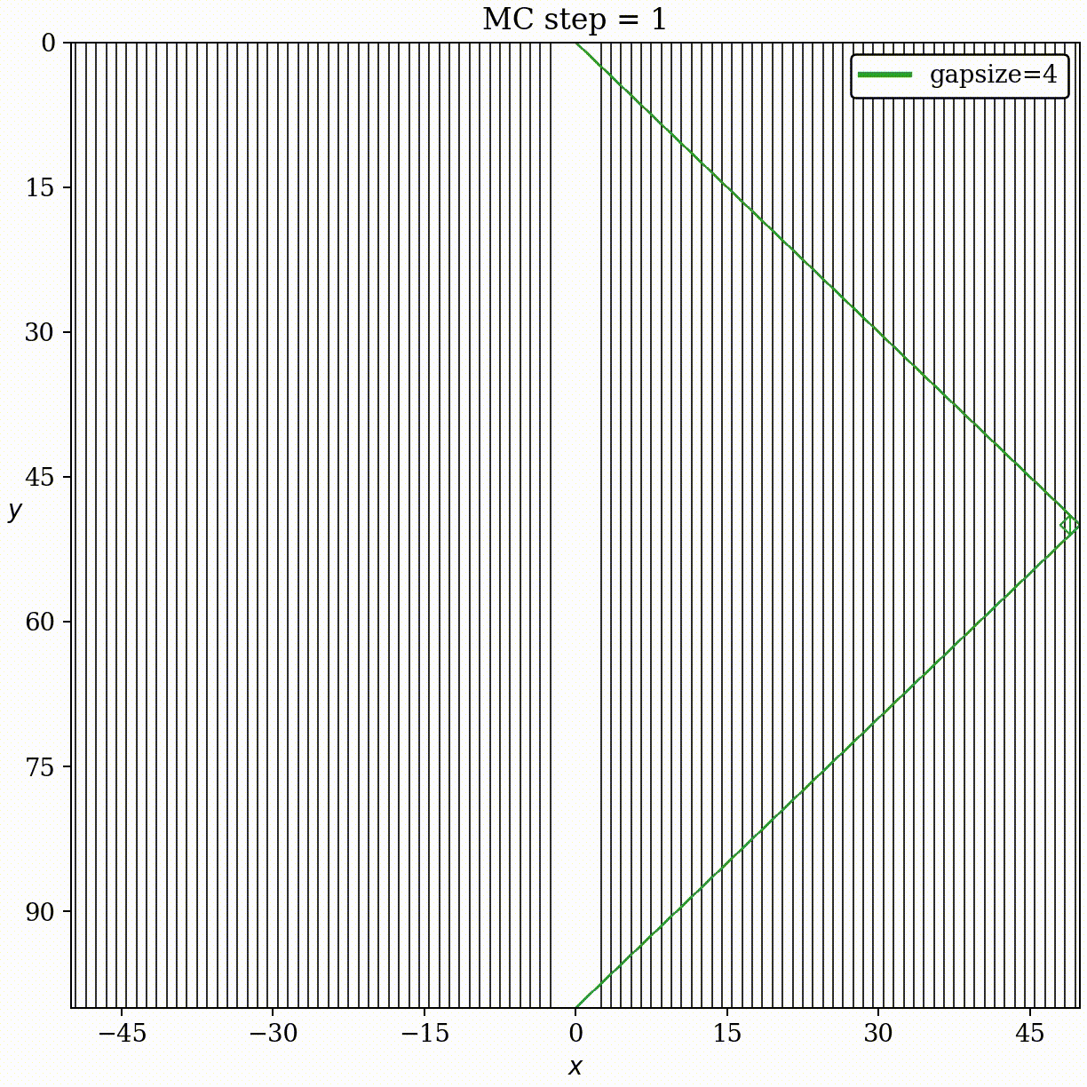
What happens with unentangled paths in the nonuniform array of obstacles
Loop on a line without lattice of obstacles, .
Unentangled loop in uniform lattice of obstacles, .
Unentangled loop in array of obstacles with a cavity, .

Slide 12
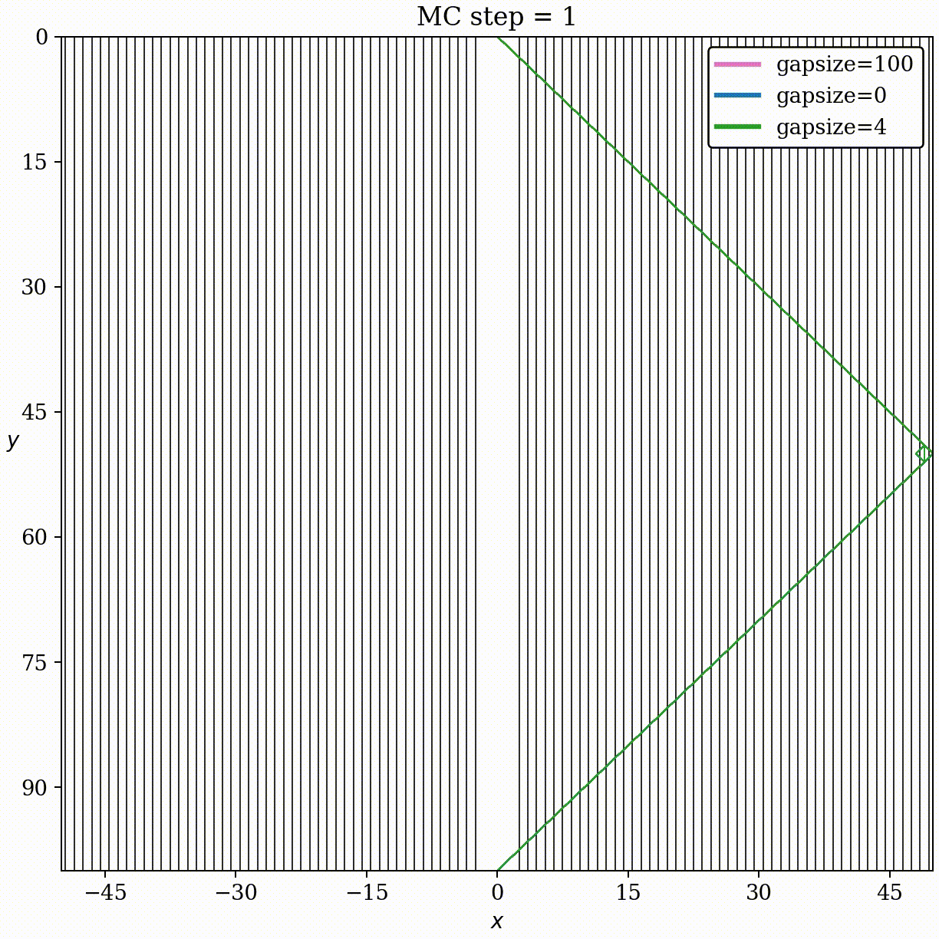
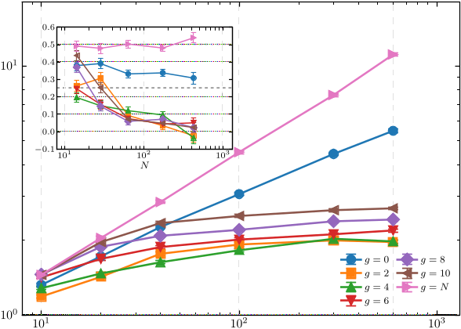
What happens with unentangled paths in the nonuniform array of obstacles
Loop on a line without lattice of obstacles, .
Unentangled loop in uniform lattice of obstacles, .
Unentangled loop in array of obstacles with a cavity, .
Summary:
Asymptotic behavior of span
Our main message:
In the nonuniform lattice of obstacles unentangled loop localizes on the cavity free of obstacles

Slide 13



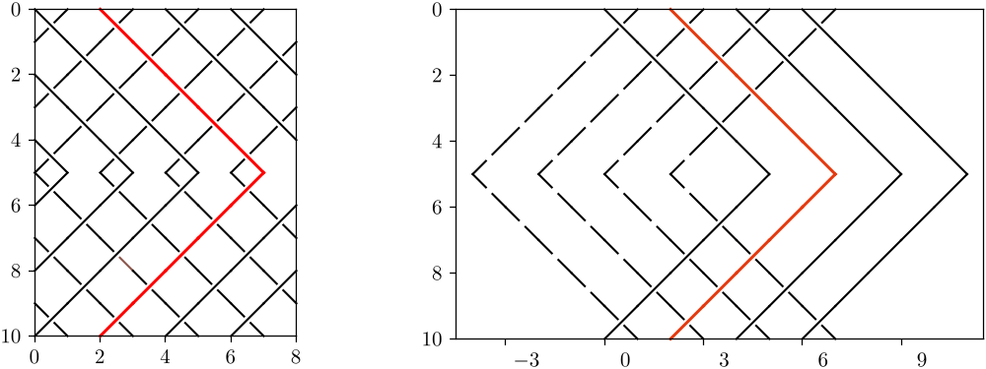
Our conjectures (simulations and analytics):
Unentangled threads in a braid are localized in the transversal direction at for some
There is a delocalization-localization phase transition of threads’ transversal fluctuations at for long braids
This statement is stronger than numerical finding of P. Serna, G. Bunin and A. Nahum. We suggest that logarithmic growth of a span is a transient regime for intermediate braid lengths N.
Preparation:
Unentangled fully expanded threads
braid wrapped on a cylinder
unwrapped braid

Slide 14
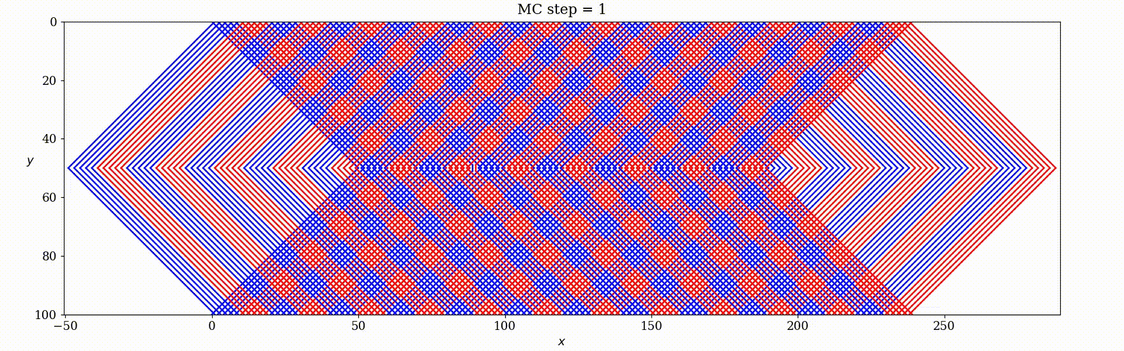
Our conjectures (simulations and analytics):
Unentangled threads in a braid are localized in the transversal direction at for some
There is a delocalization-localization phase transition of threads’ transversal fluctuations at for long braids
This statement is stronger than numerical finding of P. Serna, G. Bunin and A. Nahum. We suggest that logarithmic growth of a span is a transient regime for intermediate braid lengths N.
Preparation:
Unentangled fully expanded threads
braid wrapped on a cylinder
unwrapped braid

Slide 15
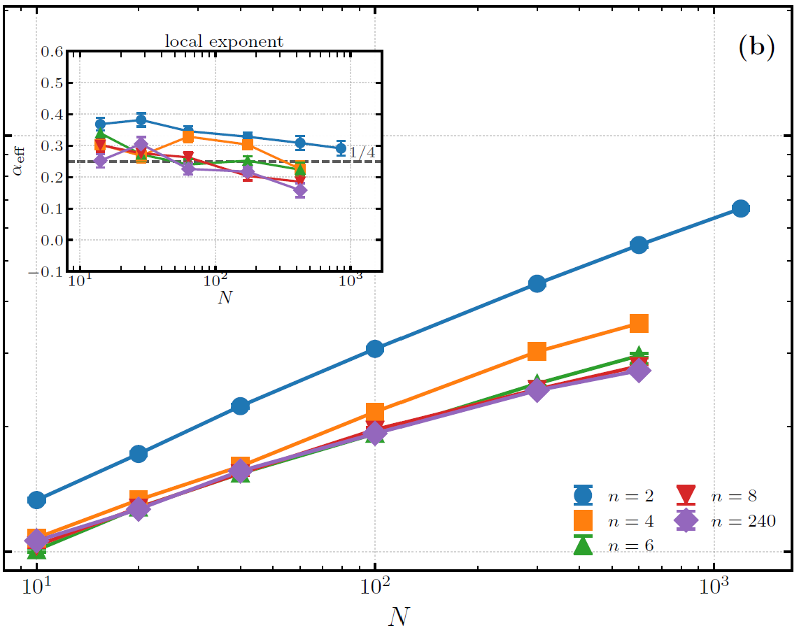
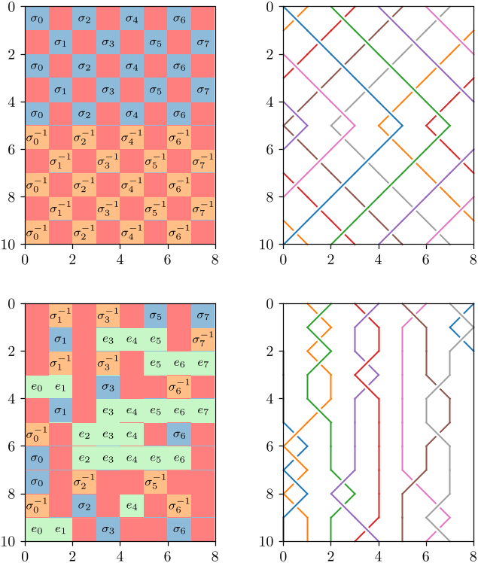

Algebraic approach to random walk on braid groups
Consider uniform distribution on generators and write random words of 2N letters. Extract subset of such words that are fully contractible. This subset constitutes the ensemble of trivial braids.
We estimate the span of the Brownian bridge (Bb) by the shortest length of the (irreducible) word written by first N letters out of 2N-letter Bb.
3-strand braid
4-strand braid
all braids with

Slide 16
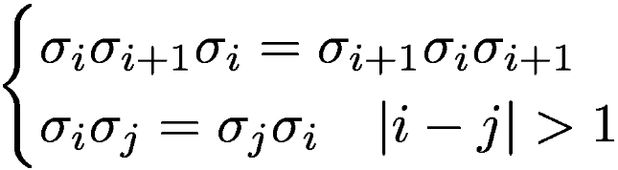
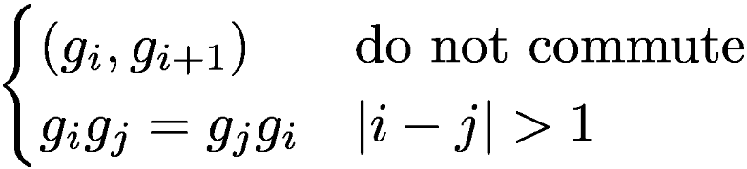
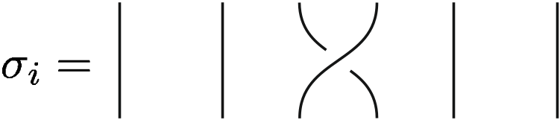
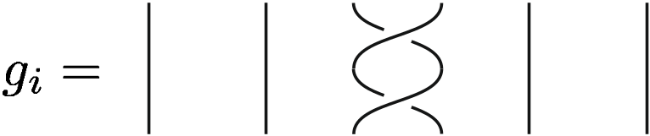
Braids and locally-free groups
We should understand how the “space of all words” of B_{n+1} looks like, i.e. what is the graph of the braid group B_{n+1}. Then we shall consider statistics of closed random walks (Brownian bridges) on this graph. The span of Bb is defined by the shortest distance along this graph of the middle point of Bb.
Braid graphs are complex objects due to triple relations. We can essentially simplify consideration by approximating braid groups by locally free groups.
Braids are considered in a “locally-free approximation” (A. Vershik, S.N., R. Bikbov, Comm. Math. Phys., 2000) where we neglect triple interactions:
Braids, B_{n+1}
Locally-free group, LF_{n}
Visualization of generators

Slide 17


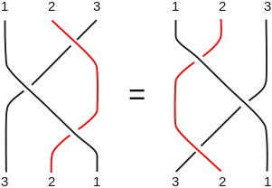


Locally free group as approximants of braid group
1. Estimation from above: Number of all shortest words of length 2K in LF_{n} denoted as gives upper estimate for number of shortest words of length 2K in braid group B_{n+1} , , because B_{n+1} is contained in LF_{n} due to absence of triple relations:
2. Estimation from below: Number of all shortest words of length K in a group LF_{n} , , gives lower estimate for number of shortest words of length 2K in braid group B_{n+1}, , because LF_{n} is constructed on squares of generators of B_{n+1}:
Hence, we get bilateral estimate for the braid group by locally-free group

Slide 18
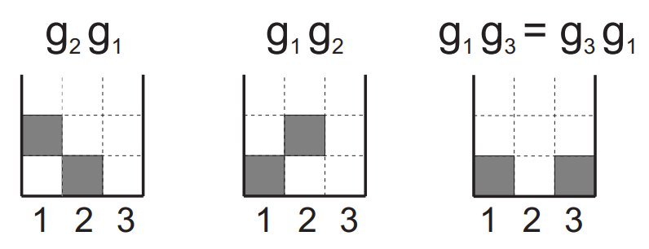


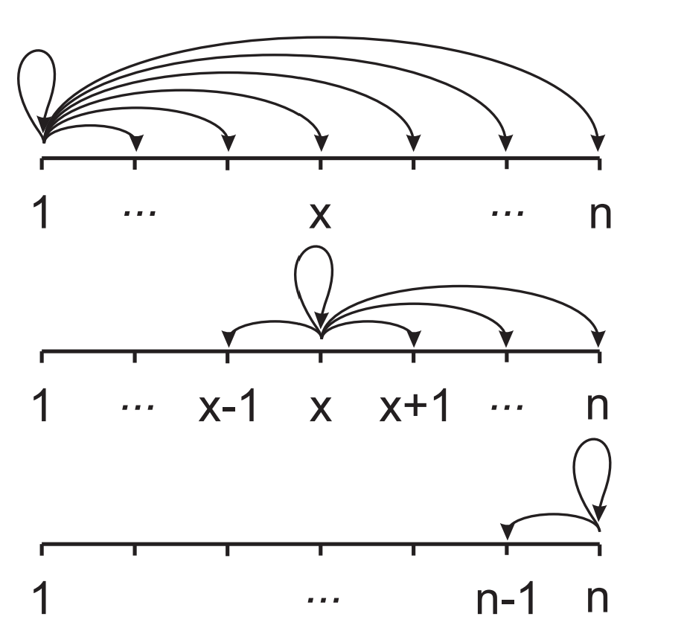
Exact word enumeration in the group LF_{n} and its Cayley graph
Normal form of a word in LF_{n}:
where and satisfy the conditions:
(i) If α_{i} = 1 then α_{i+1} = 2, . . . , n;
(ii) If α_{i} = k (2 ≤ k ≤ n − 1) then
α_{i+1} = k − 1, k + 1, . . . , n;
(iii) If α_{i} = n then α_{i+1} = n − 1.

Slide 19
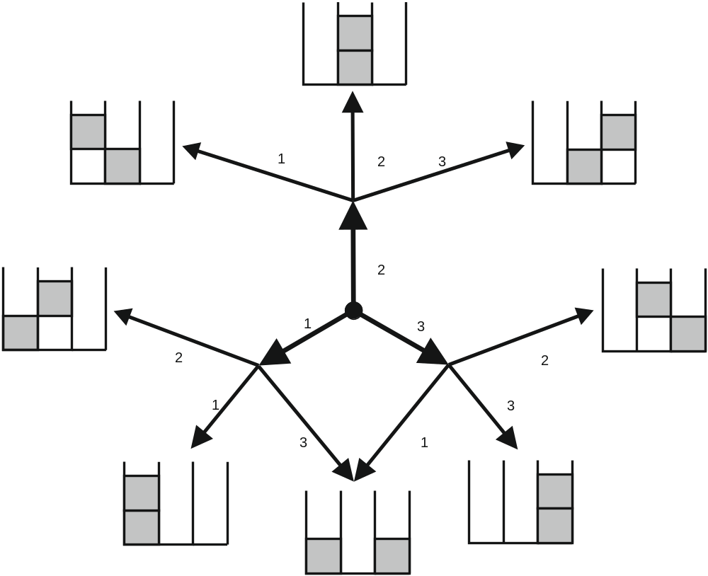
Exact word enumeration in the group LF_{n} and its Cayley graph

Slide 20
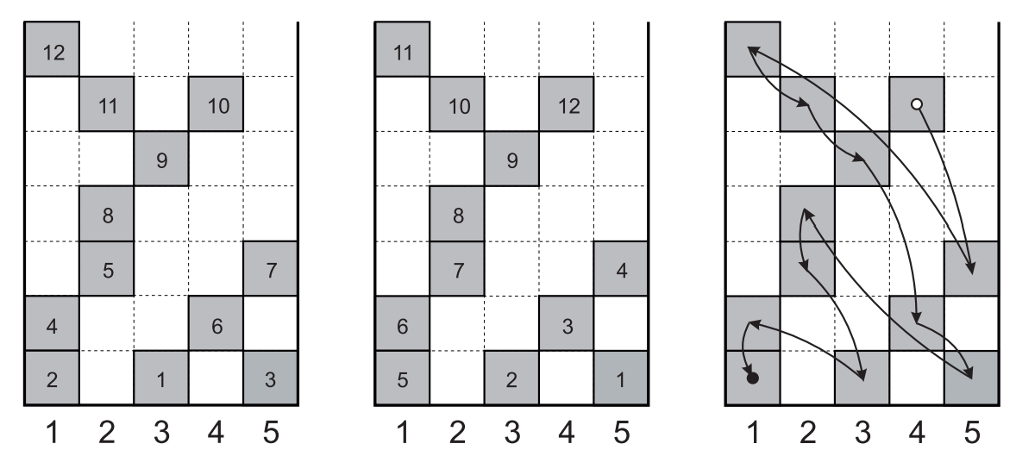
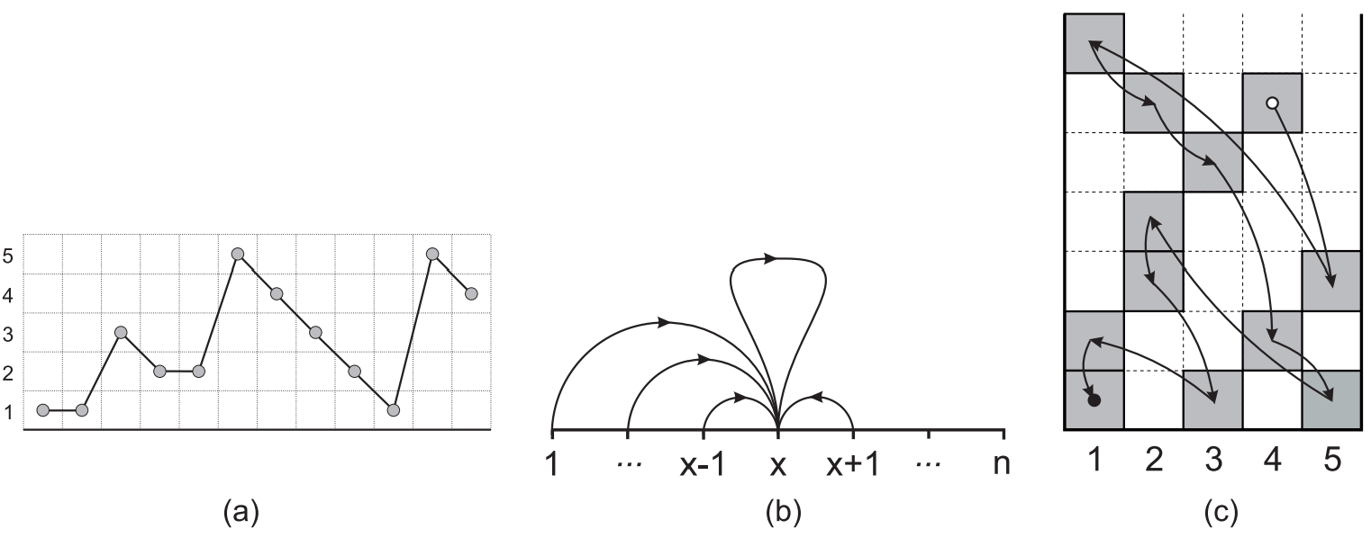
Words as heaps of pieces
“Mikado” algorithm of enumeration of words
Equivalent descriptions: Lukasiewicz paths and Mikado ordering

Slide 21
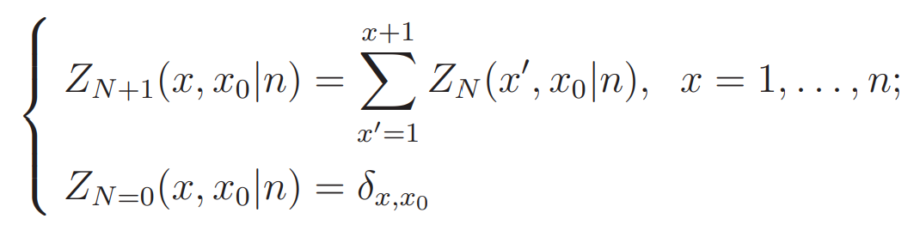
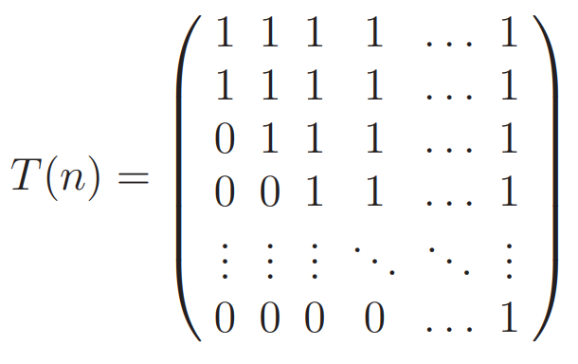
The numbers of topologically different heaps, Z_{N}(x, x₀|n), which defines the number of different words (different classes of equivalences in the semigroup of positive generators) satisfies the recursion relation
It is convenient to rewrite this recursion in a matrix form
where the matrix T(n) is the transfer matrix of Lukasiewicz paths:

Slide 22
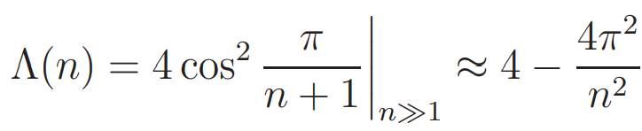
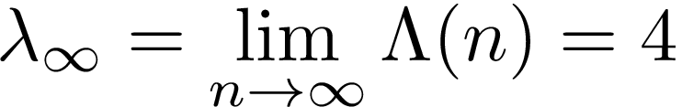

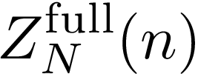

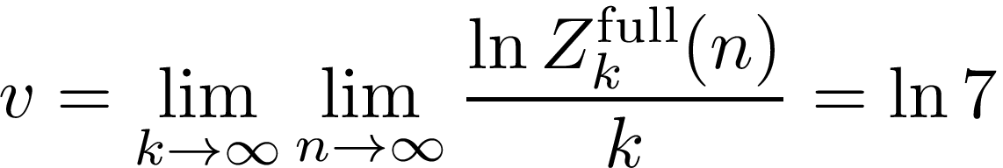
The growth rate, Λ(n), of a heap is determined by the largest eigenvalue of the transfer matrix, T(n):
Thus, in a large bounding box of base n ≫ 1 the growth rate is saturated at the value
Let us recall that geometric heaps correspond to enumeration of words in a semingroup, , constructed in terms of generators g_{i} in positive powers only. Number of pieces in a heap, N, equals to the length of shortest word, k.
The number of classes of equivalences, , in the full locally-free group, , can be exactly computed taking into account multiplicity of indices. The logarithmic volume of the group grows as

Slide 23


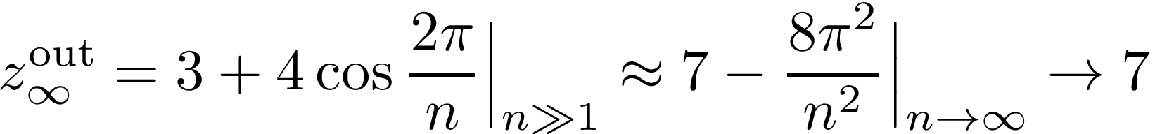
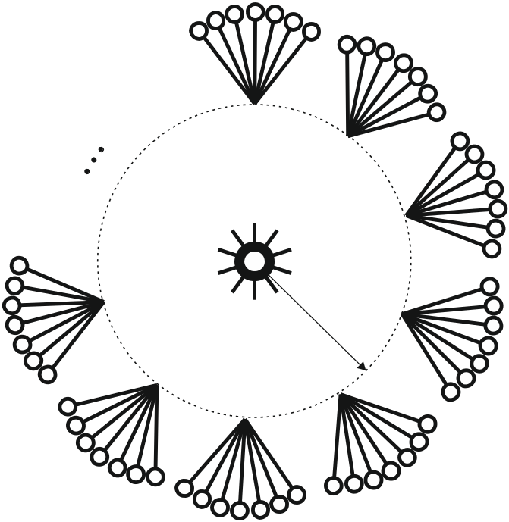

The fact that indicates that on large distances from the root point, , the graph of the locally free group (and hence of the braid group B_{n+1}) grows not faster than the effective Cayley tree with outer branches:
...while at the root point the number of branches is unbound.
Conjecture
The graph of the locally-free group at large n looks asymptotically as an effective tree with a heavy root where n is the control parameter.

Slide 24
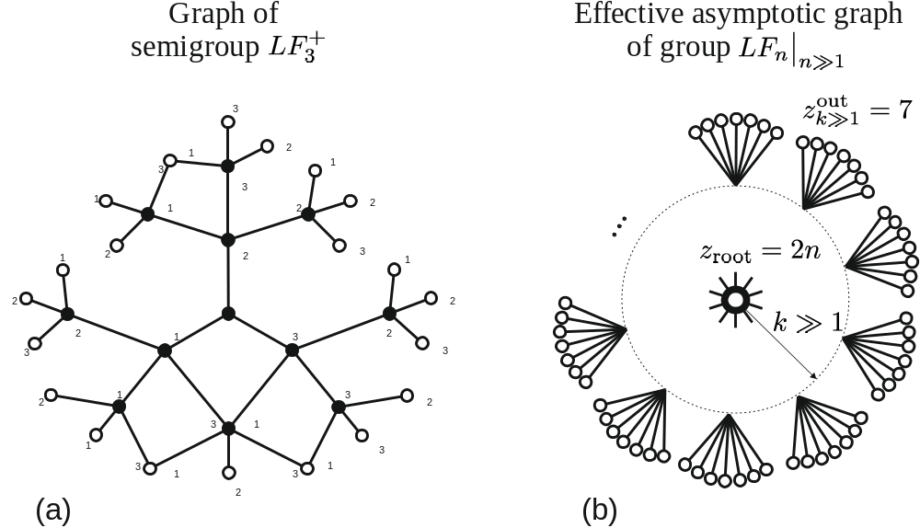

Slide 25
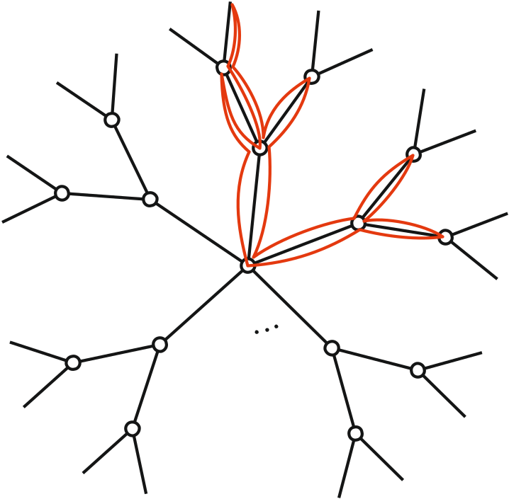







Analytic arguments in support of threads’ localization
1. Random loops on an uniform tree with a “heavy root”
Loops localize at the heavy root by the 2nd order phase transition at the critical point
At the loop has typical span on the tree;
At the loop is localized in the vicinity of the root and has a typical span on the tree.
The localization mechanism is purely entropic:
At sufficiently large values of and fixed the configurational entropy of the root exceeds the entropy of configurations expanded over the tree.

Slide 26

Analytic arguments in support of threads’ localization
2. Localization of loops on an asymptotic graph of a locally-free group
Trivial braid (all threads are unentangled) = loop (Brownian bridge) on the graph of a locally-free group
The graph of the locally free group on large distances and for looks is an effective tree with outer branches but the root point is “heavy” with branches.
Thus, we can apply the above discussion of “entropic localization” of loops at the origin of a tree-like graph with a heavy root, which support the following statement:
There is a critical n_{cr} such that for n > n_{cr} the Brownian bridges on the braid group (i.e. unentangled paths) are localized in the finite layer at the root point of the graph of the group.

Slide 27
Summary:
Collective mechanism behind spontaneous localization
Transverse moves change topological accessibility of neighboring threads, opening “gates” (holes), which provide further spontaneous localization of an unentangled chain in an effective inhomogeneous array of obstacles;
Consequently, localization of one chain generates a hole for other chains and hence is the nucleus producing avalanche of instabilities resulting in emergent microphase segregation in unentangled threads.
Algebraically, statistics of random entanglements of threads can be viewed as a random walk on the braid group. Return to the origin (Brownian bridge) means complete disentanglement of all threads. On large scales the graph of the braid group looks as a tree with a “heavy root” which favors localization of Brownian bridges.
Found behavior could have important consequences for understanding the roughness of boundaries between chromosomal territories.

Slide 28
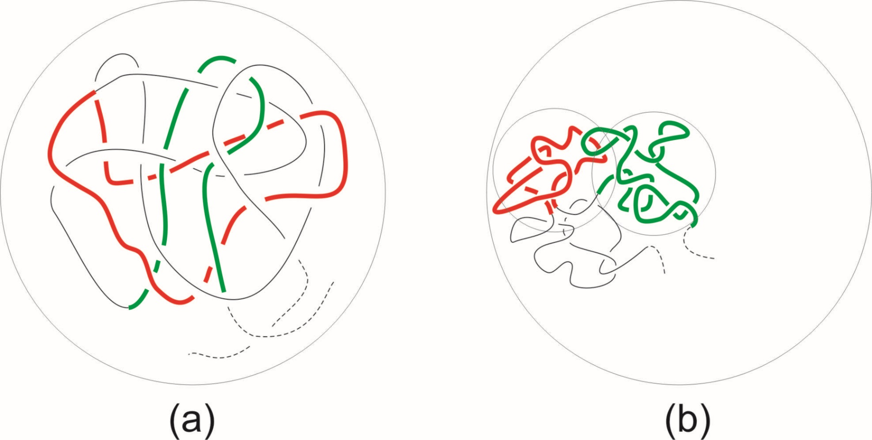
How can a linear chain be tightly packed in space so that each part would be (almost) unknotted?
X
Different chain parts penetrate into each other forming quasi-entanglements
Neighboring monomers along a chain are mostly neighbors in space and are weakly entangled

Slide 29
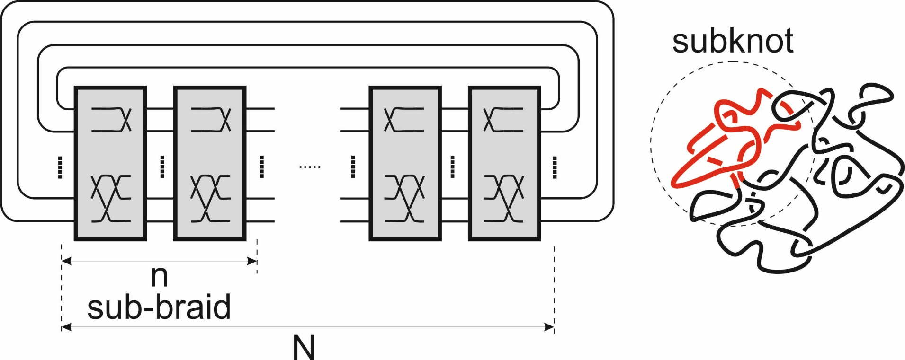
How can a linear chain be tightly packed in space so that each part would be (almost) unknotted?
M. Imakaev, K. Tchourine, S.N., L. Mirny (Soft Matter, 2014)

Slide 30
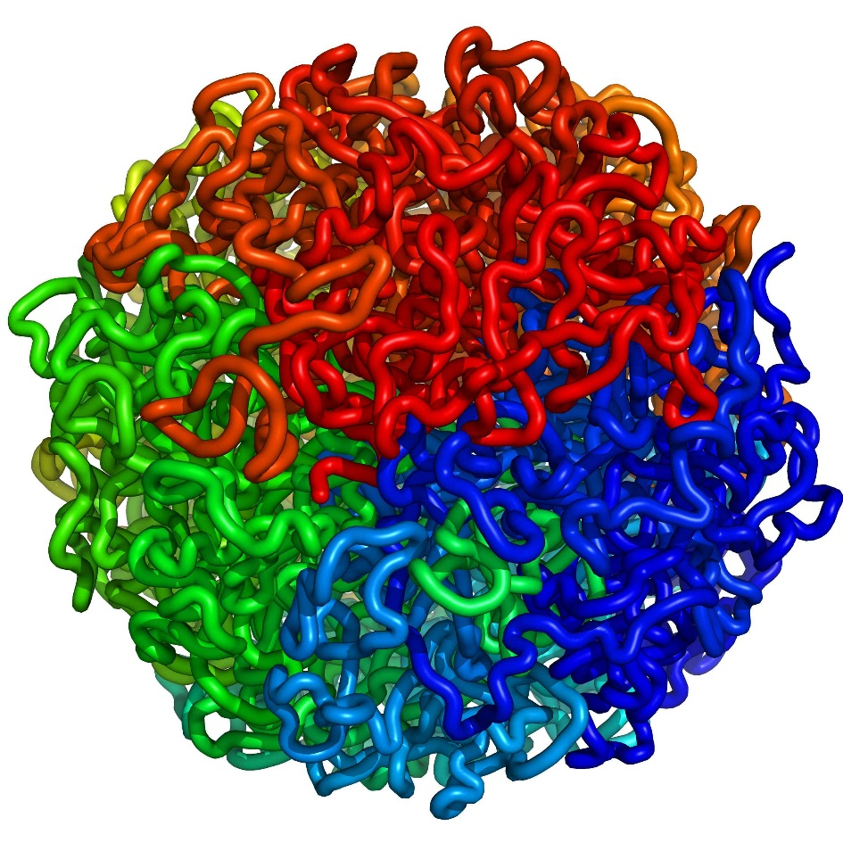
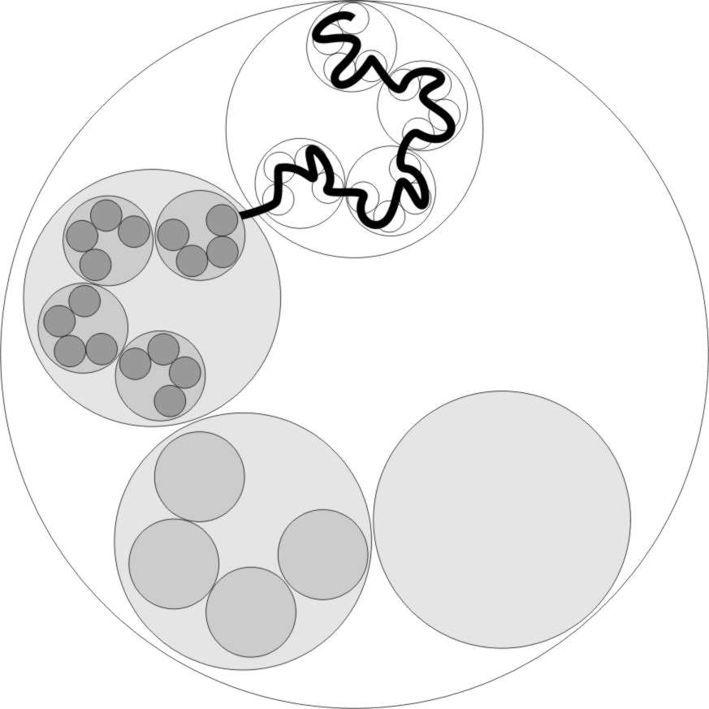
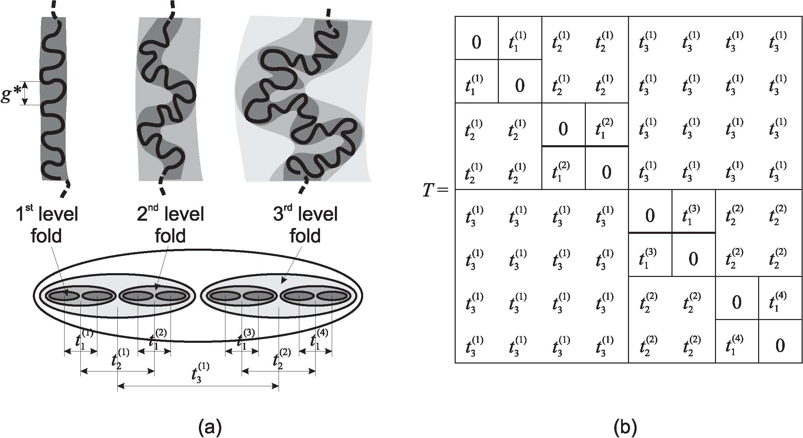
How can a linear chain be tightly packed in space so that each part would be (almost) unknotted?
Chain is continuously painted in rainbow colors from one end to the other. “Territorial structure” shows that monomers neighboring along a path are neighboring in space

