Slide 1





Contributing to reproducible software-based measurement of energy consumption in machine learning
Anthony BERTRAND
Supervisors : David HILL
Engelbert MEPHU NGUIFO

Slide 2
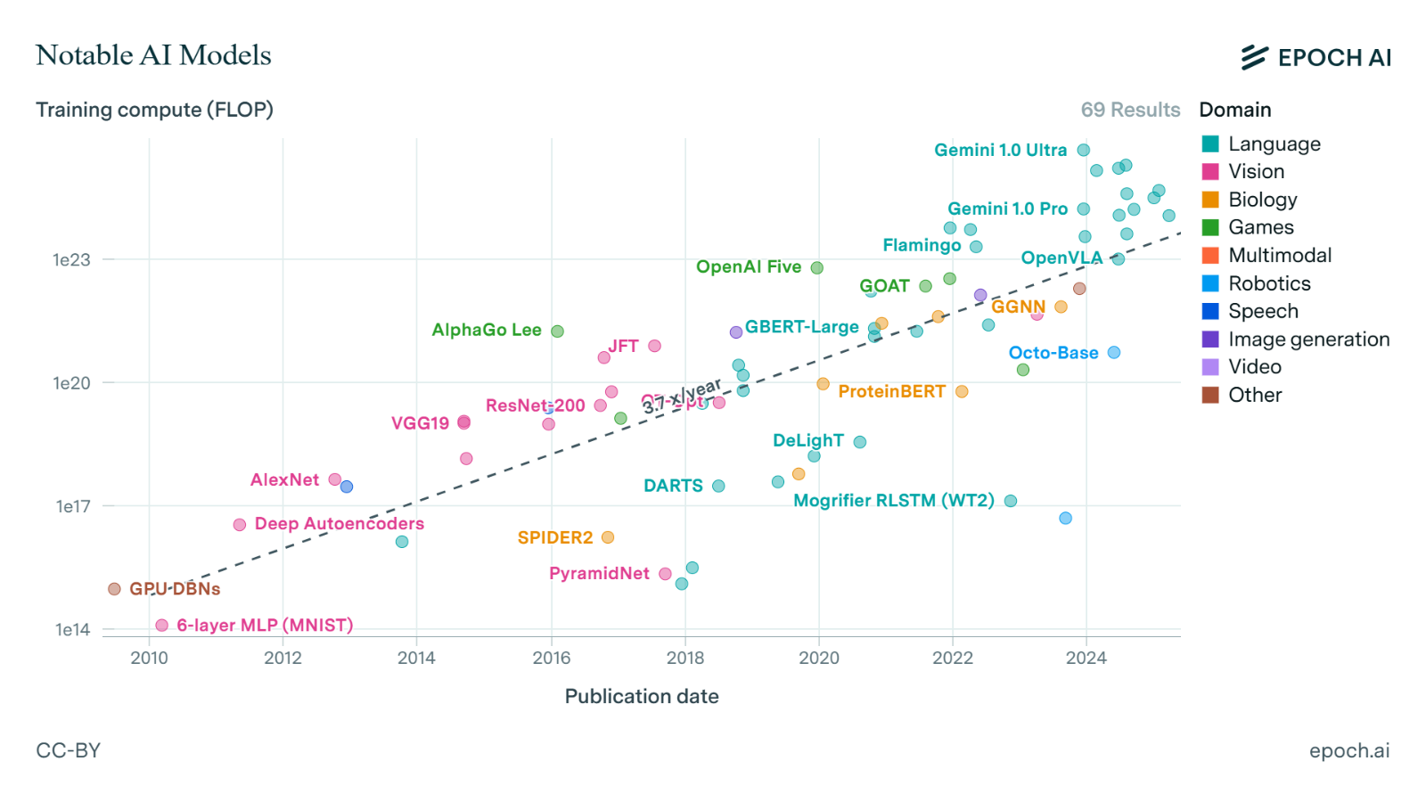
Introduction
Increasingly large AI models
increasingly lengthy AI training
Data on energy consumption?
Graph showing the increase in computing load for machine learning models from 2010 to 2025
Notes:
Avec cette croissance rapide, il est important d’avoir des données sur la consommation d’énergie des systèmes afin de pouvoir optimiser l’énergie. Aussi bien pour les concepteur de matériel informatique que pour les développeur qui utiliseront ce matériel pour y exécuter du code.

Slide 3
Introduction
Measuring energy consumption
Hardware-based measurement
Physical devices (measuring instruments) for measuring energy consumption.
(Wattmeters, smart plugs)
  High accuracy
  OS and software independent
  Lack granularity
  Expansive
Software-based measurement
Software tools to estimate energy consumption based on resources used, or other information related to system activity
  Granularity
  Cheap
  Variable accuracy
  OS-dependant
Chen, H., & Shi, W. (2012). Power Measuring and Proﬁling: State of the Art. In Handbook of Energy-Aware and Green Computing, Volume 2 (Vol. 2, p. 26). Chapman and Hall/CRC.
Notes:
Méthodes matérielles (directes)
Méthodes logicielles (indirectes)

Slide 4
Introduction
Reproducibility
In experimental sciences, this criterion distinguishes science from pseudo-science.
Since May 2025, a “reproducibility checklist” is mandatory to be published in the Journal of Artificial Intelligence Research (JAIR).
My job:
Tackle reproducibility challenges in ML.
  Spread good practices.
  Raise awareness.
Make my own research reproducible.
Gundersen, O. E., Helmert, M., & Hoos, H. (2024). Improving Reproducibility in AI Research: Four Mechanisms Adopted by JAIR. Journal of Artificial Intelligence Research, 81, 1019–1041.
Notes:
Méthodes matérielles (directes)
Méthodes logicielles (indirectes)

Slide 5
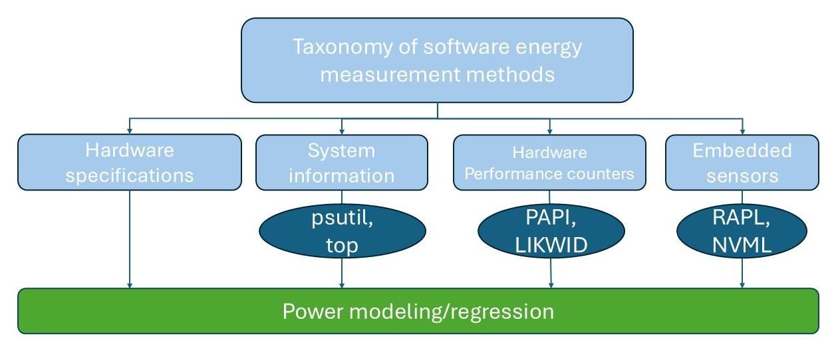
Energy measurement
Taxonomy
Notes:
Dans méthodes logicielles décrire chaque méthodes + expliqué pourquoi capteurs matériel != logicielle

Slide 6
Energy measurement
Tools
Date | Tools
2019 | Energy Usage
2020 | Experiment Impact Tracker Carbon Tracker
2021 | Cumulator CodeCarbon
2022 | Power Measurement Toolkit PowerJoular perun eco2AI
2023 | Rjoules
2024 | EA2P CPPJoules
2025 | Alumet
All these tools use RAPL
RAPL uses proprietary power models
What about Storage? Network? Fans?
Notes:
Dans méthodes logicielles décrire chaque méthodes + expliqué pourquoi capteurs matériel != logicielle

Slide 7
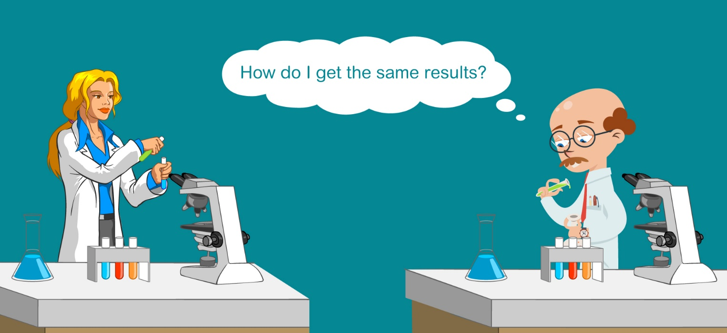
Reproducibility
Definition of reproducibility
The measurement can be obtained with stated precision by a different team using the same measurement procedure, the same measuring system, under the same operating conditions, in the same or a different location on multiple trials.
For computational experiments, this means that an independent group can obtain the same result using the author’s own artifacts.
Antunes, B., & Hill, D. R. C. (2024). Reproducibility, Replicability and Repeatability: A survey of reproducible research with a focus on high performance computing. Computer Science Review, 53, 100655.

Slide 8
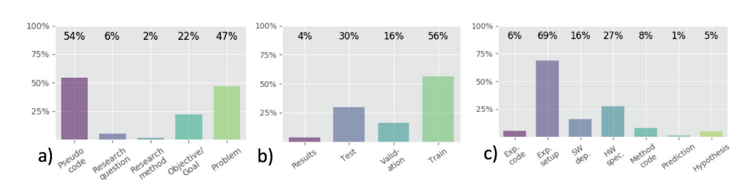
Reproducibility
Reproducibility in AI
AAAI : Association for the Advancement of Artificial Intelligence
IJCAI : International Joint Conference on Artificial Intelligence
400 articles published between 2013 and 2016:
Percentage of items meeting the criteria for each variable used in the experiment
Gundersen, O. E., & Kjensmo, S. (2018). State of the Art: Reproducibility in Artificial Intelligence. Proceedings of the AAAI Conference on Artificial Intelligence, 32(1).

Slide 9
Reproducibility
Definition of repeatability
The measurement can be obtained with stated precision by the same team using the same measurement procedure, the same measuring system, under the same operating conditions, in the same location on multiple trials.
For computational experiments, this means that a researcher can reliably repeat their own computation
For scientific programs, the stated precision must be 0. We need bitwise identical results to debug!

Slide 10
Reproducibility
Work on clustering methods
Study of K-Means, DBSCAN and Ward algorithms
  Divide them into steps
  Explain what must be define to have a deterministic algorithm
Study of the Scikit-learn implementation
  K-Means is not bitwise repeatable!
  May come from OpenMP mismanagement of floating-point operation order
  Try to compare it with other implementations

Slide 11
Reproducibility
Work on clustering methods
8 Datasets:
5 implementations:
With Scikit-learn
  DBSCAN
  Ward
  K-Means
With SciPy
  K-Means
In addition
  Custom K-Means with OpenMP
Parameters Datasets | # Instances | # Features | # Classes
Iris | 150 | 4 | 3
Toxicity | 171 | 1 203 | 2
Wine | 178 | 13 | 2
Breast cancer | 569 | 30 | 2
Taiwan | 6 819 | 95 | 2
Letter recognition | 20 000 | 16 | 26
Default of credit card clients | 30 000 | 23 | 2
Blob dataset (generated) | 60 000 | 2 | 10
Everything is bitwise-repeatable, except K-Means of scikit-learn

Slide 12
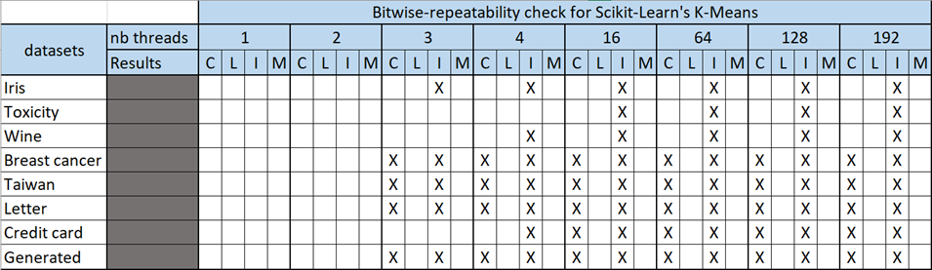
Reproducibility
Work on clustering methods
K-Means results repeatability for each dataset depending on the number of OpenMP threads used (up to 192 threads) over 30 replications.
C=final centers, L=final labels, I=inertia score, M=best iteration.
A cross indicates that different results were found in at least two runs out of the 30 replications.
Bertrand, A., Mephu Nguifo, E., Antoine, V., & Hill, D. (2025). A K-MEANS, WARD AND DBSCAN REPEATABILITY STUDY. ⟨hal-05426697v2⟩

Slide 13
Conclusion
Main goals :
Measure the energy consumption of ML models (train/inference) with software-based tools.
Tackle reproducibility issues in ML field.
Sub Goals :
Have a deterministic and repeatable ML program. This will reduce measurement inaccuracies.
Spread good practices and raise awareness of reproducibility pitfalls in ML.

Slide 14
Thank you for your attention

Slide 15
References
Antunes, B., & Hill, D. R. C. (2024). Reproducibility, Replicability and Repeatability: A survey of reproducible research with a focus on high performance computing. Computer Science Review, 53, 100655.
Bertrand, A., Mephu Nguifo, E., Antoine, V., & Hill, D. (2025). A K-MEANS, WARD AND DBSCAN REPEATABILITY STUDY. ⟨hal-05426697v2⟩
Chen, H., & Shi, W. (2012). Power Measuring and Proﬁling: State of the Art. In Handbook of Energy-Aware and Green Computing, Volume 2 (Vol. 2, p. 26). Chapman and Hall/CRC.
Gundersen, O. E., & Kjensmo, S. (2018). State of the Art: Reproducibility in Artificial Intelligence. Proceedings of the AAAI Conference on Artificial Intelligence, 32(1).
Gundersen, O. E., Helmert, M., & Hoos, H. (2024). Improving Reproducibility in AI Research: Four Mechanisms Adopted by JAIR. Journal of Artificial Intelligence Research, 81, 1019–1041.

