Slide 1




Stochastic Programming for Energy Procurement with Targets: 24/7 Matching and Its Relaxations
Gülin Yurter¹ Alessio Trivella¹
Selvaprabu Nadrajah² Daniela Guericke¹
17th International Conference on Stochastic Programming
Paris, France
29 July 2025
¹Industrial Engineering and Management Science, University of Twente
²College of Business Administration, University of Illinois at Chicago

Slide 2

Introduction
Motivation
UN Sustainable Development Goals #7
“Ensure access to affordable, reliable, sustainable, and modern energy for all”

Slide 3


Introduction
Motivation
UN Sustainable Development Goals #7
“Ensure access to affordable, reliable, sustainable, and modern energy for all”
Climate Group RE100
Over 400 companies made a commitment to go 100% renewable
- Microsoft (since 2014)
- Google (since 2017)
- Apple (since 2018)
Google’s 2030 goal: run all its operations using 24/7 carbon-free energy on every grid
24/7 Carbon-Free Energy Compact
Every kilowatt-hour of electricity demand with Carbon-Free Energy sources, every hour, every day, everywhere.

Slide 4
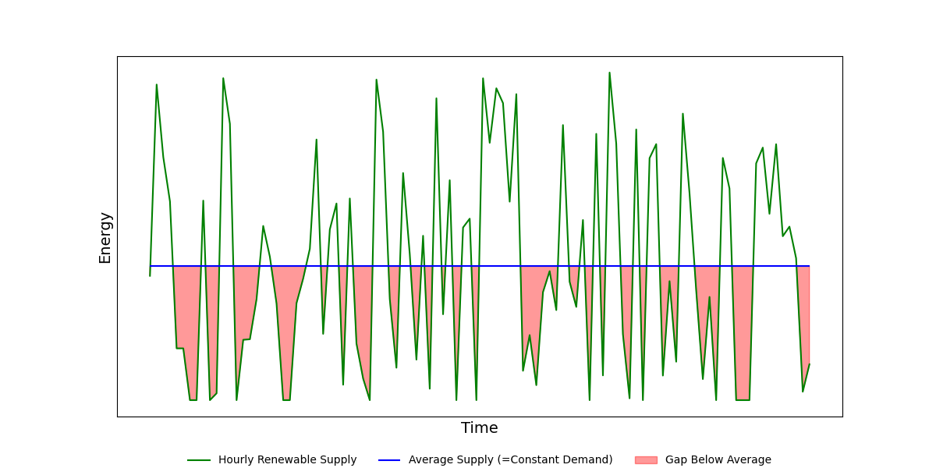
Introduction
100% and 24/7 Matching
Hourly target
meeting X fraction of demand in all time periods
100% matching (annual target)
relax
24/7 matching
relax
Temporal target

Slide 5
Introduction
100% and 24/7 Matching
Hourly target
meeting X fraction of demand in all time periods
100% matching (annual target)
relax
24/7 matching
relax
Temporal target
meeting demand 100% in X fraction of time periods

Slide 6
Introduction
100% and 24/7 Matching
Hourly target
meeting X fraction of demand in all time periods
100% matching (annual target)
relax
24/7 matching
relax
Temporal target
meeting demand 100% in X fraction of time periods
Compliance target (X) = 0.8

Slide 7
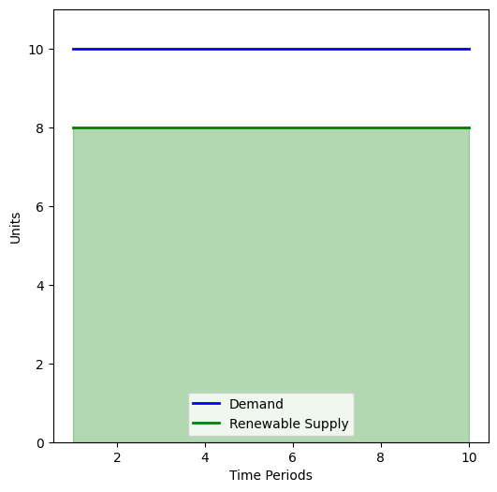
Introduction
100% and 24/7 Matching
Hourly target
meeting X fraction of demand in all time periods
Annual target (100% matching)
relax
24/7 matching
relax
Temporal target
meeting demand 100% in X fraction of time periods
Compliance target (X) = 0.8
80% satisfied in all periods

Slide 8
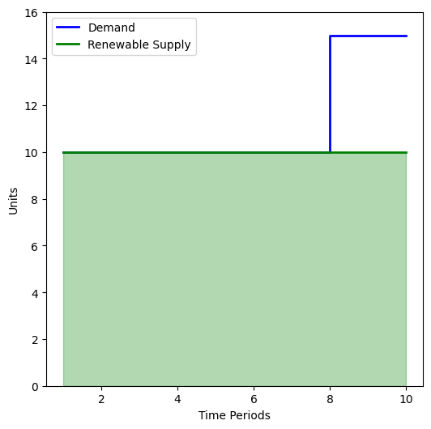
Introduction
100% and 24/7 Matching
Hourly target
meeting X fraction of demand in all time periods
Annual target (100% matching)
relax
24/7 matching
relax
Temporal target
meeting demand 100% in X fraction of time periods
Compliance target (X) = 0.8
80% satisfied in all periods
100% satisfied in 80% of time periods

Slide 9
Two-Stage Problem
Problem Setting
Power purchase agreements
Energy attribute certificates
Energy storage
Notes:
EACs are certificates that prove one unit of electricity was generated from a renewable source. They’re used to track and verify renewable energy use.
PPAs are energy contracts—you're buying the power itself. EACs are just the proof that the power was renewable, and they can be traded independently.

Slide 10
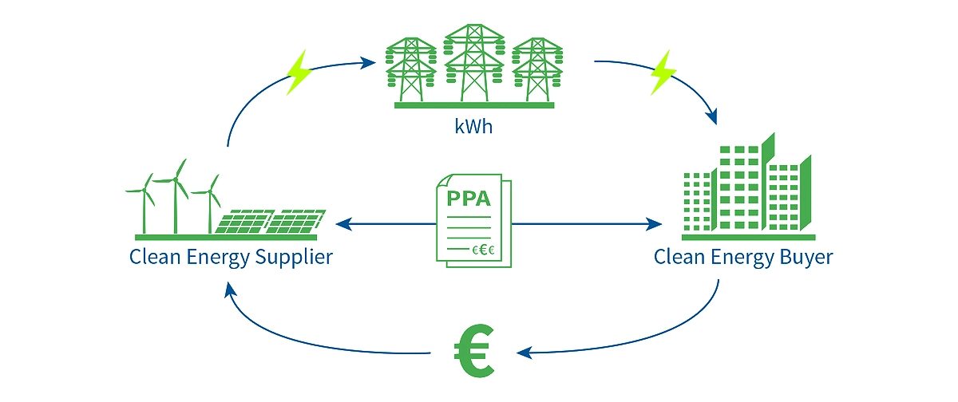
Two-Stage Problem
Problem Setting
Power purchase agreements
Energy attribute certificates
Energy storage
“Long-term contracts to buy electricity directly from renewable producers at agreed prices.”
Notes:
EACs are certificates that prove one unit of electricity was generated from a renewable source. They’re used to track and verify renewable energy use.
PPAs are energy contracts—you're buying the power itself. EACs are just the proof that the power was renewable, and they can be traded independently.

Slide 11
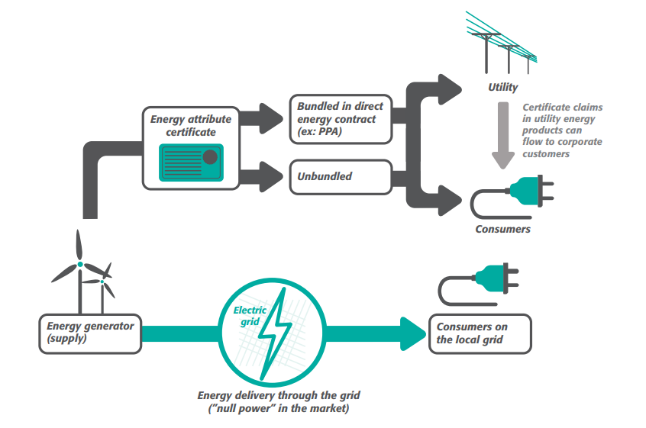
Two-Stage Problem
Problem Setting
Power purchase agreements
Energy attribute certificates
Energy storage
“Proof of renewable origin of electricity — used to claim green energy usage.”
Notes:
EACs are certificates that prove one unit of electricity was generated from a renewable source. They’re used to track and verify renewable energy use.
PPAs are energy contracts—you're buying the power itself. EACs are just the proof that the power was renewable, and they can be traded independently.

Slide 12
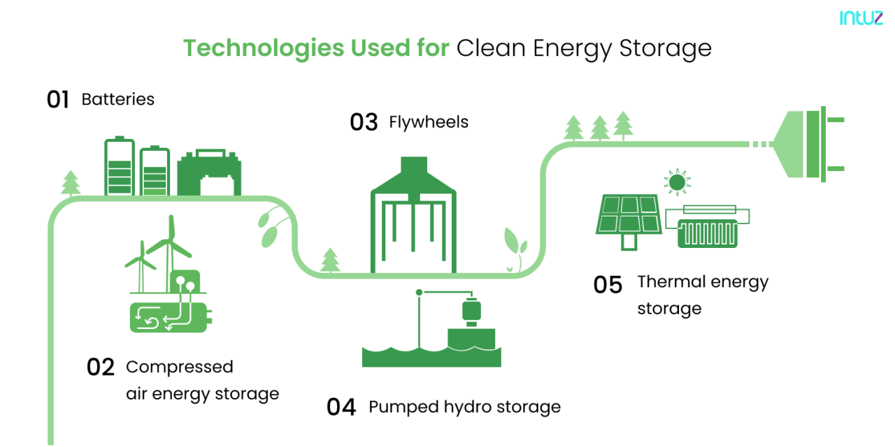
Two-Stage Problem
Problem Setting
Power purchase agreements
Energy attribute certificates
Energy storage
“Technology that stores electricity for use when renewable supply is low or demand is high.”
Notes:
EACs are certificates that prove one unit of electricity was generated from a renewable source. They’re used to track and verify renewable energy use.
PPAs are energy contracts—you're buying the power itself. EACs are just the proof that the power was renewable, and they can be traded independently.

Slide 13
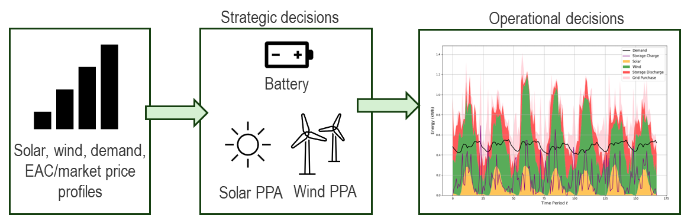
Two-Stage Problem
Problem Setting
Power purchase agreements
Energy attribute certificates
Energy storage
Trade-offs between annual and 24/7 matching, with relaxations
Optimal PPA sizes and storage capacities
Effect of uncertainty on decision-making
Two-stage problem by nature
Analytical comparison of targets
Numerical insights based on a MILP model
Notes:
EACs are certificates that prove one unit of electricity was generated from a renewable source. They’re used to track and verify renewable energy use.
PPAs are energy contracts—you're buying the power itself. EACs are just the proof that the power was renewable, and they can be traded independently.

Slide 14
Two-Stage Problem
Comparing Hourly and Temporal Targets
“For all target levels, it is possible to find instances such that the hourly compliance and temporal compliance targets have arbitrarily different costs.”
Hourly and temporal targets are incomparable: Either one can lead to significantly higher cost.

Slide 15
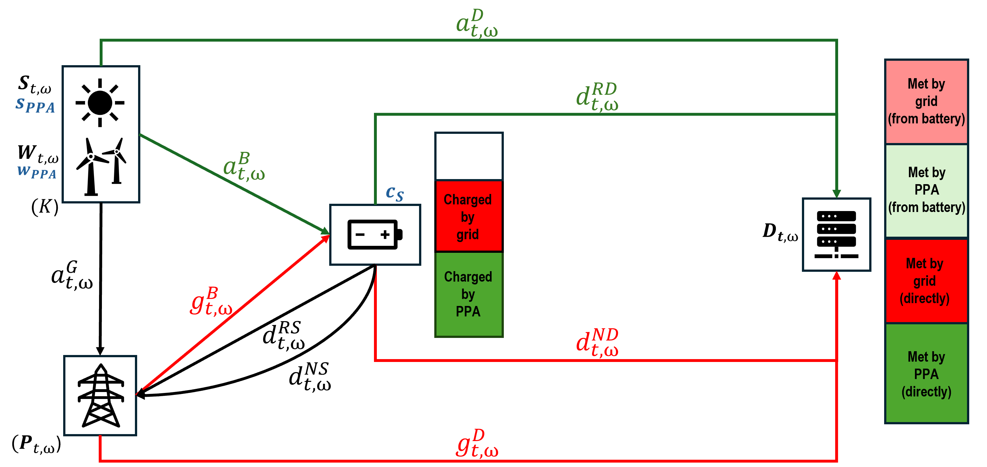
Two-Stage Problem
Flow-Based Setting

Slide 16
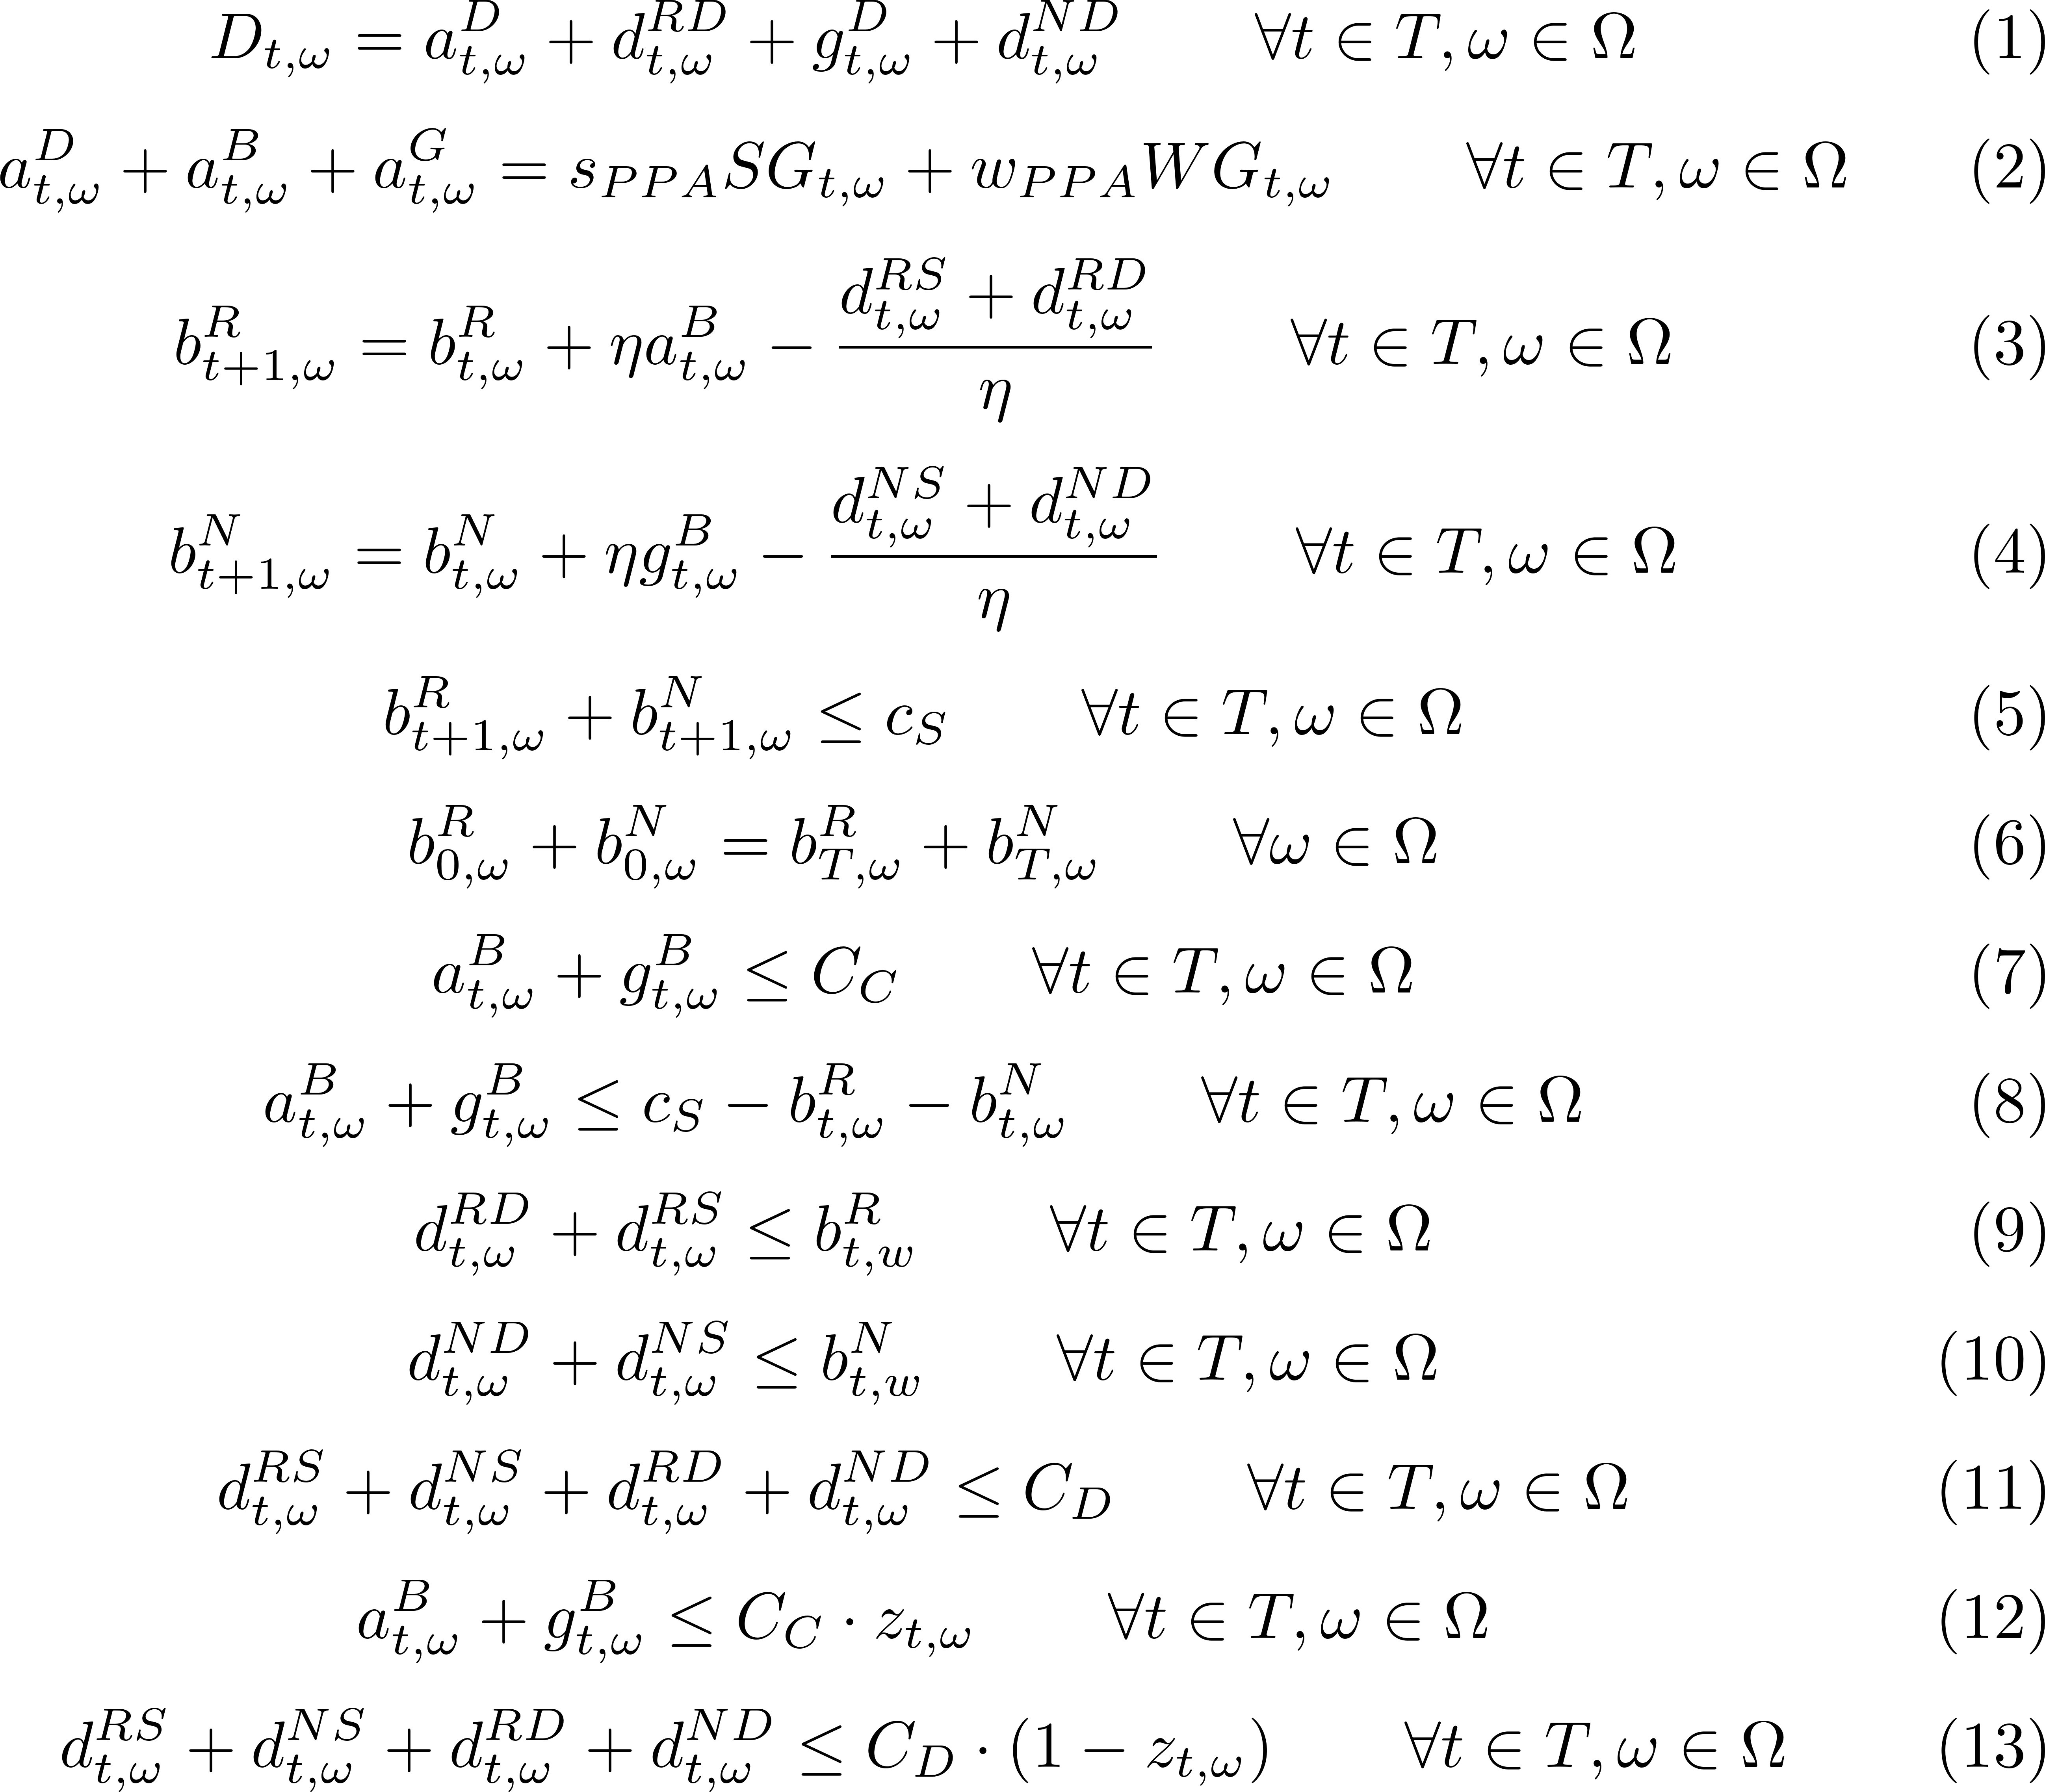
Two-Stage Problem
Full Mathematical Formulation
s.t.
Demand satisfaction
PPA supply equal to PPA usage
Storage balance renewable part
Storage balance non-renewable part
Storage capacity constraint
Initial storage equal to end storage
Charging capacities
Discharging capacities
No simultaneous charge/discharge

Slide 17
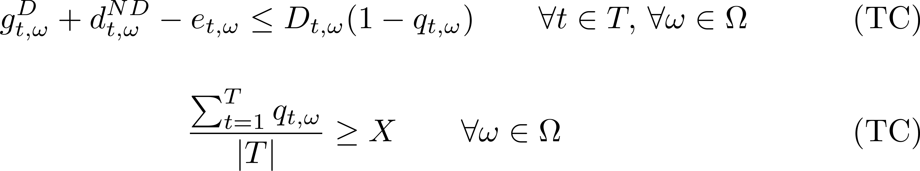
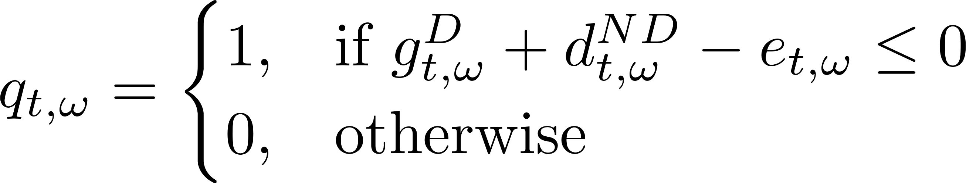
Two-Stage Problem
Targets
100% Renewable Energy Organizations purchase enough renewable energy to match their annual electricity use.
total available PPA + total EACs ≥ X * total demand
(average target)
renewable used in satisfying demand ≥ X * demand
24/7 Carbon-Free Energy
Matching electricity demand with Carbon-Free Energy generation in each hour and on each grid where demand occurs (ensuring they don’t emit in the first place).
(hourly target)
fraction of fully renewable hours ≥ X
(temporal target)
If X = 1, (TC) is equivalent to (HC)
If X ≤ 1, (AC) is a relaxation of (HC)

Slide 18
Experimental Setup
GBM-Based Scenario Generation Algorithm for Demand
Multi-year projections
Managing complexity
Scenario construction
Long-term corporate PPAs and renewable targets
Uncertain demand growth
Geometric Brownian Motion
Full resolution year modelling-intractable
Sampling approaches, ensuring alignment
Scale sampled weeks with GBM multipliers
Generate N synthetic years
Sample N’ years out of the N years
Parameter selection
# generated years = 20 (~storage lifetime/PPA duration)
# selected years = 5
# representative weeks/season = 2
# scenarios = 10
Different parameter combinations tried, aiming for computational efficiency
Notes:
To focus on compliance-driven effects, we select GBM demand paths that closely follow the expected growth trend. This keeps demand variability controlled across experiments.

Slide 19
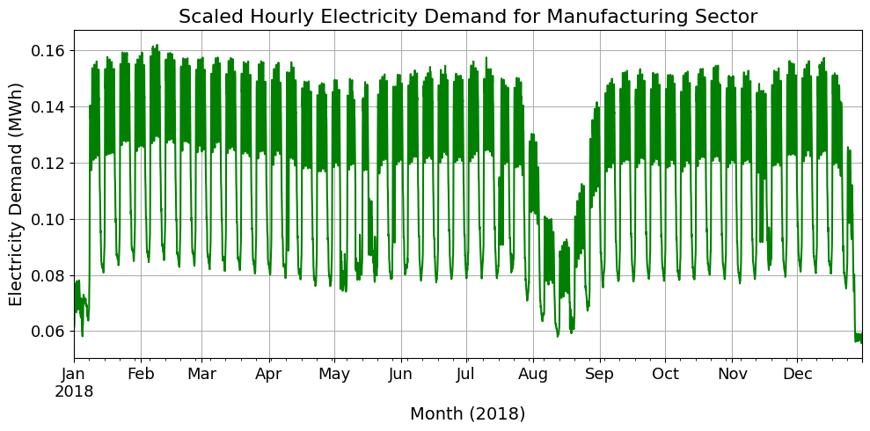
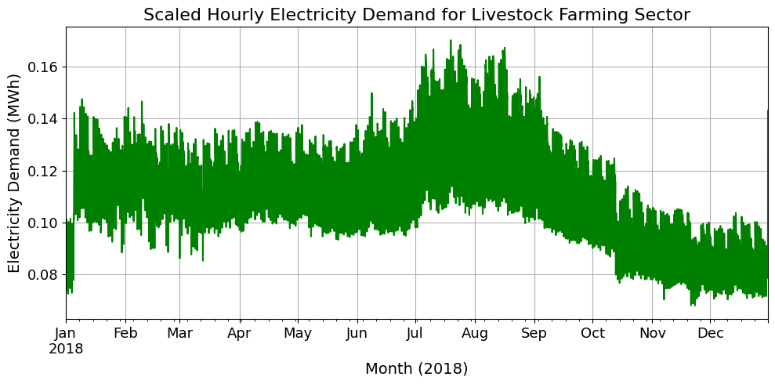
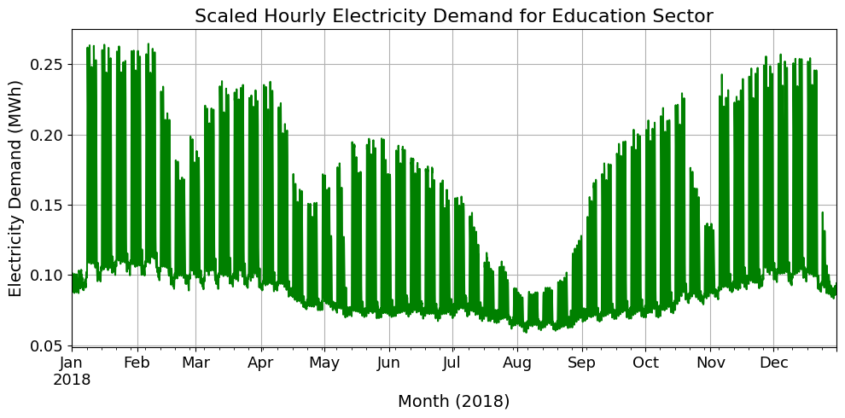
Experimental Setup
Real Demand Profiles
Manufacturing
Livestock Farming
Education

Slide 20
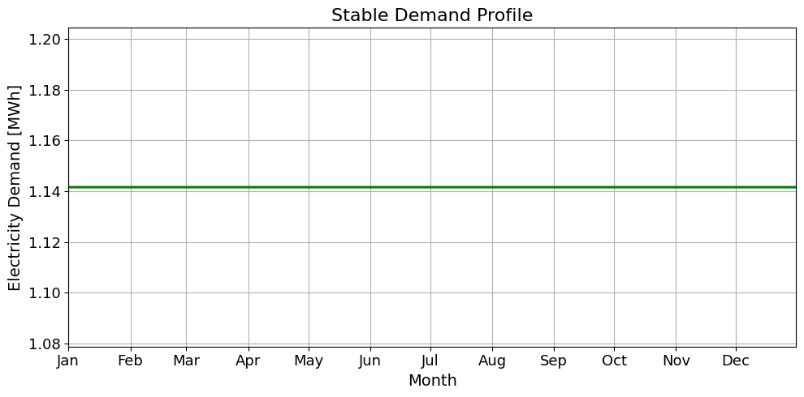
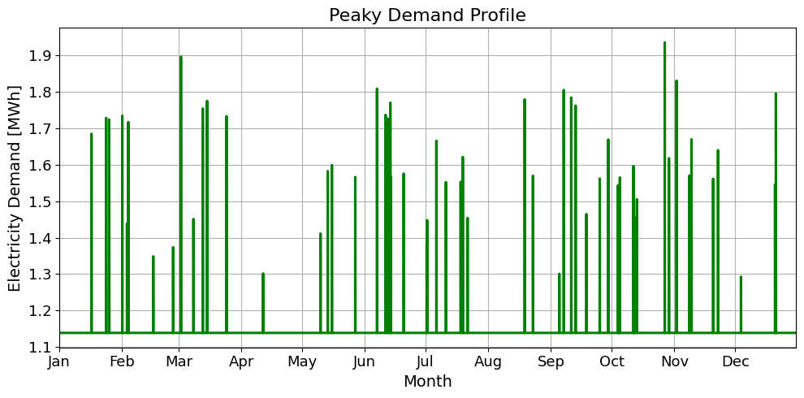
Experimental Setup
Artificial Demand Profiles
Stable Profile
Peaky Profile
Uncertainty in stable profile: GBM
Uncertainty in peaky profile: peak generation
*All profiles are scaled to the same total annual demand

Slide 21
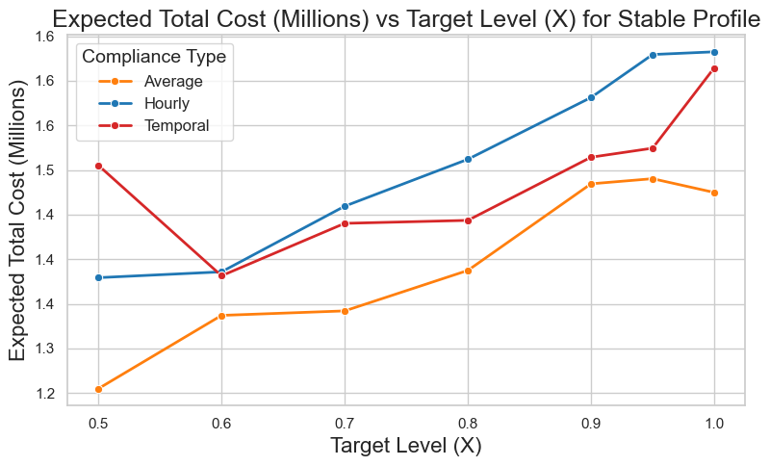
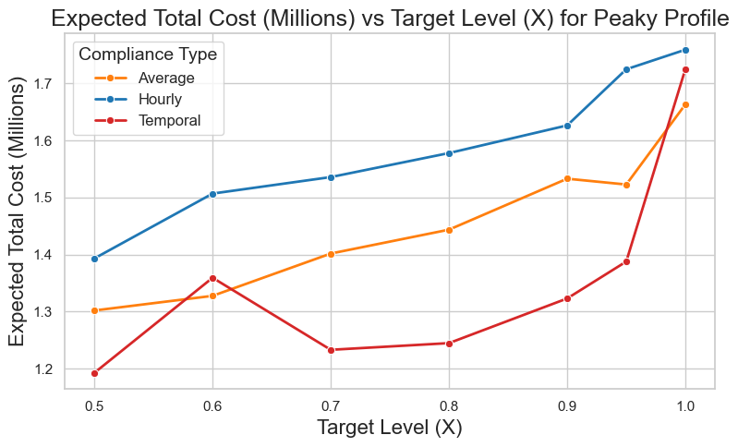
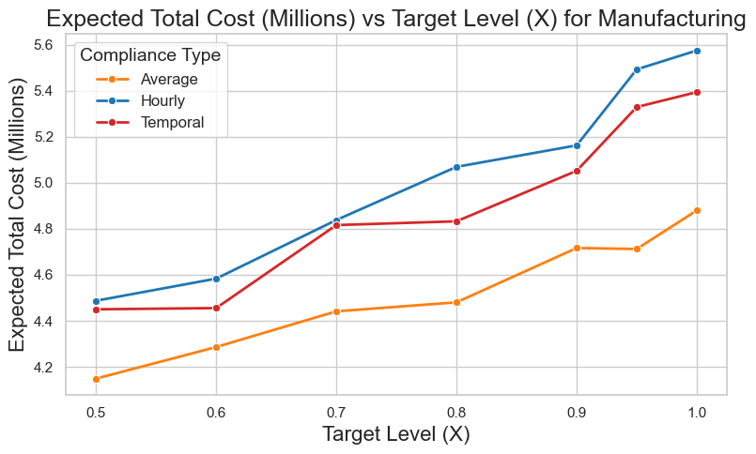
Numerical Results
Costs vs. Compliance Levels
Cost trend depends on demand shape
Stable: temporal > average
Peaky: average > temporal (temporal skips peak hours)
Manufacturing representative of real profiles
Solved with 2-hour time limit
Costs increase with higher compliance targets
Hourly compliance is consistently most expensive → (AC) is a relaxation of (HC)
Notes:
Average compliance is vulnerable to volume distortion from peaks,while temporal compliance is vulnerable to time-based constraints —so peaky profiles benefit from temporal, and stable profiles favor average.

Slide 22
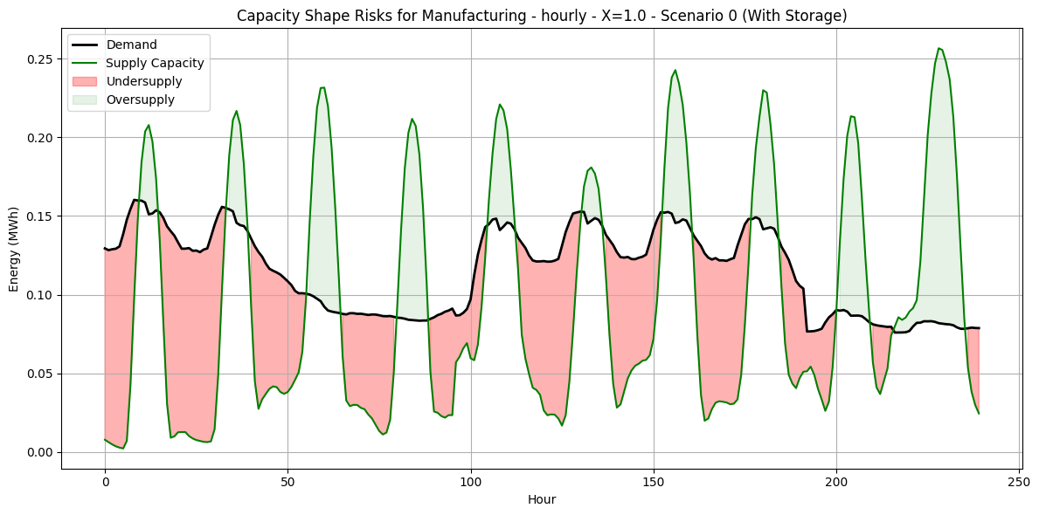
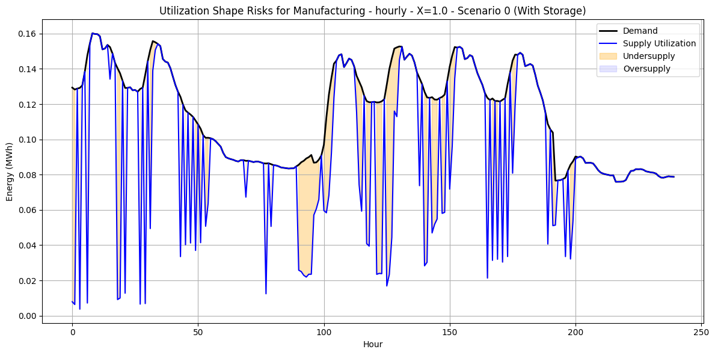
Numerical Results
Shape Risk
Capacity-based shape risk (X=1)
oversupply
Utilization-based shape risk (X=1)
$$renewable supply={WG}_{t,w}w_{PPA}+{SG}_{t,w}s_{PPA}$$
$$renewable supply=a_{t,w}^{D}+d_{t,w}^{RD}$$
undersupply
undersupply

Slide 23
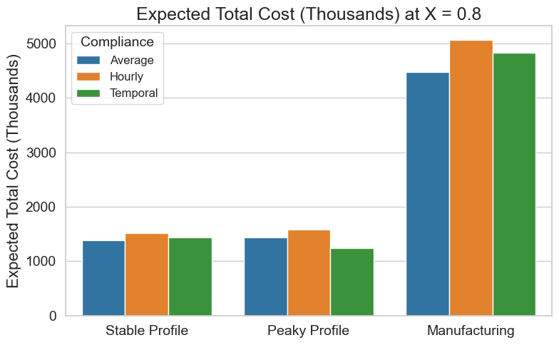
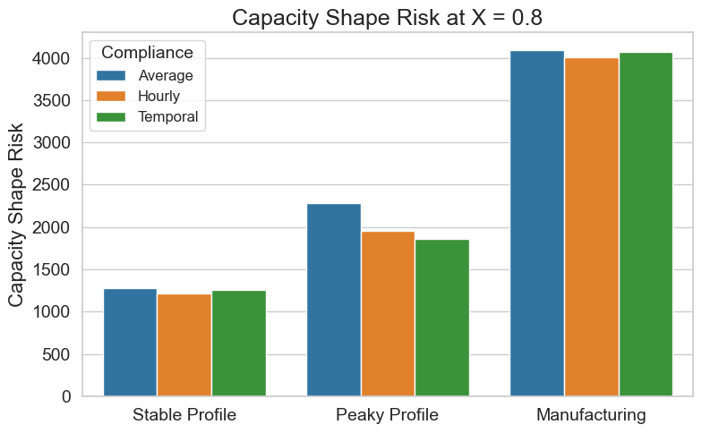
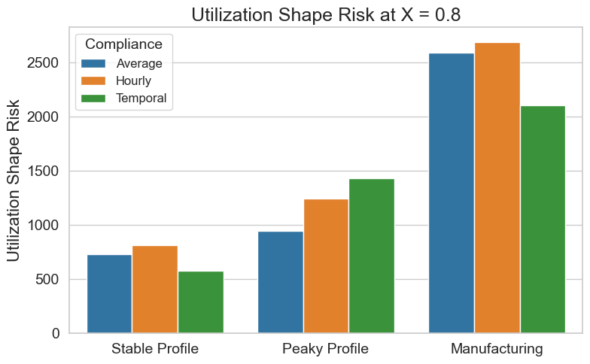
Numerical Results
Metrics Comparison
Hourly is more expensive than temporal
Temporal has more utilization shape risk than hourly
Cost vs. risk trade-off
Notes:
Optimality gaps are checked here. For temporal, 0.8, peaky , 2% and for stable it is 2.7%.

Slide 24



Conclusions
Conclusions
Demand shape matters when choosing a renewable target
Average, hourly and temporal target compared across different profiles
GBM-based scenario generation algorithm to represent stochasticity in demand
There is a trade-off between cost efficiency and risk
19

Slide 25
Conclusions
Conclusions
Next Steps
Incorporate volume risk
Analyze cases with and without storage
Compare across all demand profiles
Perform sensitivity analysis on key parameters
20

Slide 26


Q & A
Gülin Yurter
PhD Student
gulin.yurter@utwente.nl

Slide 27
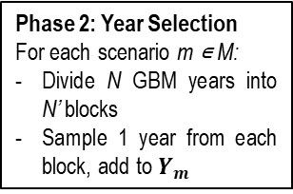
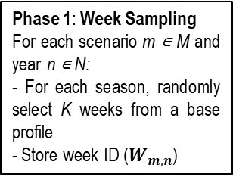
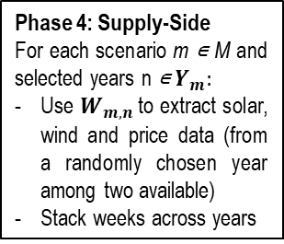
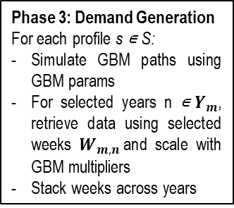
Scenario Generation Algorithm
Input: 5 demand profiles, GBM params, M scenarios, N years per scenario, N’ selected years, K weeks/season, 2 year solar/wind capacity factors and day-ahead prices
Phase 3: Demand Generation
For each profile s ∊ S:
Simulate GBM paths using GBM params
For selected years n ∊${ Y}_{m}$, retrieve data using selected weeks $W_{m,n}$and scale with GBM multipliers
Stack weeks across years
Phase 4: Supply-Side
For each scenario m ∊ M and selected years n ∊ $Y_{m}:$
Use $W_{m,n}$to extract solar, wind and price data (from a randomly chosen year among two available)
Stack weeks across years
Phase 1: Week Sampling
For each scenario m ∊ M and year n ∊ N:
- For each season, randomly select K weeks from a base profile
- Store week ID ($W_{m,n}$)
Phase 2: Year Selection
For each scenario m ∊ M:
Divide N GBM years into N’ blocks
Sample 1 year from each block, add to $Y_{m}$
Output: Synthetic multi-year demand profiles, solar/wind capacity factors and electricity market prices

Slide 28
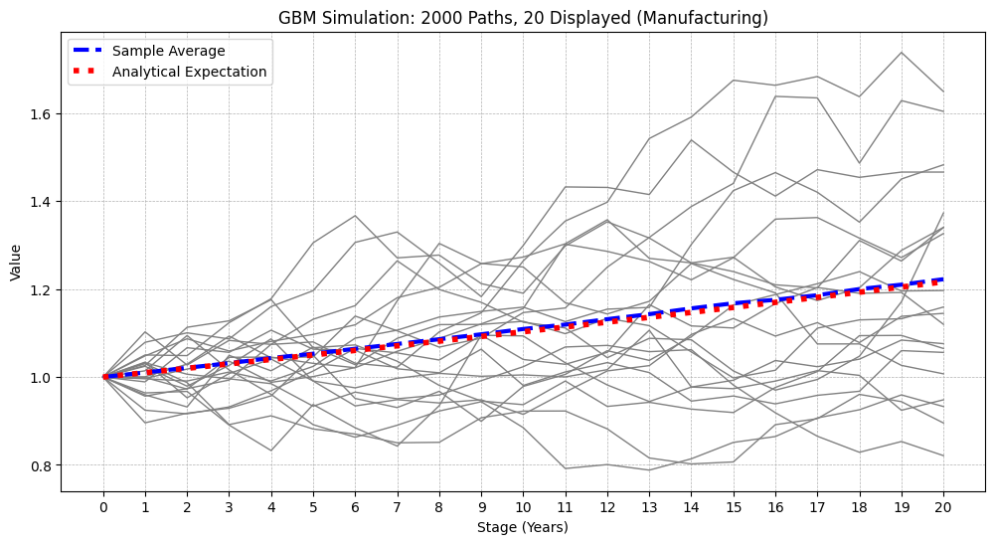
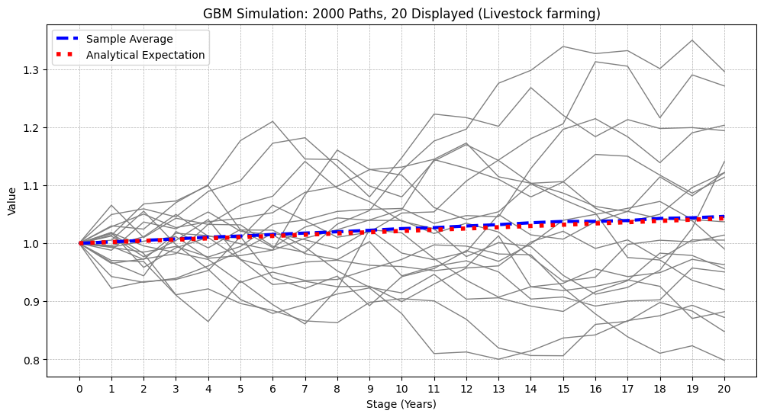
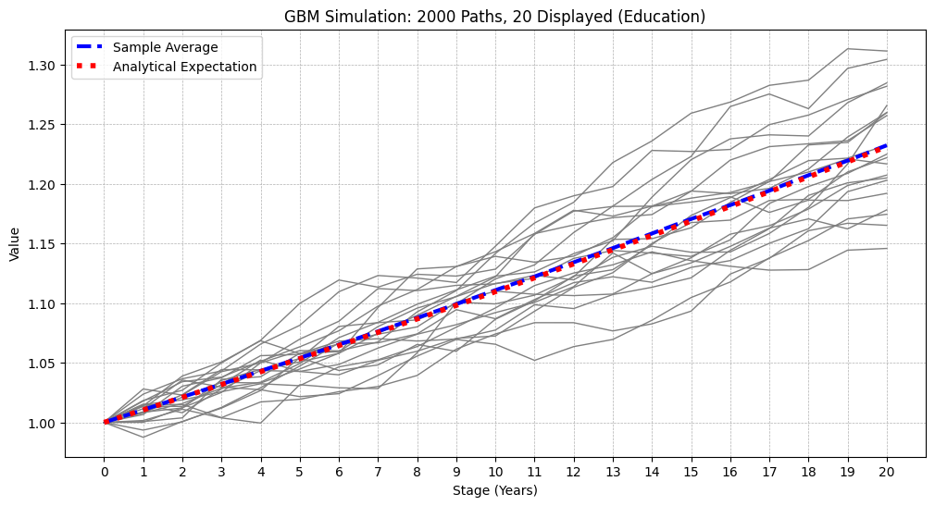
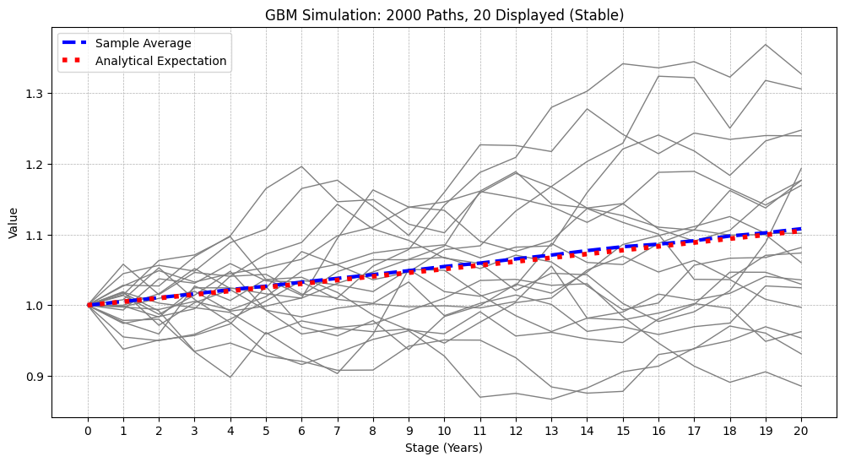
Generated GBM Paths

Slide 29
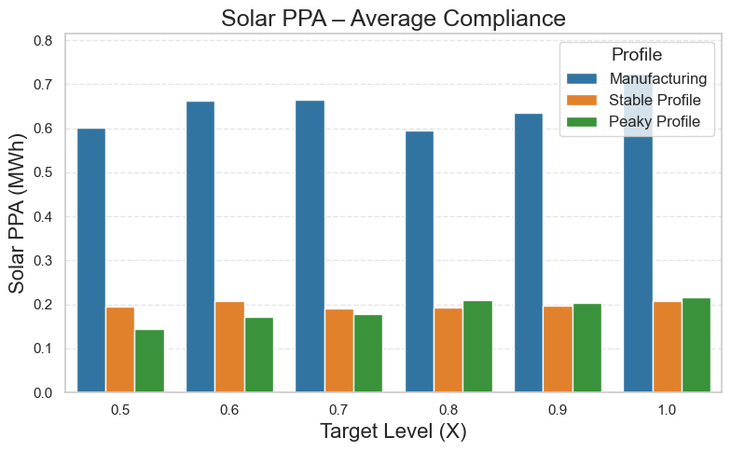
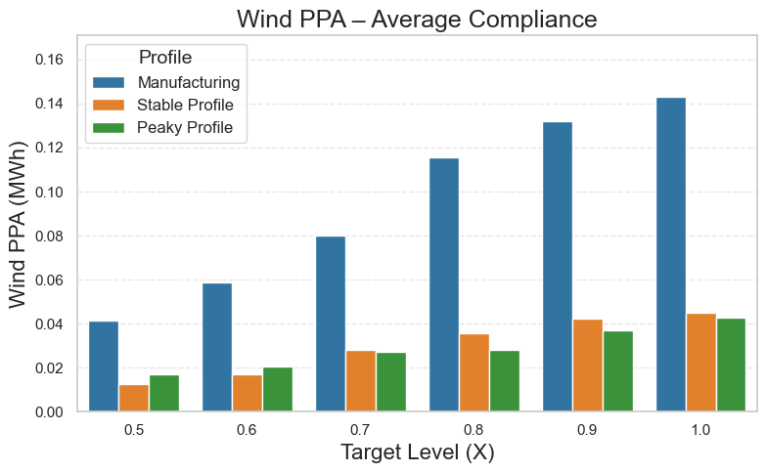
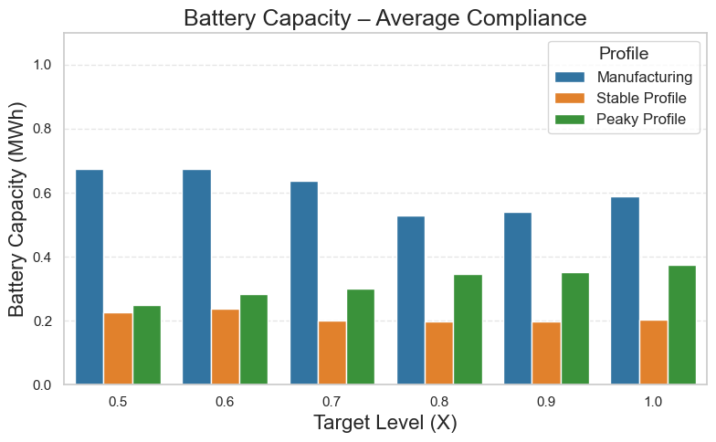
First Stage Decisions vs. Compliance Levels (Average Compliance)

Slide 30
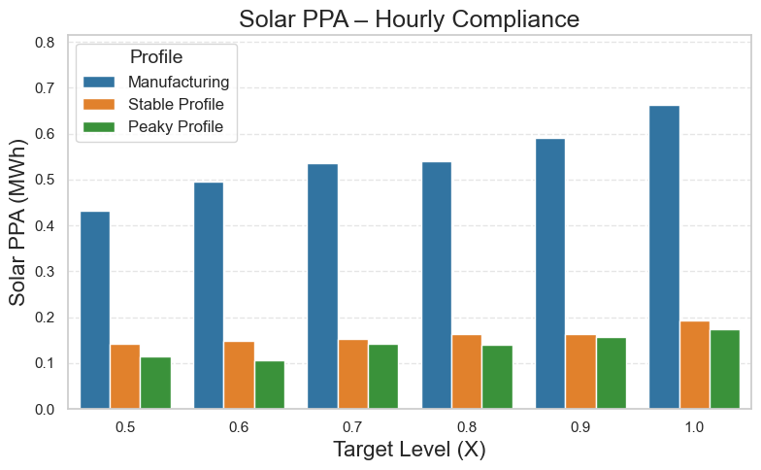
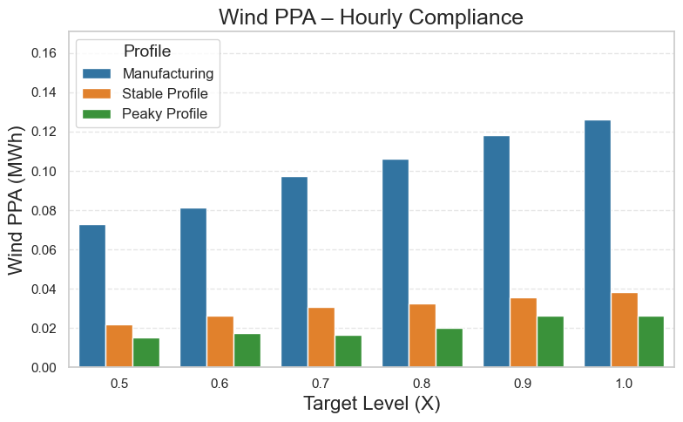
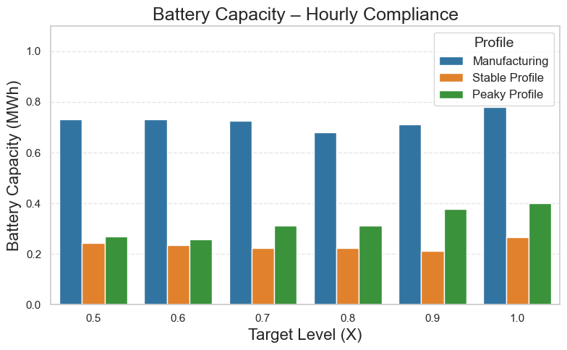
First Stage Decisions vs. Compliance Levels (Hourly Compliance)

Slide 31
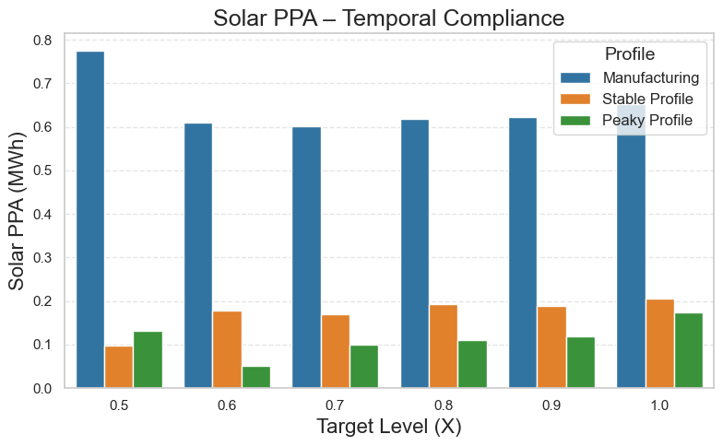
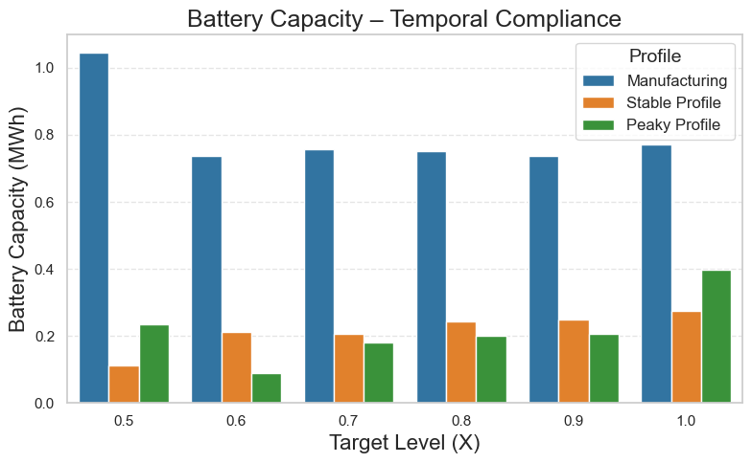
First Stage Decisions vs. Compliance Levels (Temporal Compliance)

