Slide 1





Unlocking the Inelastic Dark Matter window with Vector Mediators
Ana Luisa Foguel
in collaboration with Peter Reimitz and Renata Z. Funchal
based on:
arxiv:2410.00881
J. High Energ. Phys. 2025, 1 (2025)
afoguel@usp.br
University of São Paulo, São Paulo, Brazil
IFT/UAM, Madrid, Spain
Dark Matter and Neutrinos School
07 May 2025
$$χ_{1}$$
$$χ_{2}$$

Slide 2


Outline
Introduction and Motivations
Inelastic Dark Matter
Relic Density Computation
ReD-DeLiVeR code
Bounds
Conclusions
Theoretical framework
Decay Rates
$$χ_{2}$$
$$χ_{1}$$

Slide 3
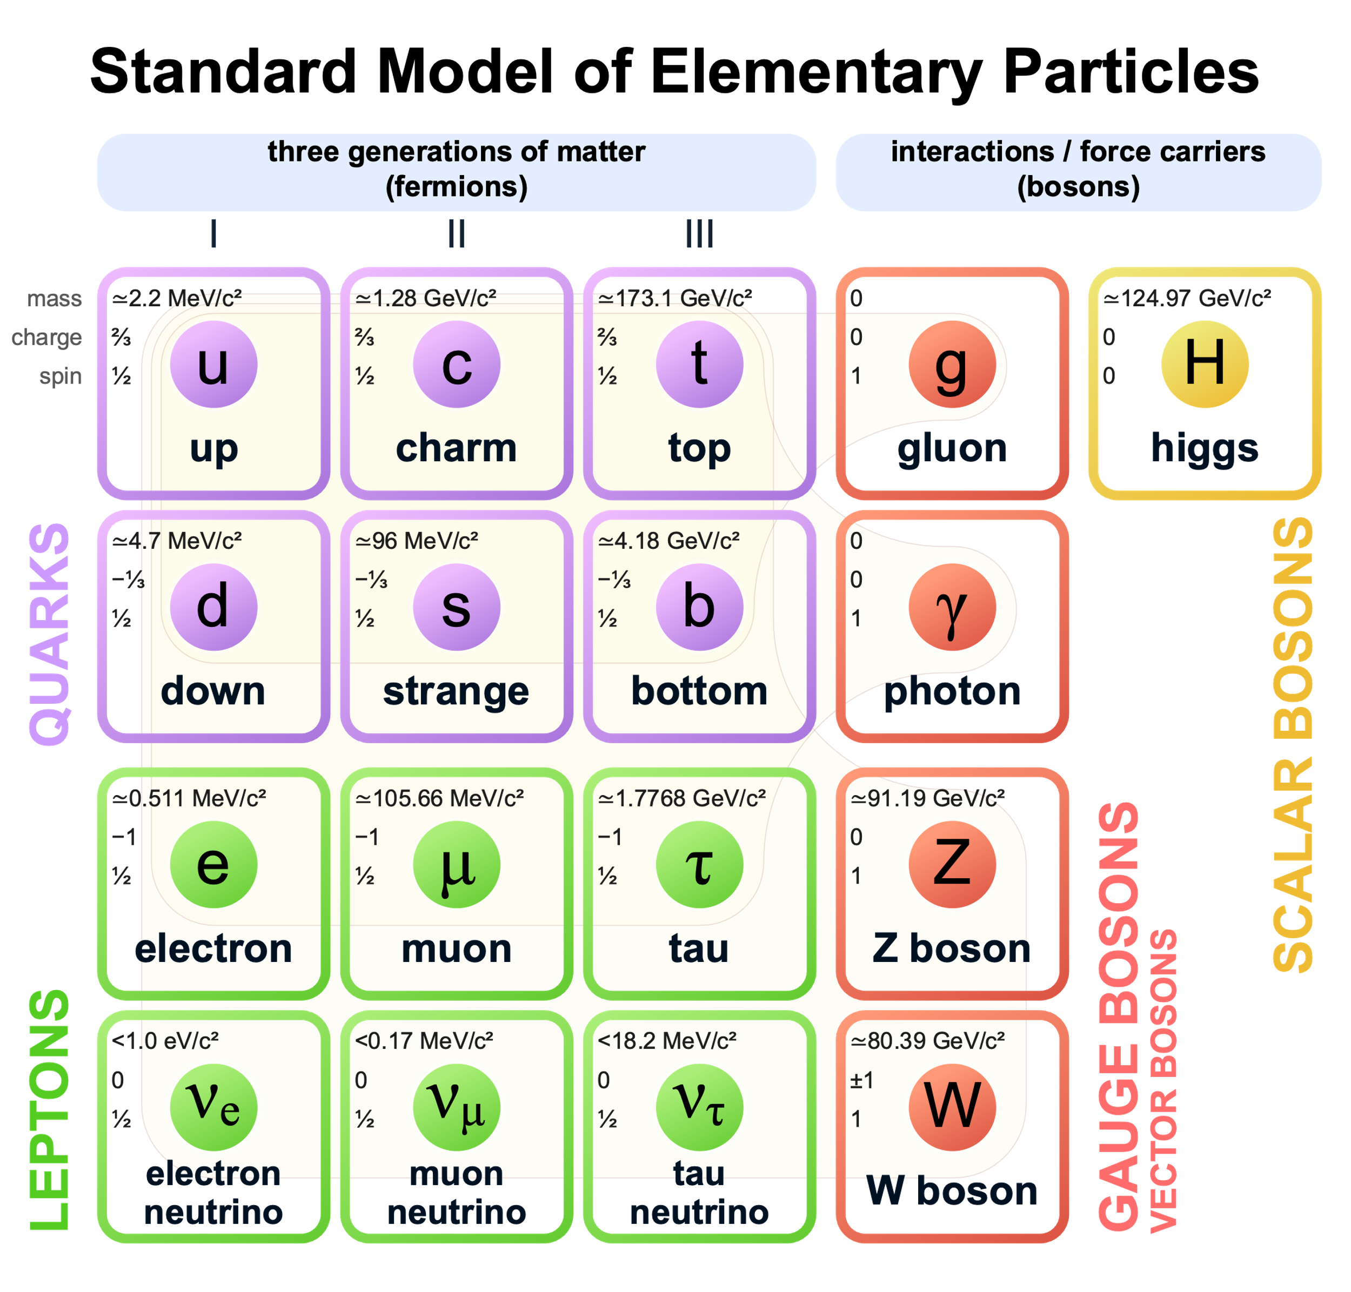


Introduction and Motivations
most successful description of the fundamental interactions between elementary particles (up to this date!)
Standard Model (SM)
several confirmed experimental predictions
However…
it cannot be the final theory of Nature!
Hierarchy Problem
Neutrino Masses
Dark Matter candidates
?
There are several problems and unanswered questions
+ $⋯$
How can we find a solution?
SM gauge group
We need to rely on Beyond the Standard Model (BSM) theories

Slide 4




Introduction and Motivations
Energy Frontier
Where can we search for BSM signals?
keV
MeV
GeV
100 TeV
Mass
Already Discovered
e
u d
s
c
b
t
1
ultralight DM
$$μ$$
$$τ$$
W Z h
composite DM
primordial BHs
QCD axion
$$⋯$$
$$⋯$$
Strongly Interacting Heavy Particles
10⁻³
Intensity Frontier
10⁻⁶
Feebly Interacting
Light Particles
Interaction Strength
Notes:
The dark matter scale is unknown.
Completely different search strategies depending on the mass of dark matter
Neutral under the SM interactions. Annihilate through new interactions
Annihilate through weak interactions

Slide 5

Introduction and Motivations
Where can we search for BSM signals?
keV
MeV
GeV
100 TeV
Mass
Already Discovered
e
u d
s
c
b
t
1
ultralight DM
$$μ$$
$$τ$$
W Z h
composite DM
primordial BHs
QCD axion
$$⋯$$
$$⋯$$
Strongly Interacting Heavy Particles
10⁻³
10⁻⁶
Feebly Interacting
Light Particles
Interaction Strength
Notes:
The dark matter scale is unknown.
Completely different search strategies depending on the mass of dark matter
Neutral under the SM interactions. Annihilate through new interactions
Annihilate through weak interactions

Slide 6

Introduction and Motivations
Where can we search for BSM signals?
keV
MeV
GeV
100 TeV
Mass
Already Discovered
e
u d
s
c
b
t
1
ultralight DM
$$μ$$
$$τ$$
W Z h
composite DM
primordial BHs
QCD axion
$$⋯$$
$$⋯$$
Strongly Interacting Heavy Particles
10⁻³
10⁻⁶
Feebly Interacting
Light Particles
Interaction Strength
Notes:
The dark matter scale is unknown.
Completely different search strategies depending on the mass of dark matter
Neutral under the SM interactions. Annihilate through new interactions
Annihilate through weak interactions

Slide 7
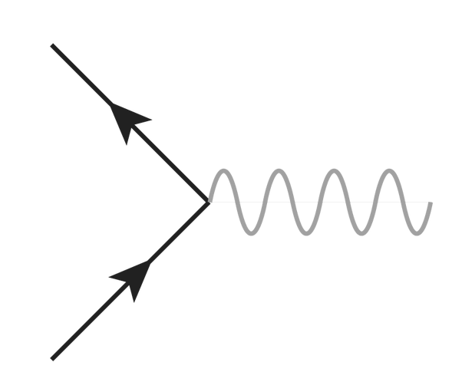




Introduction and Motivations
How can we search for light particle BSM signals?
Standard Model
PORTAL
Light
Dark Sector
Suppose we have particles $χ$ and $\overline{χ}$ in the dark sector
natural possibility:
couple to the gauge bosons of weak interactions
$$χ$$
SM
However…
Lee-Weinberg bound
$$Z$$
which means that lowering the DM mass decreases the thermal-average cross section
$$\overline{χ}$$
SM
$$→$$
DM is overproduced!

Slide 8

Introduction and Motivations
How can we search for light particle BSM signals?
DARK
PORTAL
Standard Model
Light
Dark Sector
Lee-Weinberg bound
$$⇒$$
So, how can we explore sub-GeV dark sectors?
solution:
inclusion of new light dark sector mediator states!
These light mediators will act as portals between the dark sector and the SM.

Slide 9
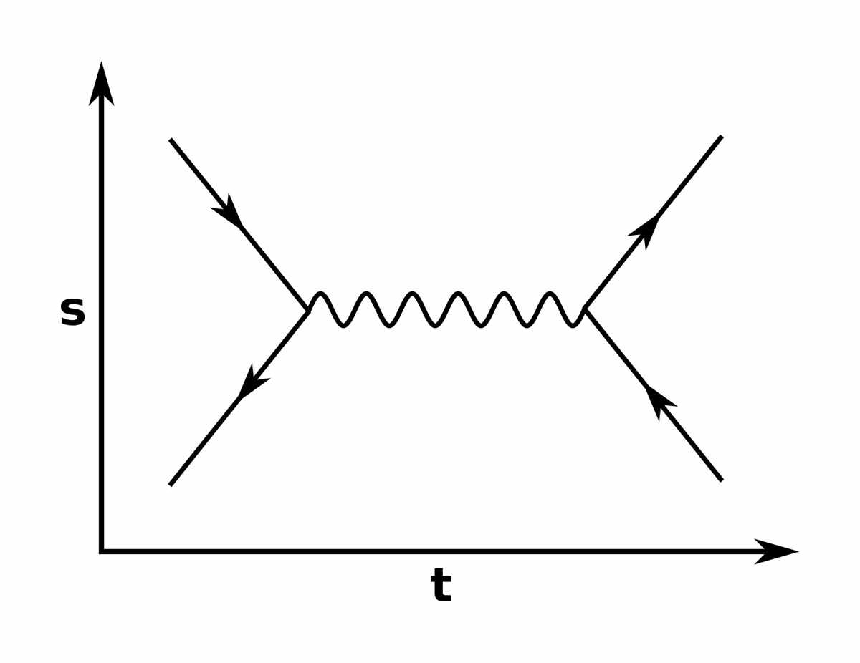
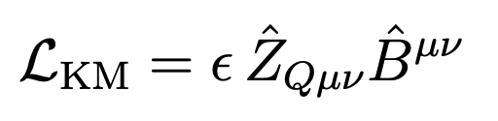
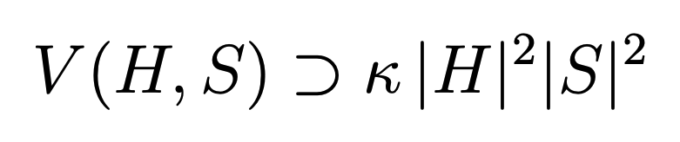
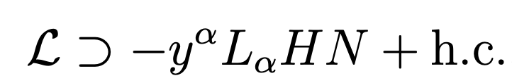


Introduction and Motivations · Hidden Portals
How can we search for light particle BSM signals?
Standard Model
PORTAL
?
?
?
Dark Sector
?
?
?
?
?
?
renormalizable
higher dimension
$$⋯$$
Vector Portal
ALP Portal
Scalar Portal
Neutrino Portal
axion-like-particle
a
photons
leptons
dark boson
dark Higgs
Heavy Neutral Lepton
$$⋯$$

Slide 10



Introduction and Motivations · Hidden Portals
How can we search for light particle BSM signals?
Inelastic Dark Matter
Standard Model
PORTAL
Dark Sector
$$χ_{1}$$
$$χ_{2}$$
$$⋯$$
Vector Portal
ALP Portal
Scalar Portal
Neutrino Portal
axion-like-particle
a
photons
leptons
dark boson
dark Higgs
Heavy Neutral Lepton
$$⋯$$

Slide 11
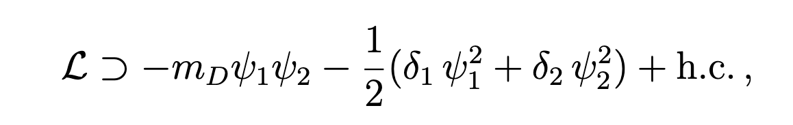

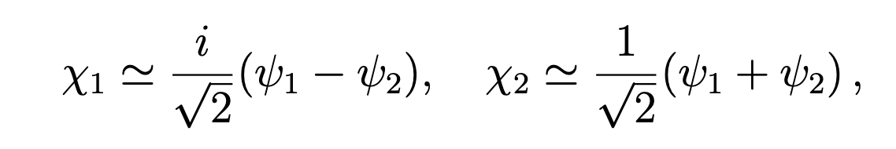
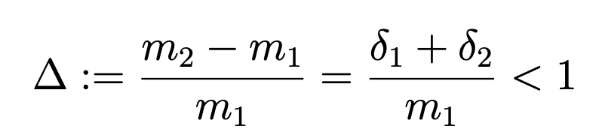
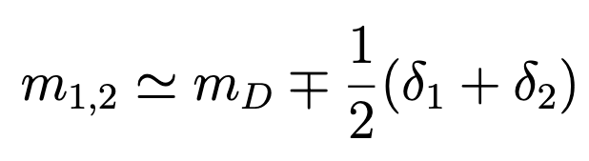








Inelastic Dark Matter
Inelastic Dark Matter
Theoretical Framework
(iDM)
$$χ_{1}$$
pseudo-Dirac pair
$$χ_{2}$$
two-component Weyl fermions forming a Dirac pair
$$⇒$$
$$χ_{1}$$
$$χ_{2}$$
Dark Sector
new vector mediator coming from a spontaneously broken U(1)_{Q} abelian gauge symmetry
$$Z_{Q}$$
From the diagonalization of the fermion mass terms
Dirac
Majorana
with
pseudo-Dirac pair with nearly degenerate masses
mass eigenstates
Mass splitting
$$⇒$$
$$⇒$$

Slide 12
Inelastic Dark Matter
Inelastic Dark Matter
Theoretical Framework
(iDM)
$$χ_{1}$$
pseudo-Dirac pair
$$χ_{2}$$
two-component Weyl fermions forming a Dirac pair
$$⇒$$
$$χ_{1}$$
$$χ_{2}$$
Dark Sector
Dark Matter
new vector mediator coming from a spontaneously broken U(1)_{Q} abelian gauge symmetry
$$Z_{Q}$$
From the diagonalization of the fermion mass terms
Dirac
Majorana
with
pseudo-Dirac pair with nearly degenerate masses
mass eigenstates
Mass splitting
$$⇒$$
$$⇒$$

Slide 13
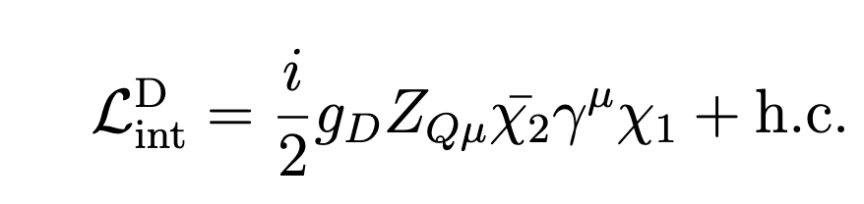
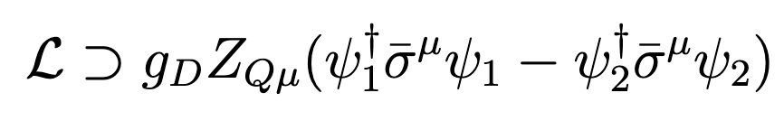







Inelastic Dark Matter
$${\overline{χ}}_{1}$$
$$Z_{Q}$$
$$g_{D}$$
Theoretical Framework
x
The interaction term with the mediator turns to be off-diagonal
$$χ_{2}$$
Motivations
Thermal relics: DM abundance can be computed via thermal freeze-out.
Evades indirect and direct detection experimental limits
The heavier state $χ_{2}$can decay into the DM candidate $χ_{1}$, depleting its abundance
$$→$$
avoid indirect detection signals
$$⇒$$
no present-day population of heavier states to co-annihilate with the DM
$$⇒$$
similarly, direct detection signals depend on up-scatter of the light state, which is kinematically suppressed
Evades stringent CMB limits
Since the abundance of $χ_{2}$ is already reduced during recombination era, coannihilations that would inject energy into the plasma are suppressed.

Slide 14

Inelastic Dark Matter
$${\overline{χ}}_{1}$$
$$Z_{Q}$$
$$g_{D}$$
Theoretical Framework
x
The interaction term with the mediator turns to be off-diagonal
$$χ_{2}$$
What’s new?
$$Z_{D}$$
In the literature: only considered the minimal scenario with a secluded dark photon portal
However…
this case has been nearly completely ruled out by experimental limits...

Slide 15

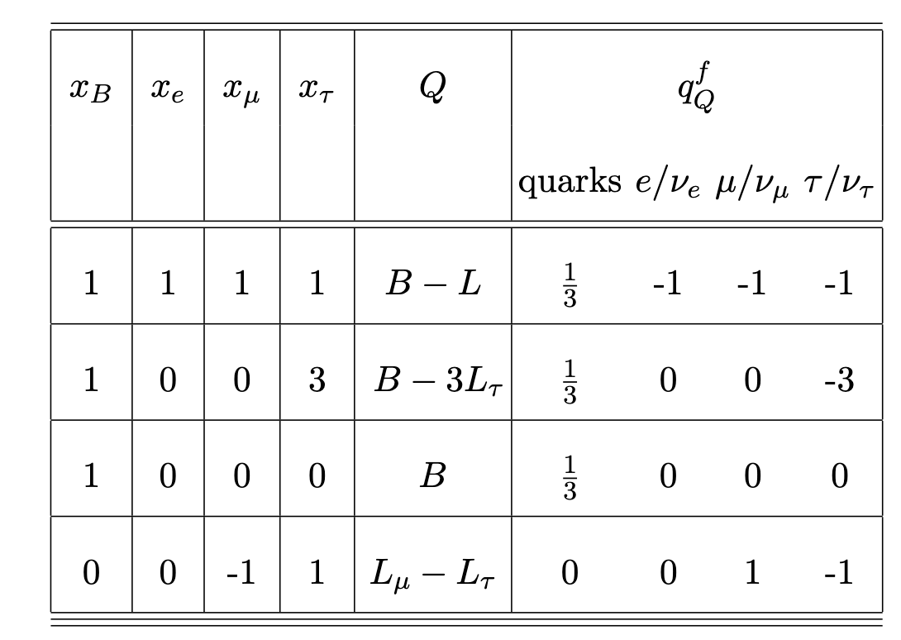
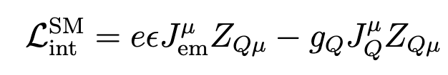
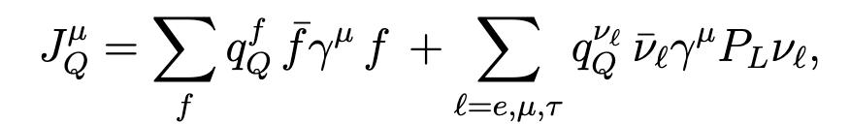

Inelastic Dark Matter
$${\overline{χ}}_{1}$$
$$Z_{Q}$$
$$g_{D}$$
Theoretical Framework
x
The interaction term with the mediator turns to be off-diagonal
$$χ_{2}$$
What’s new?
This work: we consider the case of generic charges for the U(1)_{Q} group
$$⇒$$
vector mediator also couples to the SM via direct terms depending on the choice of charge

Slide 16
Inelastic Dark Matter
$${\overline{χ}}_{1}$$
$$Z_{Q}$$
$$g_{D}$$
Theoretical Framework
x
The interaction term with the mediator turns to be off-diagonal
$$χ_{2}$$
What’s new?
This work: we consider the case of generic charges for the U(1)_{Q} group
$$⇒$$
ALF, P. Reimitz, R.Z. Funchal
vector mediator also couples to the SM via direct terms depending on the choice of charge
arXiv:2410.00881 [hep-ph]
iDM_{Q} models
free parameters:

Slide 17











Inelastic Dark Matter · Decay Rates
Hierarchy
Limit
$${\overline{χ}}_{1}$$
$$\overline{f}$$
Mediator
$$g_{Q}$$
$Z_{Q}$
$$g_{D}$$
$Z_{Q}$
x
x
prompt-decay
$$f$$
$$χ_{2}$$
$$+$$
Dark fermion

Slide 18
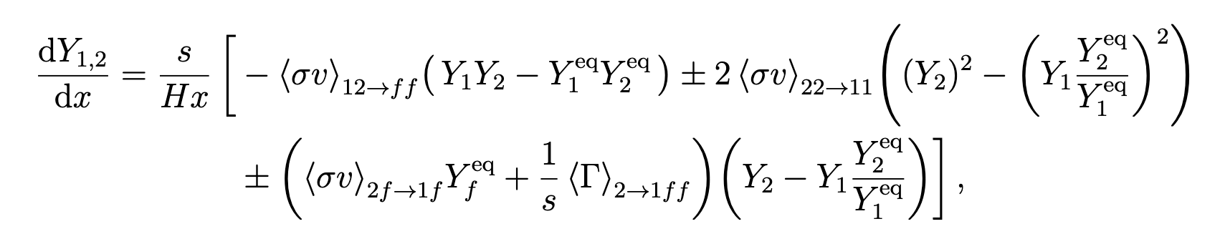
Inelastic Dark Matter
· Relic Density Computation
Boltzmann Equation

Slide 19
Inelastic Dark Matter
· Relic Density Computation
Boltzmann Equation

Slide 20
Inelastic Dark Matter
· Relic Density Computation
Boltzmann Equation

Slide 21
Inelastic Dark Matter
· Relic Density Computation
Boltzmann Equation

Slide 22
Inelastic Dark Matter
· Relic Density Computation
Boltzmann Equation

Slide 23
Inelastic Dark Matter
· Relic Density Computation
Boltzmann Equation
coannihilations dominate!

Slide 24
Inelastic Dark Matter
· Relic Density Computation
Boltzmann Equation
coannihilations dominate!
we can simplify by considering

Slide 25
Inelastic Dark Matter
· Relic Density Computation

Slide 26
Inelastic Dark Matter
· Relic Density Computation

Slide 27
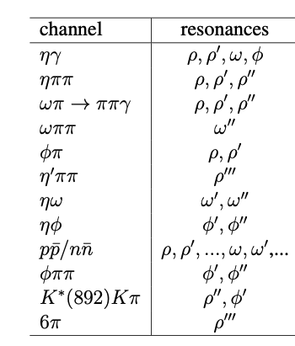
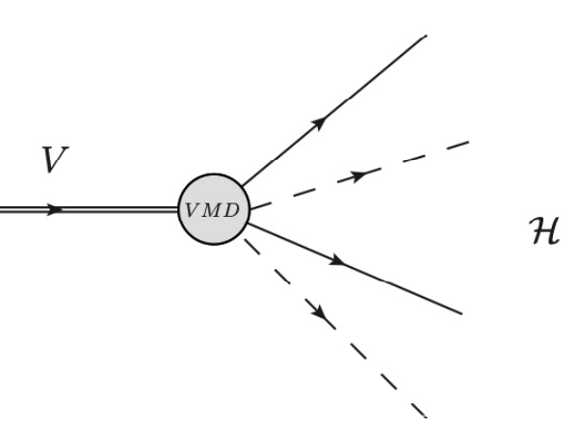
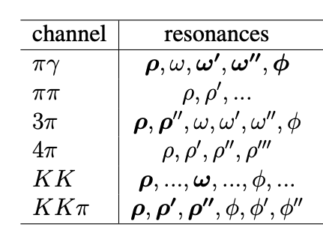


Inelastic Dark Matter
· ReD-DeLiVeR code
ReD-DeLiVeR (Relic Density with DeLiVeR)
update of the previous python package DELIVER (Decays of Light Vectors Revised), which can be used to compute decay rates and branching ratios for user-defined U(1)_{Q} charges,
key feature: includes a complete set of hadronic decays (20 channels)
ALF, P. Reimitz, R.Z. Funchal [JHEP 04 (2022)119]
$Z_{Q}$
hadronic mode
$V=ρ,ω, φ$
x
27

Slide 28
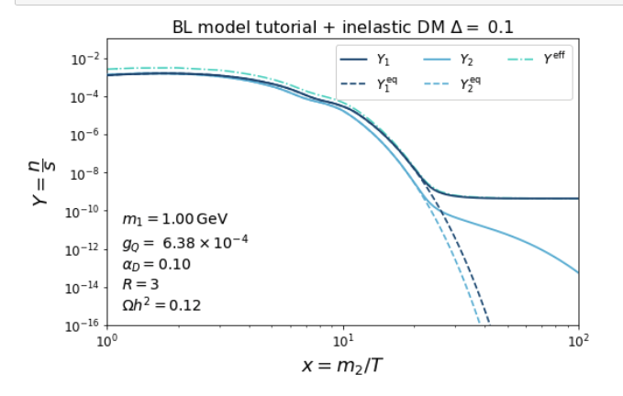
Inelastic Dark Matter
· ReD-DeLiVeR code
ReD-DeLiVeR (Relic Density with DeLiVeR)
update of the previous python package DELIVER (Decays of Light Vectors Revised), which can be used to compute decay rates and branching ratios for user-defined U(1)_{Q} charges,
key feature: includes a complete set of hadronic decays (20 channels)
new version:
inclusion of DM candidates
simplified DM models
inelastic DM
computation of relic density and rates
28

Slide 29
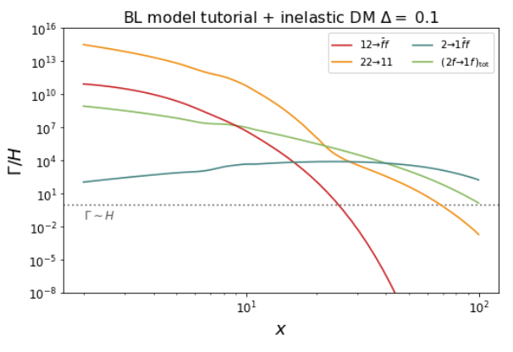
Inelastic Dark Matter
· ReD-DeLiVeR code
ReD-DeLiVeR (Relic Density with DeLiVeR)
update of the previous python package DELIVER (Decays of Light Vectors Revised), which can be used to compute decay rates and branching ratios for user-defined U(1)_{Q} charges,
key feature: includes a complete set of hadronic decays (20 channels)
new version:
inclusion of DM candidates
simplified DM models
inelastic DM
computation of relic density and rates
29

Slide 30
Inelastic Dark Matter
· ReD-DeLiVeR code
ReD-DeLiVeR (Relic Density with DeLiVeR)
update of the previous python package DELIVER (Decays of Light Vectors Revised), which can be used to compute decay rates and branching ratios for user-defined U(1)_{Q} charges,
key feature: includes a complete set of hadronic decays (20 channels)
new version:
inclusion of DM candidates
simplified DM models
inelastic DM
computation of relic density and rates
computation of thermal targets
specially for B-coupled models, it is very important to compute correctly the hadronic contributions
30

Slide 31
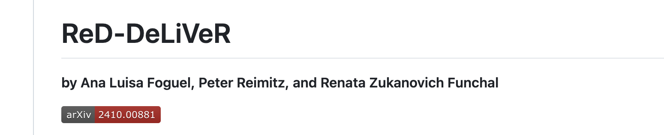
Inelastic Dark Matter
· ReD-DeLiVeR code
ReD-DeLiVeR (Relic Density with DeLiVeR)
update of the previous python package DELIVER (Decays of Light Vectors Revised), which can be used to compute decay rates and branching ratios for user-defined U(1)_{Q} charges,
key feature: includes a complete set of hadronic decays (20 channels)
new version:
inclusion of DM candidates
simplified DM models
inelastic DM
computation of relic density and rates
computation of thermal targets
publicly available on GitHub together with a Tutorial!
https://github.com/anafoguel/ReD-DeLiVeR
specially for B-coupled models, it is very important to compute correctly the hadronic contributions
31

Slide 32
Inelastic Dark Matter
· Bounds

Slide 33
Inelastic Dark Matter
· Bounds

Slide 34
Inelastic Dark Matter
· Bounds

Slide 35
Inelastic Dark Matter
· Bounds

Slide 36
Inelastic Dark Matter
· Bounds

Slide 37
Conclusions
Light Feebly Interacting Particles can shed light in several unanswered questions of the SM
As experiments increase their luminosities, and we enter the intensity frontier era of particle physics, we increase the capabilities to probe new light sectors.
As a guiding principle, we consider different portals between the Dark Sector and the SM
general vector mediators
In this work we considered a vector portal to a fermionic inelastic Dark Matter sector
iDM_{Q}
thermal relics
evade CMB bounds
evade indirect and direct detection
We developed a code that computes the relic density
ReD-DeLiVeR
Thank you for your kind attention!
With general mediators, we showed that we can unlock new regions of the parameter space of the vanilla dark photon model

Slide 38
BACKUP

Slide 39

Inelastic Dark Matter
DM Thermal Freeze-out · WIMP miracle
We know that freeze-out happens when
WIMP miracle
For couplings similar to the electroweak coupling
$$⇒$$
EW scale emerges naturally
However, this also implies that
Hence, sub-GeV DM motivates the presence of new light mediators

Slide 43
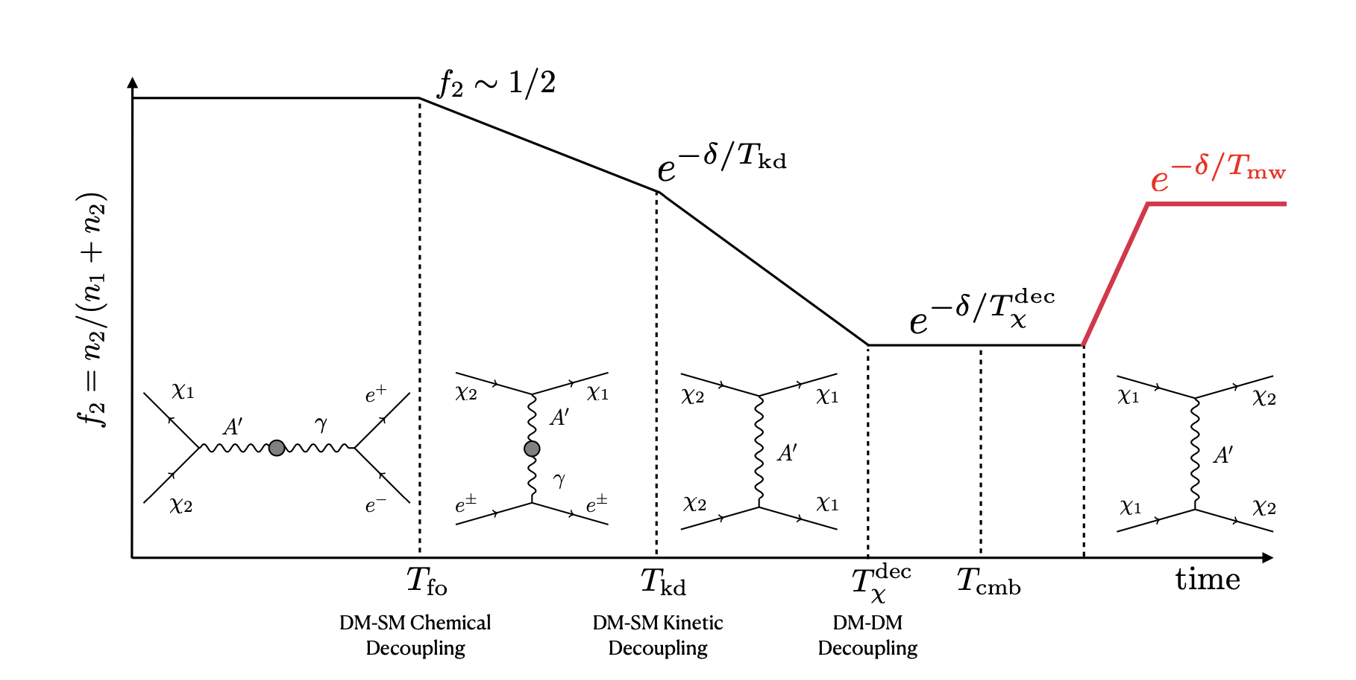
Inelastic Dark Matter
virialization of DM in the Milky Way
arXiv:2311.00032v1 [hep-ph]

Slide 44








Inelastic Dark Matter · Decay Rates
$$\overline{f}$$
$${\overline{χ}}_{1}$$
Decay rates · Mediator
$$g_{Q}$$
$$g_{D}$$
$Z_{Q}$
x
$Z_{Q}$
x
Hierarchy
Limit
$$f$$
$$χ_{2}$$
prompt-decay

Slide 45
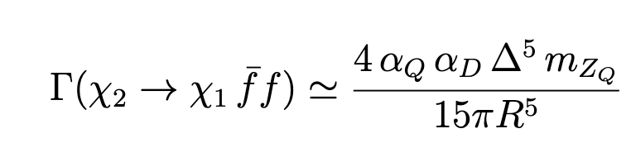
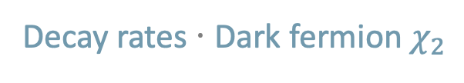
Inelastic Dark Matter · Decay Rates
Decay rates · Dark fermion $χ_{2}$

Slide 46
Inelastic Dark Matter · Decay Rates
Decay rates · Dark fermion $χ_{2}$

Slide 47

Inelastic Dark Matter
· Bounds
$$⇒$$

