Slide 1
Decoherence of Primordial Perturbations and Maldacena’s Consistency Condition
Fumiya Sano
Institute of Science Tokyo / IBS CTPU-CGA
Avenues of QFT in Curved Spacetime 2025 @ Institut Denis Poisson, France
January 22, 2025
Based on ongoing work with Junsei Tokuda (McGill University)

Slide 2
Outline
Introduction
Decoherence in cosmology
Wavefunction formalism
Decoherence rate
Local observer’s effect
Maldacena’s consistency conditions
Regularizing IR divergence

Slide 3
Outline
Introduction
Decoherence in cosmology
Wavefunction formalism
Decoherence rate
Local observer’s effect
Maldacena’s consistency conditions
Regularizing IR divergence

Slide 4
Inflation as a Source for Cosmological Perturbations
Slow-roll inflation
: Inflaton

Slide 5
Inflation as a Source for Cosmological Perturbations
Flatness, horizon problem etc. in late time
Slow-roll inflation can be an answer for ……
: Inflaton
(1)
Quasi-de Sitter
⇒ Accelerated expansion

Slide 6
Inflation as a Source for Cosmological Perturbations
Flatness, horizon problem etc. in late time
Transition from inflation to big-bang
Slow-roll inflation can be an answer for ……
: Inflaton
(2)
End of inflation
⇒ Big-bang
(Reheating)
(1)
Quasi-de Sitter
⇒ Accelerated expansion

Slide 7
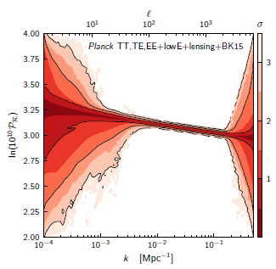
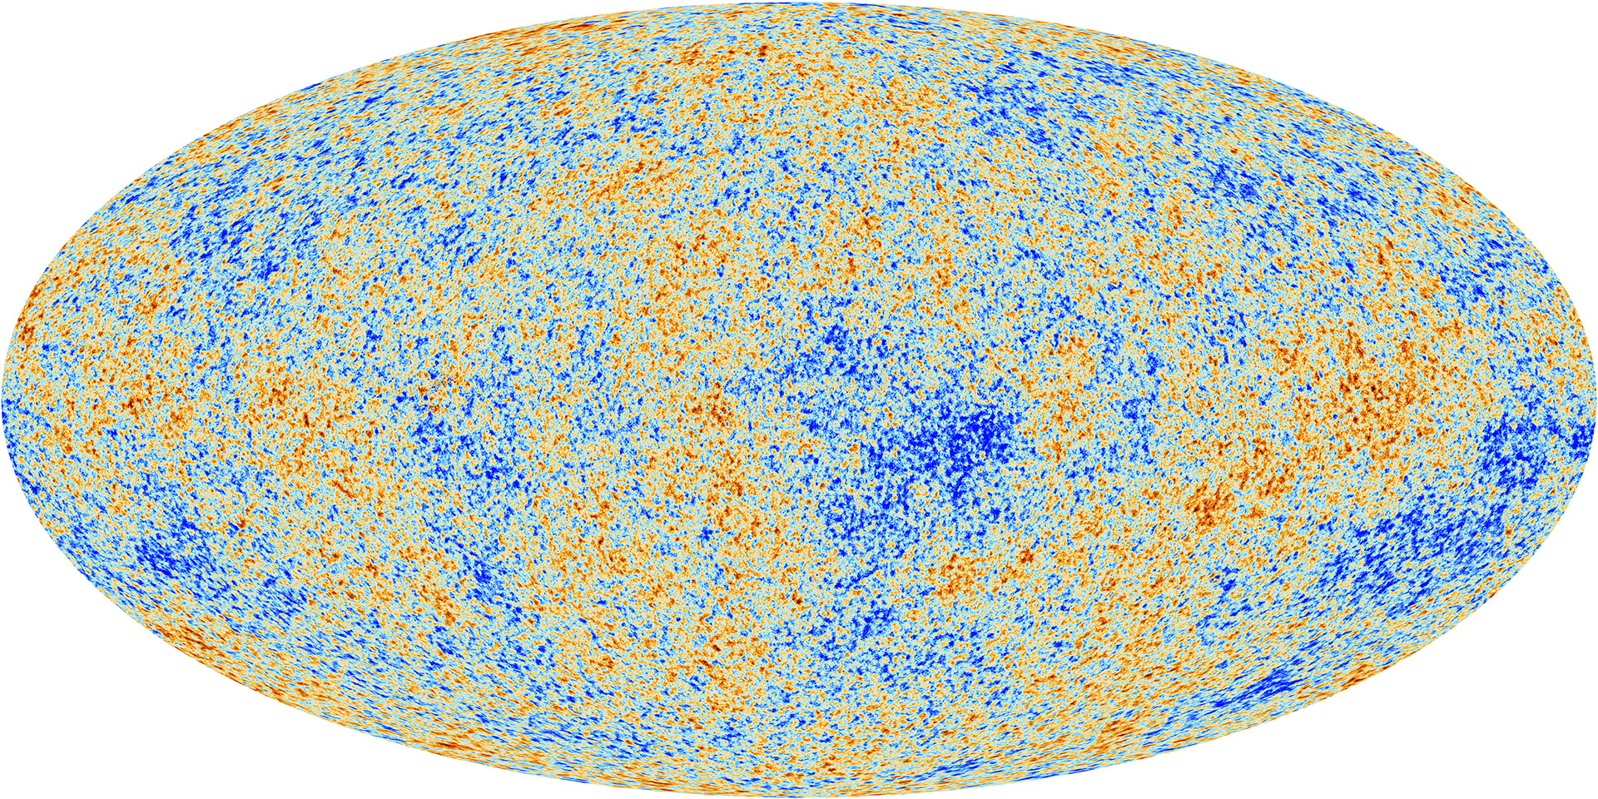
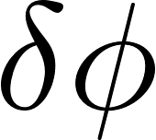
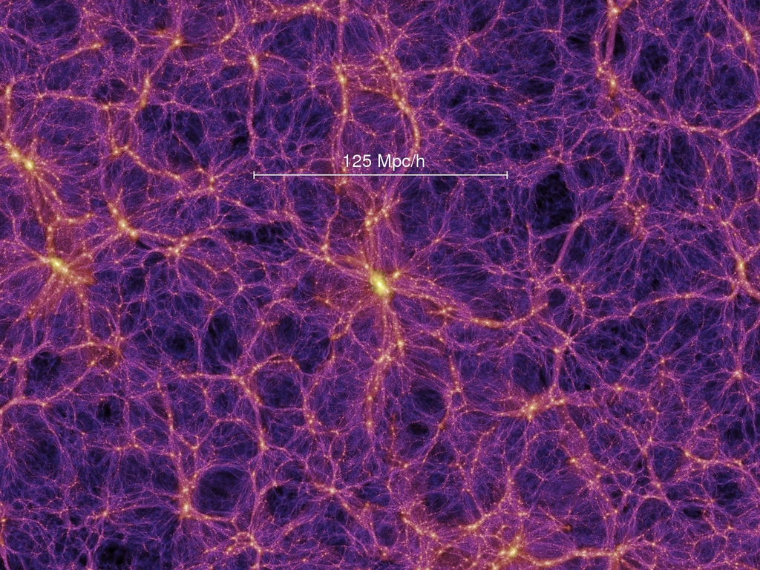
Inflation as a Source for Cosmological Perturbations
Flatness, horizon problem etc. in late time
Transition from inflation to big-bang
Origin of cosmological structures
Slow-roll inflation can be an answer for ……
: Inflaton
(3)
Quantum fluctuation around VEV
⇒ Density perturbations in late-time
(2)
End of inflation
⇒ Big-bang
(Reheating)
[Planck 1807.06211]
(1)
Quasi-de Sitter
⇒ Accelerated expansion
Late time
Classical anisotropy
and inhomogeneity
[Millennium Simulation 2005]

Slide 8
Inflation as a Source for Cosmological Perturbations
Flatness, horizon problem etc. in late time
Transition from inflation to big-bang
Origin of cosmological structures
Slow-roll inflation can be an answer for ……
: Inflaton
How (fast) classicalized?
(3)
Quantum fluctuation around VEV
⇒ Density perturbations in late-time
(2)
End of inflation
⇒ Big-bang
(Reheating)
[Planck 1807.06211]
(1)
Quasi-de Sitter
⇒ Accelerated expansion
Late time
Classical anisotropy
and inhomogeneity
[Millennium Simulation 2005]

Slide 9
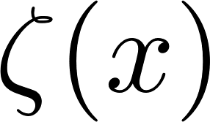
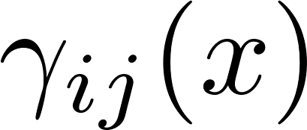
Quantization of Curvature Perturbations
Curvature perturbations
: Curvature perturbations
Perturbations of density
Perturbations of scale factor
: Tensor perturbations

Slide 10
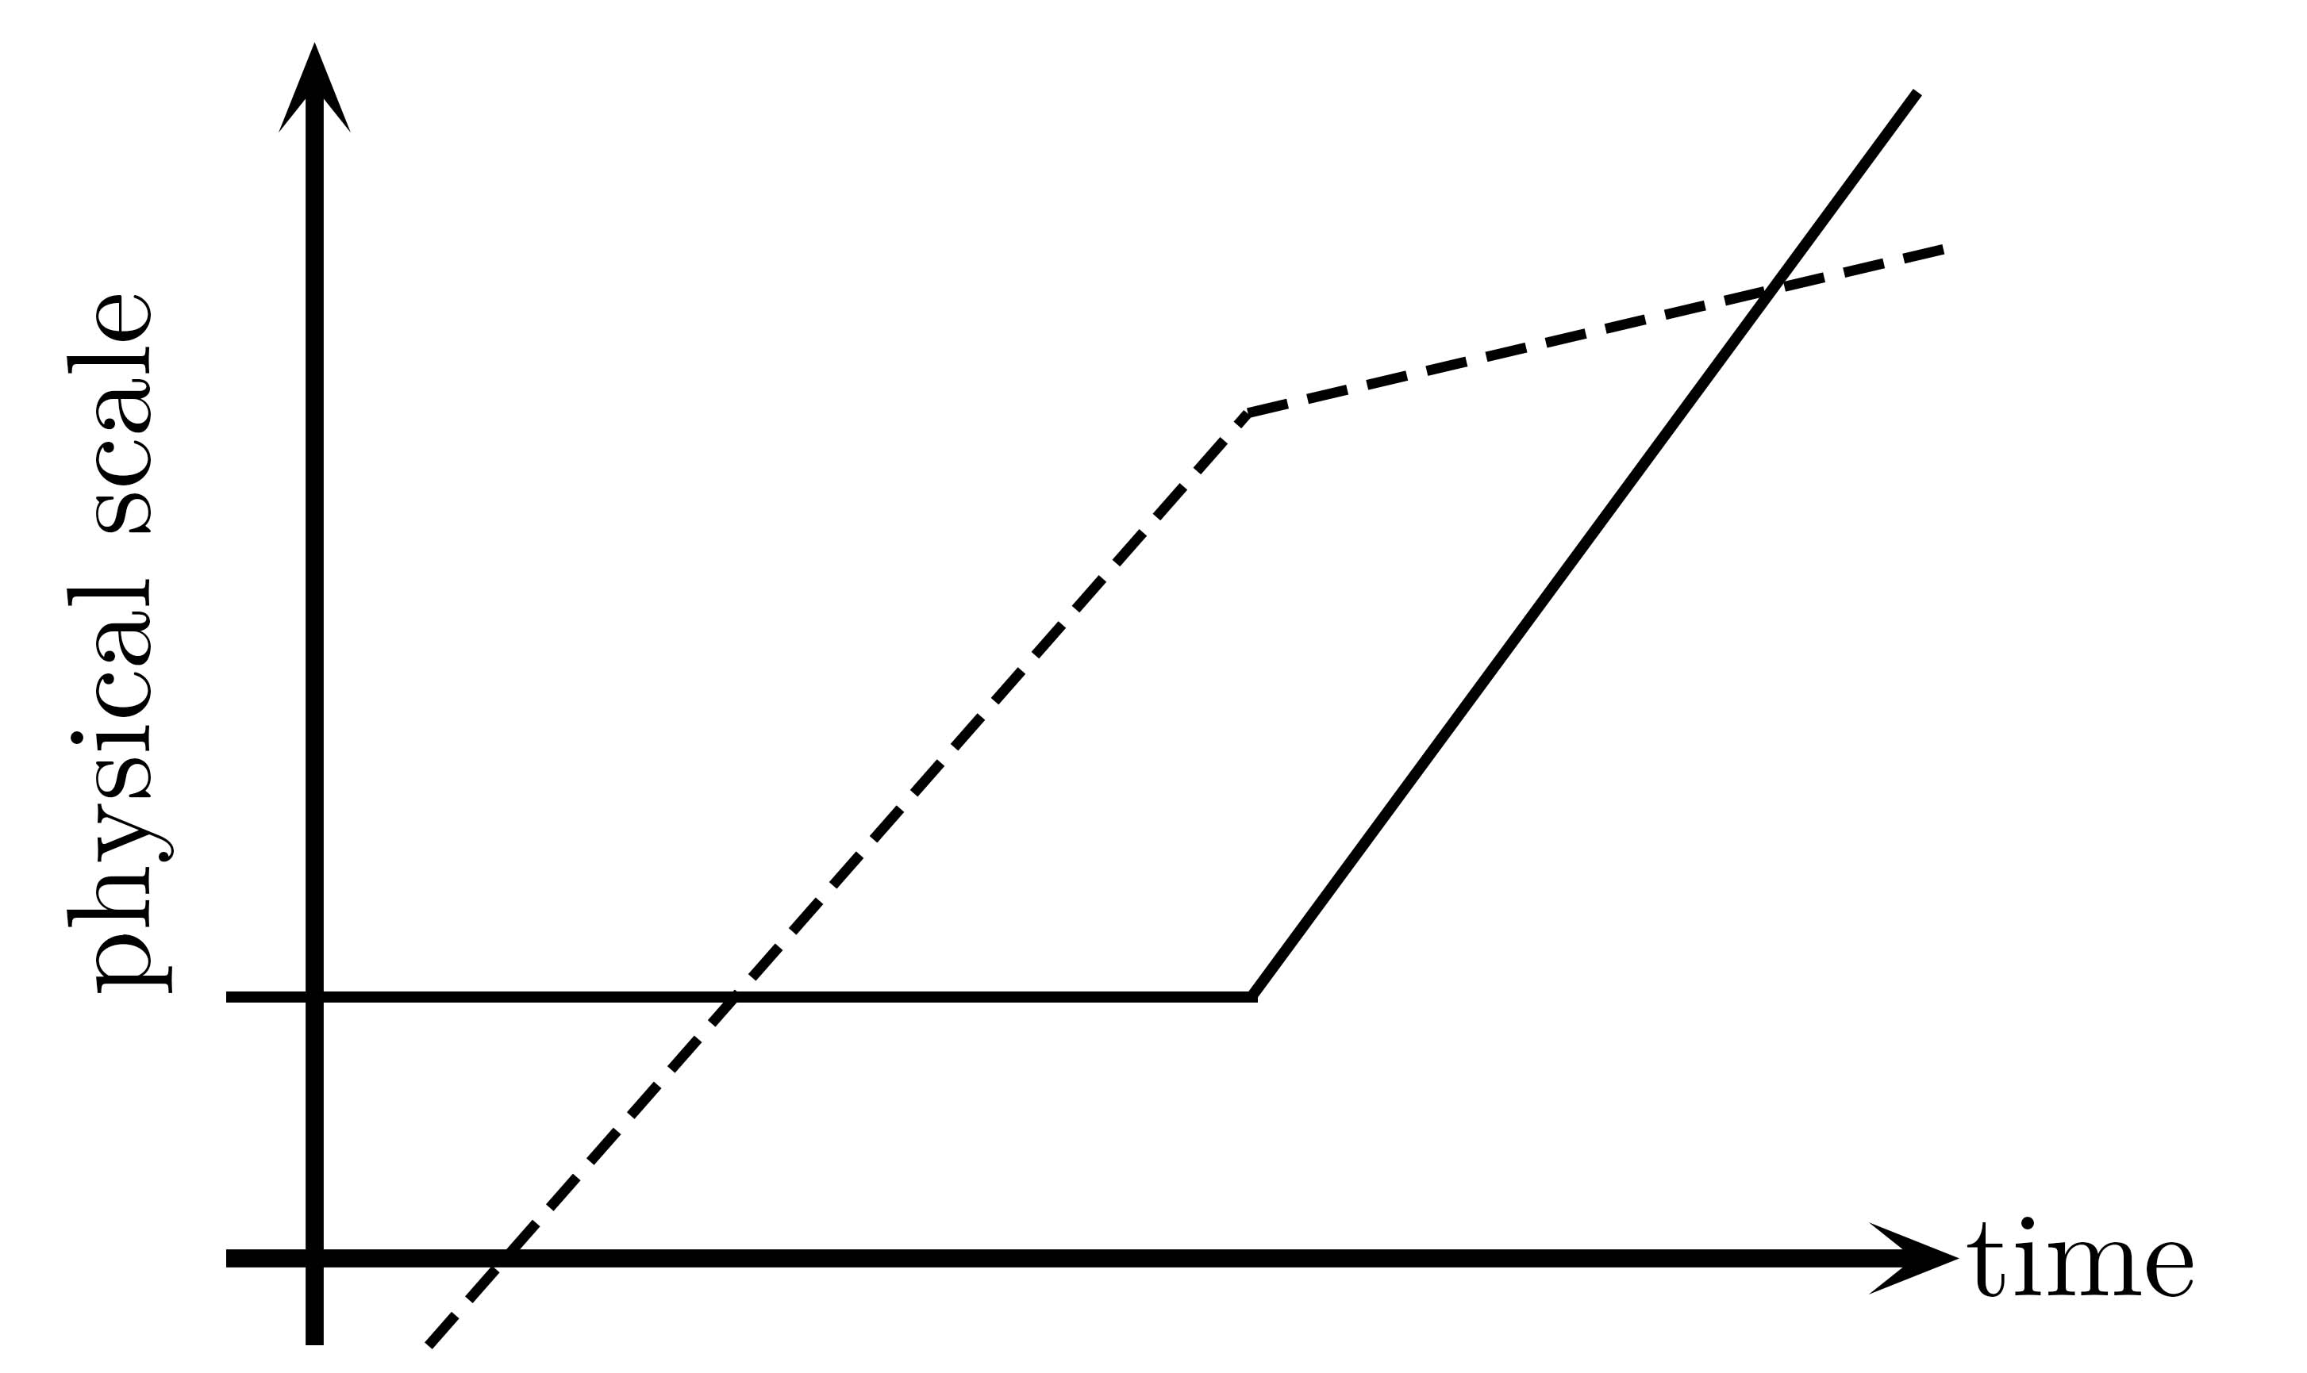
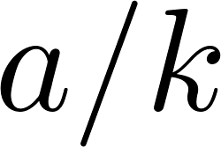
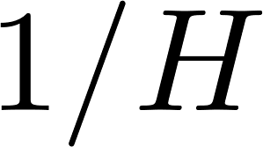
Quantization of Curvature Perturbations
Curvature perturbations
Canonical quantization with Bunch-Davies vacuum
: Curvature perturbations
Perturbations of density
Perturbations of scale factor
: Tensor perturbations
Freezed
Classicalized?
Re-entry
Horizon exit

Slide 11
Quantization of Curvature Perturbations
Curvature perturbations
Canonical quantization with Bunch-Davies vacuum
“Classicalization” of super-horizon mode
: Curvature perturbations
Perturbations of density
Perturbations of scale factor
: Tensor perturbations
Freezed
Classicalized?
Re-entry
Horizon exit
Minimal uncertainty?
Time-independent eigenstates of ?
Formally speaking?
(deterministic)

Slide 12
Quantization of Curvature Perturbations
Curvature perturbations
Canonical quantization with Bunch-Davies vacuum
“Classicalization” of super-horizon mode
Quantumness: Coherence, Entanglement, Incompatible observations etc.
- Unique in quantum theory - How interesting in cosmology?
: Curvature perturbations
Perturbations of density
Perturbations of scale factor
: Tensor perturbations
Freezed
Classicalized?
Inflationary phenomenology
(Bottom-up) quantum gravity
Re-entry
Quantum-to-classical transition
Coherence
Stochastic formalism
Open EFT of inflation
Bell test for primordial perturbations
Probing QG pheno.?
Holography, quantum cosmology,
Hawking radiation, multiverse, …
[Polarski et al. gr-qc/9504030,
Nelson 1601.03734, etc.]
[Sou et al. 2405.07141]
[Starobinsky and
Yokoyama ’94 etc.]
Horizon exit
[Hongo et al. 1805.06240, Salcedo et al. 2404.15416]
Minimal uncertainty?
Time-independent eigenstates of ?
Missing particles?
Formally speaking?
(deterministic)

Slide 13
Quantization of Curvature Perturbations
Curvature perturbations
Canonical quantization with Bunch-Davies vacuum
“Classicalization” of super-horizon mode
Quantumness: Coherence, Entanglement, Incompatible observations etc.
- Unique in quantum theory - How interesting in cosmology?
: Curvature perturbations
Perturbations of density
Perturbations of scale factor
: Tensor perturbations
Freezed
Classicalized?
Inflationary phenomenology
(Bottom-up) quantum gravity
Re-entry
Quantum-to-classical transition
Coherence
Stochastic formalism
Open EFT of inflation
Bell test for primordial perturbations
Probing QG pheno.?
Holography, quantum cosmology,
Hawking radiation, multiverse, …
[Polarski et al. gr-qc/9504030,
Nelson 1601.03734, etc.]
[Sou et al. 2405.07141]
[Starobinsky and
Yokoyama ’94 etc.]
Horizon exit
[Hongo et al. 1805.06240, Salcedo et al. 2404.15416]
Minimal uncertainty?
Time-independent eigenstates of ?
Missing particles?
Formally speaking?
(deterministic)

Slide 14
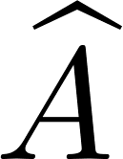
Quantum Interference and Decoherence
Closed system
Measuring state , target physical quantity
Expectation value
Density matrix
Quantum interference
e.g.,
Diagonal: classical probability
Off-diagonal: quantum superposition

Slide 15
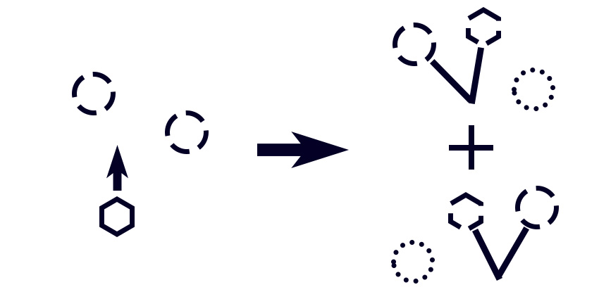
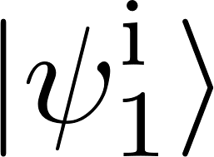
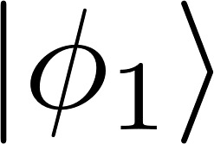
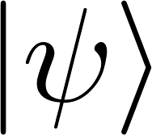
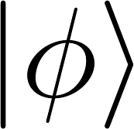
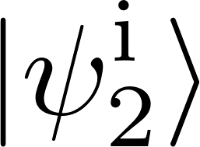
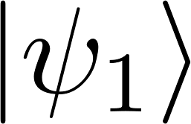
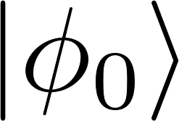
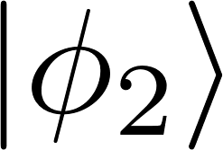
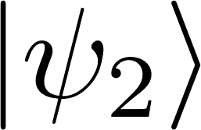
Quantum Interference and Decoherence
Closed system
Measuring state , target physical quantity
Expectation value
Density matrix
Decoherence in open system
Quantum interference
e.g.,
Diagonal: classical probability
Off-diagonal: quantum superposition
System
(observed)
Environment
(unobserved)
Quantum interactions between and

Slide 16
Quantum Interference and Decoherence
Closed system
Measuring state , target physical quantity
Expectation value
Density matrix
Decoherence in open system
Quantum interference
e.g.,
Diagonal: classical probability
Off-diagonal: quantum superposition
System
(observed)
Environment
(unobserved)
Quantum interactions between and
if scattered to independent states. More scattering, more independent, less interference.
L1 norm of coherence is used as a measure of coherence.
* Basis independent measure of coherence: Rényi entropy, purity, quantum discord, etc.
[Baumgratz et al.,1311.0275]
[Streltsov et al. 1612.07570, Henderson and Vedral quant-ph/0105028, etc.]

Slide 17
Outline
Introduction
Decoherence in cosmology
Wavefunction formalism
Decoherence rate
Local observer’s effect
Maldacena’s consistency conditions
Regularizing IR divergence

Slide 18
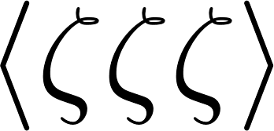
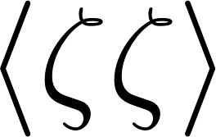
Wavefunction Formalism
[De Witt 1967, Wheeler 1987, etc.]
Observables: correlation functions

Slide 19
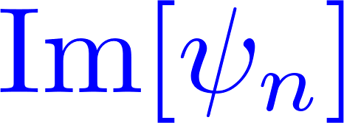
Wavefunction Formalism
[De Witt 1967, Wheeler 1987, etc.]
Observables: correlation functions
Wavefunction of the Universe (WFU)
at semi-classical level
Gravitational non-linearity
Gaussian
: wavefunction coefficient,
: phases in WFU

Slide 20
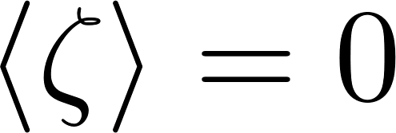
Wavefunction Formalism
[De Witt 1967, Wheeler 1987, etc.]
Observables: correlation functions
Wavefunction of the Universe (WFU)
at semi-classical level
Gravitational non-linearity
Gaussian
: wavefunction coefficient,
: phases in WFU
at tree level
* is omitted in
etc.
* Same result in all other ordering since

Slide 21
Formulation of Decoherence using WFU
[Nelson 1601.03734]
Integrating out environment modes
Mode decomposition
e.g.,
Gaussian level: free propagation
no decoherence

Slide 22
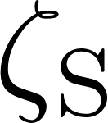
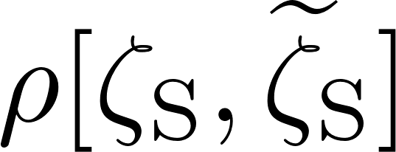
Formulation of Decoherence using WFU
[Nelson 1601.03734]
Integrating out environment modes
Mode decomposition
Tracing out environments
e.g.,
in Heisenberg picture
Gaussian level: free propagation
no decoherence
: Decoherence rate Non-linear interactions

Slide 23
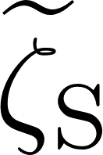
Calculation of Decoherence Rate
[Nelson 1601.03734]
Perturbative expansion
Exponentiation
Pure part
Off-diagonal
“Classical loop”
[Céspedes et al. 2311.17990]

Slide 24
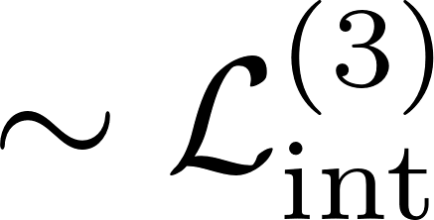
Calculation of Decoherence Rate
[Nelson 1601.03734]
Perturbative expansion
Result
Exponentiation
Pure part
Off-diagonal
[Nelson 1601.03734 , Sou et al. 2207.04435]
Decoherence rate
(Decay rate)
“Classical loop”
[Céspedes et al. 2311.17990]
Boundary
Bulk
WITH IR divergence and UV divergence

Slide 25
Calculation of Decoherence Rate
[Nelson 1601.03734]
Perturbative expansion
Result
Exponentiation
Pure part
Off-diagonal
[Nelson 1601.03734 , Sou et al. 2207.04435]
Decoherence rate
(Decay rate)
“Classical loop”
[Céspedes et al. 2311.17990]
Boundary
Bulk
WITH IR divergence and UV divergence
Stay tuned for our paper
[cf. Unruh 1110.2199]

Slide 26
Outline
Introduction
Decoherence in cosmology
Wavefunction formalism
Decoherence rate
Local observer’s effect
Maldacena’s consistency conditions
Regularizing IR divergence

Slide 27
Maldacena’s Consistency Condition
[Maldacena astro-ph/0210603, Pimentel 1309.1793, etc.]
Ward identity in WFU
Spatial gauge transformation
with
Ward identity
(momentum constraint)

Slide 28
Maldacena’s Consistency Condition
[Maldacena astro-ph/0210603, Pimentel 1309.1793, etc.]
Ward identity in WFU
Spatial gauge transformation
Consistency conditions
with
Ward identity
(momentum constraint)
with
Squeezed limit

Slide 29
Maldacena’s Consistency Condition
[Maldacena astro-ph/0210603, Pimentel 1309.1793, etc.]
Ward identity in WFU
Spatial gauge transformation
Consistency conditions
Correlation functions
with
Ward identity
(momentum constraint)
with
Squeezed limit
where
for minimal single-field inflation
Maldacena’s consistency condition

Slide 30
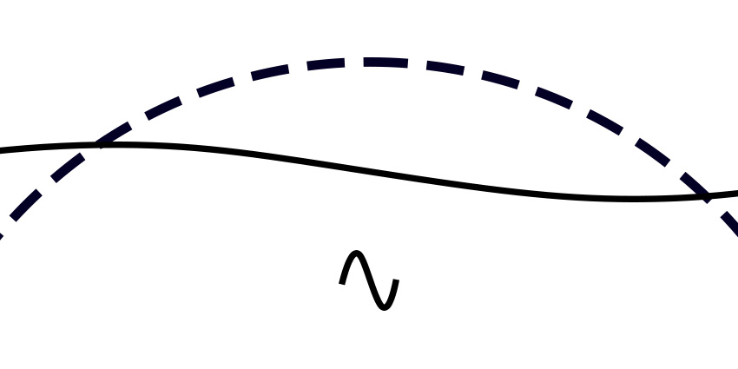
Local Observer Effect: Coordinate for Free-falling Observer
[Tanaka and Urakawa 1103.1251, Pajer et al. 1305.0824]
Correlation functions in coordinate space
Correlation between IR and UV is dominant
IR
UV

Slide 31
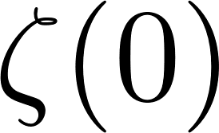
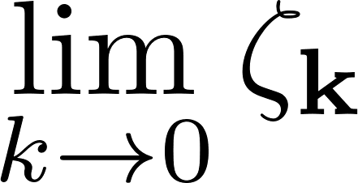
Local Observer Effect: Coordinate for Free-falling Observer
[Tanaka and Urakawa 1103.1251, Pajer et al. 1305.0824]
Correlation functions in coordinate space
(Conformal) free-falling observer (Conformal Fermi normal coordinate)
where
Correlation between IR and UV is dominant
Geodesic distance: physical
IR
: const. mode in Fourier space
UV

Slide 32
Local Observer Effect: Coordinate for Free-falling Observer
[Tanaka and Urakawa 1103.1251, Pajer et al. 1305.0824]
Correlation functions in coordinate space
(Conformal) free-falling observer (Conformal Fermi normal coordinate)
where
Correlation functions
* Not only leading order , but next-leading vanishes as well. is physical.
Correlation between IR and UV is dominant
Geodesic distance: physical
IR
: const. mode in Fourier space
UV
Integrand is decaying in , and the result is finite.

Slide 33
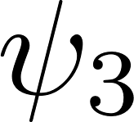
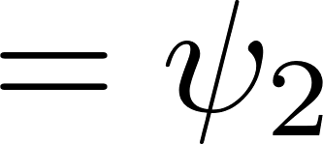
Local Observer Effect in Wavefunction Formalism
[Sano and Tokuda ongoing]
Wavefunction in geodesic coordinate
Correction to from Gaussian part
Correction to 3rd order

Slide 34
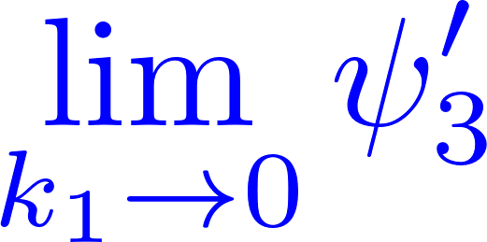
Local Observer Effect in Wavefunction Formalism
[Sano and Tokuda ongoing]
Wavefunction in geodesic coordinate
Correction to from Gaussian part
Correction to 3rd order
3rd order
Leading (and next leading) cancels

Slide 35
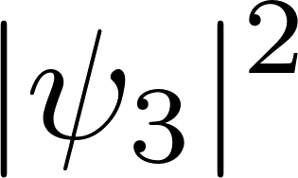
Local Observer Effect in Wavefunction Formalism
[Sano and Tokuda ongoing]
Wavefunction in geodesic coordinate
Correction to from Gaussian part
Modification to decoherence rate
Power in changes by
Correction to 3rd order
3rd order
Leading (and next leading) cancels

Slide 36
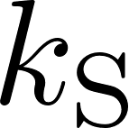
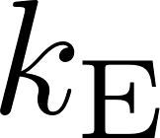
Summary and Outlook
Transition from quantum to classical is an open question.
Wavefunction formalism
Decoherence
IR divergence in decoherence rate
Local observer effect
Long and short modes do not correlate for local obs.
Modified IR contribution
Correlation function
Decoherence
(Well established in QM)
“Classical loop”
[Céspedes et al. 2311.17990]
Equilateral region is dominant contribution for decoherence,
as obtained in previous works

